Slide 1

Introduction to
Apache Airflow
Your success is our success
Funny Gorilla 诙猩猩
Notes:
Notes for title slide

Slide 2
Learning Objectives
A little bit of history
Who build pipeline
Why build pipeline
How the build pipeline built

Slide 3

A Sample Scenario

Slide 4
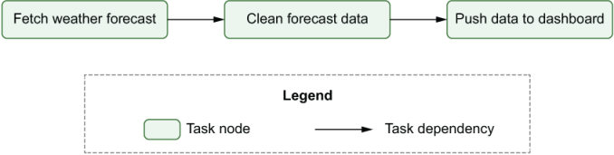

Slide 5
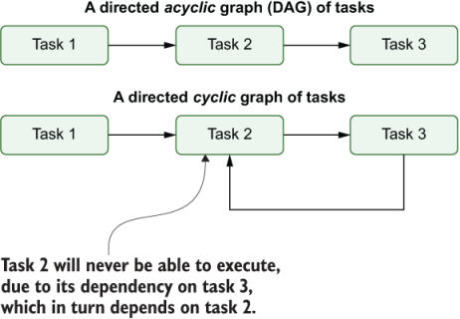
DAG

Slide 6
Execution a Pipeline

Slide 7
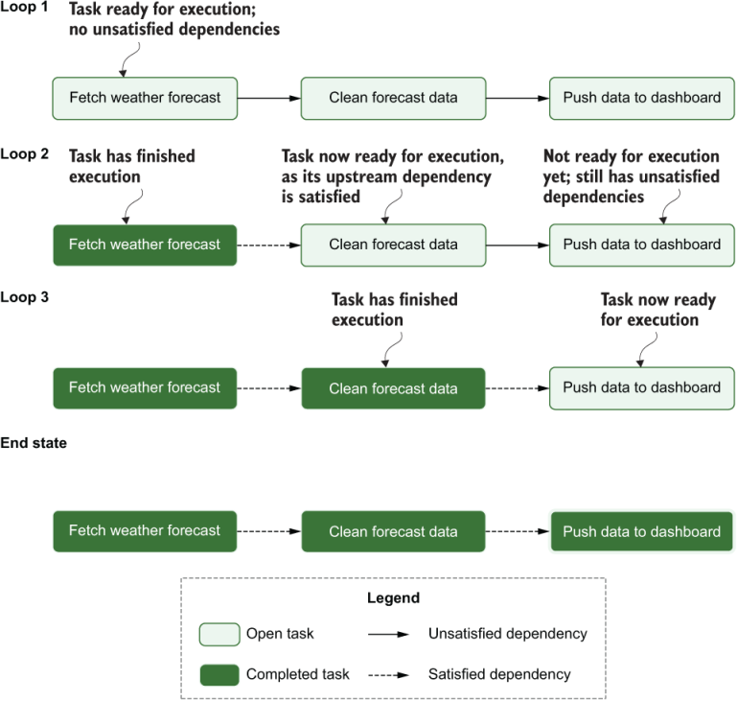
Spark

Slide 8
How Airflow Works

Slide 9
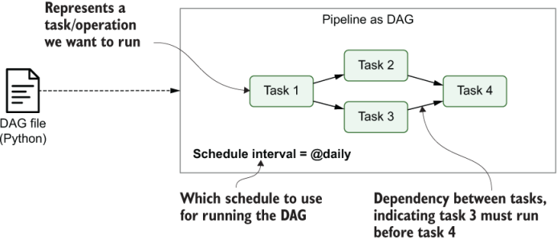

Slide 10
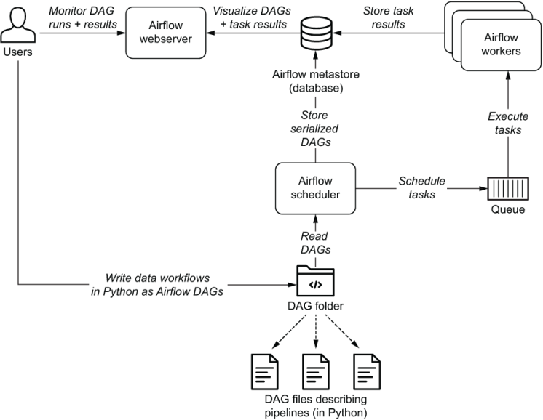
Airflow Architecture

Slide 11
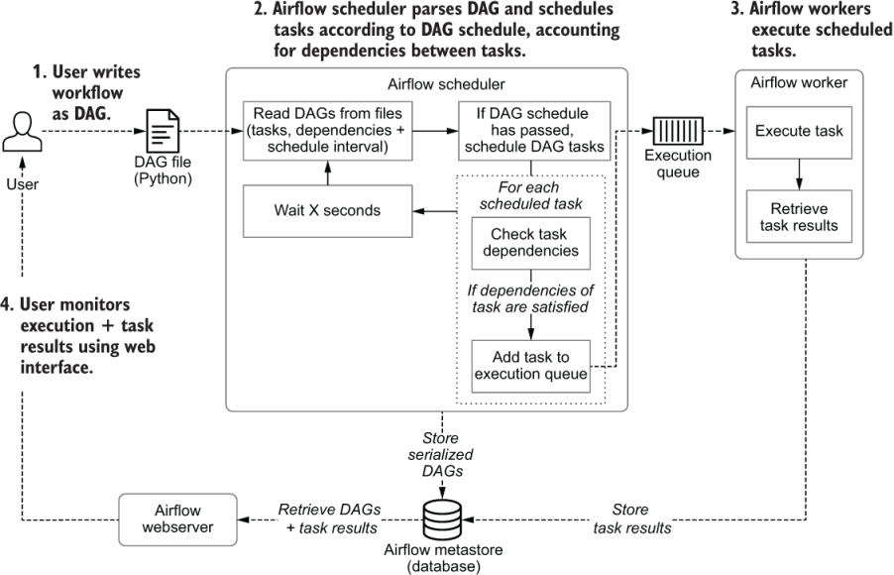

Slide 12
Anatomy of Airflow

Slide 13
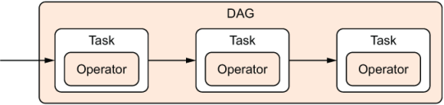
Task vs Operator
DAG is to orchestrate the execution of a collection of operators

Slide 14
Executor
Act as the compute delegate for tasks
Each executor instance operates in a disposable (transient) fashion

Slide 15
Cluster Manager
the cluster coordinator and
the delegate in charge of managing and maintaining the state of
the cluster
the executors assigned to each active Spark application

Slide 16
Reference Links
https://data-flair.training/blogs/how-apache-spark-works/
https://data-flair.training/blogs/spark-vs-hadoop-mapreduce/
https://phoenixnap.com/kb/hadoop-mapreduce

Slide 17

Your success is our success
Contact
Mail: info@funnygorilla.com.au
Linkedin: https://mt.linkedin.com/in/songqing-gu-2ba9034b/de
Web Chat: FunnyGorilla
Phone: 0420891343

