Slide 1
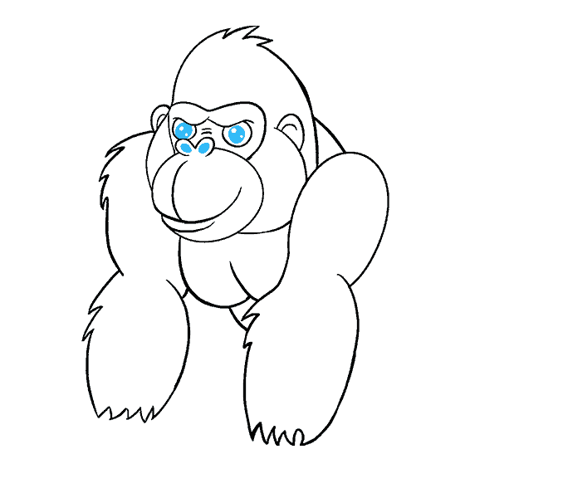
Introduction to
DAG
Your success is our success
Funny Gorilla 诙猩猩
Notes:
Notes for title slide

Slide 2
Learning Objectives

Slide 3
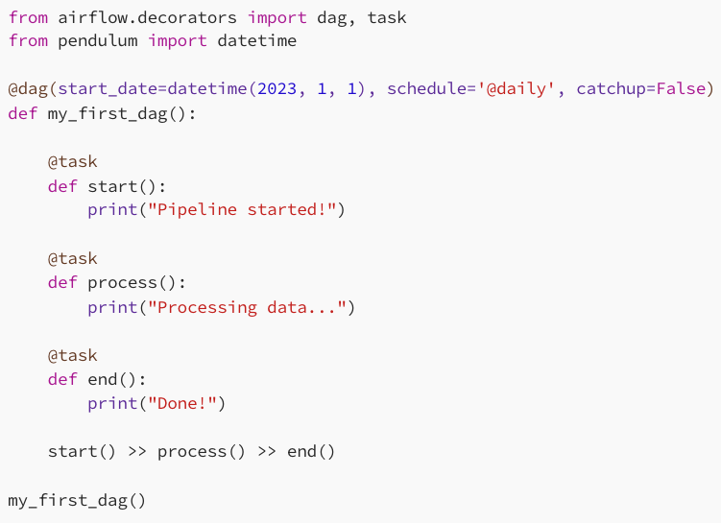
DAG – Directed Acyclic graph
a collection of tasks where all the tasks (if connected) are connected via directed lines.
defined using Python code in Airflow

Slide 4
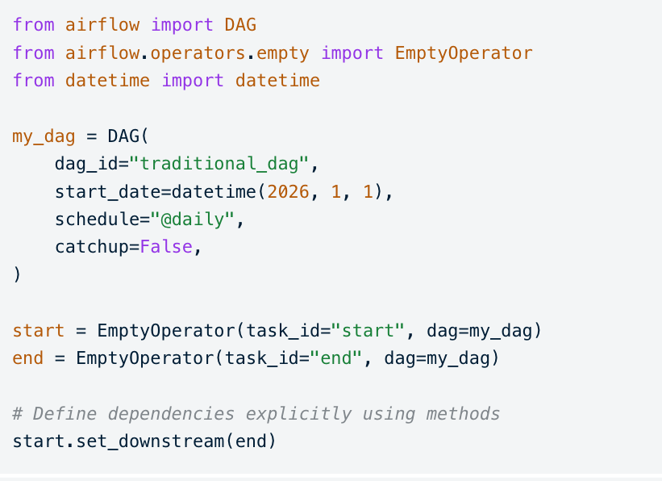
Traditional Constructor

Slide 5
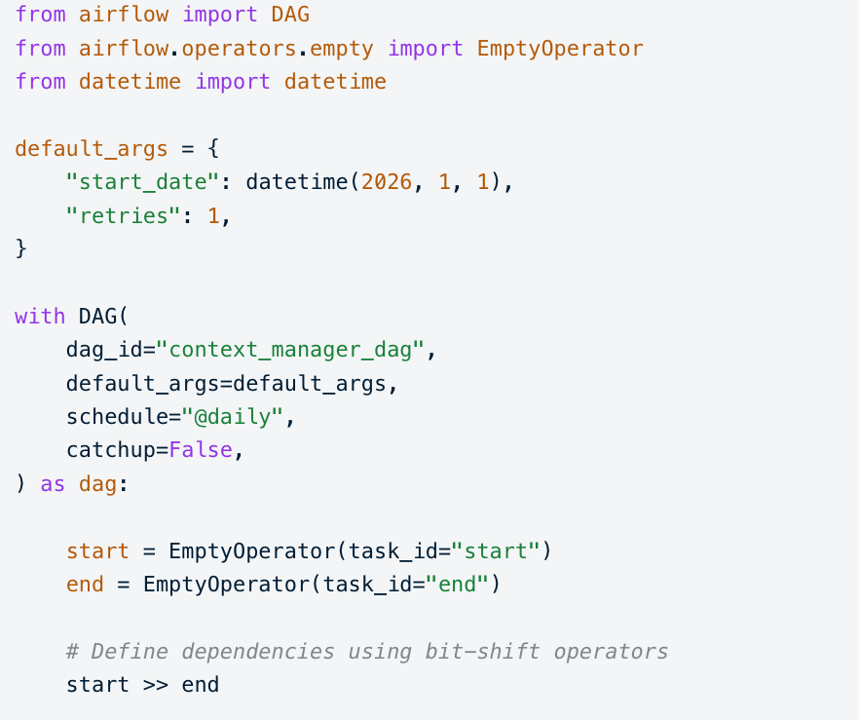
Context Manager

Slide 6
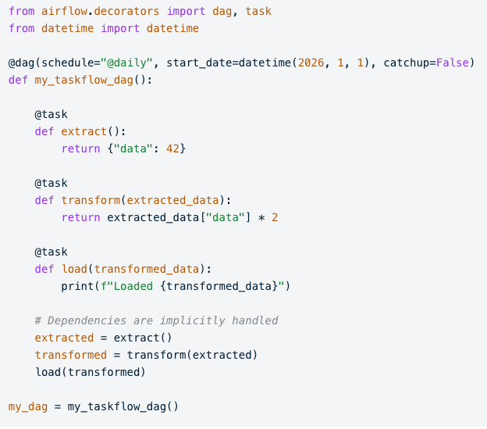
TaskFlow API
It uses the @dag and @task decorators, which implicitly handle passing data between tasks and automatically infer dependencies

Slide 7
Dependencies between tasks
Fan-in/-out dependencies
Branching within tasks

Slide 8
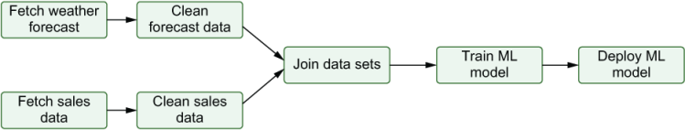

Slide 9
Reference Links
https://airflow.apache.org/docs/apache-airflow/stable/index.html

Slide 10
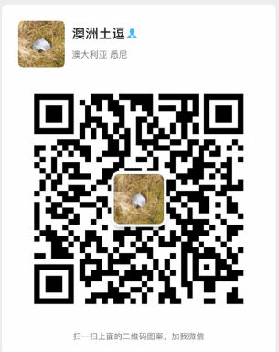
Your success is our success
Contact
Mail: info@funnygorilla.com.au
Linkedin: https://mt.linkedin.com/in/songqing-gu-2ba9034b/de
Web Chat: FunnyGorilla
Phone: 0420891343

