Slide 1

Introduction to
Data Infrastructure
Your success is our success
Funny Gorilla 诙猩猩
Notes:
Notes for title slide

Slide 2
Learning Objectives
Data Infrastructure
Data Type
Why build pipeline
How the build pipeline built

Slide 3
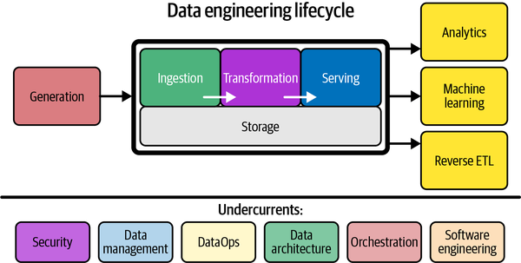
What is the Data Engineering?

Slide 4
Data Infrastructure
dollars,
engineering resources,
security
legal risk tolerance
the resulting trade-offs

Slide 5








Analytical Reporting
Operational Database - OLTP
Realtime Monitoring
Data Warehouse - ALTP
Files
Machine Learning
IOT data stream
Data Warehouse - ALTP
Application APIs

Slide 6
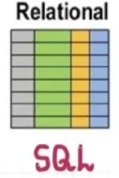
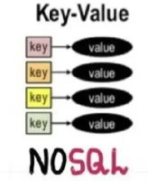

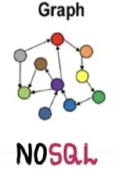
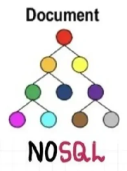



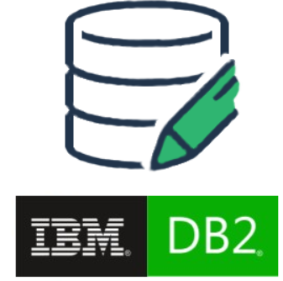
Database - OLTP

Slide 7



Data Warehouse
database where data from different systems is stored and modeled to support analysis and other activities related to answering questions with it.
Data structured and optimized is for reporting and analysis queries.

Slide 8
Data Description
Source ownership
Data Type
Volume
Data cleanliness and validity
Latency & bandwidth of source

Slide 9
Data Types

Slide 10
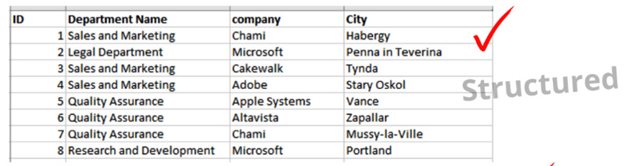
Structured

Slide 11
Unstructured
CSV,
fixed-width format (FWF), and
other flat file formats

Slide 12
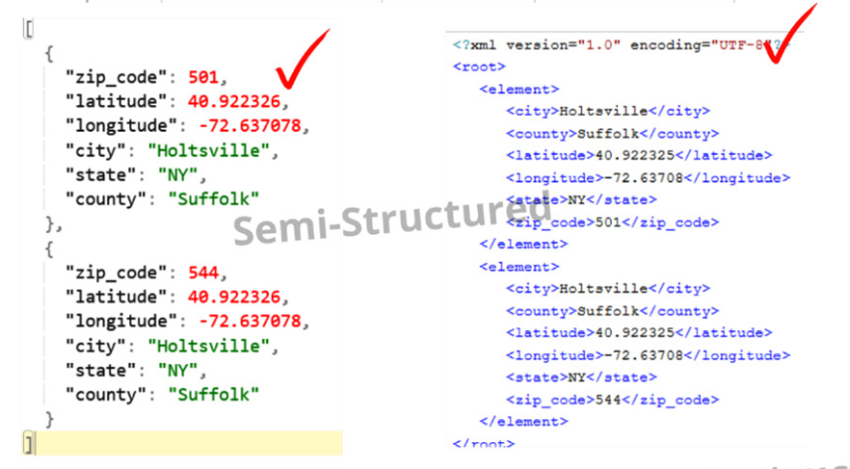
Semi - Structured

Slide 13
Data Lake
Cloud Data Infrastructure

Slide 14
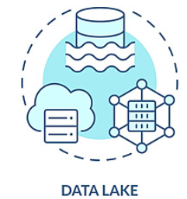
Feature Store

Slide 15
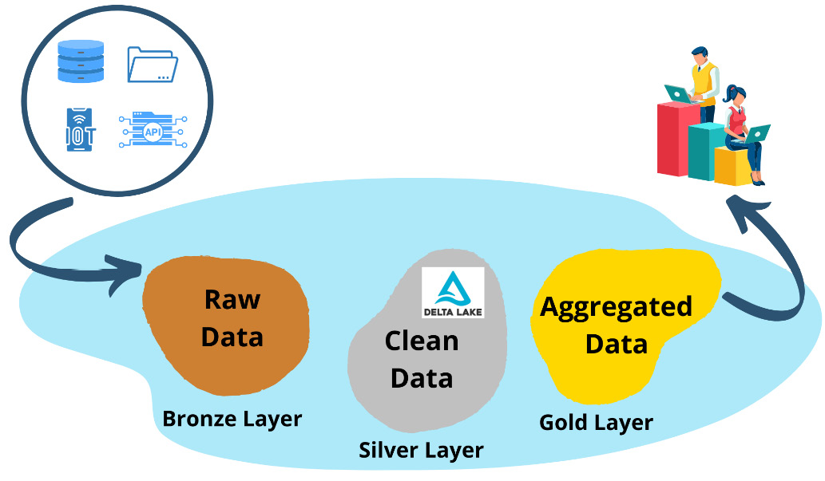

Slide 16
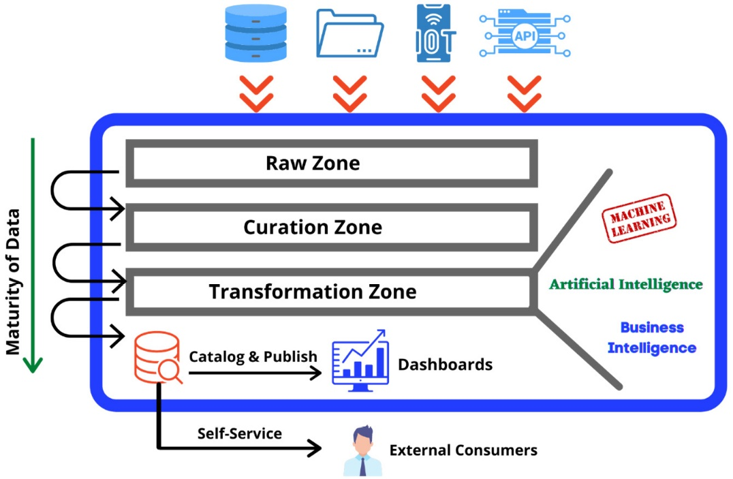
Data Lake

Slide 17
Data Laker Architecture
Traditional architecture
Lambda architecture
Kappa architecture
Lakehouse architecture

Slide 18
Data Lakehouse Architecture

Slide 19
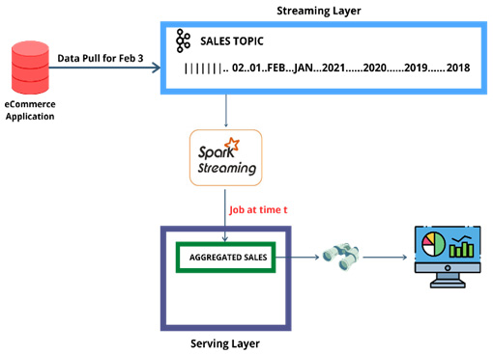
Kappa Architecture

Slide 20
Data Platform
Architecture

Slide 21
Data Platform Architecture

Slide 22
Reference Links

Slide 23

Your success is our success
Contact
Mail: info@funnygorilla.com.au
Linkedin: https://mt.linkedin.com/in/songqing-gu-2ba9034b/de
Web Chat: FunnyGorilla
Phone: 0420891343

