Slide 1

Introduction to
Data Lake
Your success is our success
Funny Gorilla 诙猩猩
Notes:
Notes for title slide

Slide 2
Learning Objectives
Pipeline and Storage
What is Data Lake
Data Lakehouse
Delta Lake
Data Lake architecture - Mediallion

Slide 3
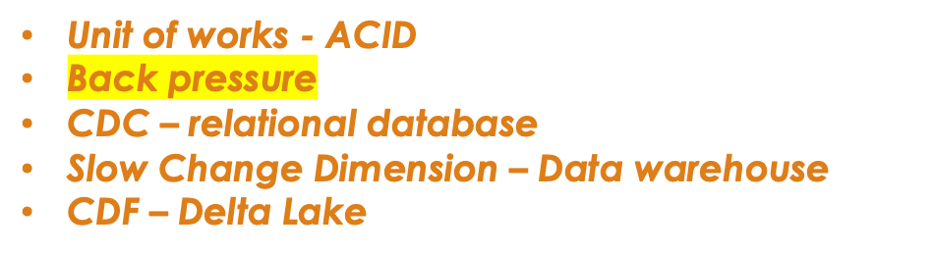


Essential concepts
Ingestion process
transformation process

Slide 4


Pipeline and storage
Combine/augment
Normalize
Aggregate
Anonymize
Security
Acquire
Cleanse
Structure
1
2
3
4
5
6
7
8
Data Storage

Slide 5
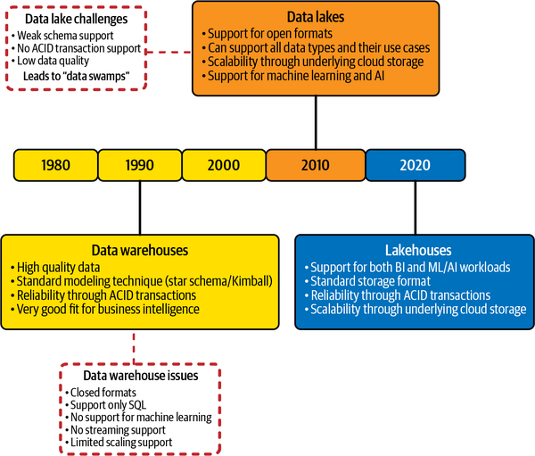
Evolution history

Slide 6
Data Lake
The first generation of big data storage in cloud

Slide 7




Why Data Lake?
What data warehouse has
only support SQL-based query tools; not well suited to store and query the variety of semi-structured/unstructured data.
have a hard time addressing these four Vs.
What big data needs is 4 vs

Slide 8



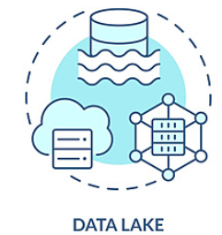





Data Lake Logic model
Demands data ware house
Feature Store

Slide 9
Lakehouse – A Data Platform
Design blueprint
Data architecture
the Lakehouse model combines the cost-effective, scalable storage of data lakes with the efficient transaction processing of data warehouses

Slide 10
Why Lakehouse?
Challenges of Data Lake:
the organization’s data teams must still transform and load the data into something like a data warehouse, resulting in an extended time to value.
“schema on read” strategy

Slide 11



What Lakehouse demands
What Lakehouse Demanded
capabilities
Support for diverse data types
Openness – support open standard data format
Support for diverse workloads
End-to-end streaming

Slide 12
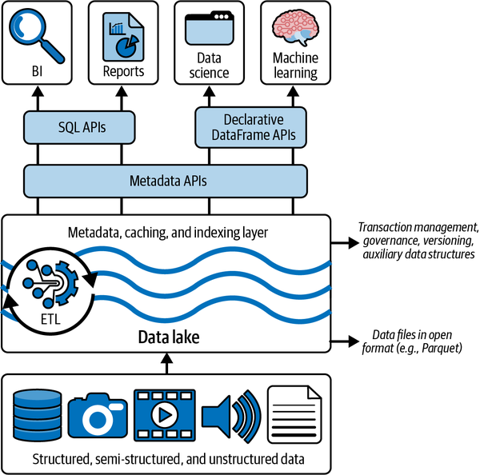
Logical model
Lakehouse
Support for diverse data types

Slide 13
Implementation – Delta Lake

Slide 14
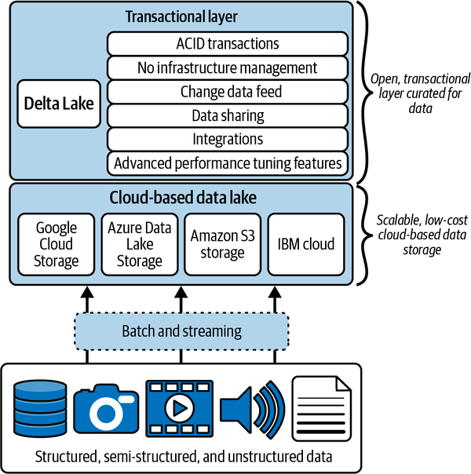
The Delta Ecosystem

Slide 15
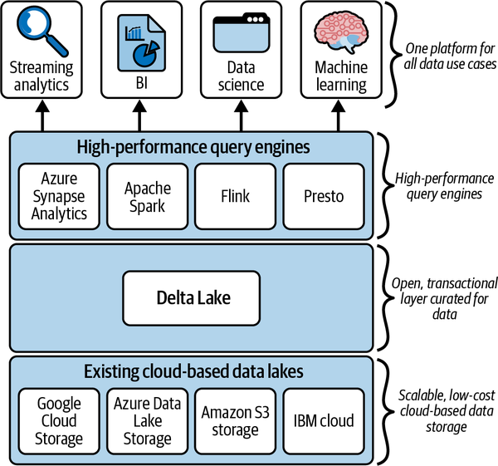
Technical full stack

Slide 16
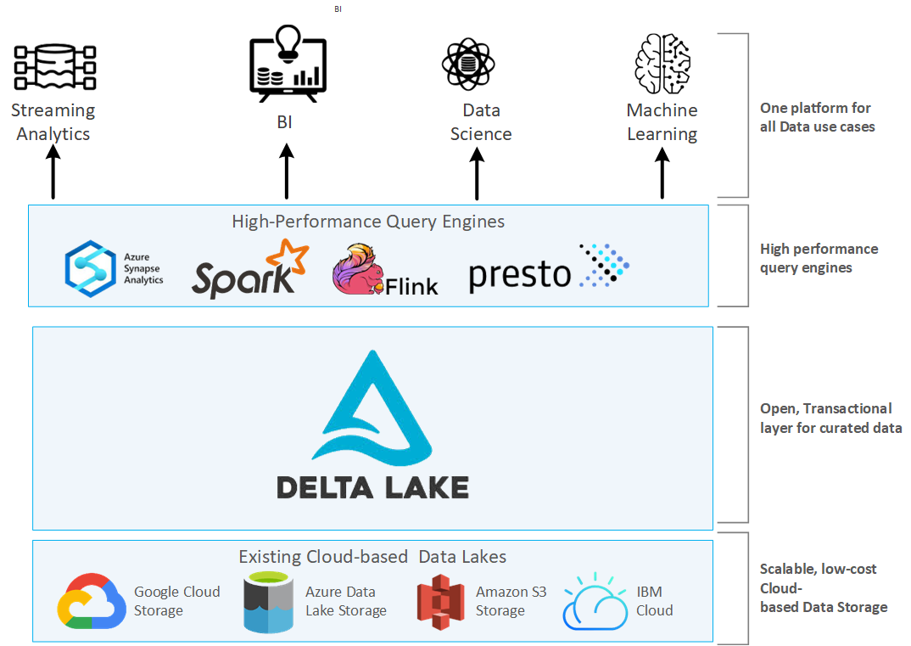

Slide 17
Data Lake Architecture - Medallion

Slide 18
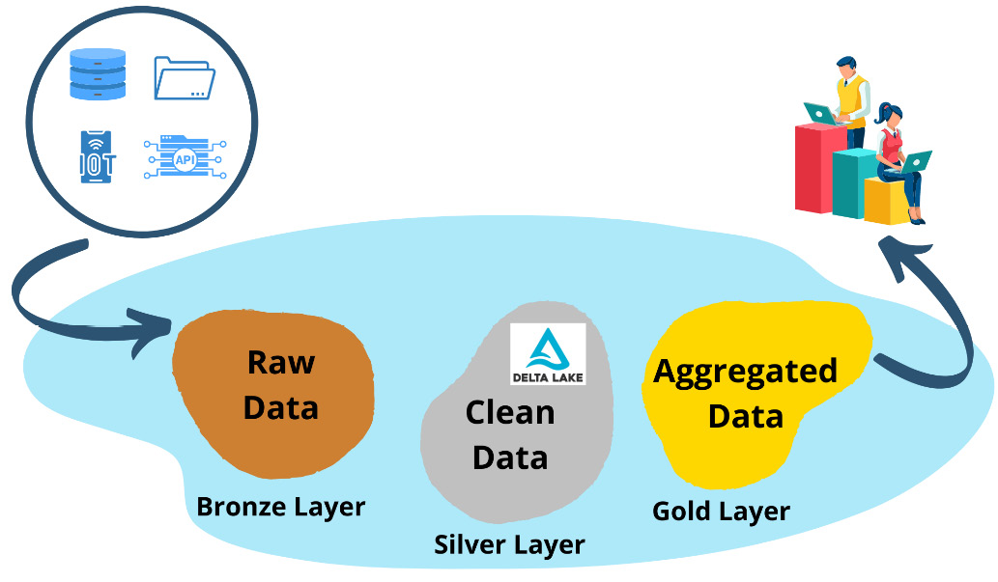
Data in the Bronze zone is typically landed “as is,” but can be augmented with additional metadata, such as the loading date and time, processing identifiers, etc.
In the Silver layer, the data from the Bronze layer is cleansed, normalized, merged, and conformed. This is where the enterprise view of the data across the different subject areas is gradually coming together.
The data in the Gold layer is “consumption-ready” data. This data can be in the format of a classic star schema, containing dimensions and fact tables, or it could be in any data model that is befitting to the consuming use case.

Slide 19
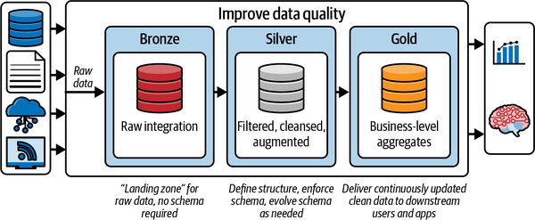
A set of CSV or TXT files on an external data lake
An on-premises database, such as Oracle or SQL Server
Streaming data sources, such as Kafka or Azure Event Hubs
REST APIs from a SAS service, such as Salesforce or ADP
a data design pattern used to logically organize data in a lakehouse, through Bronze, Silver, and Gold layers.

Slide 20
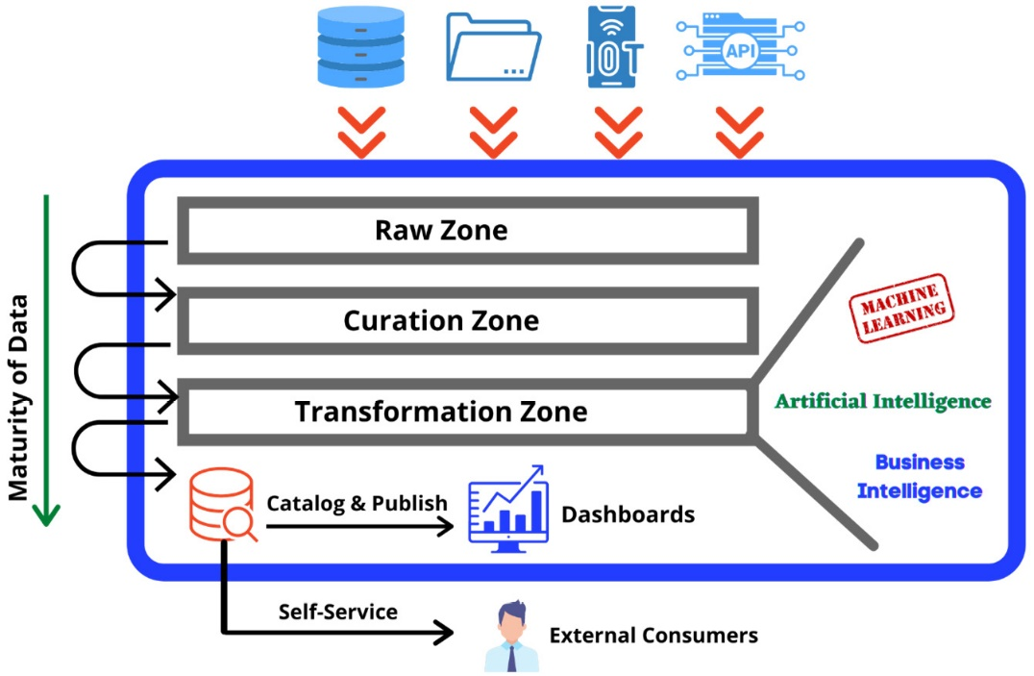

Slide 21
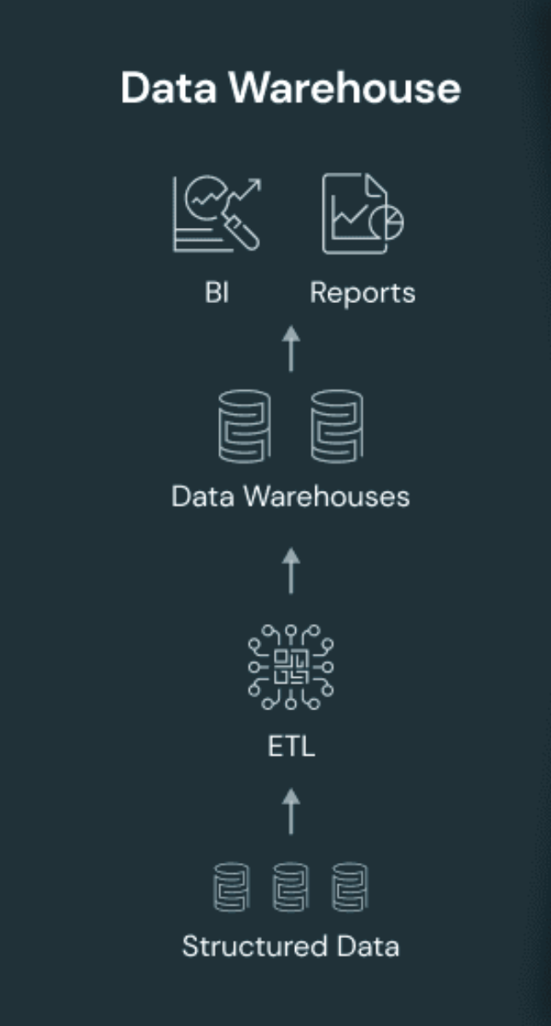
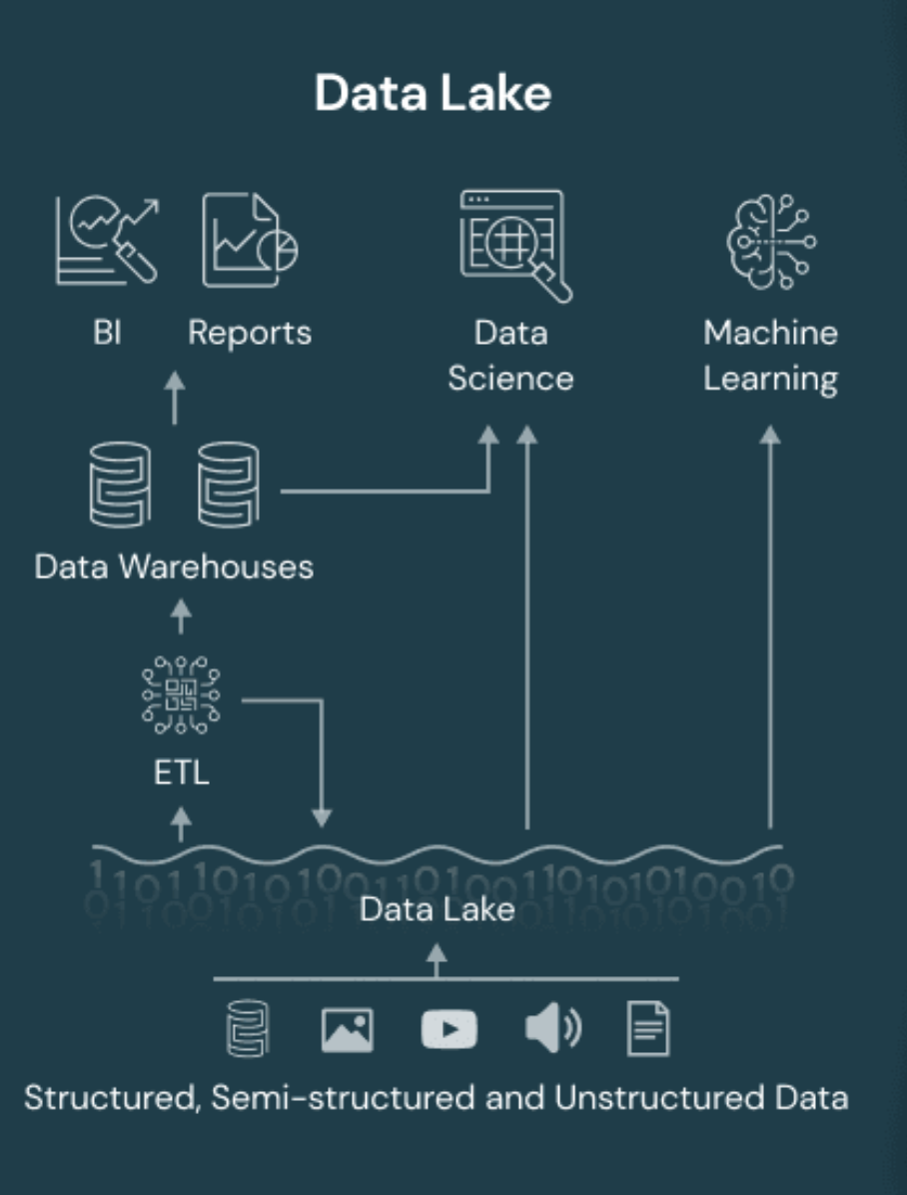
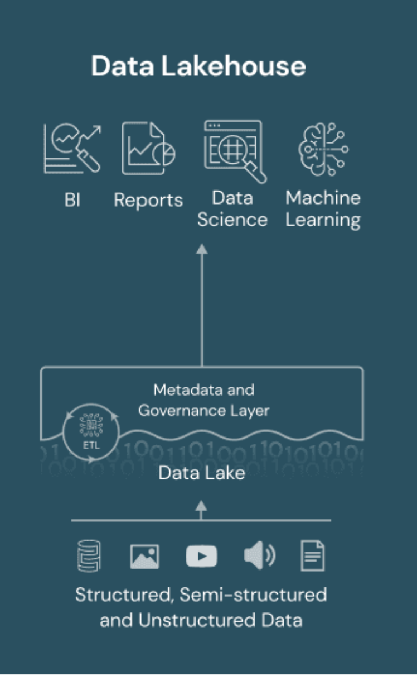
Warehouse vs Data Lake vs Data Lakehouse

Slide 22
Data organization principles

Slide 23
Reference Links

Slide 24

Your success is our success
Contact
Mail: info@funnygorilla.com.au
Linkedin: https://mt.linkedin.com/in/songqing-gu-2ba9034b/de
Web Chat: FunnyGorilla
Phone: 0420891343

