Slide 1

Pipeline Design and Development
Your success is our success
Funny Gorilla 诙猩猩
Notes:
Notes for title slide

Slide 2
Learning Objectives
Common pipeline
ETL system planning and design consideration
Recommendations for one-time historic data loads
Development tasks for incremental load processing
Real-time data warehousing considerations

Slide 3
Basic concepts
Fact and dimension
Row storage & clumn storage

Slide 4
Common pipeline

Slide 5
Master/reference data
Staging
Data
Warehouse
Delivery
Source
Landing
Source
Source
Landing & Staging
Warehouse
Data Mart

Slide 6
Pipeline Design
Step 1: Draw the High-Level Plan
Step 2: Choose an ETL Tool
Step 3: Develop Default Strategies
Step 4: Drill Down by Target Table

Slide 7
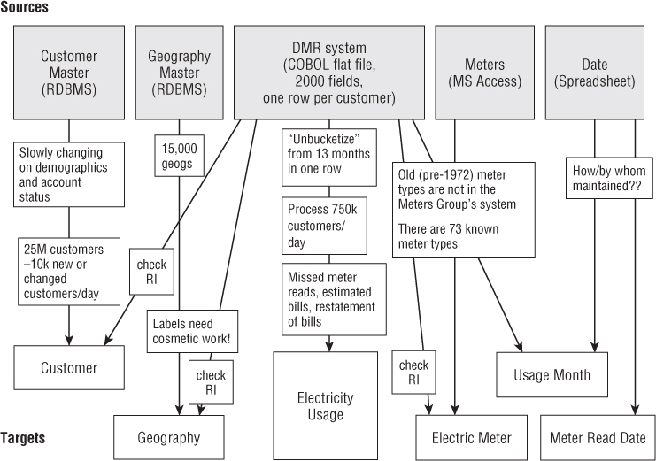
Step 1: Draw the High-Level Plan

Slide 8
Reference Links

Slide 9

Your success is our success
Contact
Mail: info@funnygorilla.com.au
Linkedin: https://mt.linkedin.com/in/songqing-gu-2ba9034b/de
Web Chat: FunnyGorilla
Phone: 0420891343

