Slide 1

Introduction to
Data Platform
Your success is our success
Funny Gorilla 诙猩猩
Notes:
Notes for title slide

Slide 2
Learning Objectives
Data Infrastructure
Data Type
Why build pipeline
How the build pipeline built

Slide 3
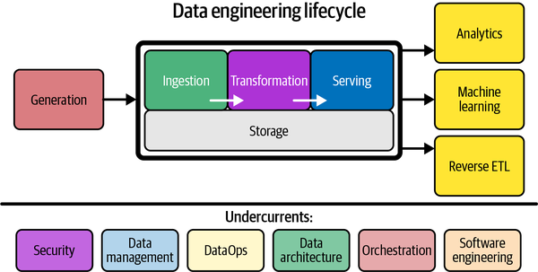
What is the Data Engineering?

Slide 4
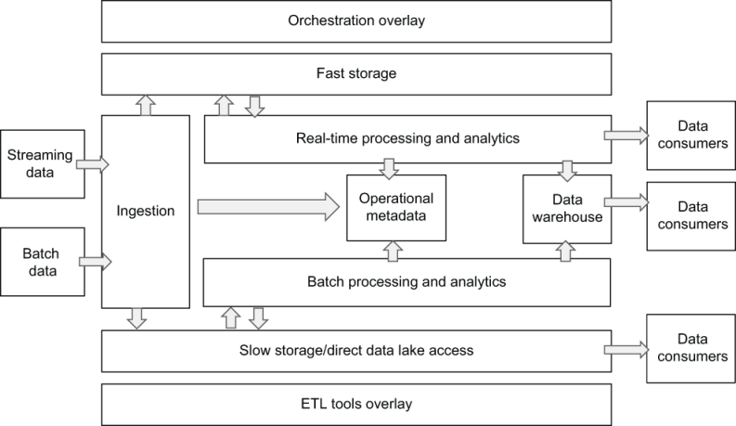
Data Platform

Slide 5
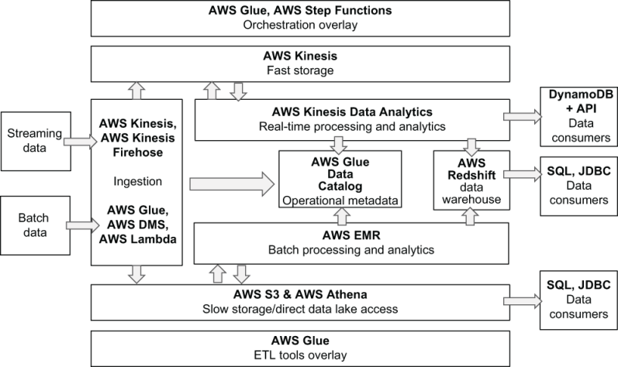
AWS

Slide 6
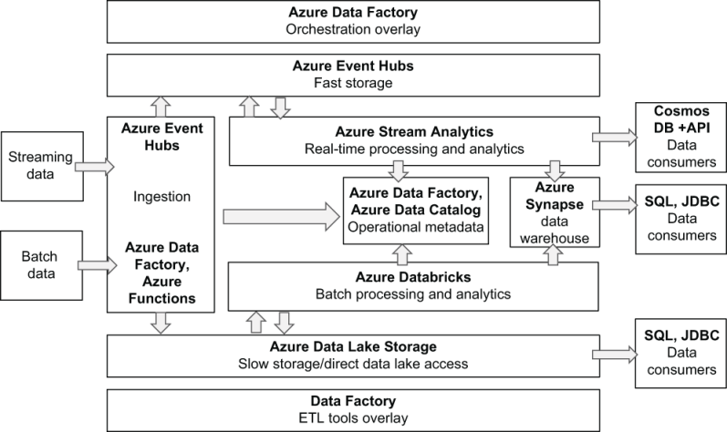
Azure

Slide 7
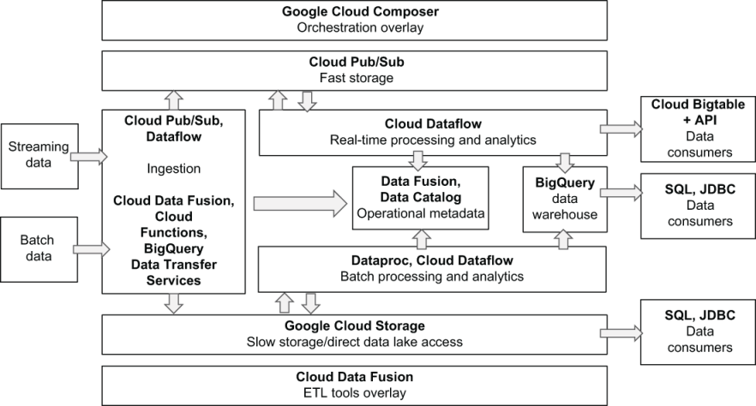
Google

Slide 8








Analytical Reporting
Operational Database - OLTP
Realtime Monitoring
Data Warehouse - ALTP
Files
Machine Learning
IOT data stream
Data Warehouse - ALTP
Application APIs

Slide 9



Data Warehouse
database where data from different systems is stored and modeled to support analysis and other activities related to answering questions with it.
Data structured and optimized is for reporting and analysis queries.

Slide 10
Data Description
Source ownership
Data Type
Volume
Data cleanliness and validity
Latency & bandwidth of source

Slide 11
Data Types

Slide 12
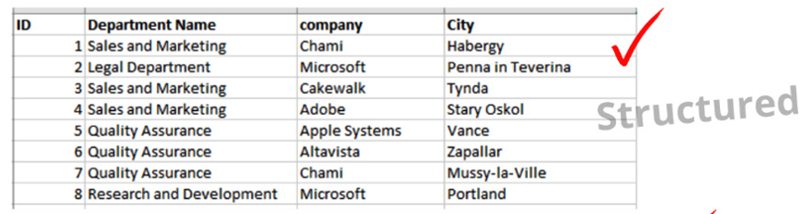
Structured

Slide 13
Unstructured
CSV,
fixed-width format (FWF), and
other flat file formats

Slide 14
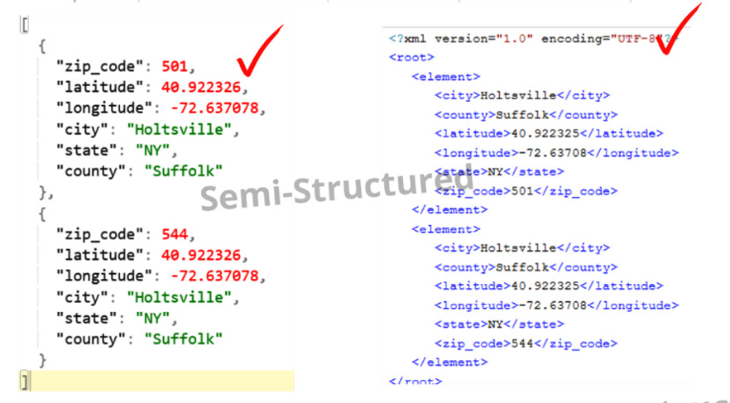
Semi - Structured

Slide 15
Data Lake
Cloud Data Infrastructure

Slide 16
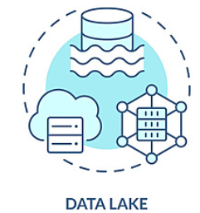
Feature Store

Slide 17
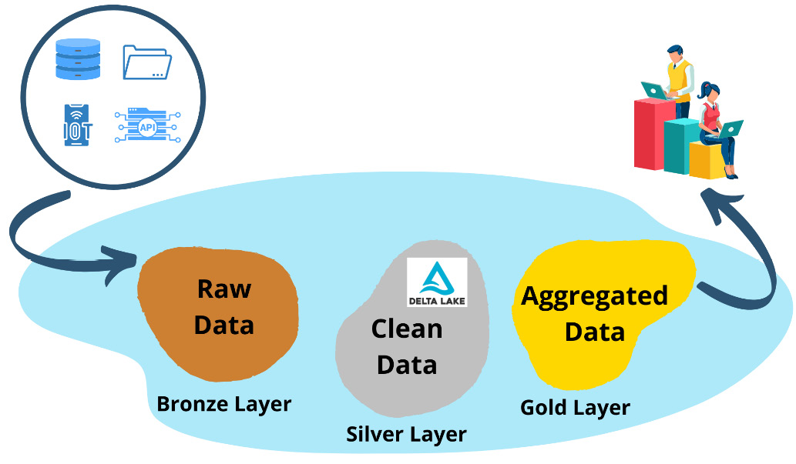

Slide 18
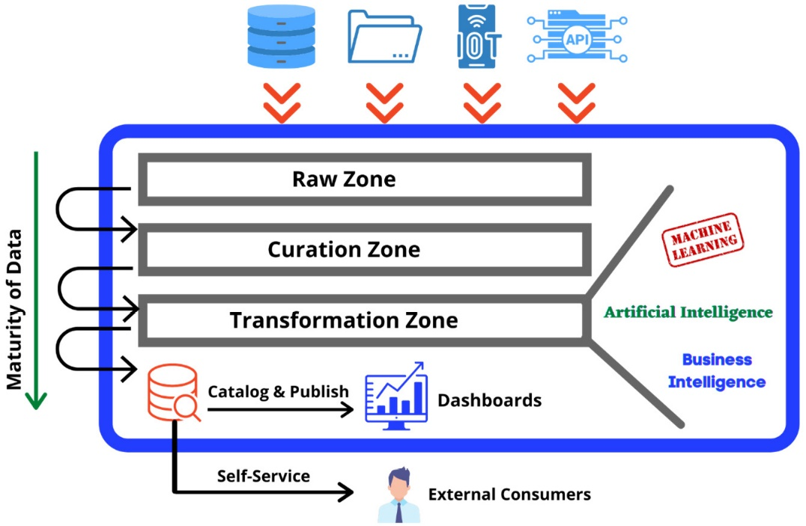
Data Lake

Slide 19
Data Laker Architecture

Slide 20
Data Laker Architecture
Traditional architecture
Lambda architecture
Kappa architecture
Lakehouse architecture

Slide 21
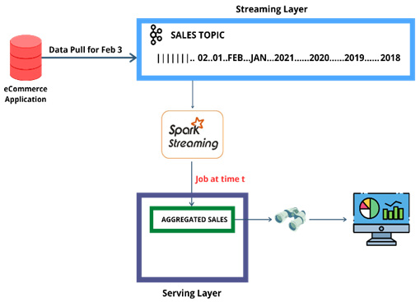
Kappa Architecture

Slide 22
Reference Links

Slide 23

Your success is our success
Contact
Mail: info@funnygorilla.com.au
Linkedin: https://mt.linkedin.com/in/songqing-gu-2ba9034b/de
Web Chat: FunnyGorilla
Phone: 0420891343

