Slide 1

Introduction to Database
Your success is our success
Part 02 - SQL
Funny Gorilla 诙猩猩
Notes:
Notes for title slide

Slide 2
Learning Objectives
By the end of this learning module, you will be able to understand and practice SQL, so that you can:
Create/Alter/Drop database
Entity relationship model
SQL

Slide 3
ER Data Modeling
business entities
attributes
relationship
Cardinality & ordinality

Slide 4
Database Lifecycle
Conceptual Design
1
Logical Design
2
Physical Design
3
Implementation
4

Slide 5
Conceptual Design - ERD
Conceptual Design
Logical Design
Physical Design
Implementation
1
2
3
4
business entities
relationship

Slide 6
Logical Design - ERD
Conceptual Design
Logical Design
Physical Design
Implementation
1
2
3
4
Find attributes for each entity
Specify cardinality for relationship
Define third entity if needed

Slide 7
Physical Design - ERD
Conceptual Design
Logical Design
Physical Design
Implementation
1
2
3
4
Define data type for attribute
Define keys for each entity

Slide 8
Conceptual Design
Logical Design
Physical Design
Implementation
1
2
3
4
Implementation - SQL

Slide 9
Structured Query Language
SQL is a computer language for Storing, Manipulating and Retrieving data stored in a relational database.
What SQL can do:
Create/drop database
Create/drop tables;
Create, read, update, delete (CRUD) data into tables;
SQL comes with core part and extension from different vendors.

Slide 10
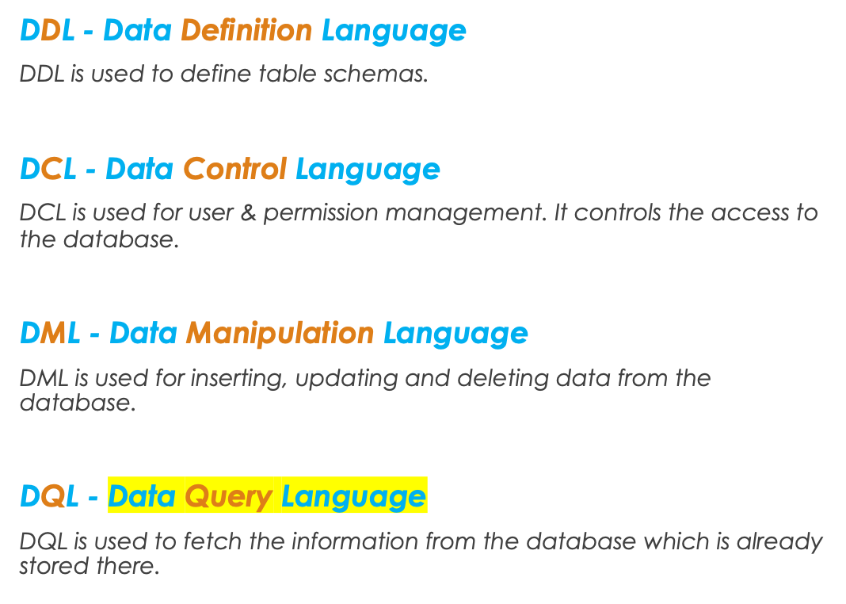
Types of SQL
1
2
3
4

Slide 11
Data Definition Language
Create
create the database or its objects
(like table, index, function, views, store procedure and triggers).
Alter
alter the structure of the database.
Drop
delete objects from the database.

Slide 12
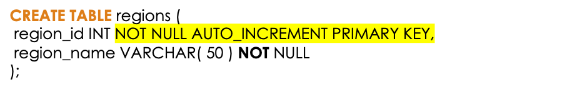
Data Definition Language
Create
Alter
ALTER TABLE regions
ADD description VARCHAR2( 500 ) NOT NULL;
Drop
DROP TABLE regions;

Slide 13
Demo - DDL
MySQL Database

Slide 14
Data Control Language
GRANT - gives user’s access privileges to database.
REVOKE - withdraw user’s access privileges given by using the GRANT command.
Example:
Create User Yi_Zhange Identified By ‘123456’;
Grant connect, view To Yi_Zhange;

Slide 15
Demo - DCL
MySQL Database

Slide 16
Data Manipulation Language
insert
INSERT INTO table_name (column1, column2, column3,..)
VALUES ( value1, value2, value3,..);
UPDATE table_name
SET column1 = value1, column2 = value2,...
WHERE condition;
DELETE FROM table_name
WHERE some_condition;
update
delete

Slide 17
Data Manipulation Language
insert
update
delete
INSERT INTO REGIONS (REGION_NAME.)
VALUES ('Europe');
UPDATE REGIONS
SET REGION_NAME = ‘Asia’
WHERE REGION_ID = 1;
DELETE FROM REGIONS
WHERE REGION_ID = 1;

Slide 18
Demo - DML
MySQL Database

Slide 19
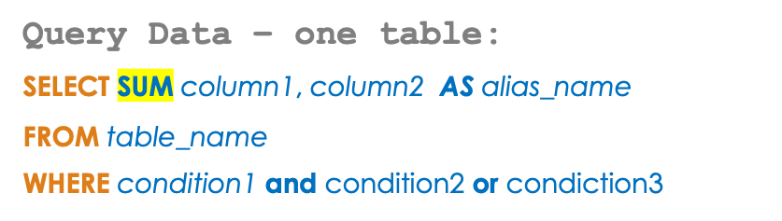


Data Query Language
Aggregates :
Sum,, avg, count
Projecting column
Filtering rows
Operators :
=, >, <, >=, <=, <>, Between, Like, In
Having condition
Order By column
Filtering at group level
By column
By grouping ?
By aggregate function

Slide 20
Demo – DQL
MySQL Database

Slide 21
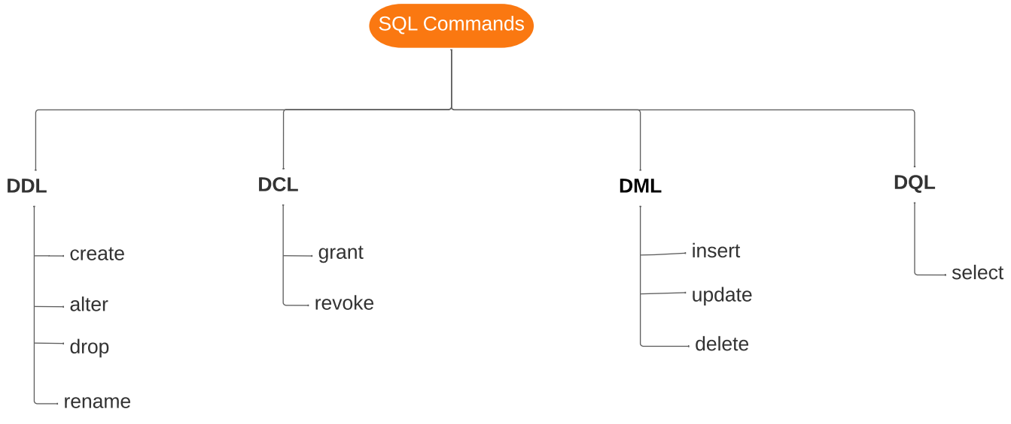
SQL Summary

Slide 22
Reference Links
https://www.w3schools.com/sql/default.asp
https://www.tutorialspoint.com/sql/sql-rdbms-concepts.htm
LeetCode practice:
https://leetcode.com/problemset/database/

Slide 23

Your success is our success
Contact
Mail: info@funnygorilla.com.au
Linkedin: https://mt.linkedin.com/in/songqing-gu-2ba9034b/de
Web Chat: FunnyGorilla
Phone: 0420891343

