Slide 1

Introduction to Database
Your success is our success
Part 03 – Advanced SQL
Funny Gorilla 诙猩猩
Notes:
Notes for title slide

Slide 2
Learning Objectives
By the end of this learning module, you will be able to understand and practice SQL, so that you can:
Create/Alter/Drop database
Entity relationship model
SQL

Slide 3
ER Data Modeling
business entities
attributes
relationship
Cardinality & ordinality

Slide 4
Database Lifecycle
Conceptual Design
1
Logical Design
2
Physical Design
3
Implementation
4

Slide 5
Data Query Language
Aggregates :
Sum,, avg, count
Projecting column
Query Data – one table:
SELECT SUM column1, column2 AS alias_name
FROM table_name
WHERE condition1 and condition2 or condiction3
Group By column
Filtering rows
Operators :
=, >, <, >=, <=, <>, Between, Like, In
Having condition
Order By column
Filtering at group level
Used with aggregate functions
By column
By grouping

Slide 6
Using Joint
Query Data across multiple table

Slide 7
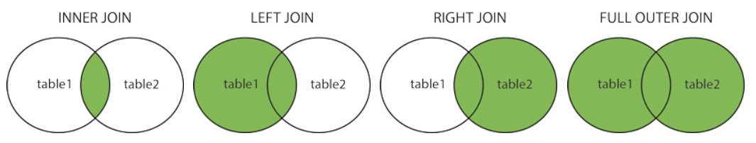
Using Joint
Query Data across multiple table
Returns records that have matching values in both tables
Returns all records from the left table, and the matched records from the right table
Returns all records from the right table, and the matched records from the left table
Returns all records when there is a match in either left or right table

Slide 8
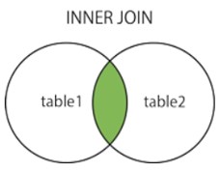
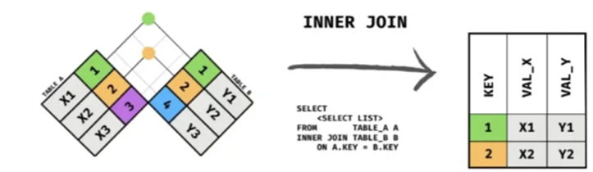
Inner Joint
Returns records that have matching values in both tables
Order
Customer
SELECT Orders.OrderID, Customers.CustomerName, Orders.OrderDate
FROM Orders
INNER JOIN Customers ON Orders.CustomerID=Customers.CustomerID;

Slide 9
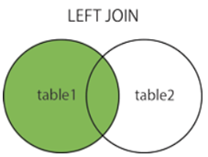
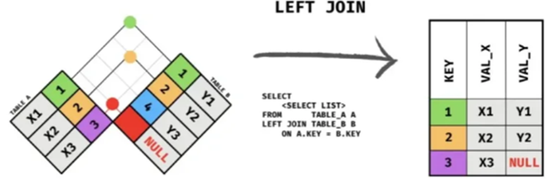
Left Joint
Returns all records from the left table, and the matched records from the right table
Order
Customer
SELECT Orders.OrderID, Customers.CustomerName, Orders.OrderDate
FROM Orders
LEFT JOIN Customers ON Orders.CustomerID=Customers.CustomerID;

Slide 10
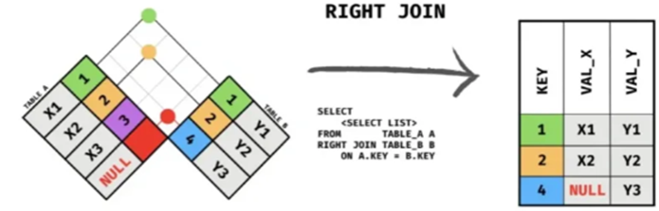
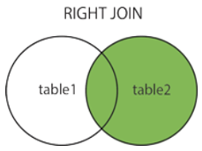
Right Joint
Returns all records from the right table, and the matched records from the left table
Order
Customer
SELECT Orders.OrderID, Customers.CustomerName, Orders.OrderDate
FROM Orders
LEFT JOIN Customers ON Orders.CustomerID=Customers.CustomerID;

Slide 11
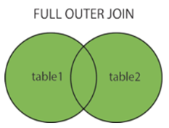
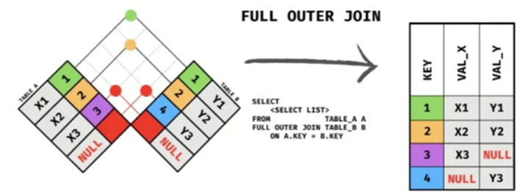
Full Joint
Returns all records from the right table, and the matched records from the left table
Order
Customer
SELECT Orders.OrderID, Customers.CustomerName, Orders.OrderDate
FROM Orders
FULL JOIN Customers ON Orders.CustomerID=Customers.CustomerID;

Slide 12
Common Table Expression (CTE)

Slide 13
CTEs, like database views and derived tables, enable users to more easily write and maintain complex queries via increased readability and simplification. This reduction in complexity is achieved by deconstructing ordinarily complex queries into simple blocks to be used, and reused if necessary, in rewriting the query.
Example use cases include:
Needing to reference a derived table multiple times in a single query
An alternative to creating a view in the database
Performing the same calculation multiple times over across multiple query components

Slide 14
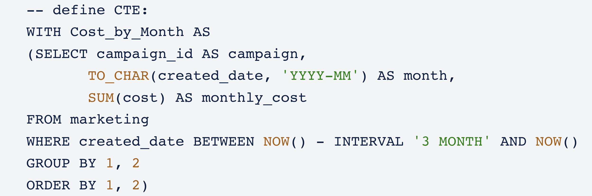

Slide 15
DQL Execution

Slide 16
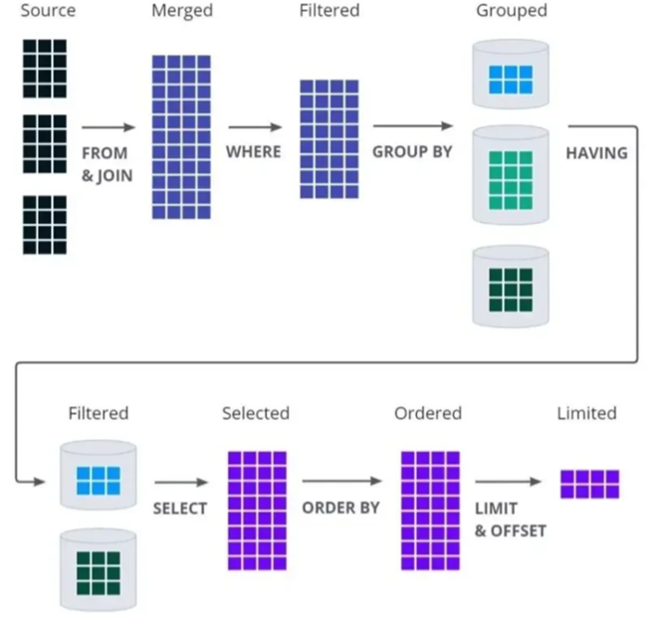
DQL Execution Order

Slide 17
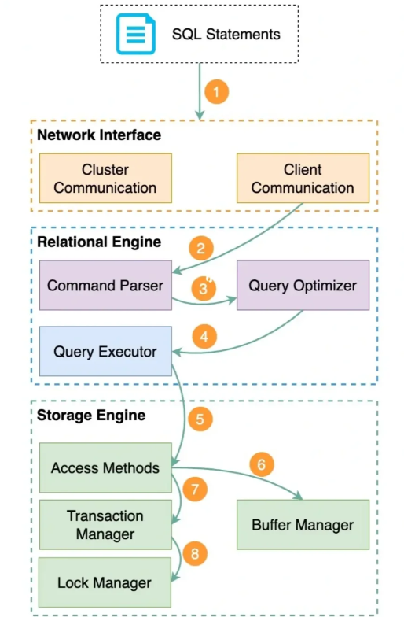
How SQL is executed in DB
MySQL服务端会按照如下流程执行该SQL语句：
客户端发送一条查询给服务器。
服务器先检查查询缓存，如果命中了缓存，则立刻返回存储在缓存中的结果。否则进入下一阶段。
服务器端进行SQL解析、预处理，再由优化器生成对应的执行计划。
MySQL根据优化器生成的执行计划，再调用存储引擎的API来执行查询。
将结果返回给客户端。

Slide 18
Index, View

Slide 19
INDEX
Indexes are special lookup tables that the database search engine can use to speed up data retrieval. Simply put, an index is a pointer to data in a table. An index in a database is very similar to an index in the back of a book.
Benefits:
Index helps to speed up SELECT queries and WHERE clauses,
but it slows down data input, with the UPDATE and the INSERT statements.
Indexes can be created or dropped with no effect on the data.
CREATE INDEX index_name ON table_name (column_name);
DROP INDEX index_name;

Slide 20
VIEW
Views, which are a type of virtual tables allow users to do the following:
Structure data in a way that users or classes of users find natural or intuitive.
Restrict access to the data in such a way that a user can see and (sometimes) modify exactly what they need and no more.
Summarize data from various tables which can be used to generate reports.
CREATE VIEW view_name AS
SELECT column1, column2.....
FROM table_name
WHERE [condition];
DROP VIEW view_name;

Slide 21
Stored Procedure

Slide 22
Stored Procedure
A Procedure in PL/SQL is a subprogram unit that consists of a group of PL/SQL statements that can be called by name. Each procedure in PL/SQL has its own unique name by which it can be referred to and called. This subprogram unit in the Oracle database is stored as a database object.

Slide 23
Stored Procedure
CREATE OR REPLACE PROCEDURE procedure_name (
parameterl IN/OUT <datatype> )
[ IS | AS ]
<declaration_part>
BEGIN
<execution part>
EXCEPTION
<exception handling part>
END;
EXEC procedure_name ( input_name );

Slide 24
Advantages:
Centralize business logic in the database
Reduce network traffic
Make database more secure
Disadvantages:
Resource usages
Troubleshooting
Maintenances

Slide 25
Constrains
Constraints are the rules enforced on the data columns of a table. These are used to limit the type of data that can go into a table. This ensures the accuracy and reliability of the data in the database.
The most commonly used constraints available in SQL:
Not Null
Default
Unique
Primary key
Foreign Key
RESTRICT,
CASCADE and
SET NULL
Check Constraint

Slide 26
Constrains
Constraints are the rules enforced on the data columns of a table. These are used to limit the type of data that can go into a table. This ensures the accuracy and reliability of the data in the database.
Following are some of the most commonly used constraints available in SQL:
Not Null Constraint − Ensures that a column cannot have NULL value.
Default Constraint - Provides a default value for a column when none is specified.
Unique Constraint - Ensures that all values in a column are different.
Primary key - Uniquely identifies each row/record in a database table.
Foreign Key - Uniquely identifies a row/record in any of the given database table.
Check Constraint - The CHECK constraint ensures that all the values in a column satisfies certain conditions.

Slide 27
Reference Links
https://www.w3schools.com/sql/default.asp
https://www.tutorialspoint.com/sql/sql-rdbms-concepts.htm
LeetCode practice:
https://leetcode.com/problemset/database/

Slide 28

Your success is our success
Contact
Mail: info@funnygorilla.com.au
Linkedin: https://mt.linkedin.com/in/songqing-gu-2ba9034b/de
Web Chat: FunnyGorilla
Phone: 0420891343

