Slide 1

Database Design Assignment
Your success is our success
Funny Gorilla 澳洲土逗-IT培训
Notes:
Notes for title slide

Slide 2
Prerequisites:
Use online ER tool - lucidchart
https://lucid.app/users/login?view=small

Slide 3
Assignment 01
1. Case study - Customer Order Management
so that you can use lucidchart:
Conceptual design - create ER conceptual view
Logical design - Create ER logical view
Physical design - Create ER physical view

Slide 4
Case Study – Customer Order Management
A fictitious company that sells computer hardware including storage, motherboard, RAM, video card, etc.
The company maintains the product information such as name, description standard cost, list price, and product line.
It also tracks the inventory information for all products including warehouses where products are available.
Because the company operates globally, it has warehouses in various locations around the world.
The company records all customer information including name, address, and website.
Each customer has at least one contact person with detailed information including name, email, and phone.
The company also places a credit limit on each customer to limit the amount that customer can owe.
Whenever a customer issues a purchase order, a sales order is created in the database with the pending status. When the company ships the order, the order status becomes shipped. In case the customer cancels an order, the order status becomes canceled.
The employee is allocated to help facilitate order delivery. One employee can look after multiple orders. its data is recorded with some basic information such as name, email, phone, job title, manager, and hire date.

Slide 5
Reference
Logical view
Physical view

Slide 6
Logical View
Customer
Contact
Region
Order
Employee
Country
Item
Category
Location
Product
Inventories
Warehouse

Slide 7
Physical View
https://www.oracletutorial.com/getting-started/oracle-sample-database/

Slide 8
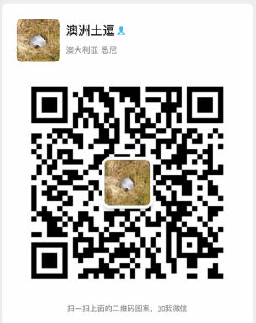
Your success is our success
Contact
Mail: info@funnygorilla.com.au
Linkedin: https://mt.linkedin.com/in/songqing-gu-2ba9034b/de
Web Chat: FunnyGorilla
Phone: 0420891343

