Slide 1

SQL Assignment
Your success is our success
Funny Gorilla 澳洲土逗-IT培训
Notes:
Notes for title slide

Slide 2
MySQL Database installed locally
Prerequisites:
Sample MySQL Database (ClassModes) loaded

Slide 3
Assignment 01 – end to end database lifecycle
1. Design Student Enrolment (case study)
Conceptual design - create ER conceptual view
Logical design - create ER logical view
Physical design - create ER physical view
2. implement Student Enrolment (case study)
Implementation - create DDL, DCL, DML, DQL
Create Database - create the database
Prepare & Load data - insert data into each table
Please refer to sample SQL clauses in work sheet.

Slide 4
Case Study
Student is allowed to enroll one course.
Each course includes multiple subjects, with each subject belonging to one course.
Subject score for students are to be persistent.
There is compulsory text book for each subject.

Slide 5
Assignment 02 - Study the sample database (ClassModels)
classicmodels
Logical design - understand ER physical view
Implementation - understand DDL, DCL, DML, DQL – be aware of sequence
Practise DQL – especially join
SELECT DISTINCT/SUM col1, col2 AS alias_name
FROM table_name
WHERE condition1 and condition2 or condiction3
Group By column
Having condition
Order By column
SELECT col(s)
FROM table_01
INNER/LEFT/RIGHT/FULL JOIN table_02
ON table_01.name = table_02.name

Slide 6
Assignment 03 - practice SQL in
LeetCode
https://leetcode.com/problemset/database/

Slide 7
Assignment 04 – Stored Procedure
Write a stored procedure:
count the number of customer, who are from USA and whose creditlimit is less than 50000.

Slide 8
Assignment 04 - practice SQL in Leetcode
LeeCode
https://leetcode.com/problemset/database/

Slide 9
Reference
W3schools
https://www.w3schools.com/sql/sql_exercises.asp
https://www.w3schools.com/sql/sql_quiz.asp
LeetCode
https://leetcode.com/problemset/database/
Stored Procedure
https://www.mysqltutorial.org/mysql-stored-procedure-tutorial.aspx

Slide 10
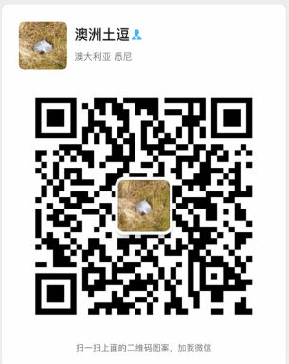
Your success is our success
Contact
Mail: info@funnygorilla.com.au
Linkedin: https://mt.linkedin.com/in/songqing-gu-2ba9034b/de
Web Chat: FunnyGorilla
Phone: 0420891343

