Slide 1

Funny Gorilla诙猩猩-IT培训
Your success is our success
API Introduction

Slide 2
Learning Objectives
By the end of this learning module, you will be able to understand:
What is API
Why API
Where is API located
API types
Transport Protocol - HTTP
Data Contract
API Governance

Slide 3
What is API?

Slide 4

Service
Business: IT consulting service
Function
Language: Chinese
Data contract
Channel: Phone
Transport protocol
Funny Gorilla

Slide 5

Service
API
Function
Data contract
Transport protocol
Communication pattern

Slide 6
Where is API Located?

Slide 7


Where is API Located?
API
service contract
HTML/CSS/JS
JSON/Http
SQL/JDBC
Web Tier
Business Tier
Database Tier
Client System
Client – Server Delivery Model

Slide 8
What can we do with API?

Slide 9
Server programming
API
Requirement
Service contract
Client programming
Test plan
Test cases
Function
Data contract
Transport protocol
Design
Communication pattern

Slide 10
Data Contract

Slide 11
XML
JSON

Slide 12
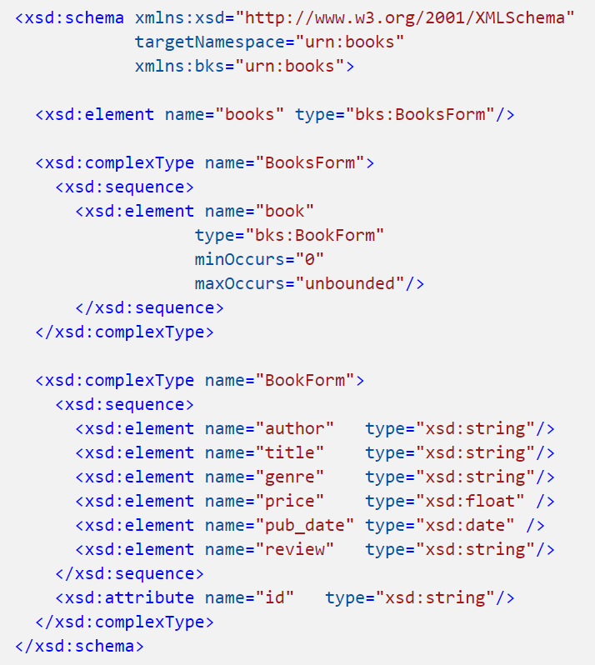
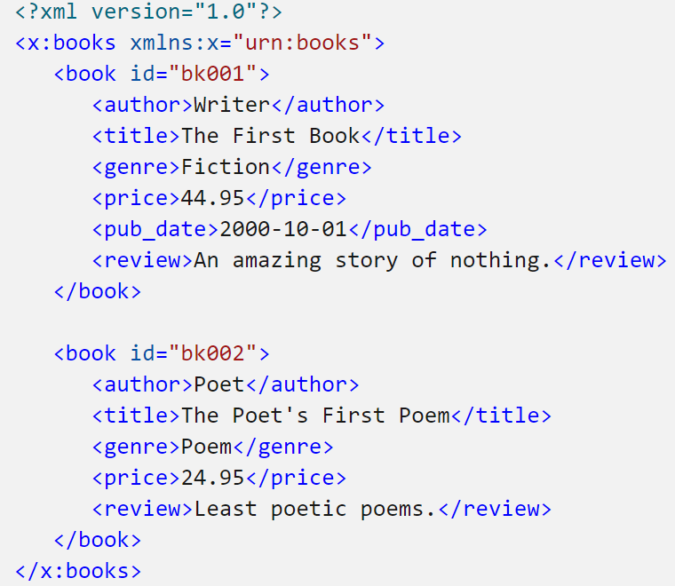
XML
Xml Schema Definition - XSD

Slide 13
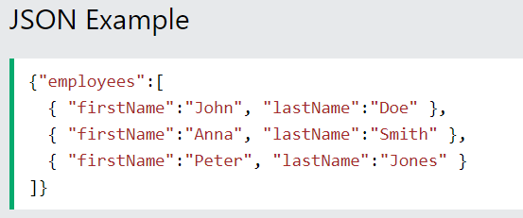
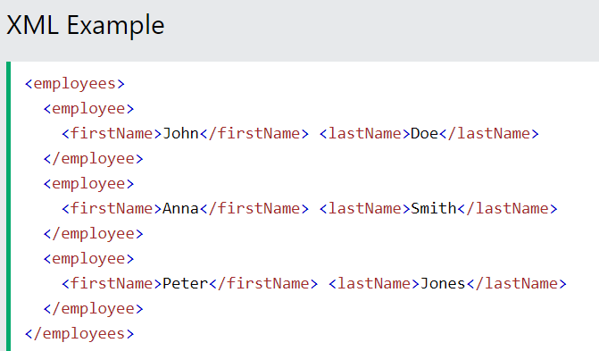
JSON

Slide 14
Transport protocol

Slide 15
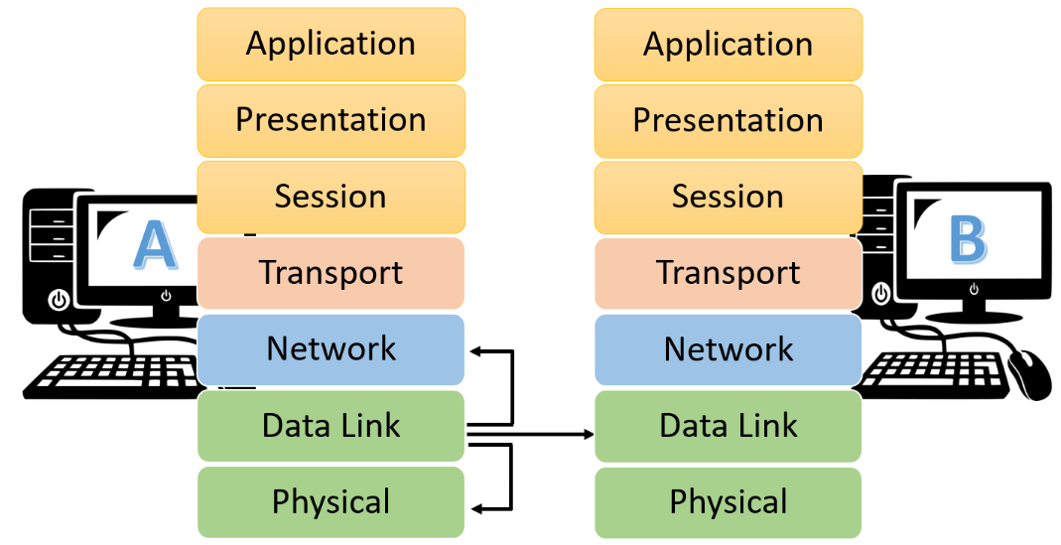
OSI Model

Slide 16
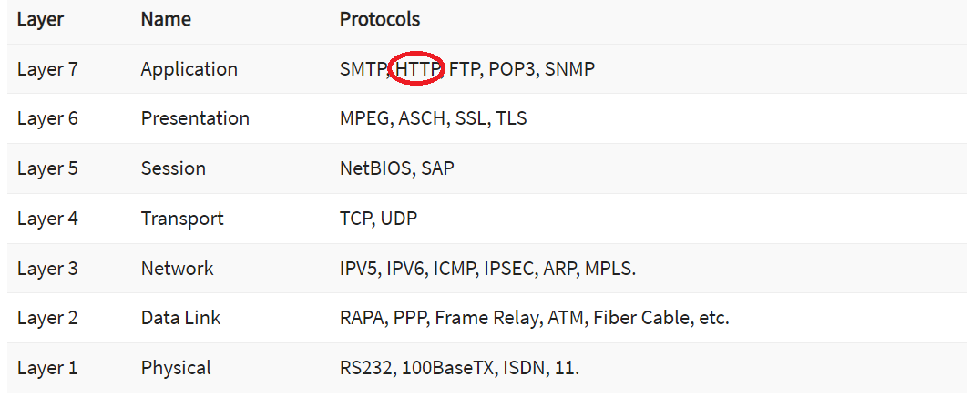
Transport protocol

Slide 17
Communication Patterns
https://reflectoring.io/microservice-communication-patterns/

Slide 18
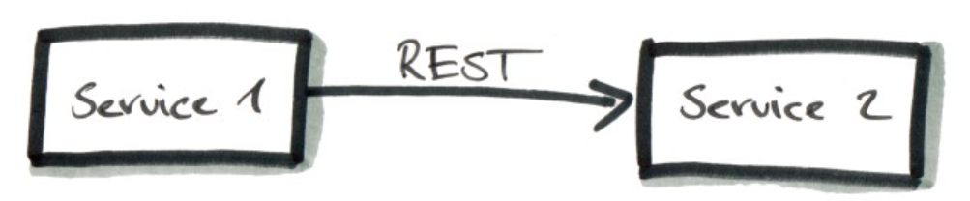
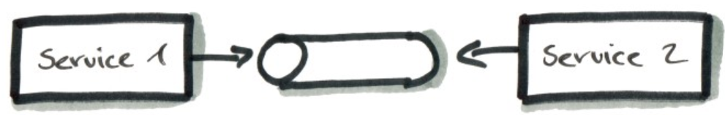
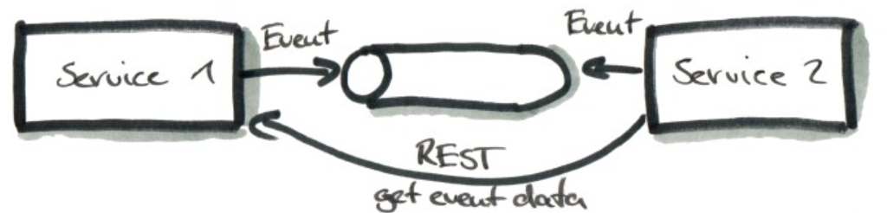
Synchronous vs Asynchronous
https://reflectoring.io/microservice-communication-patterns/

Slide 19

Real World APIs
Data Centre/Cloud
Credit card
Account management
Order management
Inventory management
Credit checking
Customer management
API

Slide 20

Real World Applications
Credit card
A Company
Data Centre/Cloud
Account management
Web application
Order management
Inventory management
Credit checking
Customer management
DMZ
API
Fire Wall

Slide 21
API Types

Slide 22
Data Contract
Transport Protocol
Communication Pattern
SOAP API
REST API
GraphQL
Sync
Webhooks API
WebSocket API
gRPC API
Server-sent event API
Async
https://blog.postman.com/intro-to-apis-what-is-an-api/

Slide 23
Important API Types
1
SOAP API
2
REST API
3
GraphQL

Slide 24
API Governance

Slide 25
Design
Test
Production
Versioning
Deprecated
Retired
https://blog.postman.com/api-lifecycle-blueprint/

Slide 26
References
Http | https://www.tutorialspoint.com/http/http_overview.htm
XML | https://www.w3schools.com/xml/default.asp
SOAP | https://www.tutorialspoint.com/soapui/soap_introduction.htm
SOAPUI | https://support.smartbear.com/readyapi/docs/get-started.html
JSON | https://www.w3schools.com/js/js_json_intro.asp
REST | https://aws.amazon.com/what-is/restful-api/
Postman | https://learning.postman.com/docs/getting-started/introduction/
https://blog.devgenius.io/how-to-speed-up-your-api-tests-using-the-advanced-features-of-postman-350c453b376

Slide 27

Contact
Your success is our success
Mail: info@funnygorilla.com.au
Linkedin: https://mt.linkedin.com/in/songqing-gu-2ba9034b/de
Web Chat: FunnyGorilla
Phone: 0420891343

