Slide 1

Funny Gorilla诙猩猩-IT培训
Your success is our success
HTTP Introduction

Slide 2
Learning Objectives
By the end of this learning module, you will be able to understand:
What is Transport Protocal
Http introduction
URI
Request Method
Response Code
Data format

Slide 3
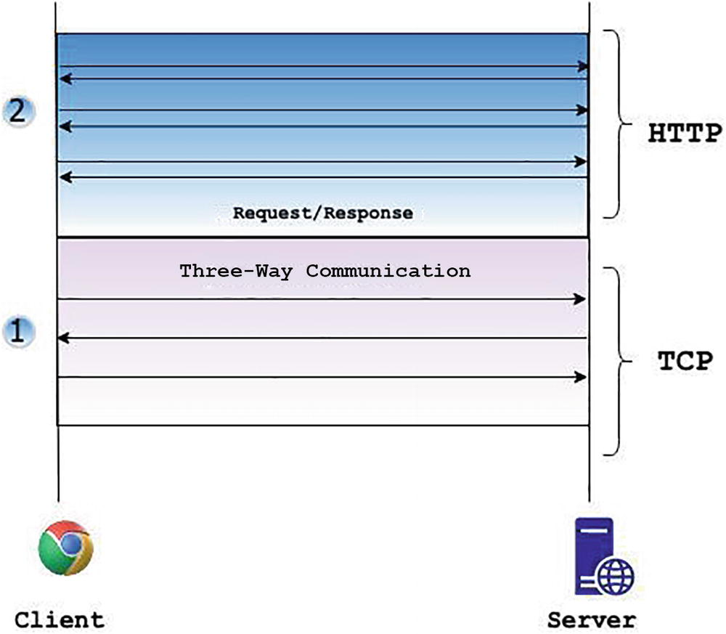
HTTP Introduction
Message
URI
Header
Body
Request / Response
Request Methods
Status Code
Response Message
Synchronous Communication pattern
Request
Message

Slide 4
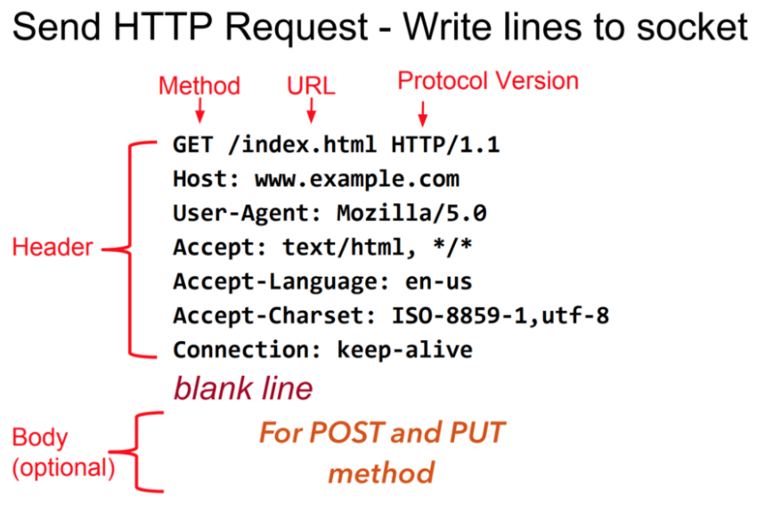
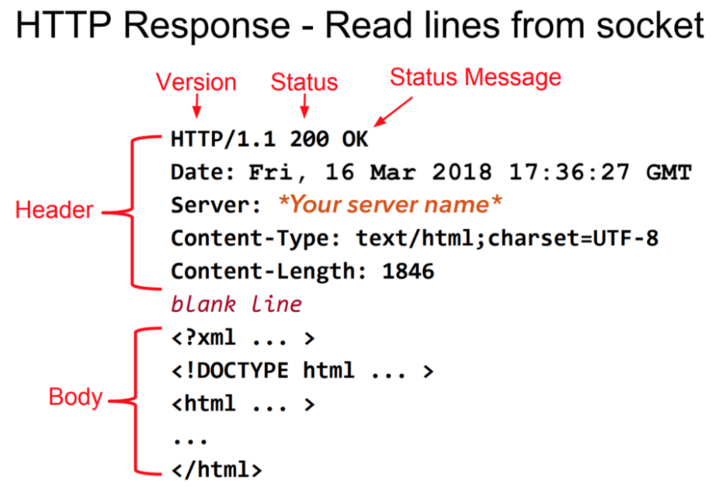
HTTP Sample - header, body, request, response

Slide 5

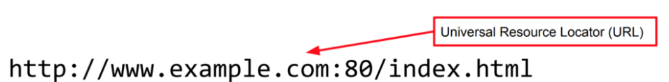
HTTP – URI, URL
www.example.com
168.112.10.10
DNS
Localhost -> 127.0.0.1

Slide 6

HTTP – Request Methods

Slide 7
HTTP - Status Code
2xx — The request was successful
4xx — The request contains an error of some kind.
  400 Bad Request – This means that client-side input fails validation.
  401 Unauthorized – This means the user isn’t not authorized to access a resource. It usually returns when the user isn’t authenticated.
  403 Forbidden – This means the user is authenticated, but it’s not allowed to access a resource.
  404 Not Found – This indicates that a resource is not found.
5xx — The server encountered an error fulfilling the request.
  500 Internal server error – This is a generic server error. It probably shouldn’t be thrown explicitly.
  503 Service Unavailable – This indicates that something unexpected happened on server side (It can be anything like server overload, some parts of the system failed, etc.).

Slide 8
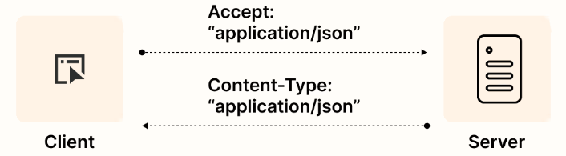
Data format in HTTP

Slide 9
Demo - HTTP

Slide 10
Event Listener - HTTP

Slide 11
References
Http | https://www.tutorialspoint.com/http/http_overview.htm
XML | https://www.w3schools.com/xml/default.asp
SOAP | https://www.tutorialspoint.com/soapui/soap_introduction.htm
SOAPUI | https://support.smartbear.com/readyapi/docs/get-started.html
JSON | https://www.w3schools.com/js/js_json_intro.asp
REST | https://aws.amazon.com/what-is/restful-api/
Postman | https://learning.postman.com/docs/getting-started/introduction/
https://blog.devgenius.io/how-to-speed-up-your-api-tests-using-the-advanced-features-of-postman-350c453b376

Slide 12

Your success is our success
Contact
Mail: info@funnygorilla.com.au
Linkedin: https://mt.linkedin.com/in/songqing-gu-2ba9034b/de
Web Chat: FunnyGorilla
Phone: 0420891343

