Slide 1

Funny Gorilla诙猩猩-IT培训
Your success is our success
SOAP API Introduction

Slide 2
Learning Objectives
By the end of this learning module, you will be able to understand:
SOAP API
WSDL
SOAP Request
SOAP Response

Slide 3
SOAP API
SOAP = XML/HTTP
Download SoapUI: https://www.soapui.org/downloads/soapui/

Slide 4
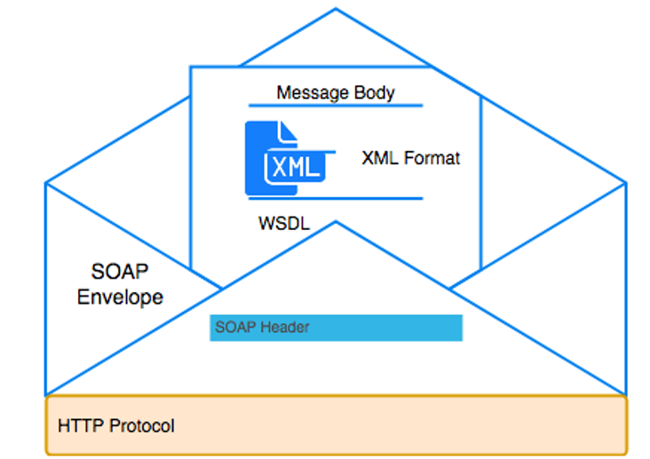
SOAP Message Layout

Slide 5
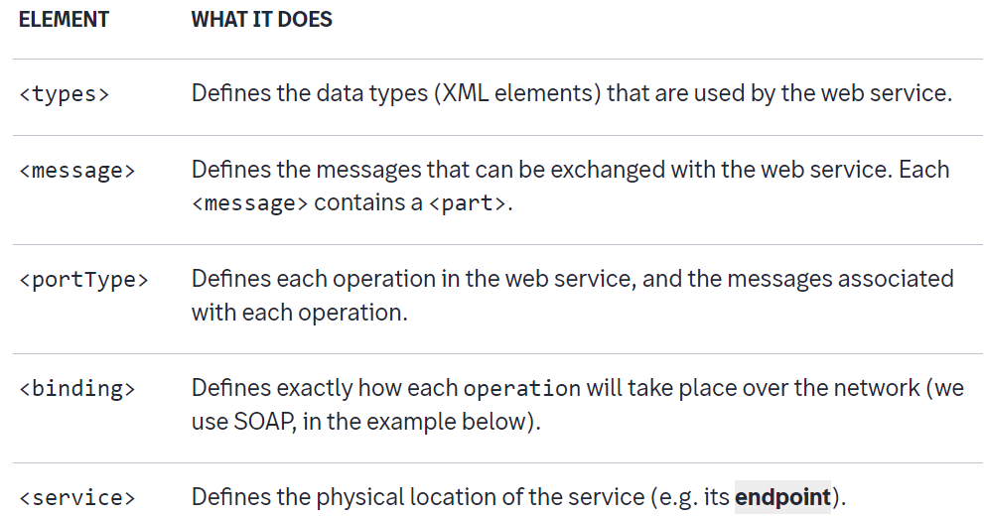
WSDL Introduction

Slide 6
WSDL Introduction
Data Types
Bindings
Messages
Port Types
Services

Slide 7
SOAP Messages request response

Slide 8
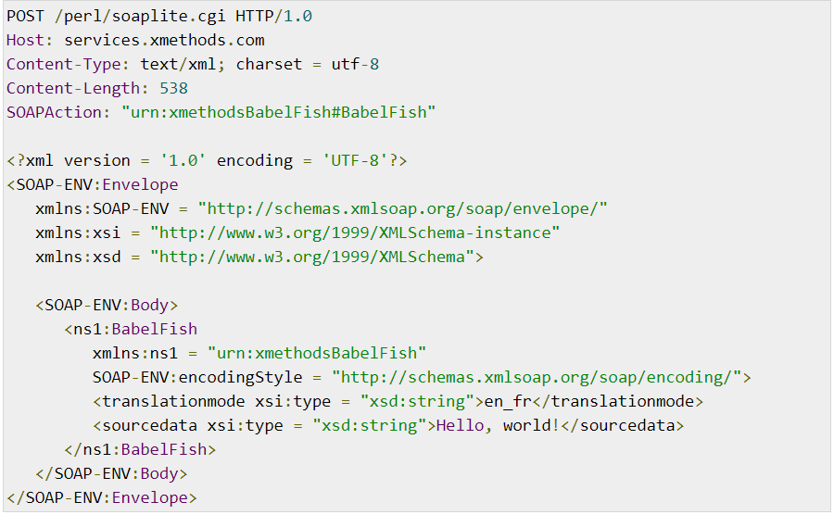
SOAP API - request

Slide 9
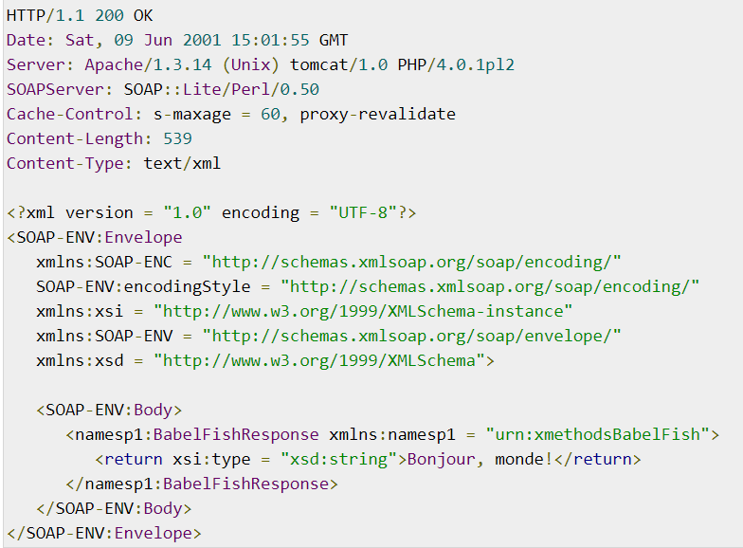
SOAP API – response

Slide 10
Demo - SOAP API
https://www.soapui.org/learn/tutorials/web-service-example-projects/
https://support.smartbear.com/readyapi/docs/samples/index.html

Slide 11
Disadvantages
Xml message body
Strict Schema validation

Slide 12
References
Http | https://www.tutorialspoint.com/http/http_overview.htm
XML | https://www.w3schools.com/xml/default.asp
SOAP | https://www.tutorialspoint.com/soapui/soap_introduction.htm
SOAPUI | https://support.smartbear.com/readyapi/docs/get-started.html
JSON | https://www.w3schools.com/js/js_json_intro.asp
REST | https://aws.amazon.com/what-is/restful-api/
Postman | https://learning.postman.com/docs/getting-started/introduction/
https://blog.devgenius.io/how-to-speed-up-your-api-tests-using-the-advanced-features-of-postman-350c453b376

Slide 13

Your success is our success
Contact
Mail: info@funnygorilla.com.au
Linkedin: https://mt.linkedin.com/in/songqing-gu-2ba9034b/de
Web Chat: FunnyGorilla
Phone: 0420891343

