Slide 1

Funny Gorilla诙猩猩-IT培训
Your success is our success
REST API Introduction

Slide 2
Learning Objectives
By the end of this learning module, you will be able to understand:
What is API
Why API
Where is API located
API types
Transport Protocol - HTTP
Data Contract
Rest API
OpenAPI Specification
API lifecycle

Slide 3
Service
API
Function
Data contract
Transport protocol
Communication pattern

Slide 4
REST API
Representational State Transfer

Slide 5
REST API
A client-server architecture made up of clients, servers, and resources, with requests managed through HTTP.
Stateless client-server communication, meaning no client information is stored between get requests and each request is separate and unconnected.
A layered system that organizes each type of server (those responsible for security, load-balancing, etc.) involved the retrieval of requested information into hierarchies, invisible to the client.

Slide 6
REST API – concept (optional)
A uniform interface between components so that information is transferred in a standard form.
This requires that: resources requested are identifiable and separate from the representations sent to the client.
resources can be manipulated by the client via the representation they receive because the representation contains enough information to do so.
self-descriptive messages returned to the client have enough information to describe how the client should process it.
hypertext/hypermedia is available, meaning that after accessing a resource the client should be able to use hyperlinks to find all other currently available actions they can take.
https://www.redhat.com/en/topics/api/what-is-a-rest-api

Slide 7
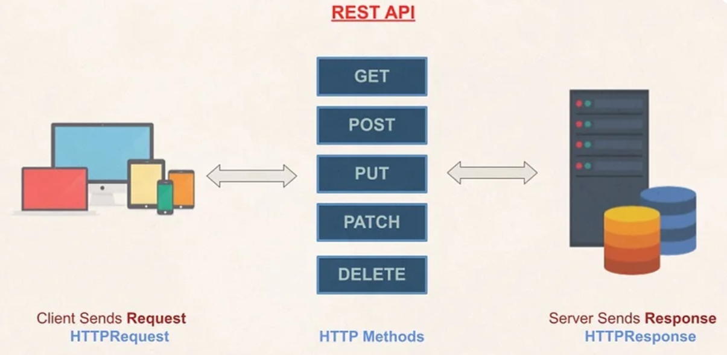
End point

Slide 8
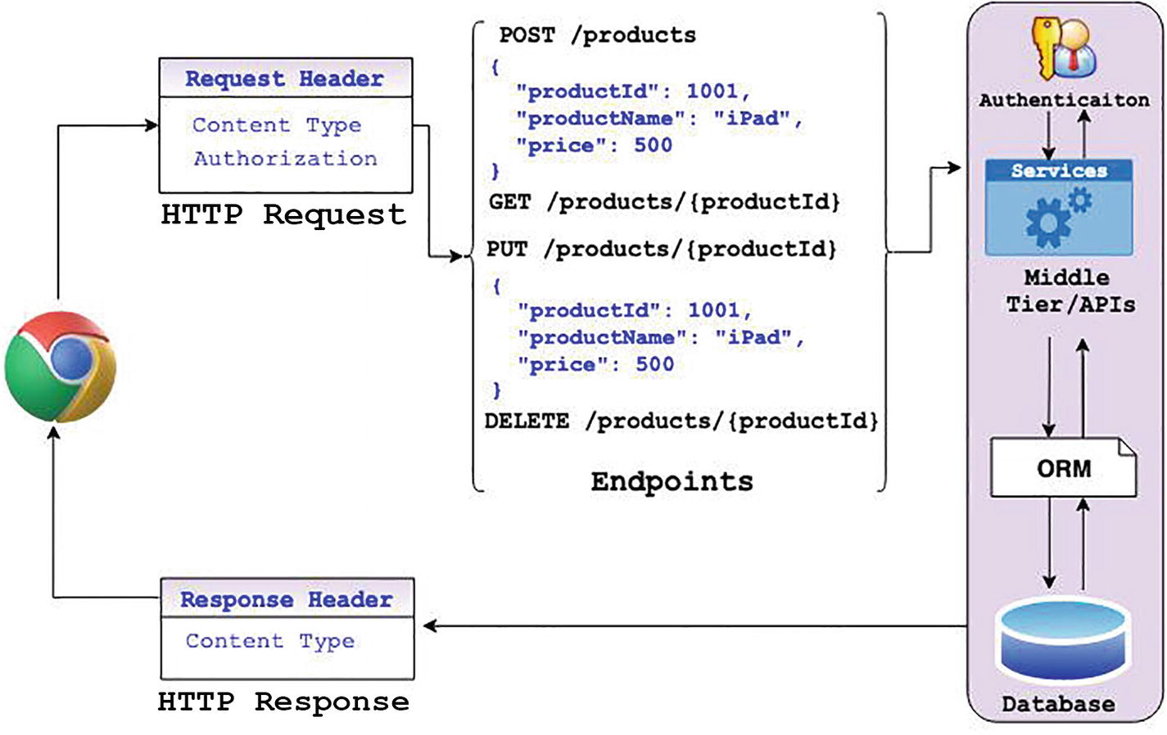

Slide 9
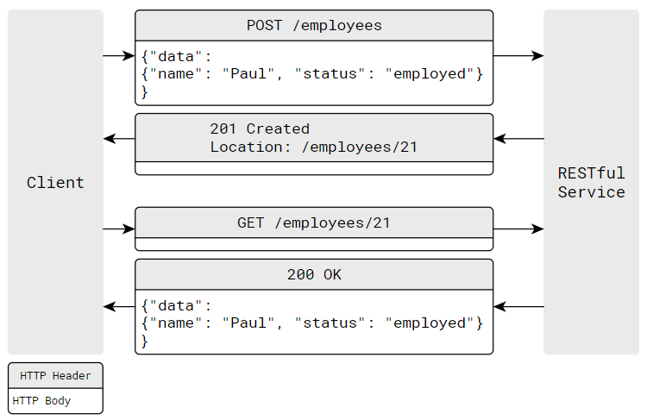
REST API – POST

Slide 10
Demo – REST API

Slide 11
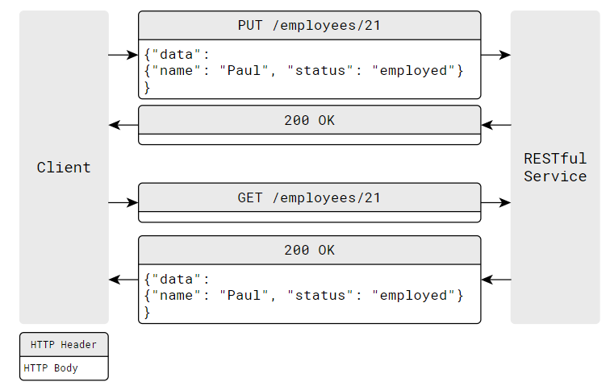
REST API – PUT

Slide 12
Demo – REST API

Slide 13
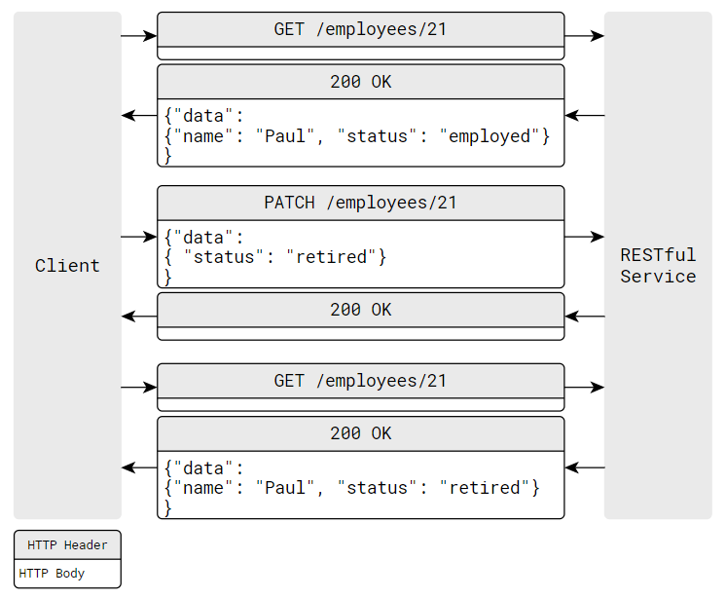
REST API – PATCH

Slide 14
Rest API Example - HTTP Method, URL, resource path
No | API Name | Method | Resource Path | Status Code | Description
1 | Get students | Get | /api/v1/students/ | 200 | All students are retrieved
2 | Create students | Post | /api/v1/students/ | 201 | The student is created
3 | Get student | Get | /api/v1/students/{id} | 200 | The student is retrieved
4 | Update student | Put | /api/v1/students/{id} | 202 | The student is updated
5 | Delete students | Delete | /api/v1/students/{id} | 204 | The student is deleted
6 | Modify students | Patch | /api/v1/students/{id} | 204 | The student is modified

Slide 15
Deployment

Slide 16

End Point
Triplet
Http Method
Host Name
Resource Path
Get
http://www.hostname/
Accounts/66

Slide 17
REST API Specifications
RAML
API Blueprint
OpenAPI/Swagger

Slide 18
OpenAPI/Swagger – Demo
Swagger Editor
https://editor.swagger.io/
Example Petstore API
https://petstore.swagger.io/v2/swagger.json

Slide 19
Restful API Governance
https://blog.postman.com/api-lifecycle-blueprint/

Slide 20
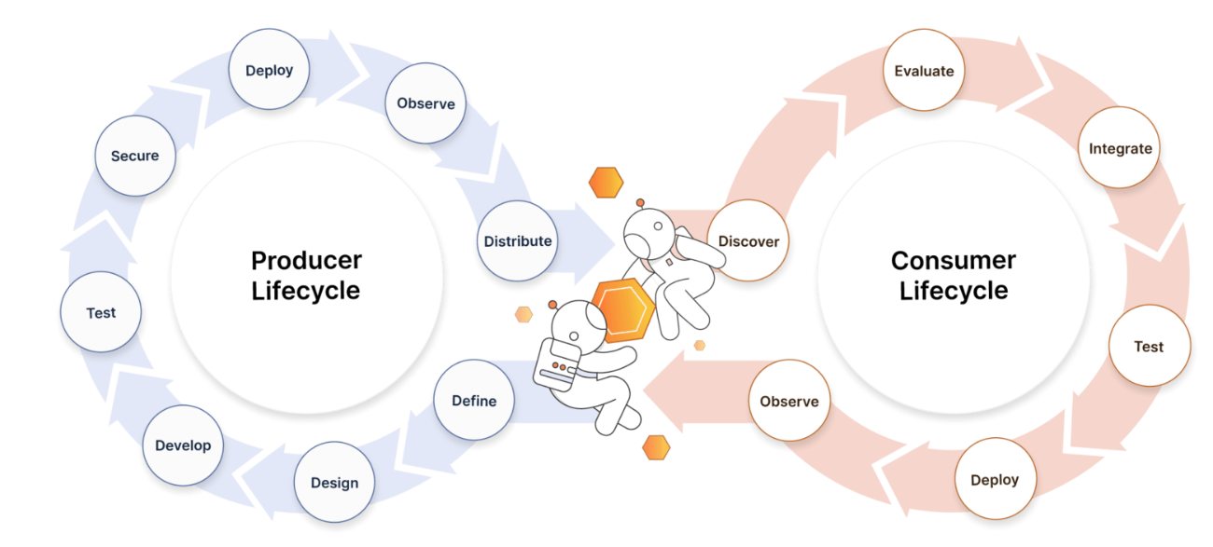
API Lifecycle
https://blog.postman.com/api-lifecycle-blueprint/

Slide 21
References
Http | https://www.tutorialspoint.com/http/http_overview.htm
XML | https://www.w3schools.com/xml/default.asp
SOAP | https://www.tutorialspoint.com/soapui/soap_introduction.htm
SOAPUI | https://support.smartbear.com/readyapi/docs/get-started.html
JSON | https://www.w3schools.com/js/js_json_intro.asp
REST | https://aws.amazon.com/what-is/restful-api/
Postman | https://learning.postman.com/docs/getting-started/introduction/
https://blog.devgenius.io/how-to-speed-up-your-api-tests-using-the-advanced-features-of-postman-350c453b376

Slide 22

Your success is our success
Contact
Mail: info@funnygorilla.com.au
Linkedin: https://mt.linkedin.com/in/songqing-gu-2ba9034b/de
Web Chat: FunnyGorilla
Phone: 0420891343

