Slide 1

Funny Gorilla诙猩猩-IT培训
Your success is our success
API Security

Slide 2
Learning Objectives
By the end of this learning module, you will be able to understand:
What is API
Why API
Where is API located
API types
Transport Protocol - HTTP
Data Contract
Rest API
OpenAPI Specification
API lifecycle

Slide 3
API Security – OAuth 2.0
Notes:
The goal of the OAuth 2.0 client credentials grant is to allow two automated services to interact securely. It does this primarily by replacing the old scheme, HTTP Basic, with a token-based authentication scheme that greatly reduces the number of requests that expose sensitive access credentials.
The problems with HTTP Basic:
it sends the username and password with every request.
This means that each and every request between each and every service is a major potential security risk.
Did the headers get leaked in a log file?
Did somebody forget to force HTTPS?
One mistake and credentials are compromised.
Further, because usernames and passwords often don’t have expiration dates, and because many people will (sadly) reuse these credentials across services, such a leak can expose a hole the size of a barn in a system’s security barrier.

Slide 4
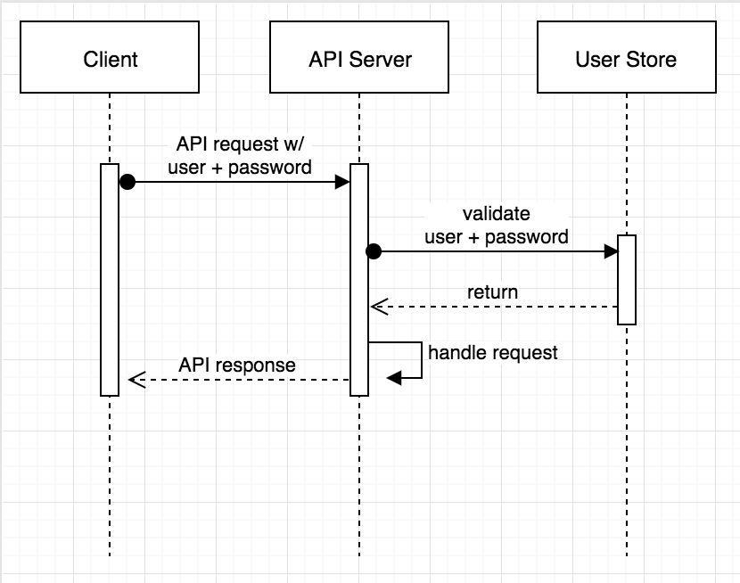
The problems with HTTP Basic
Notes:
The goal of the OAuth 2.0 client credentials grant is to allow two automated services to interact securely. It does this primarily by replacing the old scheme, HTTP Basic, with a token-based authentication scheme that greatly reduces the number of requests that expose sensitive access credentials.
The problems with HTTP Basic:
it sends the username and password with every request.
This means that each and every request between each and every service is a major potential security risk.
Did the headers get leaked in a log file?
Did somebody forget to force HTTPS?
One mistake and credentials are compromised.
Further, because usernames and passwords often don’t have expiration dates, and because many people will (sadly) reuse these credentials across services, such a leak can expose a hole the size of a barn in a system’s security barrier.

Slide 5
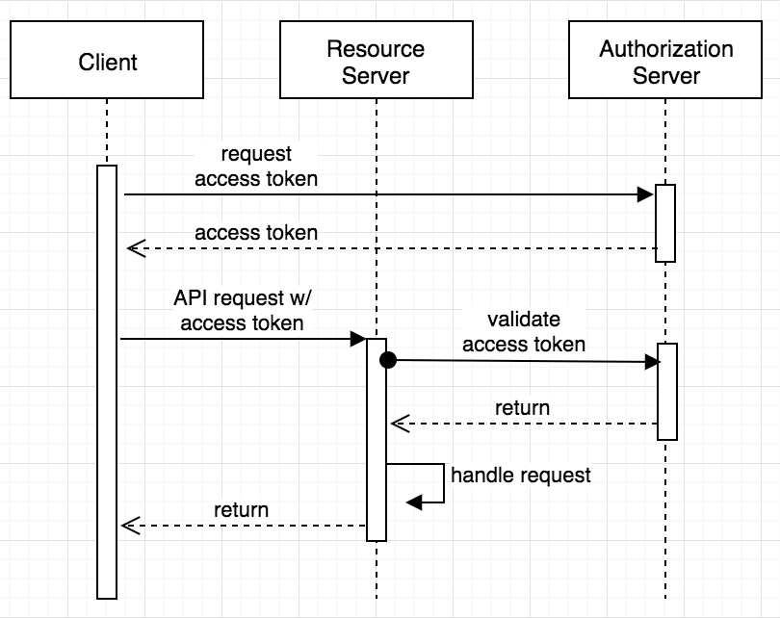
OAuth 2.0
Notes:
The primary benefit:
that the service credentials are only exposed when a new token must be requested or refreshed.
this request is performed in a far more controlled manner, since it happens between the client and the authorization server.
With HTTP Basic, in essence, every server has to act as an authorization server, with the increased security risk this poses.
when the service that receives the request validates the token. It makes a request to the authorization server, sending only the token, not exposing the username and password of the client.
Another major benefit is that the tokens should expire and can be scoped. Passwords only expire when they are changed. Tokens have an expiration built into them.
Further, the scope of the token and the authenticated identity of the token holder can be used to restrict the actions that the token holder is allowed to perform.

Slide 6
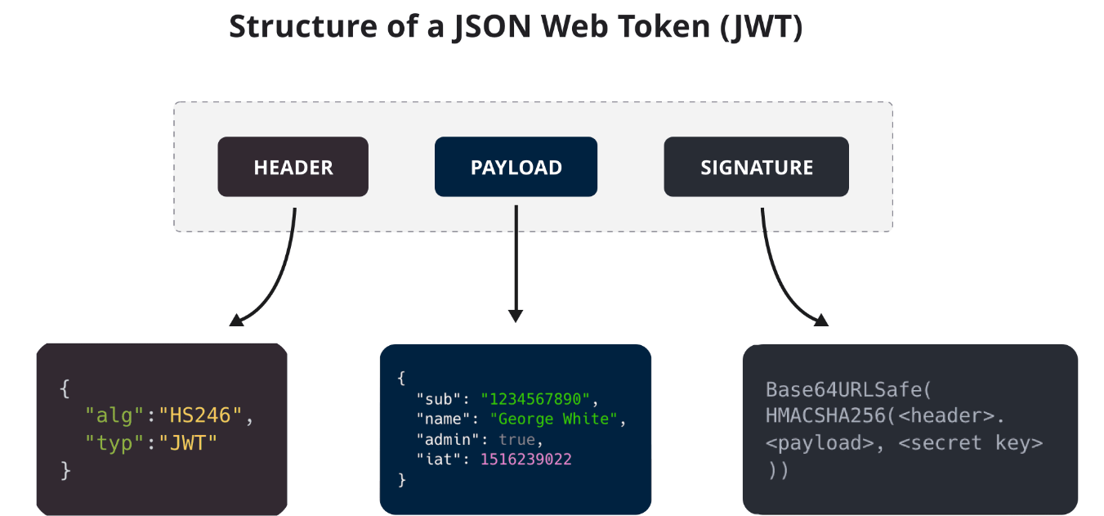

Slide 7
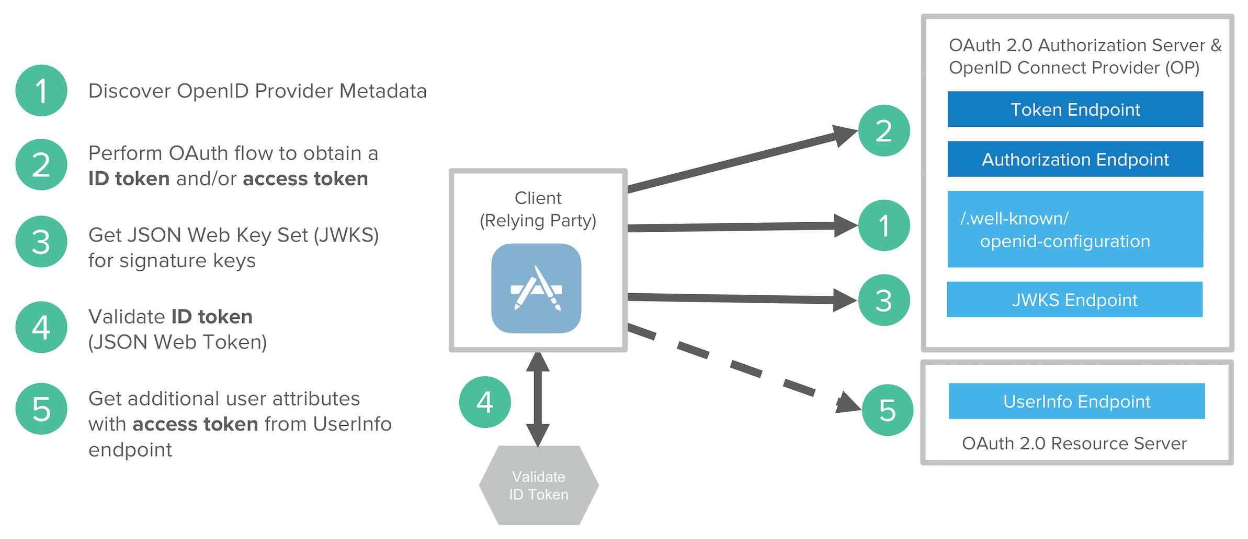
https://developer.okta.com/blog/2020/03/23/microservice-security-patterns

Slide 8
References
https://developer.okta.com/blog/2021/05/05/client-credentials-spring-security

Slide 9

Your success is our success
Contact
Mail: info@funnygorilla.com.au
Linkedin: https://mt.linkedin.com/in/songqing-gu-2ba9034b/de
Web Chat: FunnyGorilla
Phone: 0420891343

