Slide 1

Funny Gorilla诙猩猩-IT培训
Your success is our success
HTTP Introduction

Slide 2
Learning Objectives
By the end of this learning module, you will be able to understand:
What is Transport Protocol
Http introduction
URI
Request Method
Response Code
Data format

Slide 3
Transport protocol

Slide 4
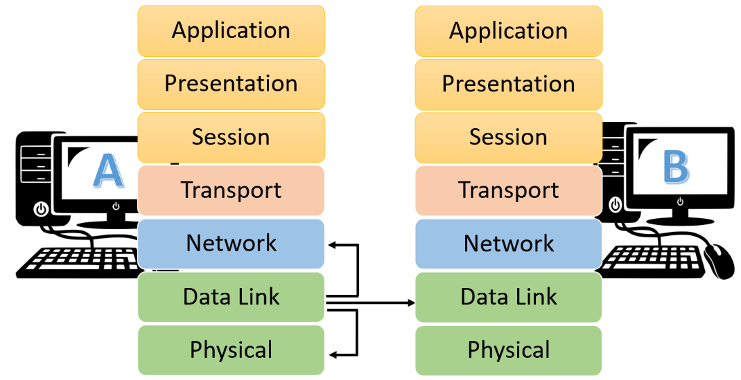

Slide 5
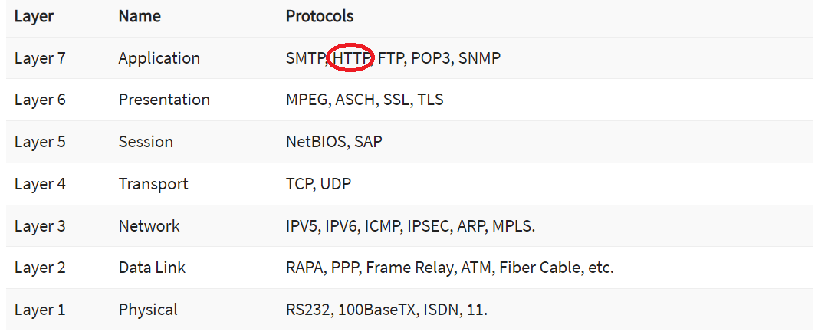
Transport protocol

Slide 6
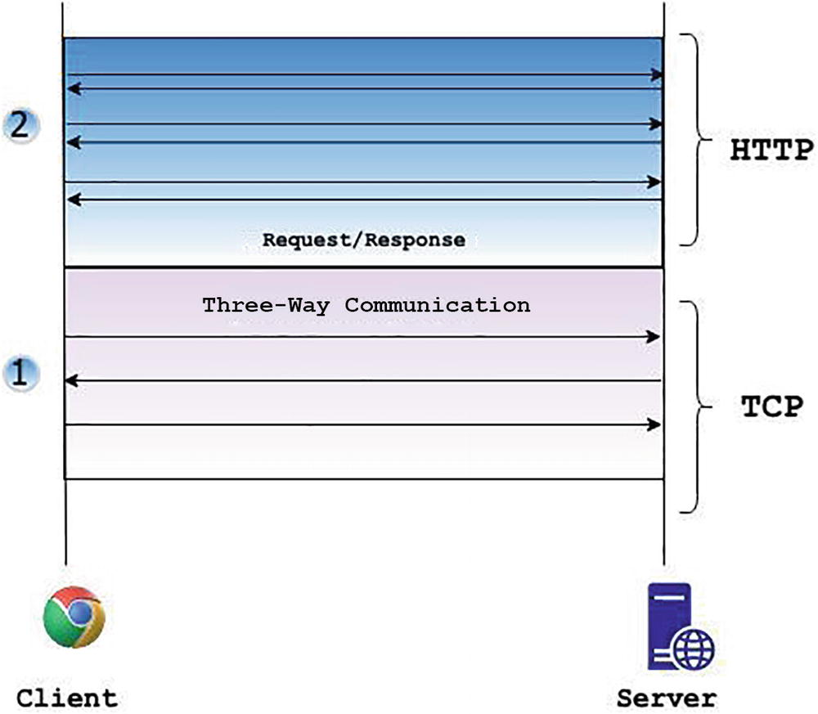
HTTP Introduction
Message
Request / Response
URI
Header
Body
Request Methods
Status Code
Request
Message
Response Message
Synchronous Communication pattern

Slide 7
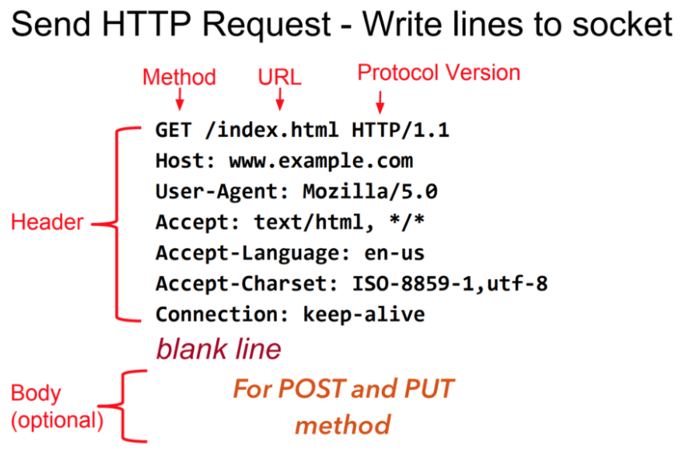
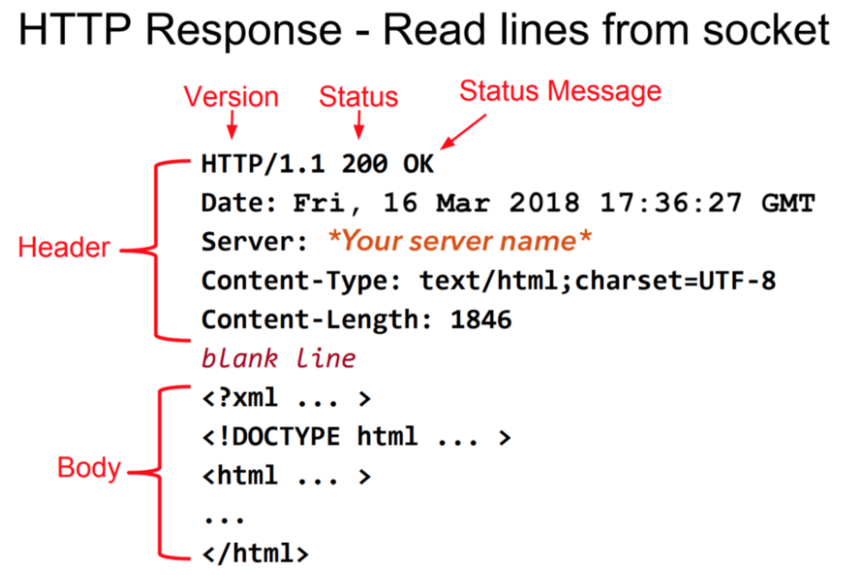
HTTP Sample - header, body, request, response

Slide 8

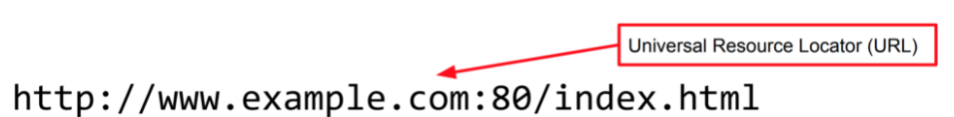
HTTP – URI, URL
www.example.com
168.112.10.10
DNS

Slide 9
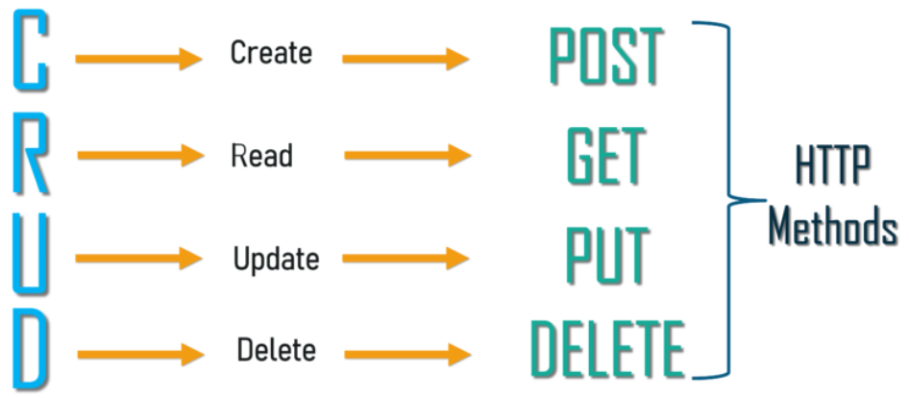
HTTP – Request Methods

Slide 10
HTTP - Status Code
2xx — The request was successful
3xx — The client is redirected to a different resource.
4xx — The request contains an error of some kind.
  400 Bad Request – This means that client-side input fails validation.
  401 Unauthorized – This means the user isn’t not authorized to access a resource. It usually returns when the user isn’t authenticated.
  403 Forbidden – This means the user is authenticated, but it’s not allowed to access a resource.
  404 Not Found – This indicates that a resource is not found.
5xx — The server encountered an error fulfilling the request.
  500 Internal server error – This is a generic server error. It probably shouldn’t be thrown explicitly.
  503 Service Unavailable – This indicates that something unexpected happened on server side (It can be anything like server overload, some parts of the system failed, etc.).

Slide 11
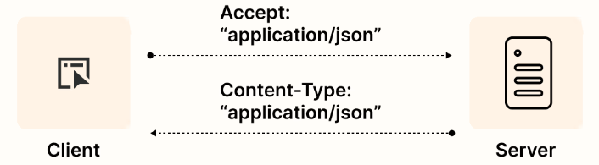
Data format in HTTP

Slide 12
Demo - HTTP

Slide 13
Session & cookies

Slide 14
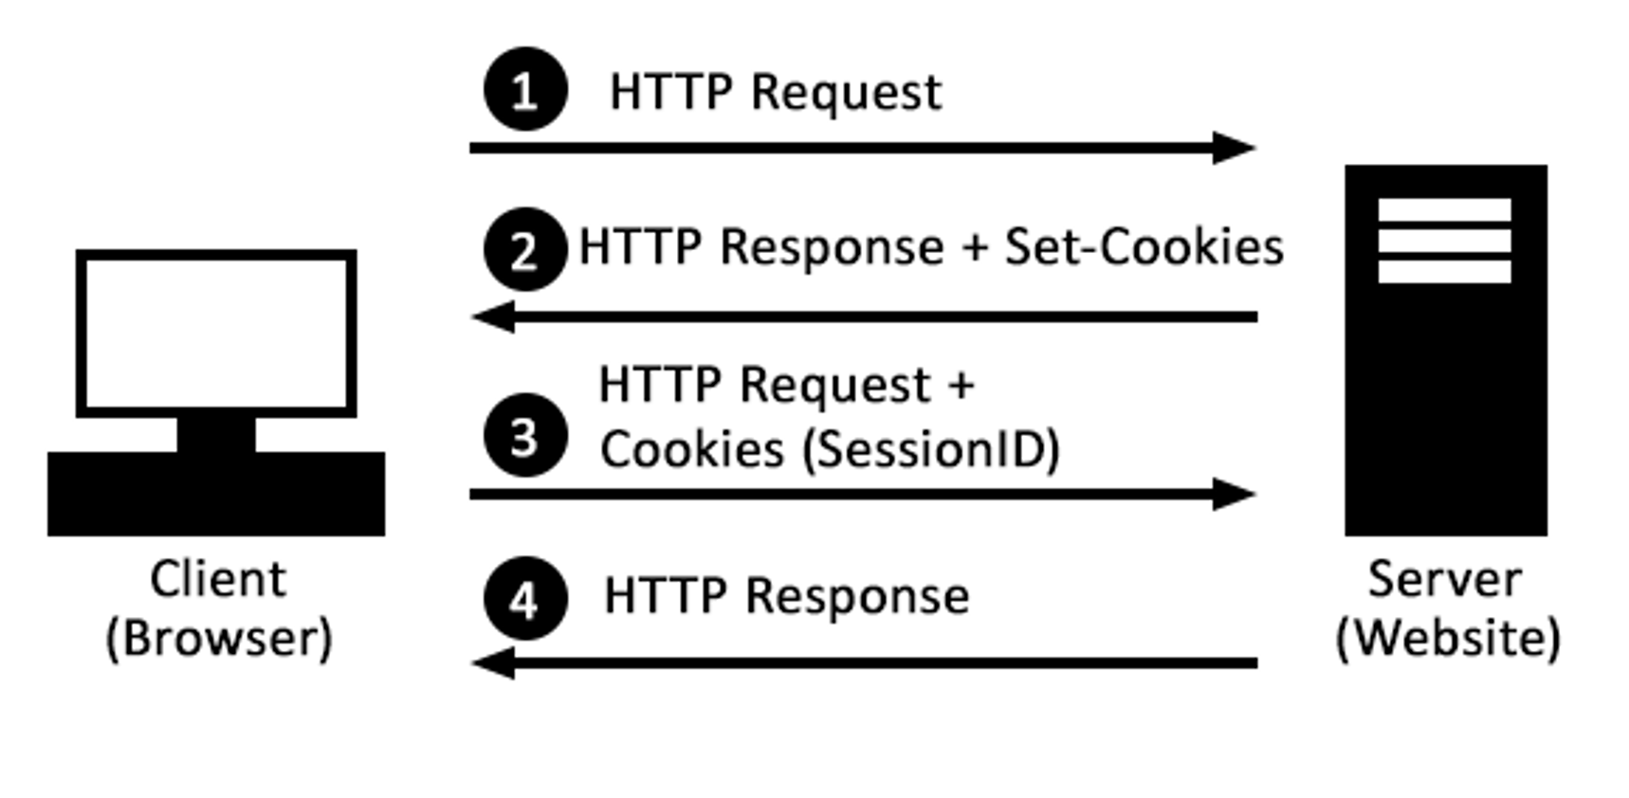
session
Notes:
When the client sends request to the server for the first time, the server creates the corresponding session data package according to the relevant information submitted by the user.
The server responds to the client's request and returns the unique identification information SessionID to the browser. The browser stores the returned SessionID in the cookie, and the cookie records which domain name the SessionID belongs to.
When the client visits the server for the second time, the request automatically determines whether there is cookie information under this domain name. If it does, the cookie information will be sent to the server.
The server will obtain the SessionID from the cookie, and then look up the corresponding session information according to the SessionID.
If the session is found to prove that the user has logged in, you can perform the following operations; if it is not found, it means that the user has not logged in or failed.

Slide 15
Web Storage - HTTP

Slide 16
Event Listener - HTTP

Slide 17
References
Http | https://www.tutorialspoint.com/http/http_overview.htm
XML | https://www.w3schools.com/xml/default.asp
SOAP | https://www.tutorialspoint.com/soapui/soap_introduction.htm
SOAPUI | https://support.smartbear.com/readyapi/docs/get-started.html
JSON | https://www.w3schools.com/js/js_json_intro.asp
REST | https://aws.amazon.com/what-is/restful-api/
Postman | https://learning.postman.com/docs/getting-started/introduction/
https://blog.devgenius.io/how-to-speed-up-your-api-tests-using-the-advanced-features-of-postman-350c453b376

Slide 18

Your success is our success
Contact
Mail: info@funnygorilla.com.au
Linkedin: https://mt.linkedin.com/in/songqing-gu-2ba9034b/de
Web Chat: FunnyGorilla
Phone: 0420891343

