Slide 1
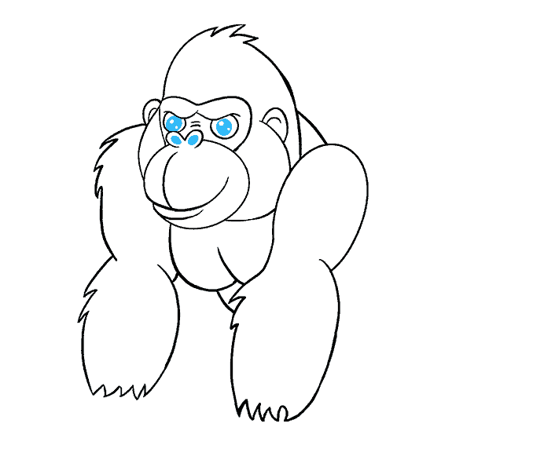


Funny Gorilla诙猩猩-IT培训
Your success is our success
GIT Introduction

Slide 2

Local vs Remote

Slide 3
GitHub - remote

Slide 4
GIT Commands – remote
//Clone from remote
git clone http://github.com/arthurguau/GITTraining.git
//set remote
git remote add origin http://github.com/arthurguau/GITTraining.git
//pull – get latest from remote
git pull
//push to remote
git push origin myBranch
//list remote branch
git branch -r

Slide 5
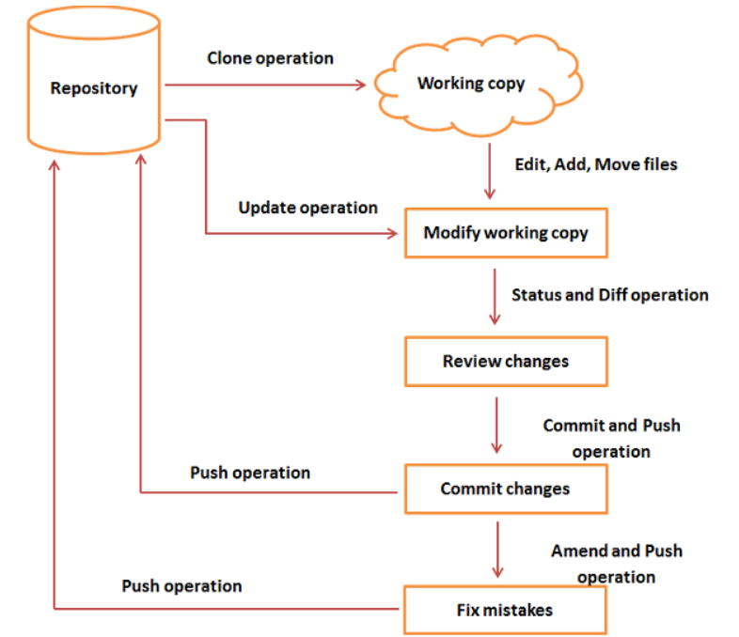

Summary - GIT Workflow

Slide 6
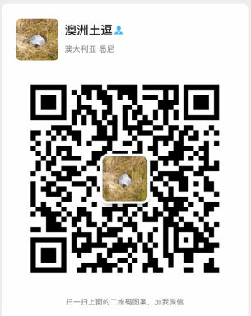
Your success is our success
Contact
Mail: info@funnygorilla.com.au
Linkedin: https://mt.linkedin.com/in/songqing-gu-2ba9034b/de
Web Chat: FunnyGorilla
Phone: 0420891343

