Slide 1



Funny Gorilla诙猩猩-IT培训
Your success is our success
Branching Strategy

Slide 2
Branching Strategy

Slide 3
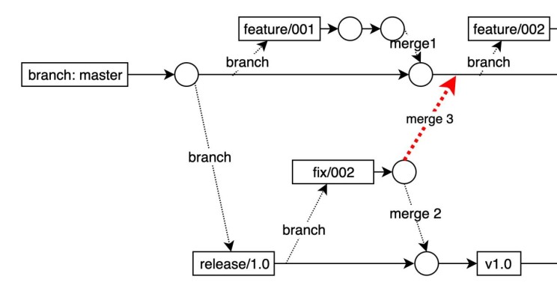

Slide 4
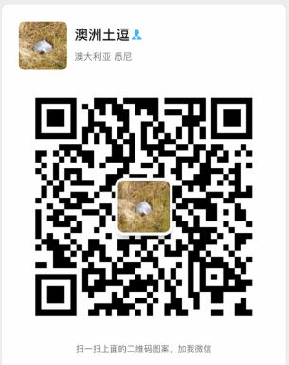
Your success is our success
Contact
Mail: info@funnygorilla.com.au
Linkedin: https://mt.linkedin.com/in/songqing-gu-2ba9034b/de
Web Chat: FunnyGorilla
Phone: 0420891343

