Slide 1

Introduction to
Data Structure & Algorism
Your success is our success
Funny Gorilla 诙猩猩
Notes:
Notes for title slide

Slide 2
Data Structure
List interface allows null and duplicate values and retains the order of insertion of objects.
Set doesn’t allow addition of duplicate objects.
Tuple a list of immutable of data
Queue is a linear collection that supports FIFO.
Stack is a linear collection that supports FIILO
Dictionary interface allows to store key/value pairs

Slide 3
List
an ordered collection
allows us to add and remove elements

Slide 4
List
‘a’
‘b’’
‘c’
01. index - starts from 0
02. can contain any data types
03. mutable - append, update, delete
04. concatenation
05. nesting
06. slicing
07. sorting
08. native methods

Slide 5
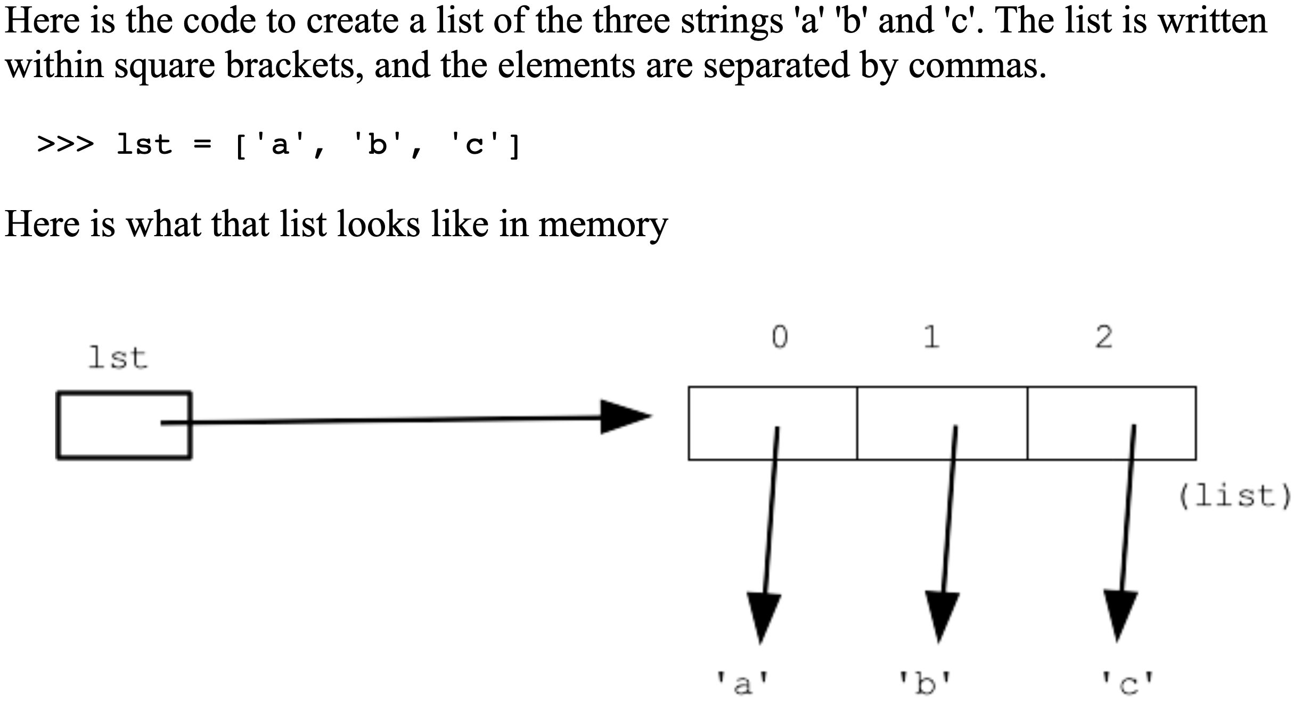
List example

Slide 6
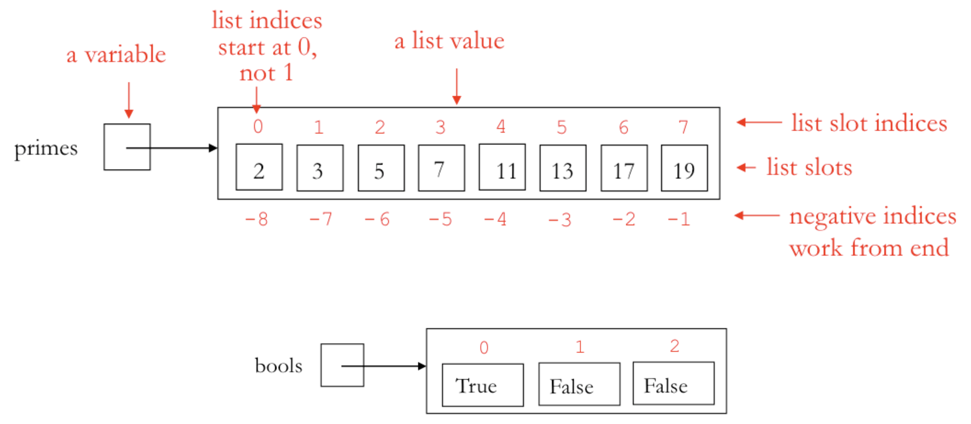
List Memory Diagram

Slide 7
Set
01. non-ordered
02. unique
03. immutable

Slide 8
Tuple
01. index - starts from 0
02. slicing
03. immutable
04. convert to List

Slide 9
Queue & Stack
Queue - First In, First Out manner
Stack - First In, Last Out manner

Slide 10
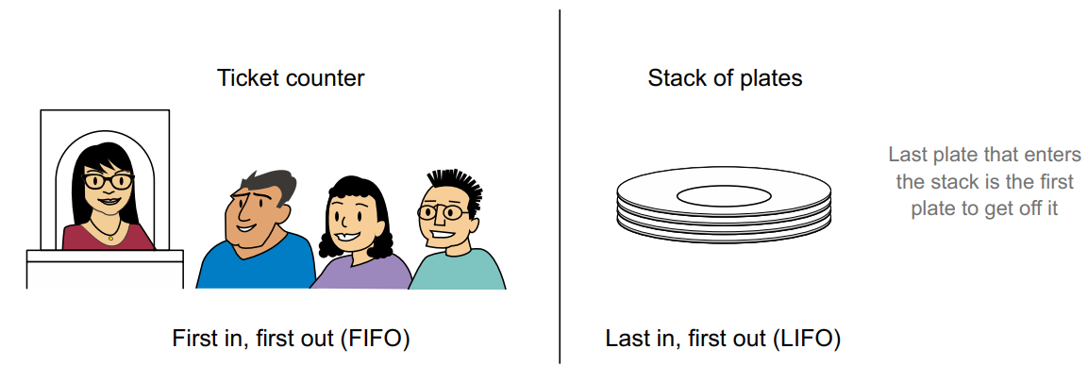
Real life examples

Slide 11
Queue Methods

Slide 12
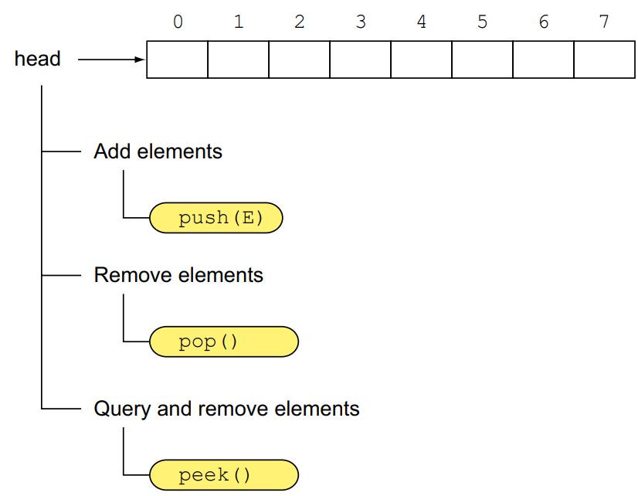
Stack Methods

Slide 13
Hands-on Coding

Slide 14
Linked List

Slide 15
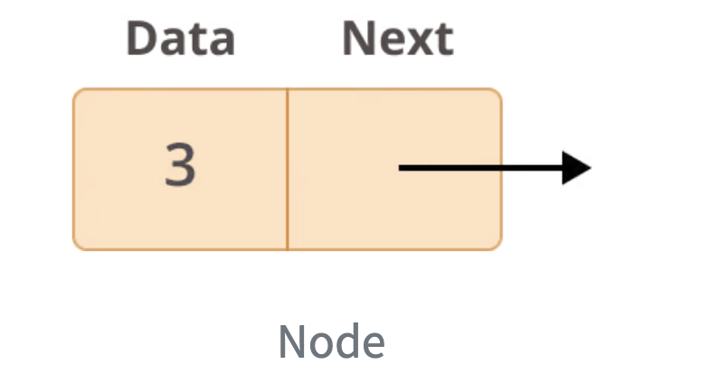
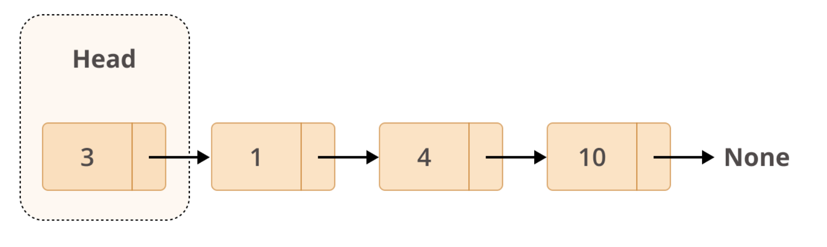
every node has two different fields:
Data contains the value to be stored in the node.
Next contains a reference to the next node on the list.

Slide 16
Binary Search Tree

Slide 17
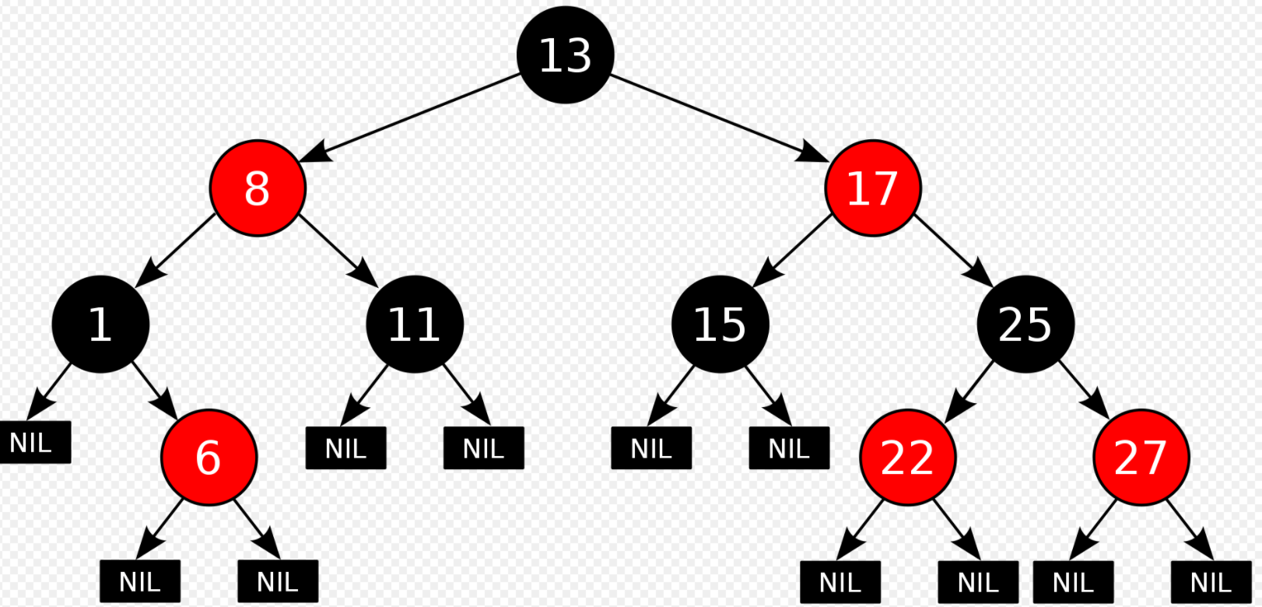
Binary Search Tree -> balanced

Slide 18
Reference
https://www.callicoder.com/java-arraylist/
https://www.programiz.com/java-programming/collections

Slide 19

Your success is our success
Contact
Mail: info@funnygorilla.com.au
Linkedin: https://mt.linkedin.com/in/songqing-gu-2ba9034b/de
Web Chat: FunnyGorilla
Phone: 0420891343

