Slide 1

Introduction to
Data Structure
Your success is our success
Funny Gorilla 诙猩猩
Notes:
Notes for title slide

Slide 2
Data Structure
List interface allows null and duplicate values and retains the order of insertion of objects.
Set doesn’t allow addition of duplicate objects.
Queue is a linear collection that supports FIFO.
Deque is a linear collection that supports the insertion and removal of elements at both its ends.
Map interface allows to store key/value paires

Slide 3
List
an ordered collection that
allows us to add and remove elements like an array.

Slide 4
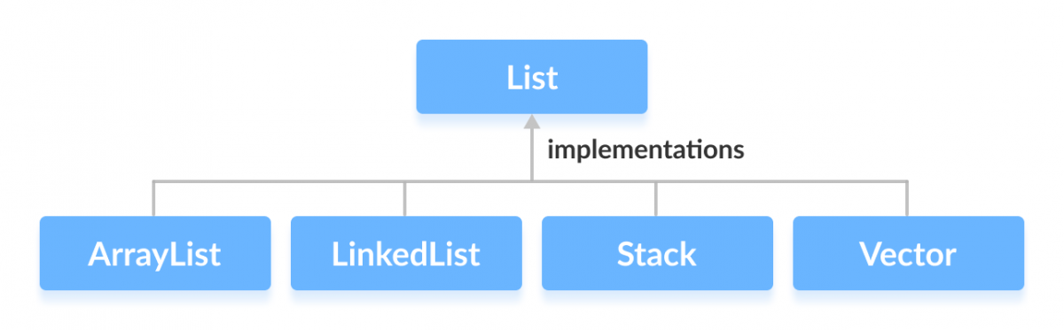
List
an ordered collection that
allows us to add and remove elements like an array.

Slide 5
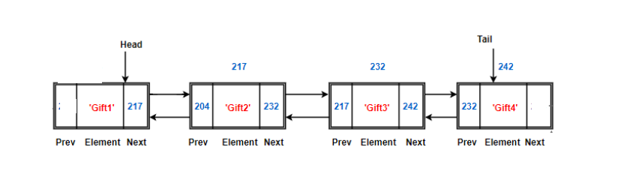
LinkedList

Slide 6
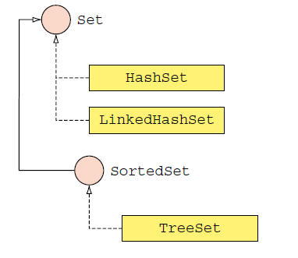
Set
allows us to store elements in different sets similar to the set in mathematics. It cannot have duplicate elements.
each key has a single value associated with it.

Slide 7
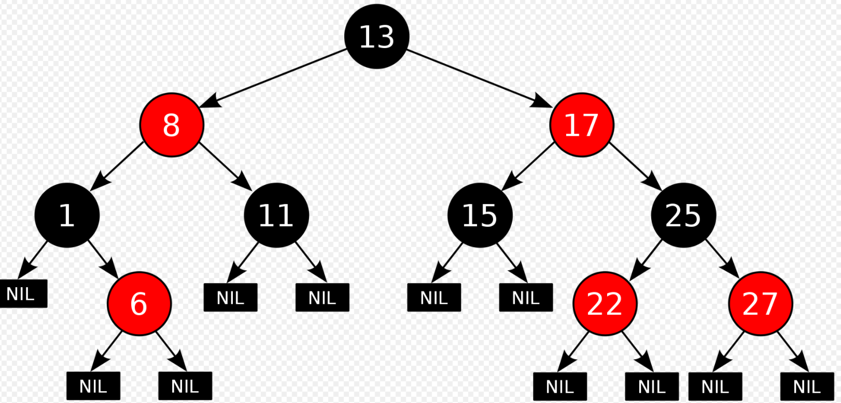
TreeSet

Slide 8
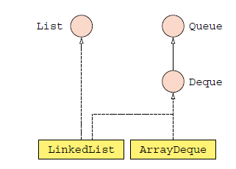
Queue
used when we want to store and access elements in First In, First Out manner.

Slide 9
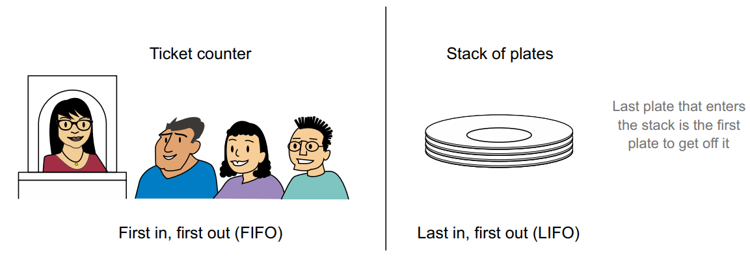
Real life examples

Slide 10
Queue Methods
Queue methods used to work with Deque as a FIFO data structure

Slide 11
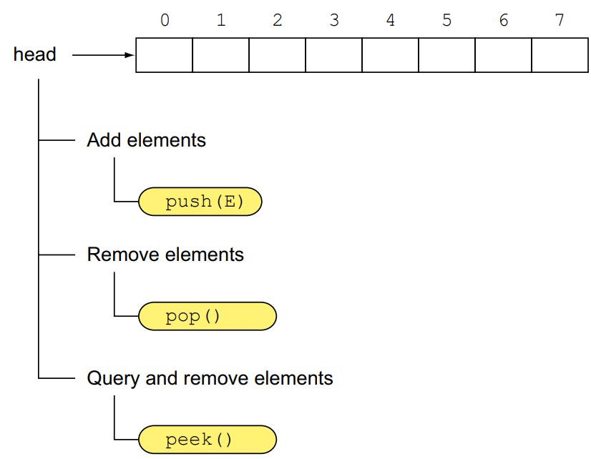
Stack Methods
The stack methods used to work with Deque as a LIFO data structure

Slide 12
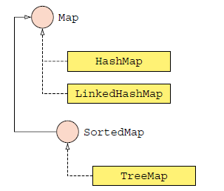
Map
each key has a single value associated with it.
allows elements to be stored in key/value pairs. Keys are unique names that can be used to access a particular element in a map. And, each key has a single value associated with it.

Slide 13
Hands-on Coding
Missing Element
Write a function:
Class Solution { public int solution (int[] A) }
That , given an Array A, returns the value of the missing element.
For example,
Input: arr[] = {1, 2, 4, 6, 3, 7, 8}
Output: 5
Input: arr[] = {1, 2, 3, 5}
Output: 4

Slide 14
Reference
https://www.callicoder.com/java-arraylist/
https://www.programiz.com/java-programming/collections

Slide 15
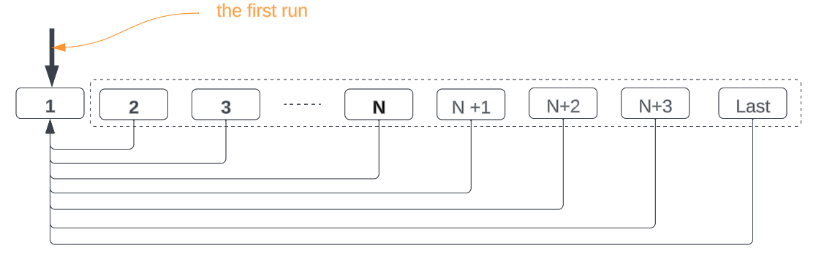
LeetCode

Slide 16
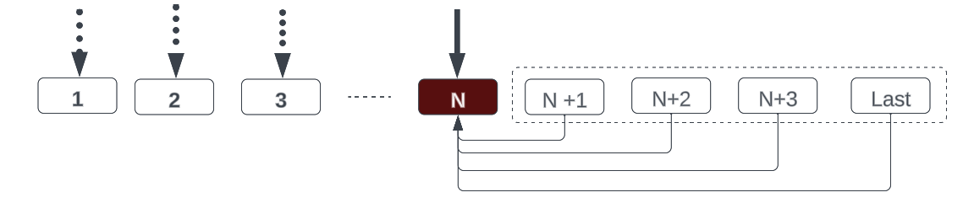
LeetCode

Slide 17
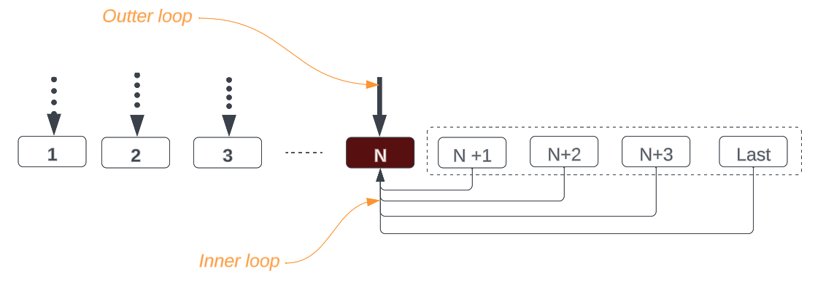
LeetCode

Slide 18

Your success is our success
Contact
Mail: info@funnygorilla.com.au
Linkedin: https://mt.linkedin.com/in/songqing-gu-2ba9034b/de
Web Chat: FunnyGorilla
Phone: 0420891343

