Slide 1

Funny Gorilla诙猩猩-IT培训
Your success is our success
Software Engineering
Introduction
Notes:
egsfgds

Slide 2
Learning Objectives
By the end of this learning module, you will be able to understand:
Web Application & Architecture
Client server delivery model
Microservice architecture

Slide 3
Web Application Architecture

Slide 4


Business Tier
HTML/CSS/JS
Web Tier
Business Tier
Database
Web Tier
Data Access Tier
Web Server

Slide 5
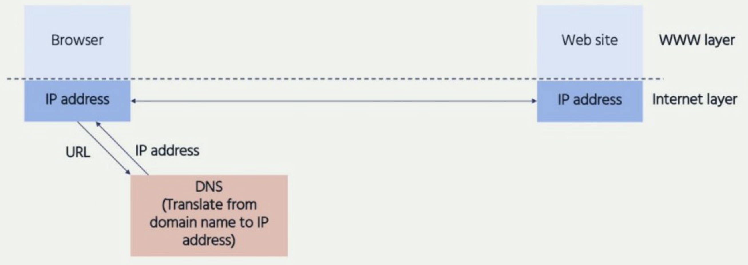
Some concepts
OS assigned virtual connection point to each system in this computer
IP address/host name
port number
Client – Server Delivery Model
Tiering – horizontal
Layering - vertical

Slide 6
How 3 tiers work
API - service contract
HTML/CSS/JS
JSON/Http
SQL/JDBC
JavaScript
Web Tier
Business Tier
Database Tier
JSON/Http
Client – Server Delivery Model

Slide 7
Web Tier

Slide 8


Web Tier
html
CSS
javaScript
http://hostname:port/resource
Web Container
Tomcat,
Jetty,
httpd,
Apache web server

Slide 9
Business Tier

Slide 10


Business application
API - service contract
API endpoints
Remote system
interface layer
service layer
integration layer

Slide 11
Interface/API – a channel to provide service
http://hostname:port/resource
Data
Format
Transport
Network
API

Slide 12
Data access Tier - database

Slide 13
Microservice architecture

Slide 14
Some concepts
Monolithic application
Mircoservice application – business domain
Event driven application

Slide 15

Event driven architecture
Credit card
Account management
Web
application
Order
management
Inventory management
Credit checking
Customer management
API

Slide 16
Web application demo

Slide 17
Network protected

Slide 18

Real World Applications
Network – security zone
Credit card
Trading partner
Data Centre/Cloud
Account management
Web application
Order management
Inventory management
Credit checking
Customer management
Fire Wall
API

Slide 19
Firewall basic
Acts as gatekeeper and traditionally inspect the 5-tuple:
Source IP address/port number
Destination IP address/port number
Protocol
Filter can filter on outgoing and incoming traffic of a network zone.
Default deny policy – if no firewall rule exists., the communication is rejected

Slide 20

Contact
Your success is our success
Mail: info@funnygorilla.com.au
Linkedin: https://mt.linkedin.com/in/songqing-gu-2ba9034b/de
Web Chat: FunnyGorilla
Phone: 0420891343

