Slide 1

Funny Gorilla诙猩猩-IT培训
Your success is our success
Software Engineering
Deployment
Notes:
egsfgds

Slide 2
Learning Objectives
By the end of this learning module, you will be able to understand:
Application runtime
Application deployment

Slide 3
Application Runtime
Docker
Kubernetes

Slide 4
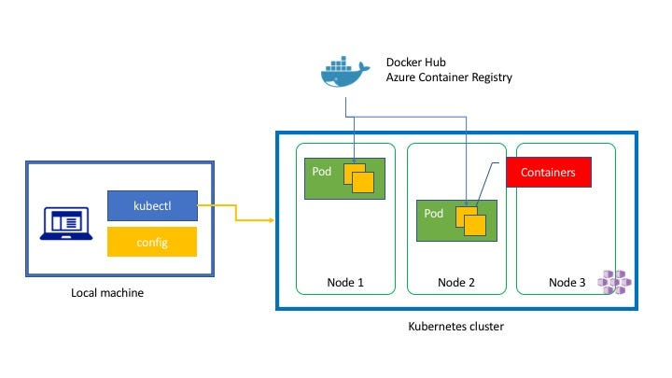

Slide 5
Demo
- Web application deployment

Slide 6
Cloud Application Runtime

Slide 7
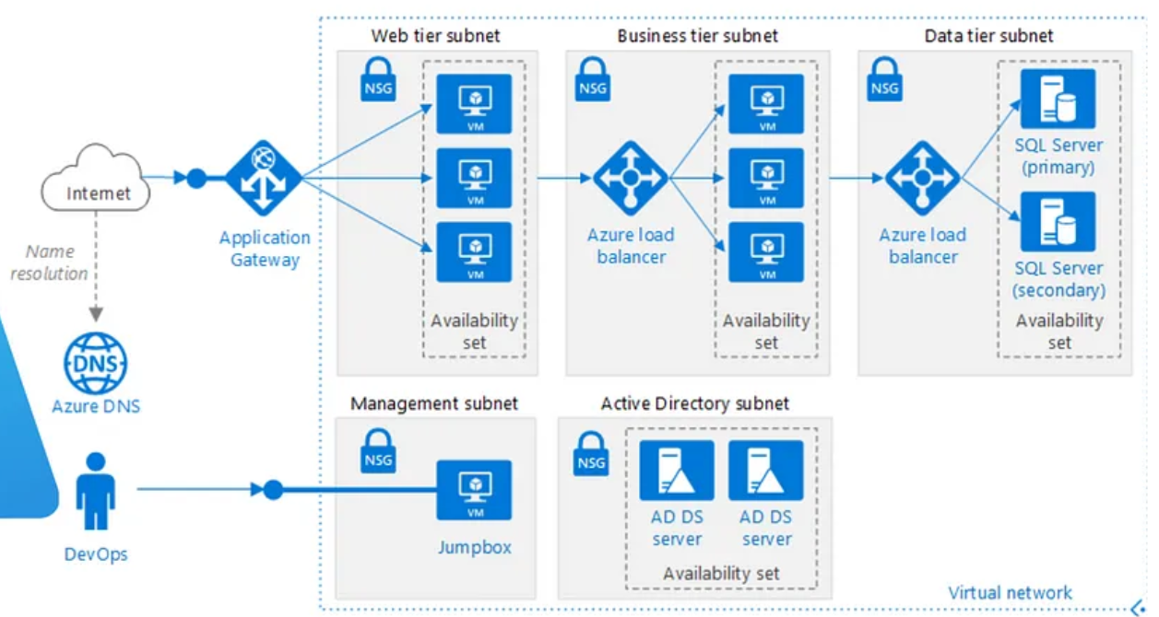

Slide 8
Deployment automation – CI/CD

Slide 9
Configuration Management
Post-Deployment Checks
Unit Testing
Integration Testing
Code Compilation
Code Analysis
Containerization and Packaging
Environment-specific Deployments

Slide 10
Demo – CI/CD

Slide 11

Contact
Your success is our success
Mail: info@funnygorilla.com.au
Linkedin: https://mt.linkedin.com/in/songqing-gu-2ba9034b/de
Web Chat: FunnyGorilla
Phone: 0420891343

