Slide 1
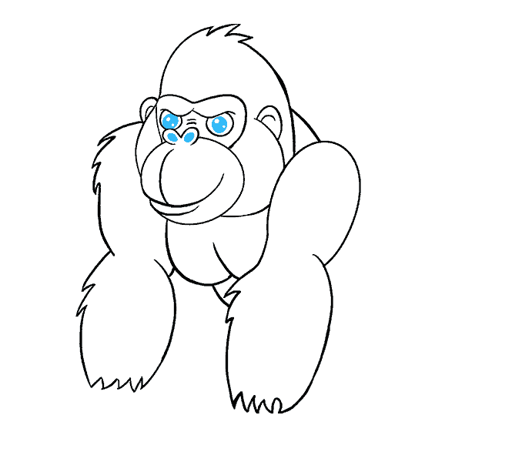
Introduction to Task
Your success is our success
Funny Gorilla 诙猩猩
Notes:
Notes for title slide

Slide 2
Learning Objectives
Task definition
Task graph

Slide 3
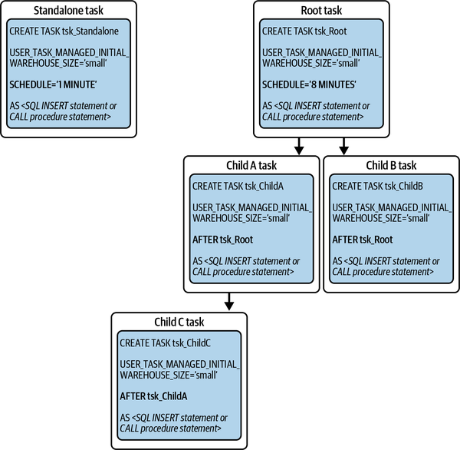

Slide 4
Snowflake Tasks
https://docs.snowflake.com/en/user-guide/tasks-intro

Slide 5
Create a task administrator role
2. Define a new task using CREATE TASK.
  Assign compute resources
  Define schedules or triggers
  Define what happens when a task fails
  Define additional session parameters
3. Manually test tasks using EXECUTE TASK.
4. Allow the task to run continuously using ALTER TASK … RESUME.
5. Monitor task costs
6. Refine the task as needed using ALTER TASK.

Slide 6
Task graph

Slide 7
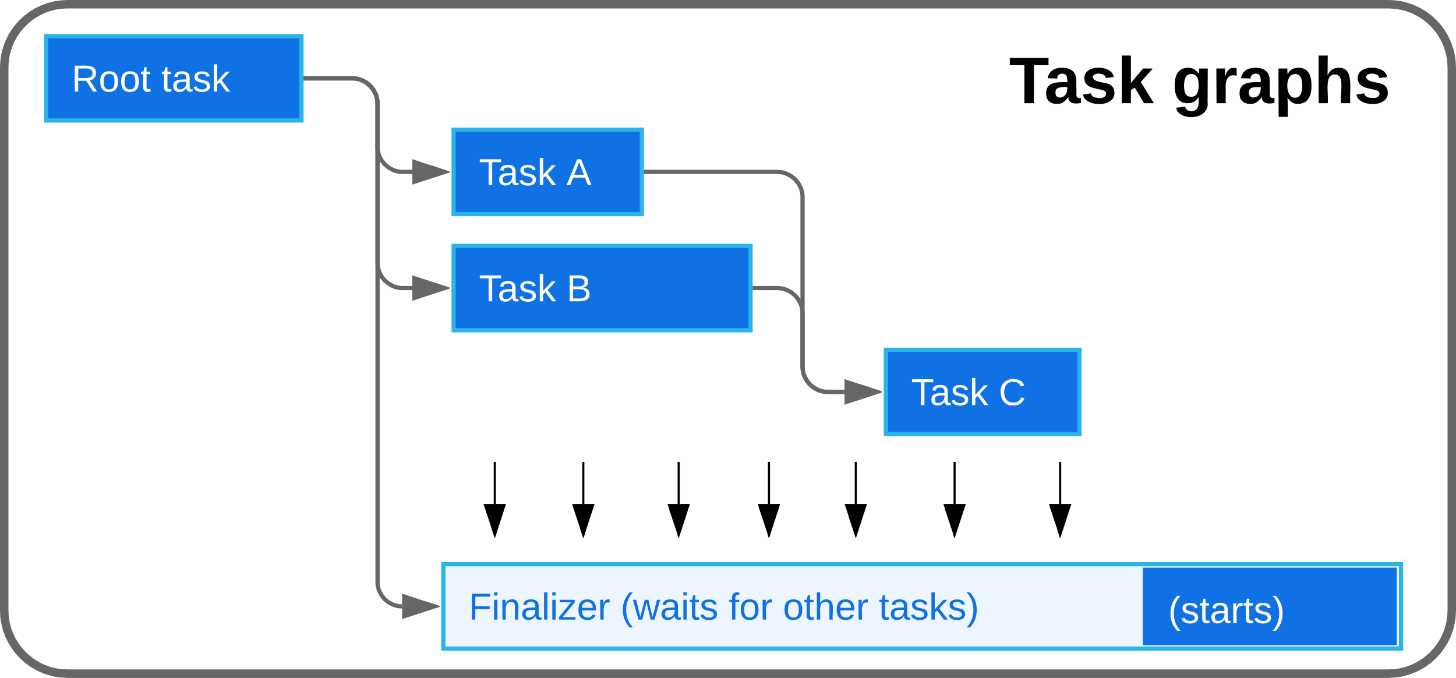
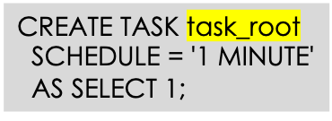
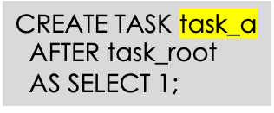
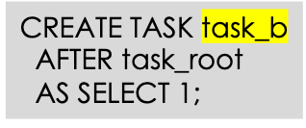
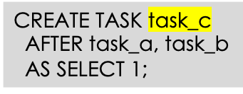

Slide 8
Considerations
A task graph is limited to a maximum of 1000 tasks.
A single task can have a maximum of 100 parent tasks and 100 child tasks.
When tasks run in parallel on the same user-managed warehouse, the compute resources must be sized to handle the concurrent task runs.

Slide 9
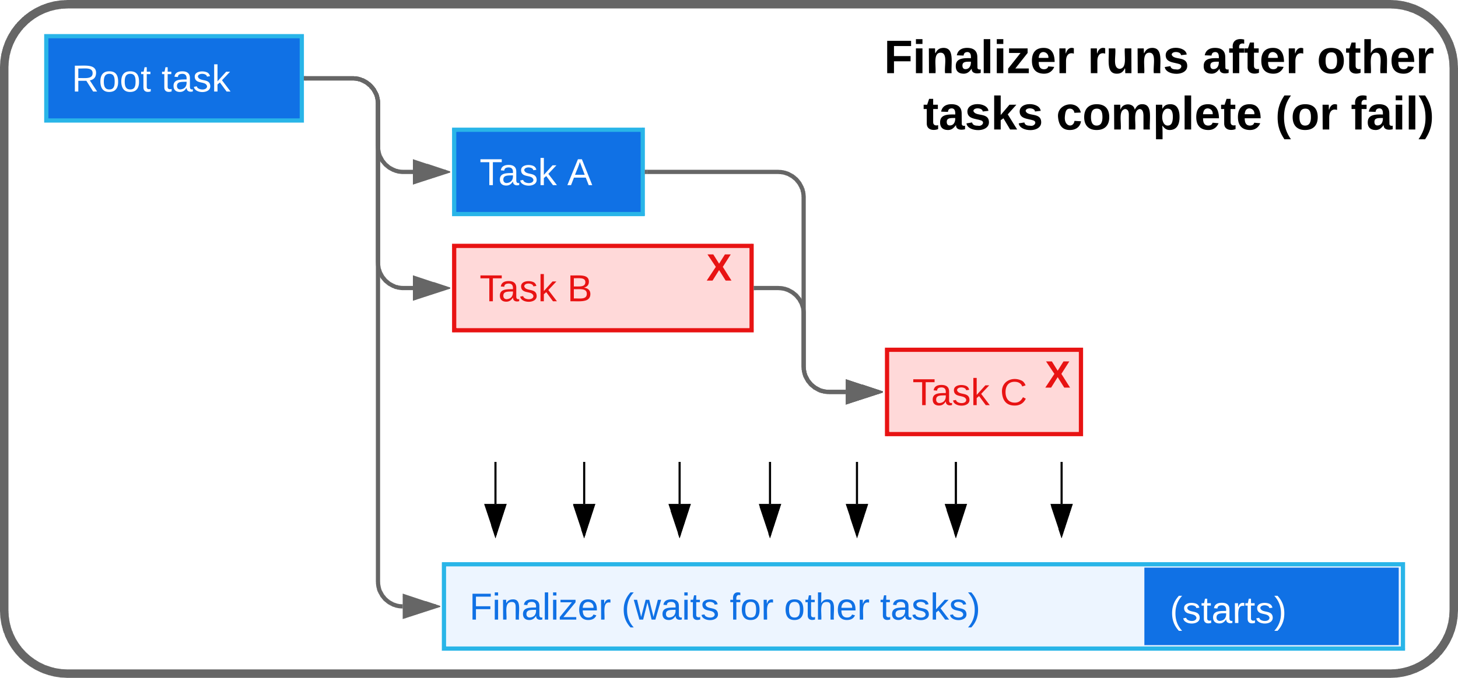
CREATE TASK task_finalizer
FINALIZE = task_root
AS SELECT 1;

Slide 10
Considerations
always associated with a root task. Each root task can have only one finalizer task, and a finalizer task can be associated with only one root task.
When the root task of a task graph is skipped (for example, because of overlapping task graph runs), the finalizer task won’t be started.
A finalizer task cannot have any child tasks.
A finalizer task is scheduled only when no other tasks are running or queued in the current task graph run.

Slide 11
Task & Stream

Slide 12
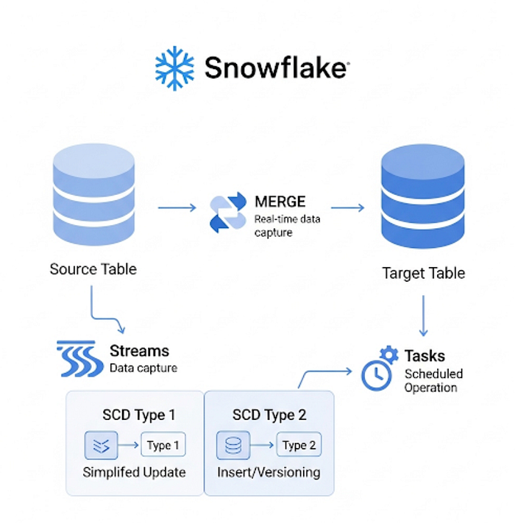

Slide 13
Reference Links

Slide 14

Your success is our success
Contact
Mail: info@funnygorilla.com.au
Linkedin: https://mt.linkedin.com/in/songqing-gu-2ba9034b/de
Web Chat: FunnyGorilla
Phone: 0420891343

