Slide 1

Development lifecycle
Snowflake & DBT
Your success is our success
Funny Gorilla 诙猩猩
Notes:
Notes for title slide

Slide 2
Learning Objectives
Data Ingestion
Factors to consider when designing data ingestion
Why build pipeline
How the build pipeline built

Slide 3
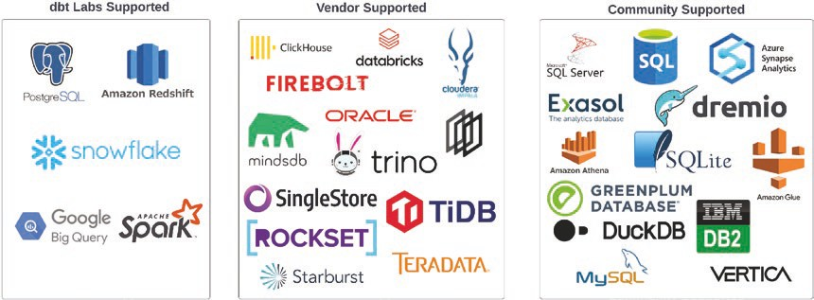

Slide 4
High level introduction

Slide 5
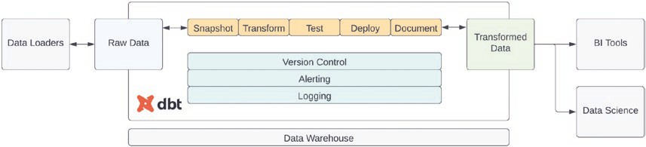
Modelling as code
validate that the data is accurate
snapshot the raw data
transforming data
deployment
documentation
.

Slide 6
Common model methodologies
Data vault: Utilizes hubs, links, and satellites to store data
Dimensional: Utilizes facts and dimensions to store data
One big table: Denormalized data where all values are stored in a single table
Relational: Data stored in a normalized state
Common data models: Open source and community-supported data models used within specific industries

Slide 7
Snapshot

Slide 8
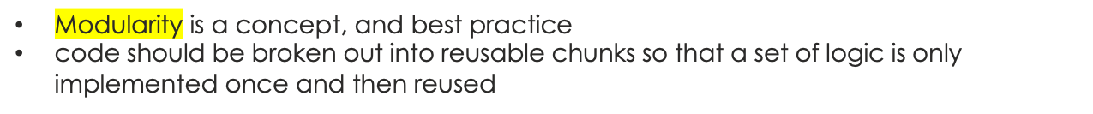
Modular Data Transformation
Modularity adds a layer of abstraction and can hide the complexity of data transformations

Slide 9



Source OrderItems
Fact Orders
Source Orders
Dim Customers
Source Products
Dim Products
Source Customers
Source Staging
Orders Orders
Source Staging OrdersItems OrdersItems
Source Staging
Products Products
Staging
Customers
Intermediate OrderItems Products Joined
Dim Products
Dim Customers
Fact Orders

Slide 10
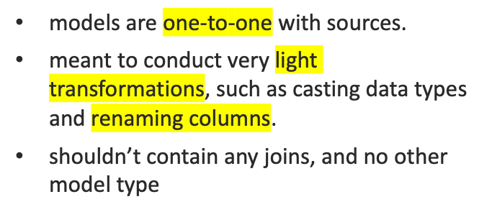
select from upstream staging models
conduct transformations that are reusable by models downstream
A
Staging models
Mart model
B
Staging models
warehousing models
C
Staging models
Mart model
Staging models
D
include both fact and dimension models
represent the models exposed to end users
be the result of transformations of staging and/or intermediate models.

Slide 11
Landing zoon
Minimize retrieval times from source systems
Fault tolenrent

Slide 12
Staging layer

Slide 13
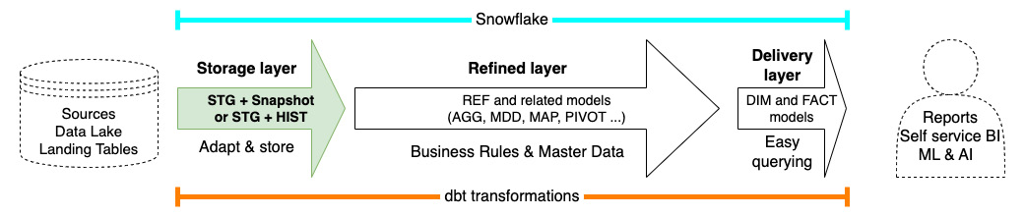
Staging layer

Slide 14
Goal & common tasks
to adapt external data to how we want to see and use it in our project.
Pick the desired columns
Rename the columns to follow conventions and use project-designated names
Manage data types, performing conversions to desired data types
Common tasks
Apply “hard rules” with non-destructive transformations, e.g. time-zone conversions
Add the default record (only for dimensions, not needed for facts/events)
Add the desired/available metadata, based on the input specifics
Make keys and change tracking explicit by adding hash-based keys and diff fields

Slide 15

LOAD_TS:
RECORD_SOURCE:
EXTRACTION_TIME:
CREATION_TIME:
EFFECTIVE_FROM:
HASH_KEY
7. Identity and
change detection fields
HASH_DIFF
LOAD_TS
https://docs.getdbt.com/docs/build/projects

Slide 16
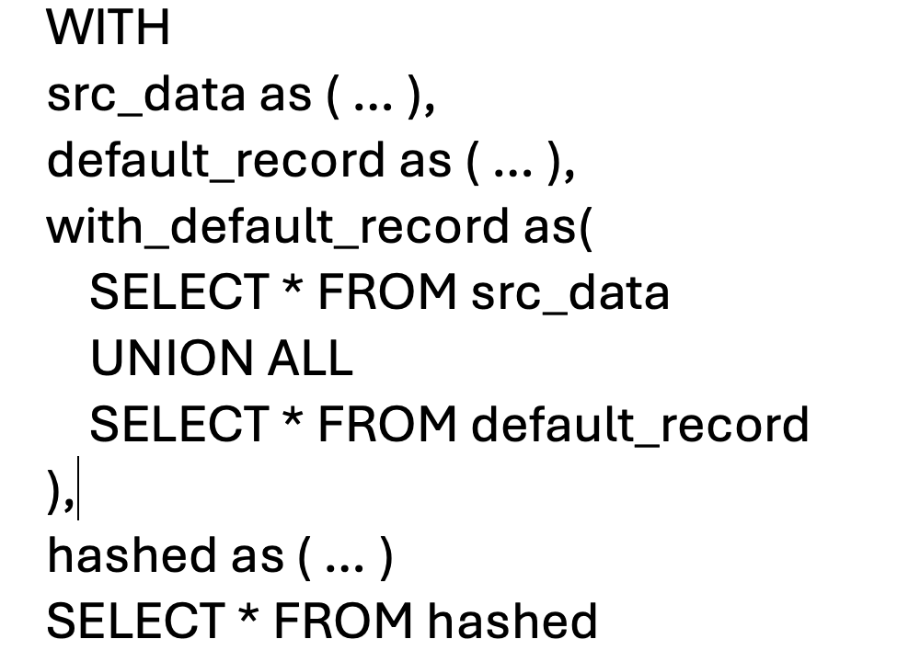

Slide 17
Warehousing layer
https://docs.getdbt.com/docs/build/projects

Slide 18
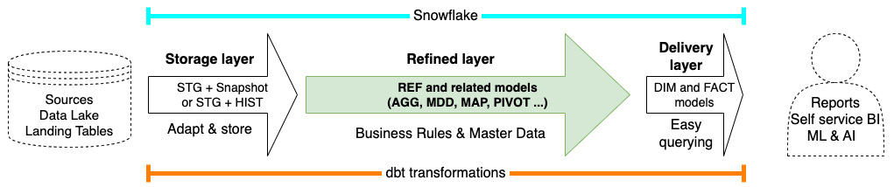
Refined layer
https://docs.getdbt.com/docs/build/projects

Slide 19
Goal & common tasks
applying business rules, including combining multiple sources, produce “refined” data that can be used in the data marts to provide useful information for the platform users
https://docs.getdbt.com/docs/build/projects

Slide 20


Types of models
This is a catch-all type for models that you create for intermediate calculations that do not represent a proper business concept or that cannot exist by themselves
represent a recognizable business concept, at any level, with the level needing to be clear from the name
Master Data Dimension (MDD) model
implement dimensions provided directly from the master data management system.
Aggregated (AGG) model
Pivoted (PIVOT) model
aggregated or summarized data
Mapping model (MAP)
pivoted data
This is the type for models that support conversion from one reference system to another, by providing the mapping for keys in one system to the equivalent key in the other system.
https://docs.getdbt.com/docs/build/projects

Slide 21
Delivery layer
https://docs.getdbt.com/docs/build/projects

Slide 22
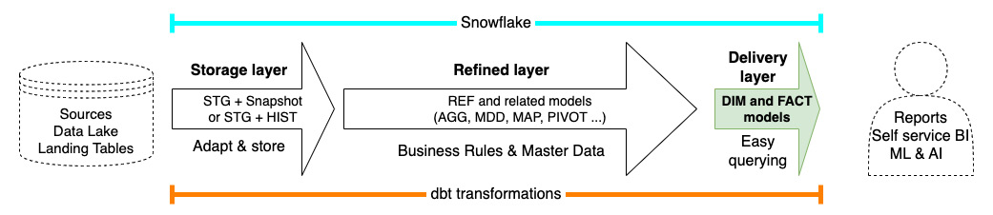
Delivery layer
https://docs.getdbt.com/docs/build/projects

Slide 23
The general plan is to have one data mart for each domain.
https://docs.getdbt.com/docs/build/projects

Slide 24
Project folder structure
https://docs.getdbt.com/docs/build/projects

Slide 25
a piece of jinja code that can be reused
analyses
dbt_packages
logs
macros
models
seeds
snapshots
target
tests
Jinja is a pythonic templating language that can be used in dbt to do things that usually aren't possible with SQL, like if/else, for loop.
CSV files in your dbt project and are best used for smaller, static datasets that rarely change
https://docs.getdbt.com/docs/build/projects

Slide 26
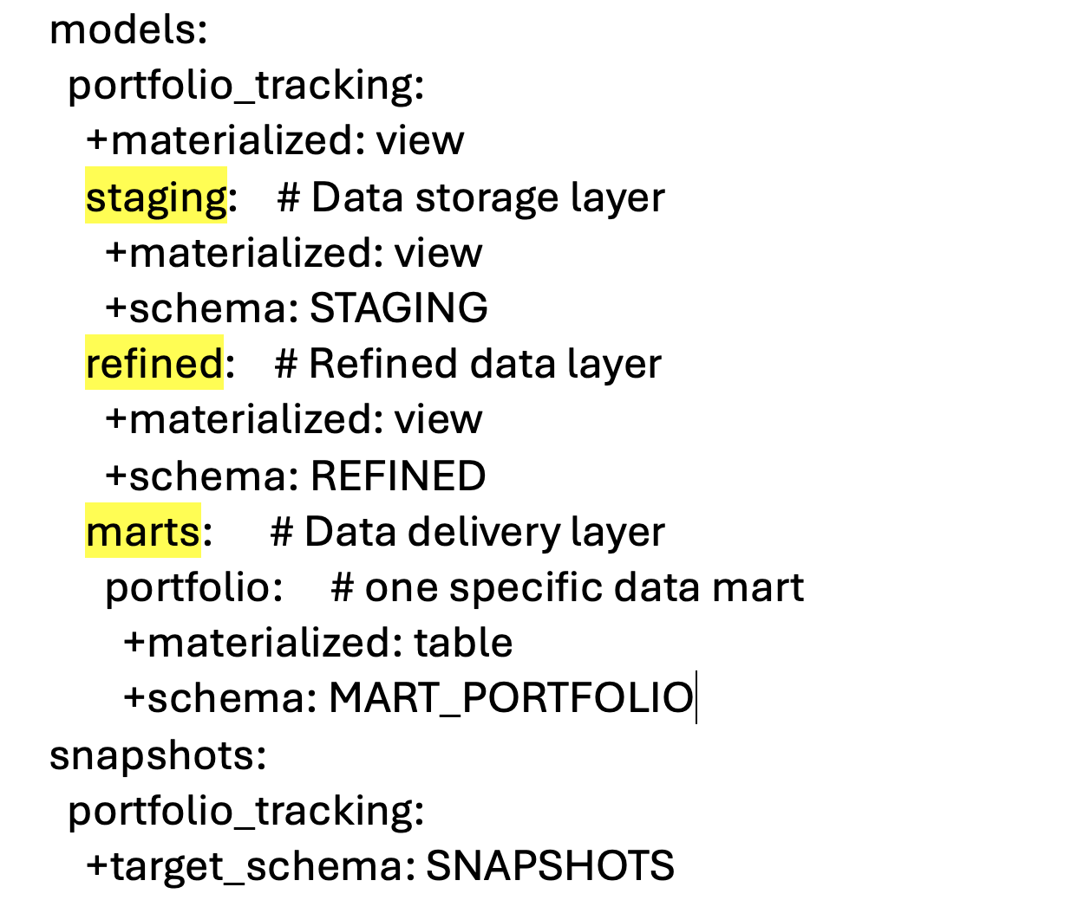
They are always generated as tables, loaded incrementally.

Slide 27
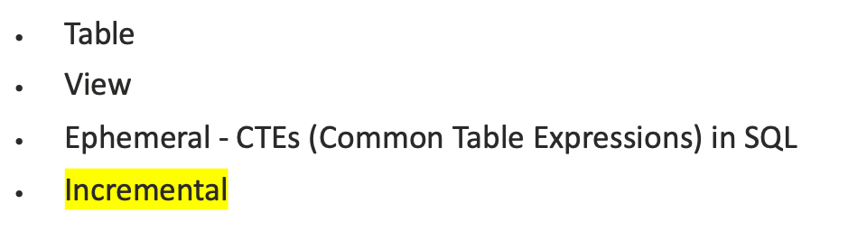
Materializing a model

Slide 28
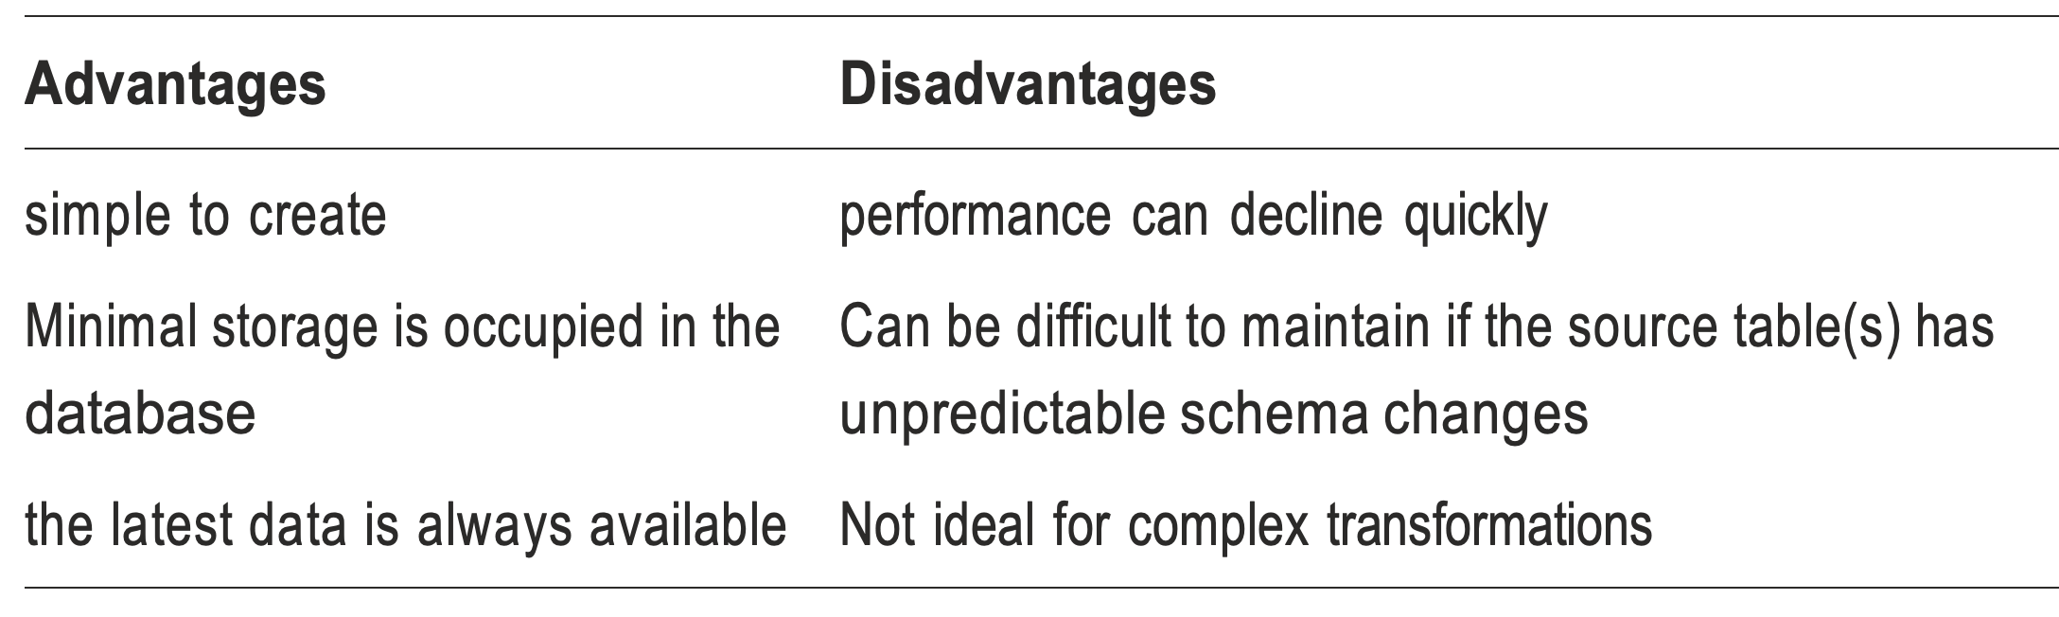
View model

Slide 29
Configuration hierarchy

Slide 30
The configuration hierarchy
Lowest priority
Highest priority
dbt_project.yml
model_schema.yml
model.sql

Slide 31
Test

Slide 32
not_null: Tests that a column is never null in the table.
unique: Tests that the values in a column are unique.
relationships: Tests the referential integrity between two tables, meaning that each value of the foreign key in the table exists in the named column of the named table. Said in another way, you test that there are no orphans in the tested table.
Generic tests
accepted_values: Tests that the values in the column are one of the listed values.
Singular tests

Slide 33
DBT Commands

Slide 34
Project management
dbt init: Initializes a new dbt project in the current directory.
dbt deps: Downloads and installs dbt packages defined in the packages.yml file.
dbt clean: Deletes the target/ and dbt_modules/ directories.
dbt debug: Validates your dbt setup and connection to the data warehouse.

Slide 35
Model execution
dbt run: Compiles and executes all models in the project.
dbt run --select model_name: Executes a specific model.
dbt run --select model_name+: Executes a specific model and its downstream dependencies.
dbt run --select +model_name: Executes a specific model and its upstream dependencies.
dbt run --select +model_name+: Executes a specific model, its upstream, and downstream dependencies.
dbt run --exclude model_name: Executes all models except the specified one.
dbt build: Executes seeds, snapshots, models, and tests in DAG order.

Slide 36
Data Loading & Snapshots
dbt seed: Loads CSV files from the seeds/ directory into the data warehouse.
dbt seed --full-refresh: Reloads all seeds, dropping and recreating tables.
dbt snapshot: Executes snapshot jobs defined in the snapshots/ directory.

Slide 37
Testing:
dbt test: Runs all tests defined in the project.
dbt test --select model_name: Runs tests only for a specific model.
dbt test --data: Runs only generic (data) tests.
dbt test --schema: Runs only singular (schema) tests.

Slide 38
Documentation:
dbt docs generate: Generates the dbt project documentation website.
dbt docs serve: Serves the generated documentation locally in a web browser.

Slide 39
Other Useful Commands:
dbt compile: Compiles the SQL for all models without executing them, generating the compiled SQL in the target/ directory.
dbt ls (or dbt list): Lists resources in your dbt project (models, sources, seeds, etc.).
dbt source freshness: Checks the freshness of your declared sources.
dbt run-operation macro_name: Invokes a dbt macro from the command line.
dbt retry: Retries the last failed dbt command from the point of failure (dbt v1.6+).

Slide 40
Deploy

Slide 41
Monitor

Slide 42
Document

Slide 43
Common code practice

Slide 44
use meaningful model names, prefixes, and suffixes; use a good, layered architecture and apply patterns in a consistent way
Make the code easy to re-read/understand – CTE pattern
One model should do one thing, do it well, and communicate it well with its name
Keep the dependencies ordered and going only in one direction, from one layer to the next in the architecture.
Continue to seek improvement, refactor your models to keep them current

Slide 45
Reference Links

Slide 46

Your success is our success
Contact
Mail: info@funnygorilla.com.au
Linkedin: https://mt.linkedin.com/in/songqing-gu-2ba9034b/de
Web Chat: FunnyGorilla
Phone: 0420891343

