Slide 1
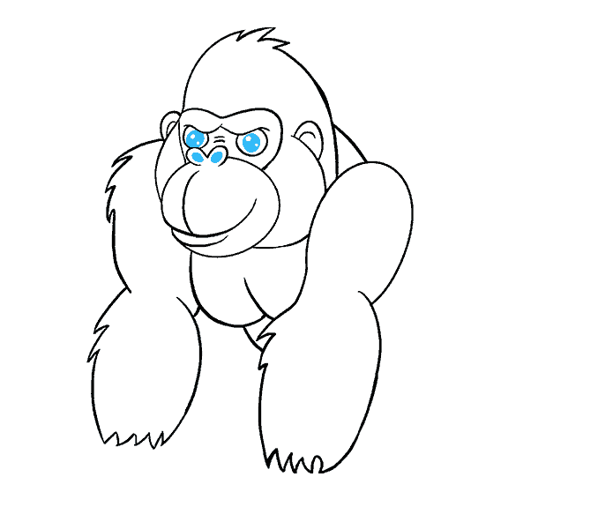
Performance Tunning
Snowflake
Your success is our success
Funny Gorilla 诙猩猩
Notes:
Notes for title slide

Slide 2
Learning Objectives
Query lifecycle
Query compilation process
SIMD
Query profiling

Slide 3
Query Optimizer

Slide 4
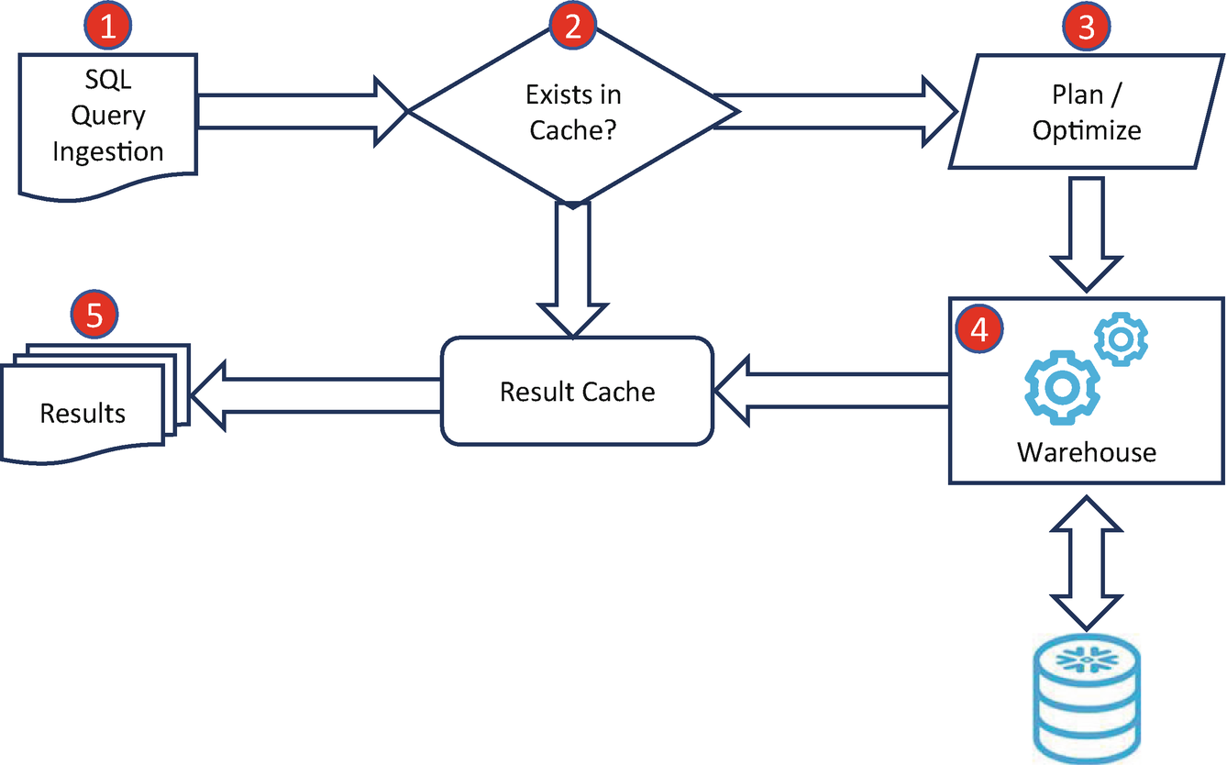
Query Lifecycle

Slide 5
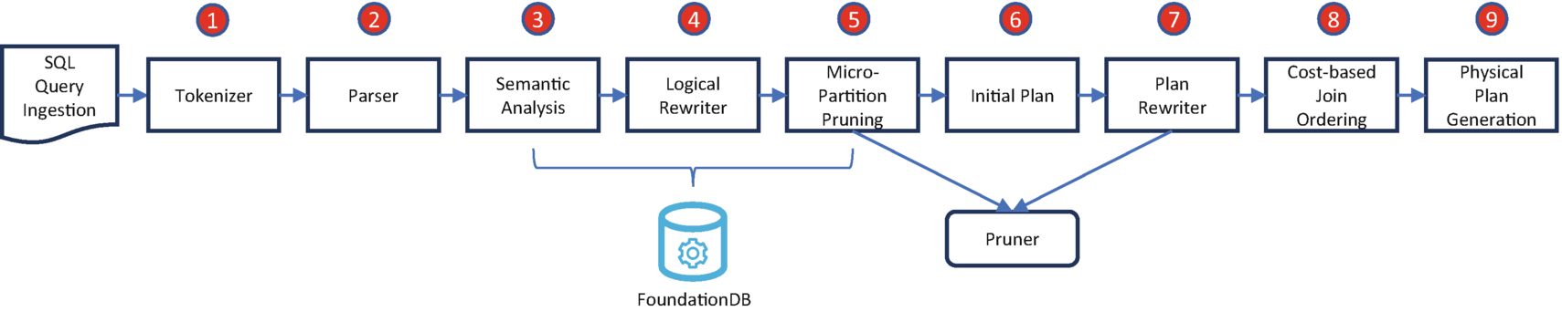
Query Compilation process

Slide 6
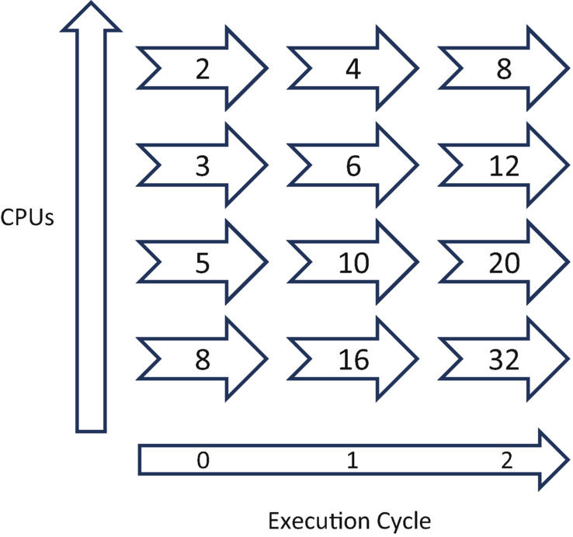
Single Instruction, Multiple Data (SIMD)

Slide 7
Query Profiling

Slide 8
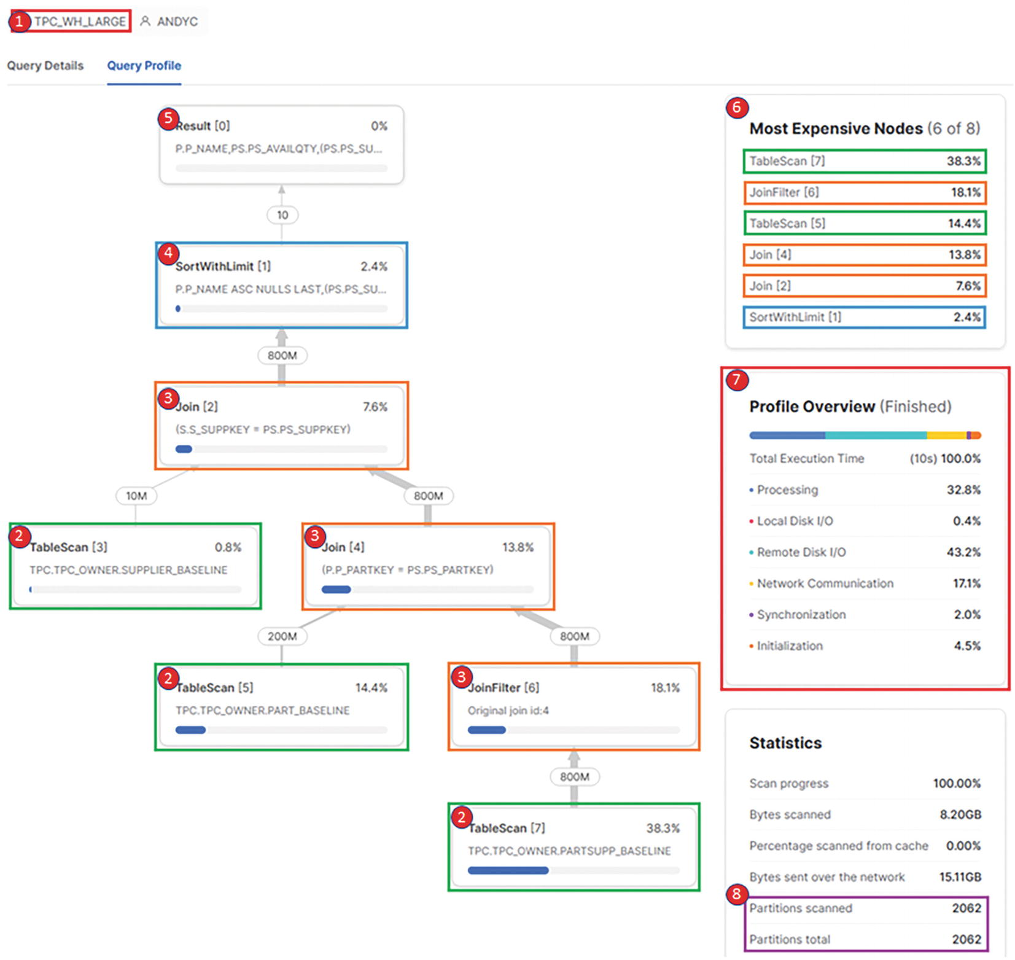

Slide 9
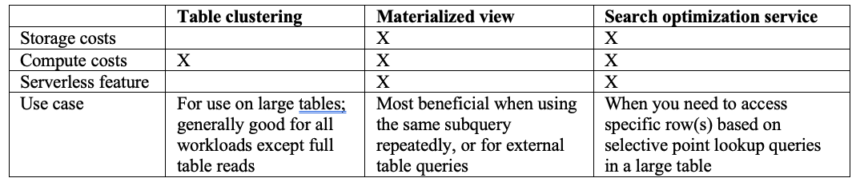
Comparison

Slide 10
Reference Links

Slide 11

Your success is our success
Contact
Mail: info@funnygorilla.com.au
Linkedin: https://mt.linkedin.com/in/songqing-gu-2ba9034b/de
Web Chat: FunnyGorilla
Phone: 0420891343

