Slide 1
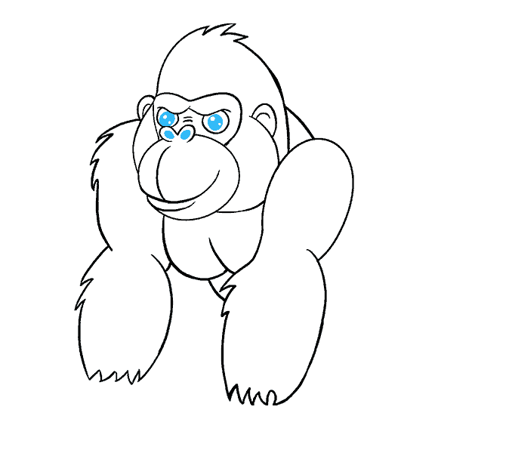
Governance
Snowflake
Your success is our success
Funny Gorilla 诙猩猩
Notes:
Notes for title slide

Slide 2
Learning Objectives
Query lifecycle
Query compilation process
SIMD
Query profiling

Slide 3
Overall picture

Slide 4
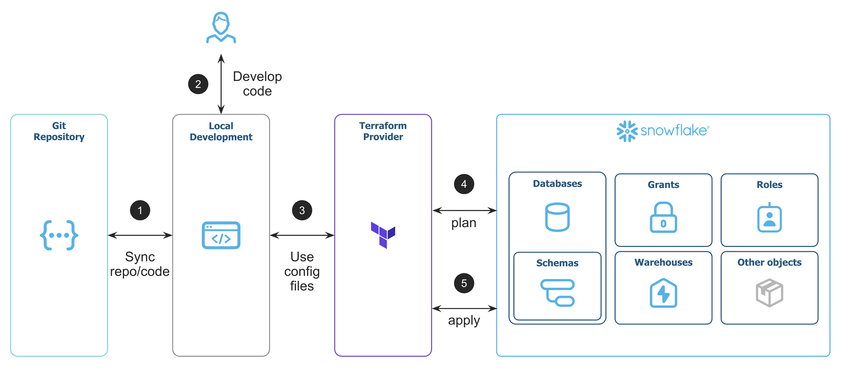
Overall picture

Slide 5
Detailed development steps

Slide 6

Create code repository
Create service user
Declare resources
Prepare terraform project
run terraform project
Change and ad resource
Commit changes to repository
Apply changes
Clean up

Slide 7
Reference Links
https://docs.snowflake.com/en/guides-overview-govern

Slide 8
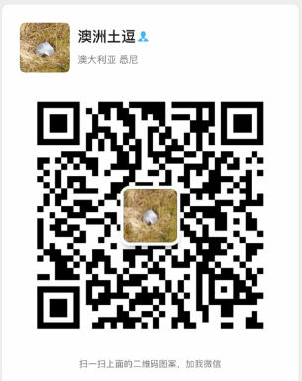
Your success is our success
Contact
Mail: info@funnygorilla.com.au
Linkedin: https://mt.linkedin.com/in/songqing-gu-2ba9034b/de
Web Chat: FunnyGorilla
Phone: 0420891343

