Slide 1

DV pipeline Design
Your success is our success
Funny Gorilla 诙猩猩
Notes:
Notes for title slide

Slide 2
Project Development Lifecycle

Slide 3
User Case
Security requirement
Infrastructure
Data modelling
Transformational
Data modelling
Orchestration mechanism
ETL/ELT pipeline
Ingestion pipeline
Implementation/DBT
Deploy
Alerting and monitoring
Observability
Performance tuning
Cost optimization

Slide 4

High level process - Diagram
Common design
What we want
Understand overall process
No code in your mind
How it can help
Know each technical components
Common solutions for common steps
Verbal description
1
2
3
4
retrieve
Make it working
load
Implement with design ideas
transform
Other alternatives?
performance
Technical stack
security
Pull / push
cost
Functional requirements
Non- Functional requirements

Slide 5
Use Case
Files
Query

Slide 6
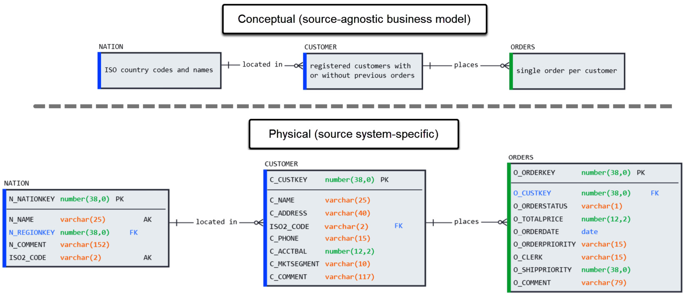
Source system

Slide 7
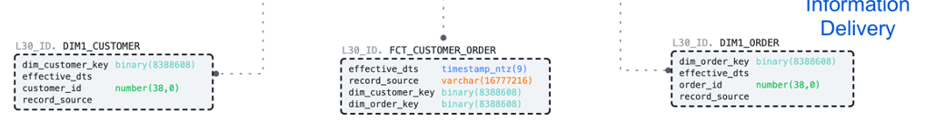
Delivery schema - Star schema
query to break down orders by nation, region and order_priority_bucket
(all attributes we derived in Business Data Vault).

Slide 8
Infrastructure data modelling
Basic idea about warehousing
Why Star schema?
Why data vault?

Slide 9
Stage Schema

Slide 10
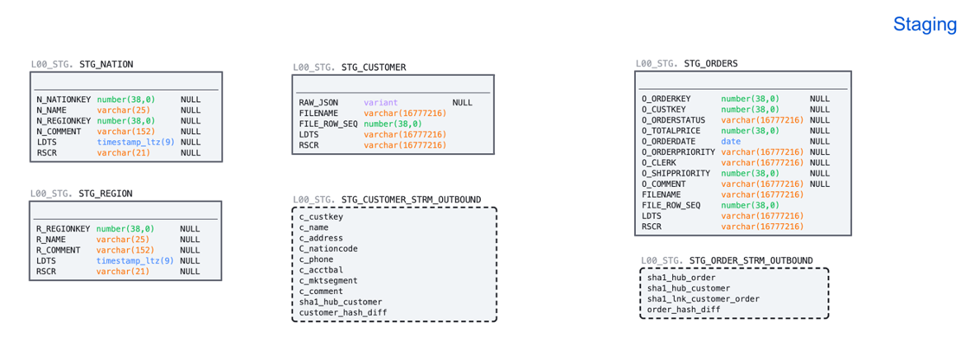
Stage schema

Slide 11
Ware housing layer

Slide 12
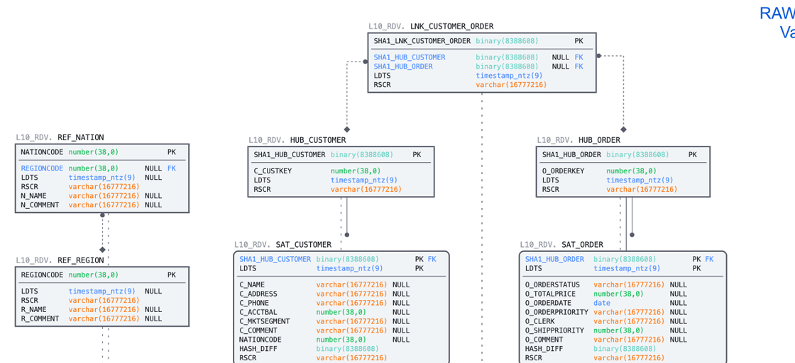
Raw Vault

Slide 13
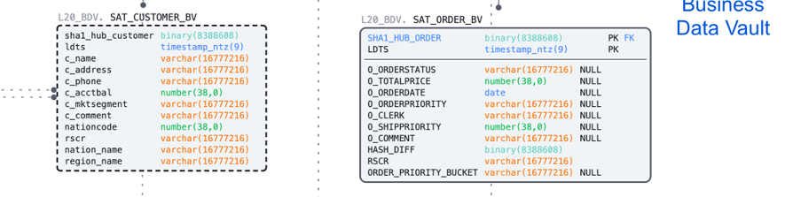
Business Vault

Slide 14
Modeling Raw Vault

Slide 15
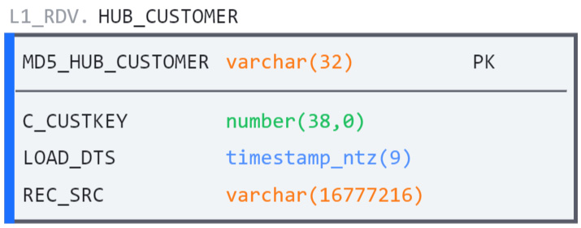
Hub

Slide 16
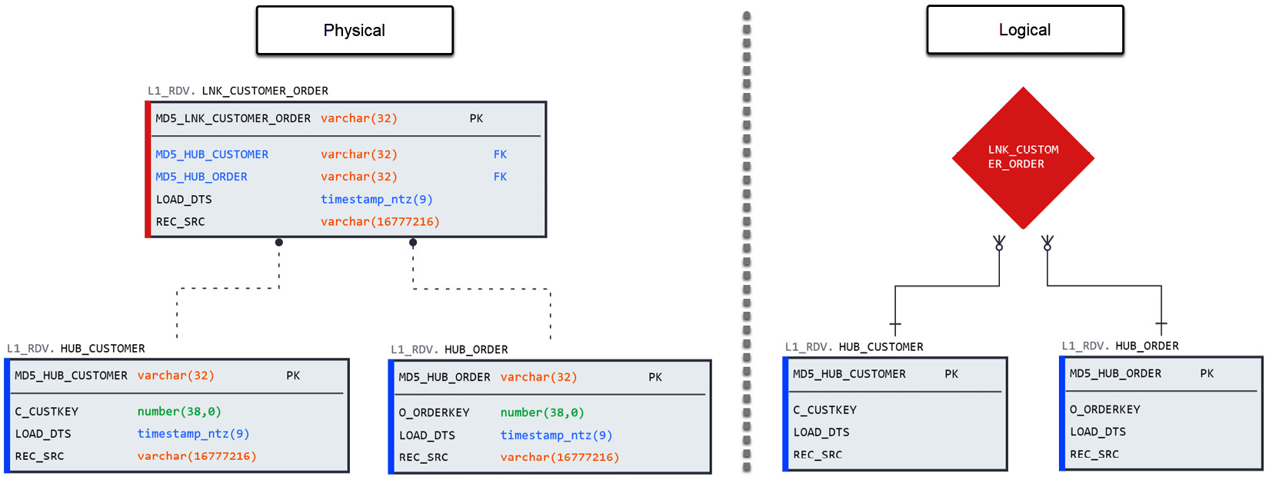
Link

Slide 17
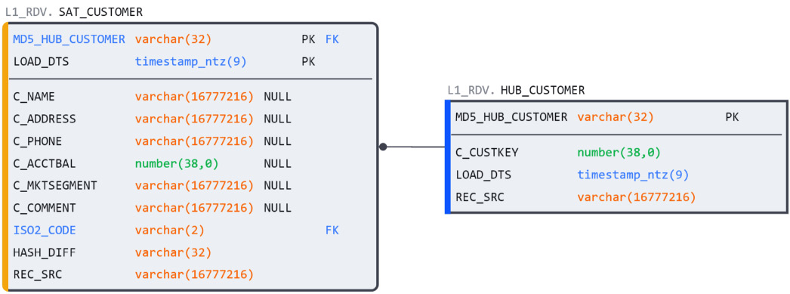
Satellite

Slide 18
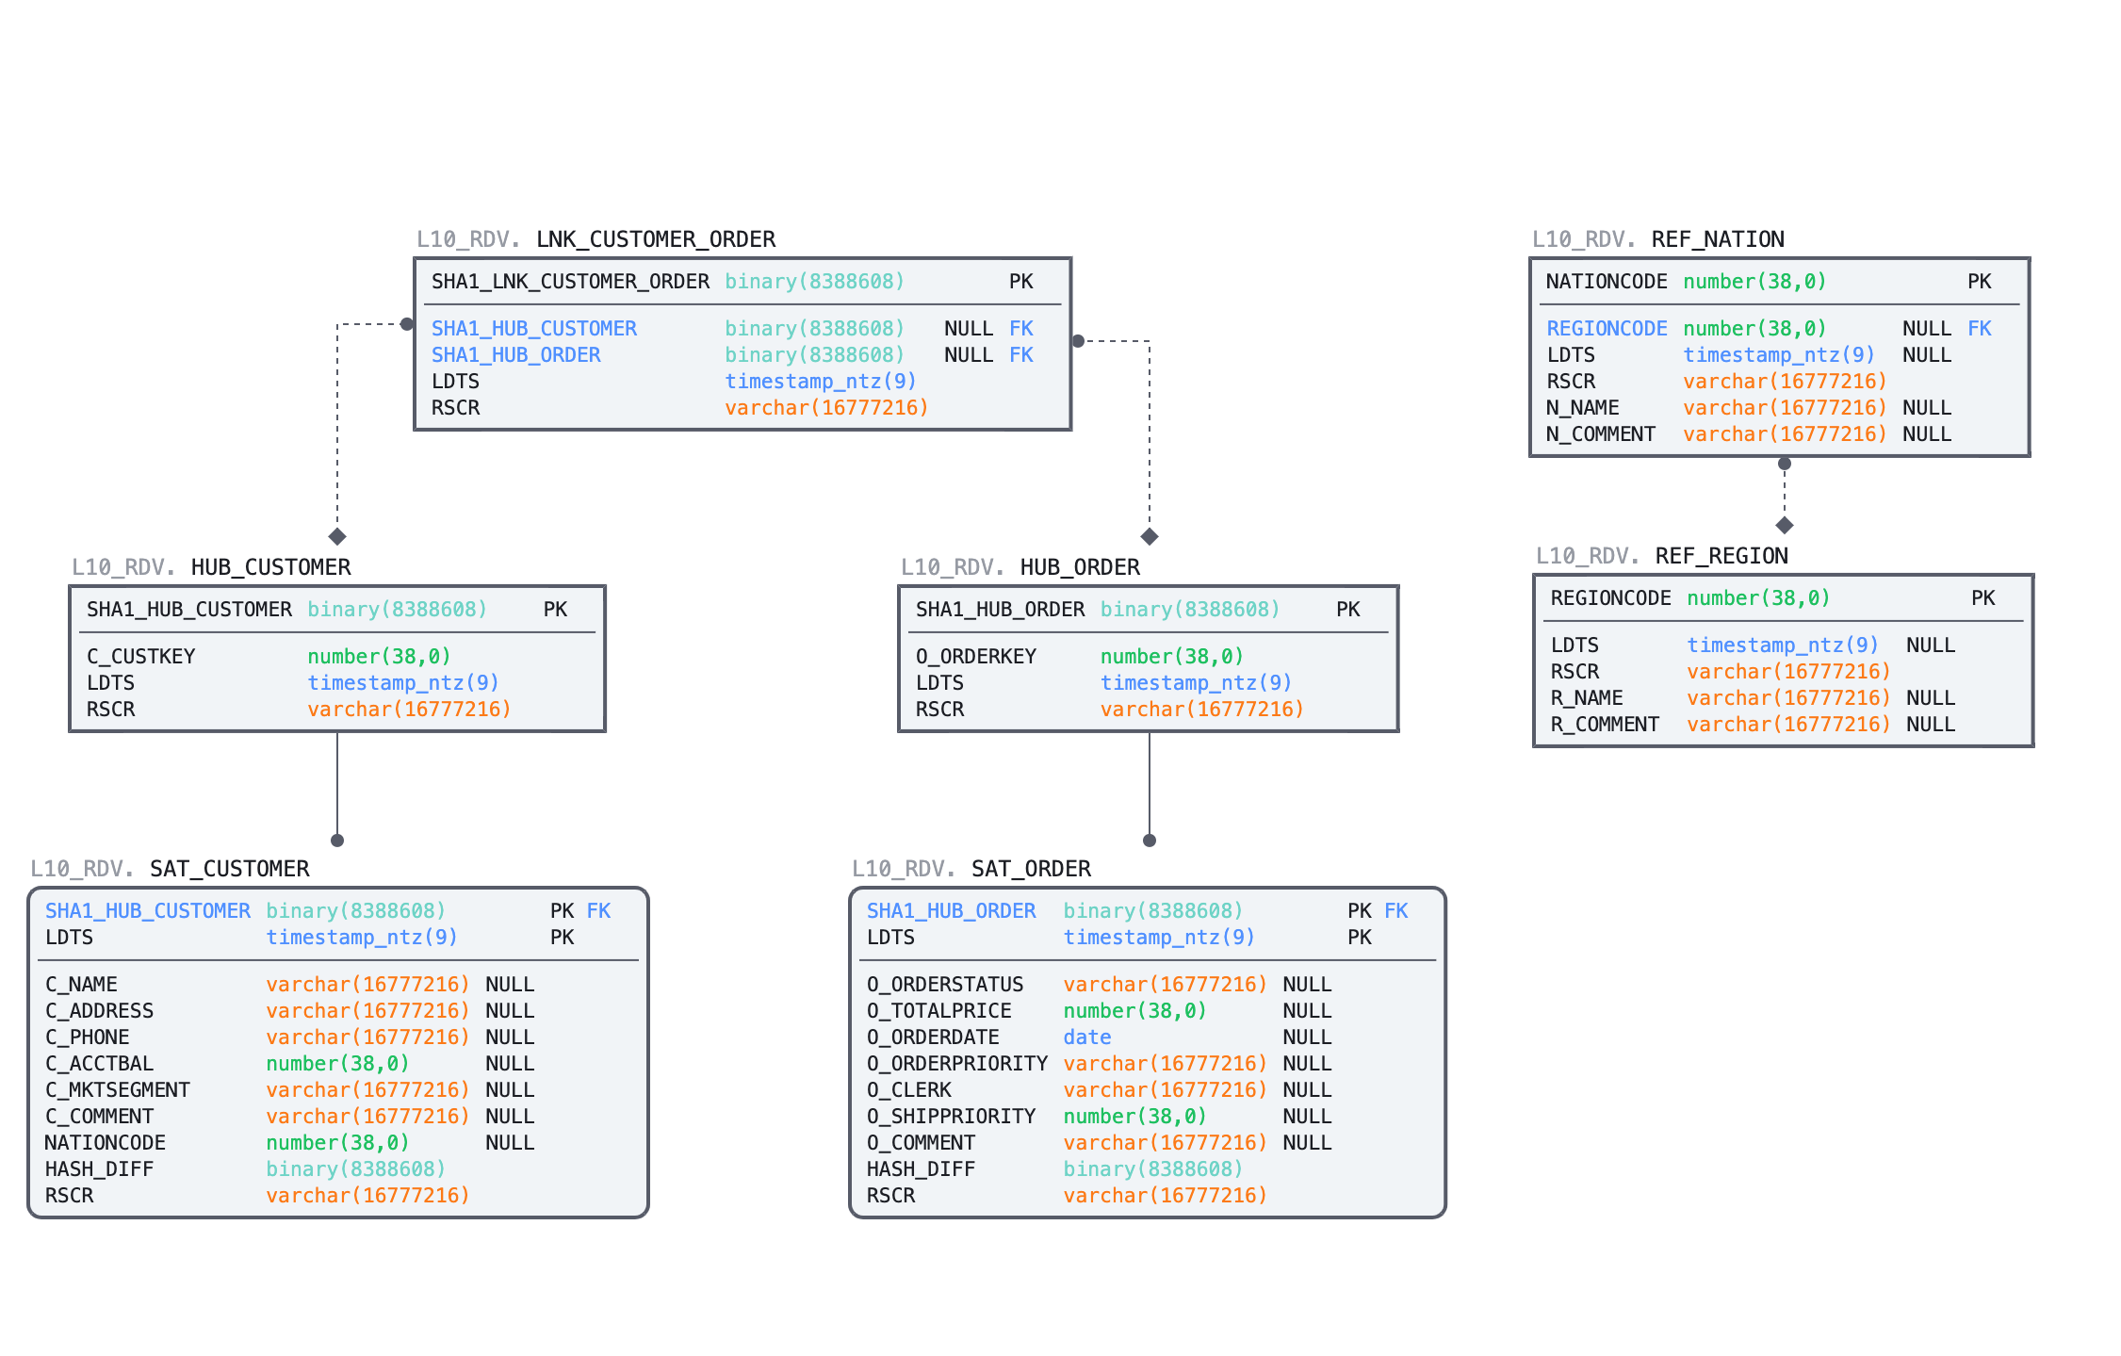
Raw Vault

Slide 19
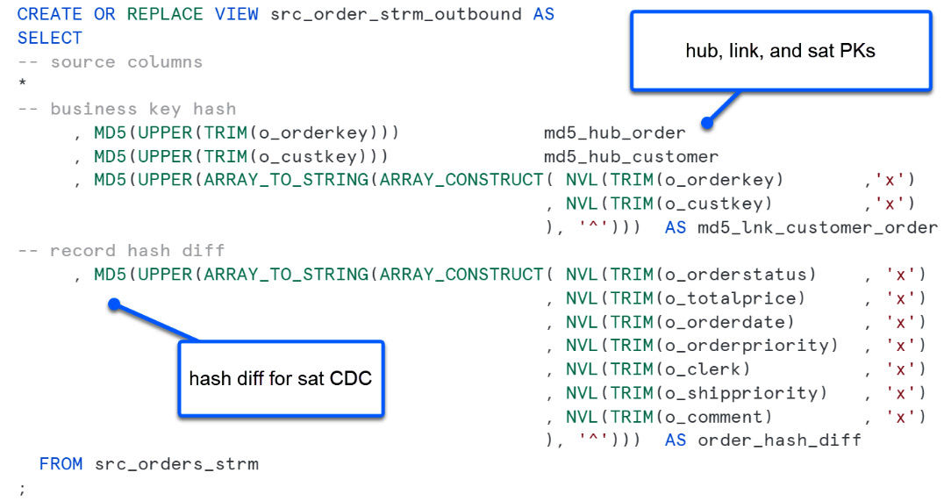
multi-table insert operator to allow users to perform such an operation efficiently

Slide 20
Modeling Business Vault

Slide 22
Pipeline Design

Slide 23
Master/reference data
Source
Staging
Data
Warehouse
Delivery
Source
Landing
Landing & Staging
Warehouse
Data Mart

Slide 24





Master/reference data
Staging
Raw
Vault
Business
Vault
Source
Delivery
Source
Landing

Slide 25




Right mechanism to move data in near real time?
Right mechanism to transform data? - view
Situation with source data?
Master/reference data
Avoid duplication?
Staging
Raw
Vault
Business
Vault
Source
Delivery
snowpipe
task
task
task
Source
Landing
Automatically ingest?

Slide 26
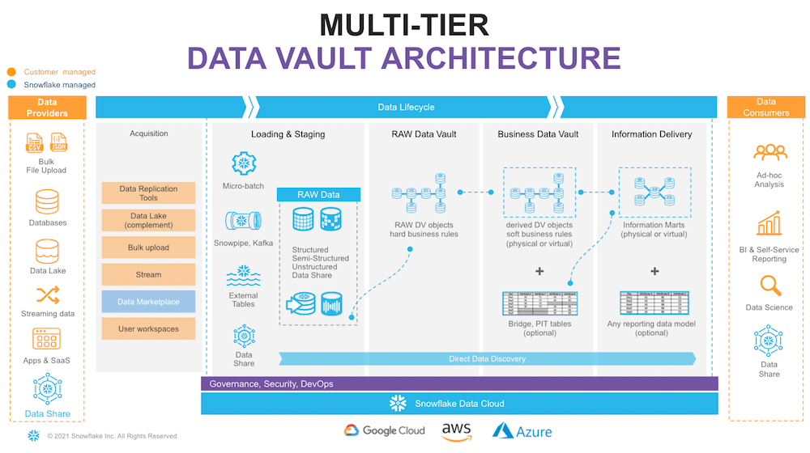

Slide 27
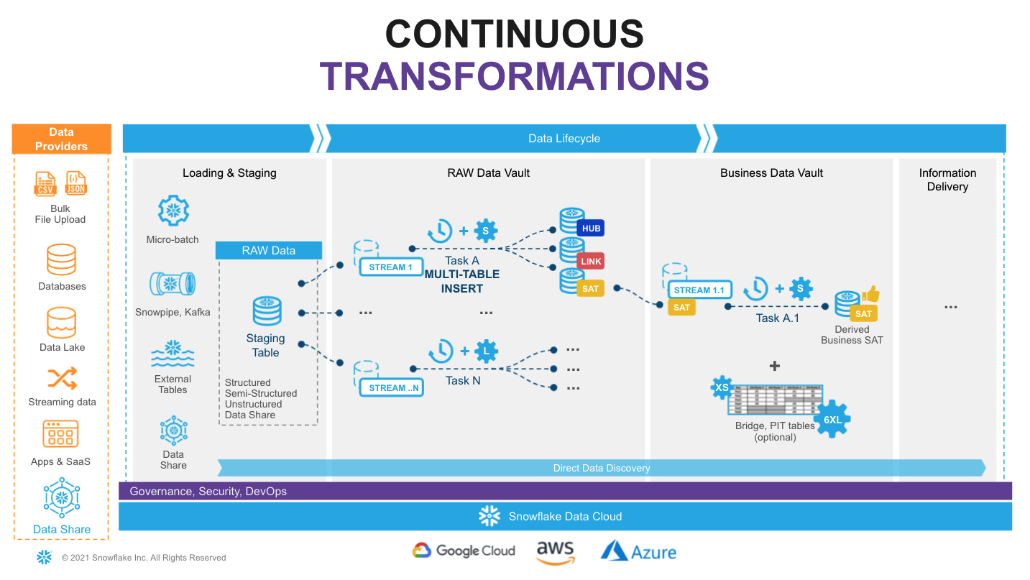

Slide 28
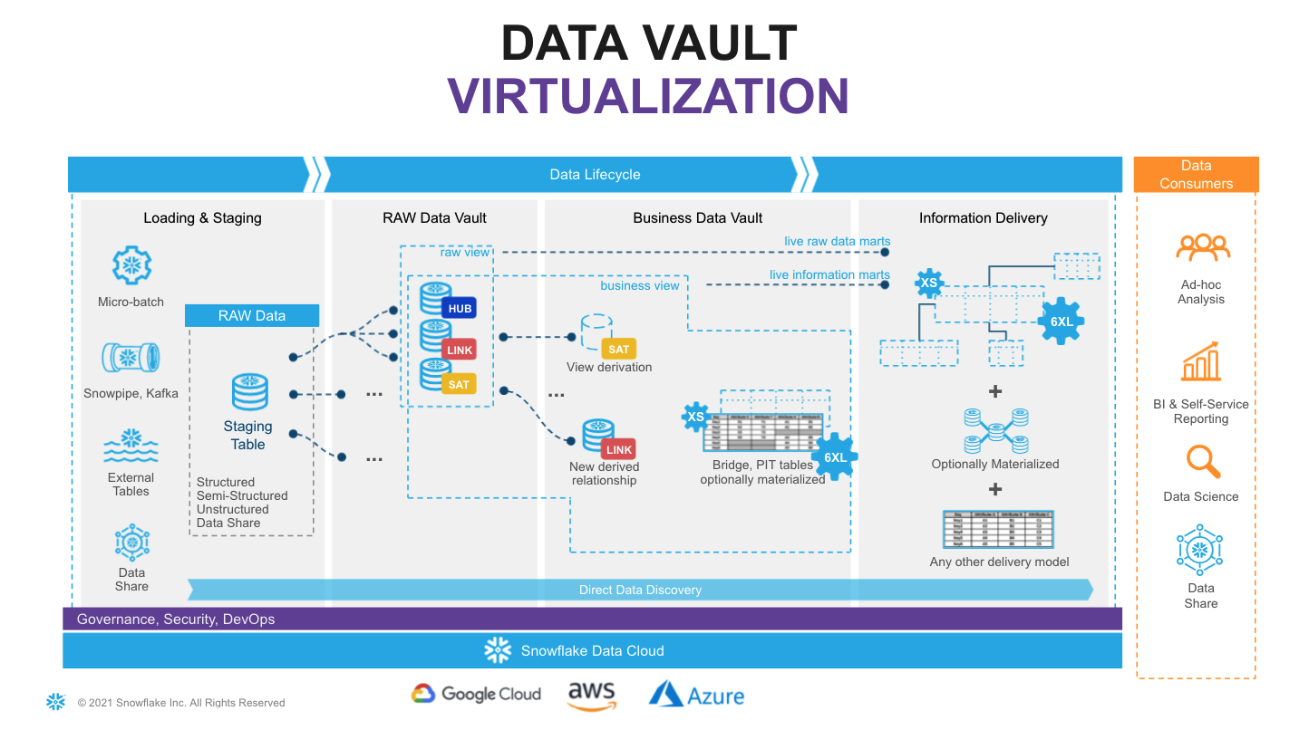

Slide 29
Modeling the data marts
a subset of a data warehouse designed to serve a specific department or function within an organization. Data marts are typically designed using a star or snowflake schema model.

Slide 30
Reference Links

Slide 31

Your success is our success
Contact
Mail: info@funnygorilla.com.au
Linkedin: https://mt.linkedin.com/in/songqing-gu-2ba9034b/de
Web Chat: FunnyGorilla
Phone: 0420891343

