Slide 1
Agent-based modeling of an epidemic
Notes:
See speak + storyboard for video at:
https://docs.google.com/document/d/1-Y_PeO3UXHfrTS_SYd5FA4mTE2rKcft5_H8yP__Rh2w/edit#

Slide 2
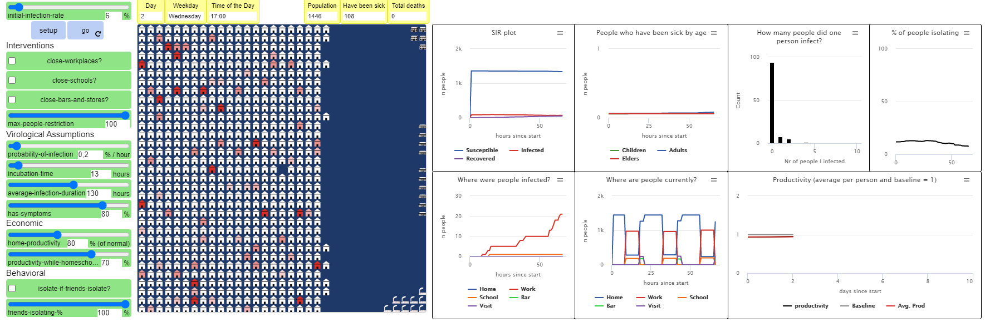
The University curricular unit
Theory of Science, BA and MA (2-hour lecture & workshop)
What are models, and how do they embody ‘theory’?
What are the limitations of models, and how does that affect what we can know with a model?

Slide 3

Agent behavior
Inhabitants in a town (population ≈ 1500)
Households of 1-6 people
Agents attend school or work, go to bars and stores, and visit friends
Agent behavior depends on their age group (child, young adult, adult, elder)
But now, a new virus is spreading!
The color of a building indicates the number of infected people there
If an agent shows symptoms, they will self isolate in their home
Agents can infect other agents who are in the same building
A simulation run stops when there are no infected people left.
Notes:
(SCREENCAP OF MODEL INSTEAD OF THIS SLIDE)

Slide 4
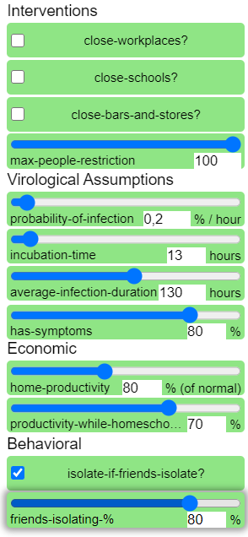
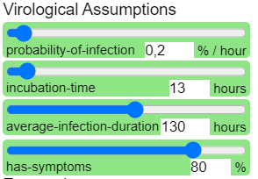
Widgets and interface
Interventions can be activated before or during a model run. They limit agents’ activities.
Assumptions (virological, economic, behavioural) are set before a model run. They affect how the virus spreads, how productive agents are in different situations, and how agents react if their friends start self isolating
Notes:
(SCREENCAP OF MODEL INSTEAD OF THIS SLIDE)

Slide 5
What big question does the model answer?
(How can we strike a balance between a healthy population/good public health and a healthy economy during an epidemic?)
(men nej – for det er jo bare productivity assumptions? @Arthur?)
(another BIG question?)
The model may not give specific answers, but it helps us better understand the connections and interdependencies in the complex system, so we can ask better questions
Notes:
slide

Slide 6
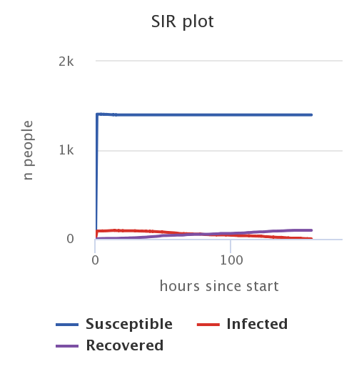
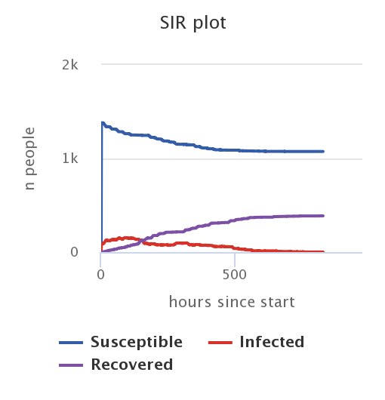
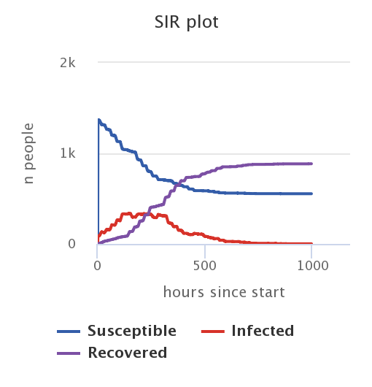
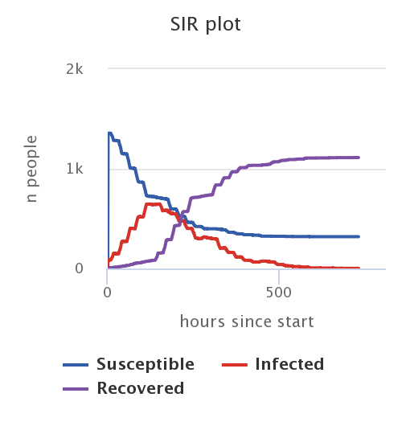
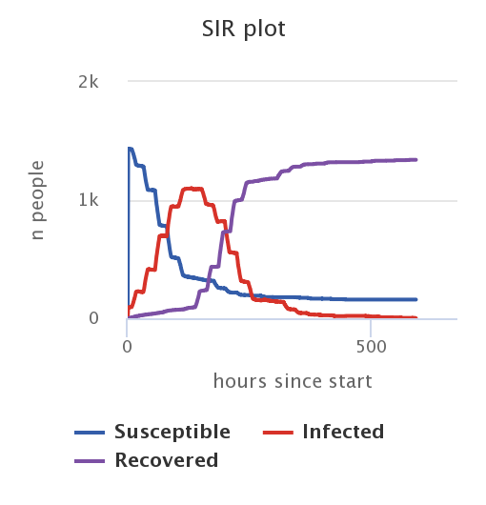
example: % agents with symptoms
Varying the percentage of infected people that develop symptoms
100%
75%
50%
25%
0%
Notes:
KUN DEN HER!
Forklar: hvorfor selv under de same antagelser om menneskelig adfærd ser vi de her ændringer? (gennemgå kausalkæden)
(få plots på same skala – stop efter fx 1200 ticks)
This change affects agent behavior: only people with symptoms know they’re infected and start isolating
Notice the non-linearity
(also look at other plots, show in model run: productivity plot and % of people isolating. It’s all connected!
Maybe mention: every run is different, so slight variation (these aren’t average plots, but just plots from single runs)
(notice shorter timescale in the first plot)
All other settings kept constant: initial rate 6%, no interventions, max people 100, 0.2% inf, 13 hours inc, 130 hours avg dur, isolate if friends isolate OFF

Slide 7
The causal chain: on agent-level
Agent develops symptoms
Agent self isolates and stops spreading the virus
An agent gets infected
INCUBATION TIME
Agent does not know they are sick, but can still spread the virus
Agent does NOT self isolate and may continue spreading the virus
Agent does NOT develop symptoms
Notes:
Explain causal chain

Slide 8
(Specific examples and contrasts 2)
Interventions: close schools, workplaces, and bars + restrict nr of people
Governmental action: go into heavy lockdown
(show live (sped-up) model run, insert pictures here)
(if done all at once, clear shift in all plots)
Show effects on: number of infections >< productivity (assumption it’ll be worse from home)…
(think critically: what does the model NOT include? (e.g. agents’ psychological wellbeing))

Slide 9


Try it out for yourself!
Download the model at (LINK)
Documentation at (LINK)
(more things to try?)
(contact info?)

