Slide 1
Agent-Based Modeling & Complex Systems

Slide 3



example of SIMPLE Agent-Based Model
Sheep & Wolves
I walk around
And metabolize energy
If I run out of energy, I die
If I have enough energy, I might reproduce
If there is grass/sheep nearby, I eat and gain energy
Grass
I am green if I can be eaten, brown if I can’t
If I am eaten, I grow back after a while

Slide 4
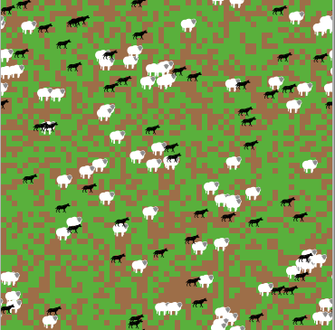
Running model

Slide 5
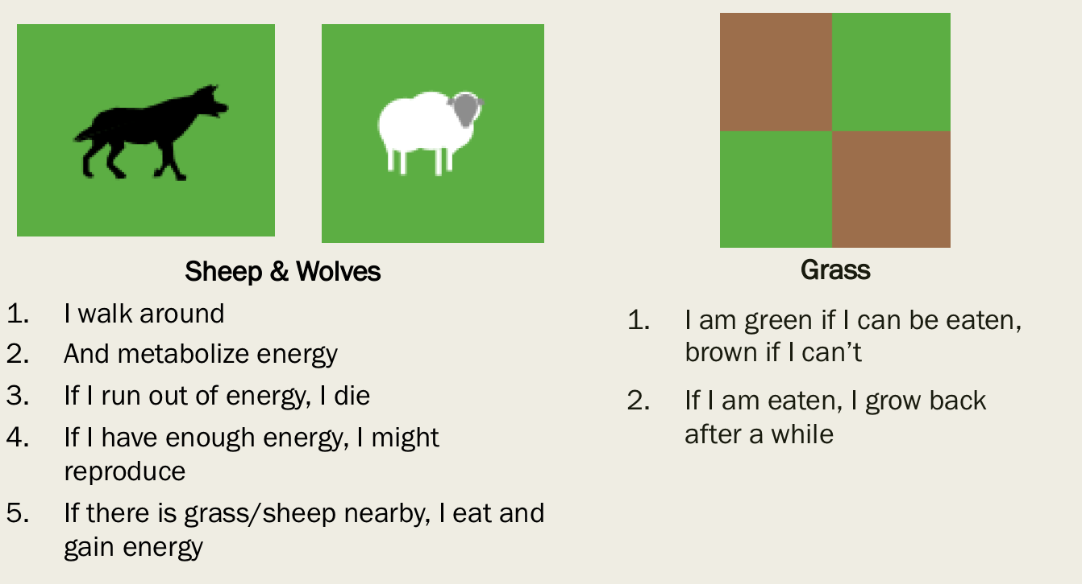
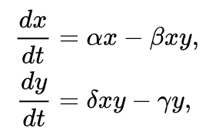
Comparing Representations
Concise
Conceptually difficult to experiment on
Deterministic -> predicable, less accurate
Few people have necessary training to solve them
Less concise, but underlying logic clear to everyone
Kindergarteners understand the logic
Easy to experiment on
Probabilistic -> less predictable, more accurate
Notes:
So now that we have these computational representations that let more people work with complex systems, how do we get them into classrooms or other educatonal contexts? And what does that look like?
First want to talk briefly about how I typically work

Slide 6
But how does this help learning?
Give students a laboratory to
- test ideas
- observe results
- work with data
And align their inner, mental model of a phenomenon with the external model
“Complex Systems Thinking”

Slide 7
Insert Quote text, for next level ENTER and TAB
Insert Name

