Slide 1
this is a title

Slide 2
Overordnet indhold (note-slide)
Overordnet indhold:
Agentadfærd
Undervisningskontekst
Widgets & interface
Det store spørgsmål, modellen besvarer
Mere specifikke eksempler og sammenligning. F.eks. økonomi >< sundhed. Forklar: hvorfor er det en spændende kontrast?
"Download to try it out for yourself!"

Slide 3

Agent behavior
Inhabitants in a town (population ≈ 1500)
Households of 1-6 people
They attend school or work, go to bars and stores, and visit friends
Agent behavior depends on their age group (child, young adult, adult, elder)
Every agent also has a different level of social needs which affects how often they attend social events
But now, a new virus is spreading!
The colour of a building indicates the number of infected people there
If an agent shows symptoms, they will self isolate in their home
Agents can infect other agents who are in the same building
A simulation run stops when there are no infected people left.

Slide 4
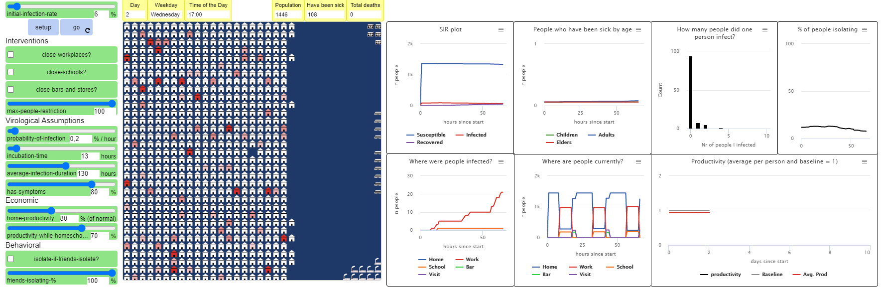
The University curricular unit
Theory of Science, BA and MA (2-hour lecture & workshop)
What are models, and how do they embody ‘theory’?
What are the limitations of models, and how does that affect what we can know with a model?

Slide 5
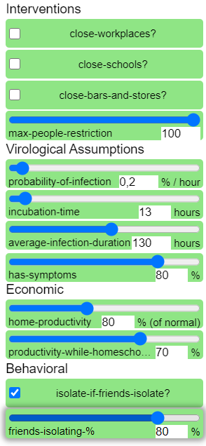
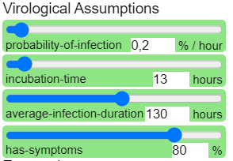
Widgets and interface
Interventions can be activated before or during a model run. They limit agents’ activities.
Assumptions (virological, economic, behavioural) are set before a model run. They affect how the virus spreads, how productive agents are in different situations, and how agents react if their friends start self isolating

Slide 6
What big question does the model answer?
(How can we strike a balance between a healthy population/good public health and a healthy economy during an epidemic?)
(men nej – for det er jo bare productivity assumptions? @Arthur?)
(another BIG question?)
The model may not give specific answers, but it allows us to ask better questions

Slide 7
(cut to showing the model in action)
(screen capture, video)

Slide 8
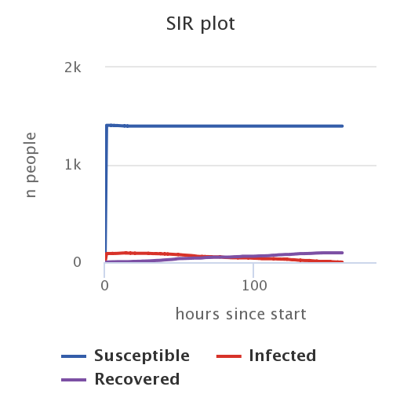
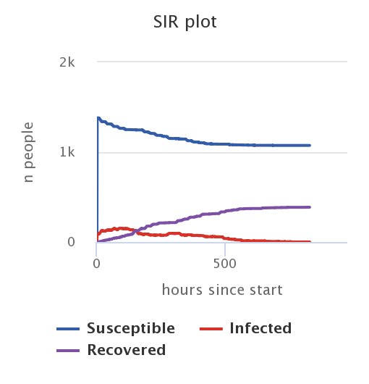
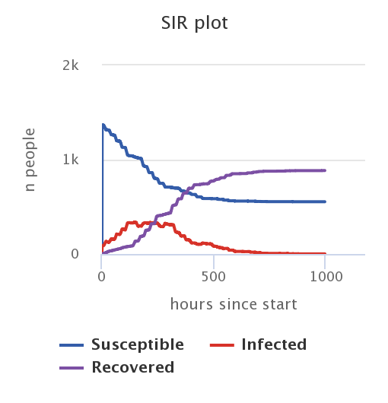
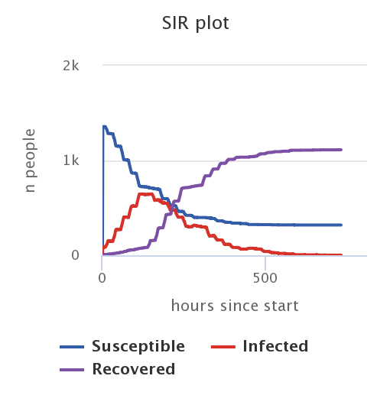
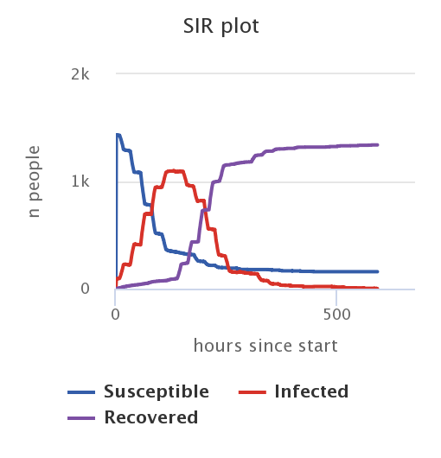
(Specific examples and contrasts 1)
Varying the percentage of infected people that develop symptoms
100%
75%
50%
25%
0%
Notes:
This change affects agent behavior: only people with symptoms know they’re infected and start isolating
Notice the non-linearity
(also look at other plots, show in model run: productivity plot and % of people isolating. It’s all connected!
Maybe mention: every run is different, so slight variation (these aren’t average plots, but just plots from single runs)
(notice shorter timescale in the first plot)
All other settings kept constant: initial rate 6%, no interventions, max people 100, 0.2% inf, 13 hours inc, 130 hours avg dur, isolate if friends isolate OFF

Slide 9
(Specific examples and contrasts 2)
Interventions: close schools, workplaces, and bars + restrict nr of people
Governmental action: go into heavy lockdown
(show live (sped-up) model run, insert pictures here)
(if done all at once, clear shift in all plots)
Show effects on: number of infections >< productivity (assumption it’ll be worse from home)…
(think critically: what does the model NOT include? (e.g. agents’ psychological wellbeing))

Slide 10


Try it out for yourself!
Download the model at (LINK)
Documentation at (LINK)
(more things to try?)
(contact info?)

