Slide 1


Agent based modelling of Language development on SktThomas

Slide 2
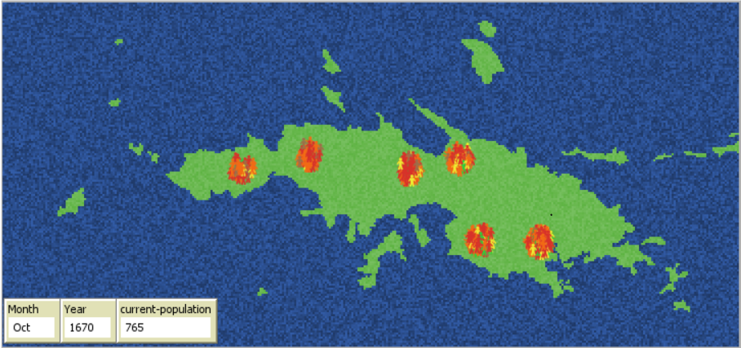
The University curricular unit
Linguistics, BA and MA (2-hour lecture & workshop)
What are models, and how do they embody ‘theory’?
What are the limitations of models, and how does that affect what we can know with a model?

Slide 3
What big question does the model answer?
What model assumptions must be there for the simulation to result in convergence on a common language?
The model / simulation is a virtual lab
Notes:
slide

Slide 4
Limitations
Remember: the model is a simplification of reality
What does it NOT include?
The lexical development of the population

Slide 5
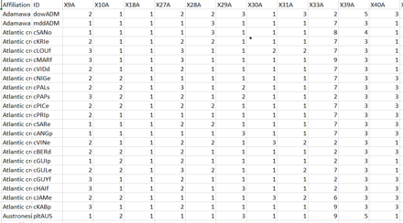
Development of language
How their language is represented
WALS-Features
Phonetic and Grammatical

Slide 6
Overordnet indhold (note-slide)
Overordnet indhold:
Undervisningskontekst
Agentadfærd
Widgets & interface
Det store spørgsmål, modellen besvarer
Mere specifikke eksempler og sammenligning. F.eks. økonomi >< sundhed. Forklar: hvorfor er det en spændende kontrast?
"Download to try it out for yourself!"

