Slide 1
EDU-IT Science at Home, Aarhus University
Notes:
Welcome to this video about EDU-IT.
We are a team working under Science at Home for Aarhus University, and we develop learning materials for students at university-level.

Slide 2
Agent-Based Models: The Virtual Laboratory
[add images for visuals]
Notes:
We create ABMs, which we like to think of as virtual laboratories. We use available data to build simulation-like models, which enables students to investigate and test out hypotheses in fields in which carrying out similar investigations in the real world is not possible for some reason, whether it be economical, ethical reasons or practical reasons.

Slide 3
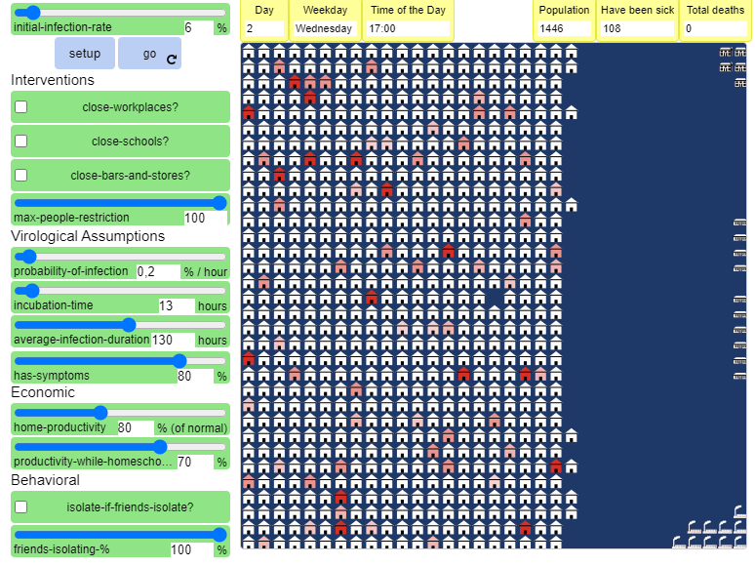
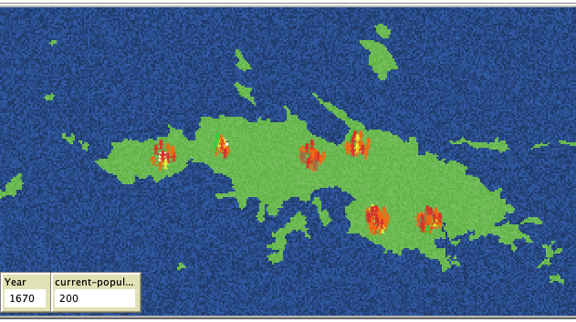
Collaboration Partners
Theory of Science
[insert big question here]?
Linguistics
[insert big question here]?
Notes:
The departments that we have collaborated with so far include linguistics and theory of science.
With theory of science, we made a model to try to understand the spread of virus in a society during an epidemic.
With the linguistics department, we looked into how a creole (new language) might emerge, when different language-speaking people meet and need to communicate.
If you are interested in learning more about these models, they are available here on the website.
And now, allow me to elaborate on what exactly agent-based models are.

Slide 4
Agent-Based Models
[insert visuals]
Notes:
ABMs are computational representations of complex systems; that is phenomena, that consists of several autonomously interacting parts, which makes them difficult to make predictions about! Because they are non-linear and prone to feedback loops etc.
Let’s make it clearer with an example: Here is an ecosystem consisting of three elements: Wolves, sheep, and grass.

Slide 5



Example of a SIMPLE Agent-Based Model
Sheep & Wolves
I walk around
And metabolize energy
If I run out of energy, I die
If I have enough energy, I might reproduce
If there is grass/sheep nearby, I eat and gain energy
Grass
I am green if I can be eaten, brown if I can’t
If I am eaten, I grow back after a while
Notes:
We know that each of these three groups have different behaviors from one another. We can generalize their behavior to build an ABM. We need to describe how the group functions and interacts with the others.
In this case, we can say that wolves need energy to live, and they get that from eating sheep. If they don’t get that energy, they die. If they get a surplus of energy, there is a chance that they will reproduce.
Similarly for the sheep, they also need energy to live, which they get from eating grass. If they don’t get enough, they die. If they get plenty energy, they reproduce. Oh, and then they might get eaten by a hungry wolf.
Finally, we have a third agent – the grass, which has a very simply behavior. It can be eaten by sheep; in which case it will take a certain amount of time for it to regrow.

Slide 6
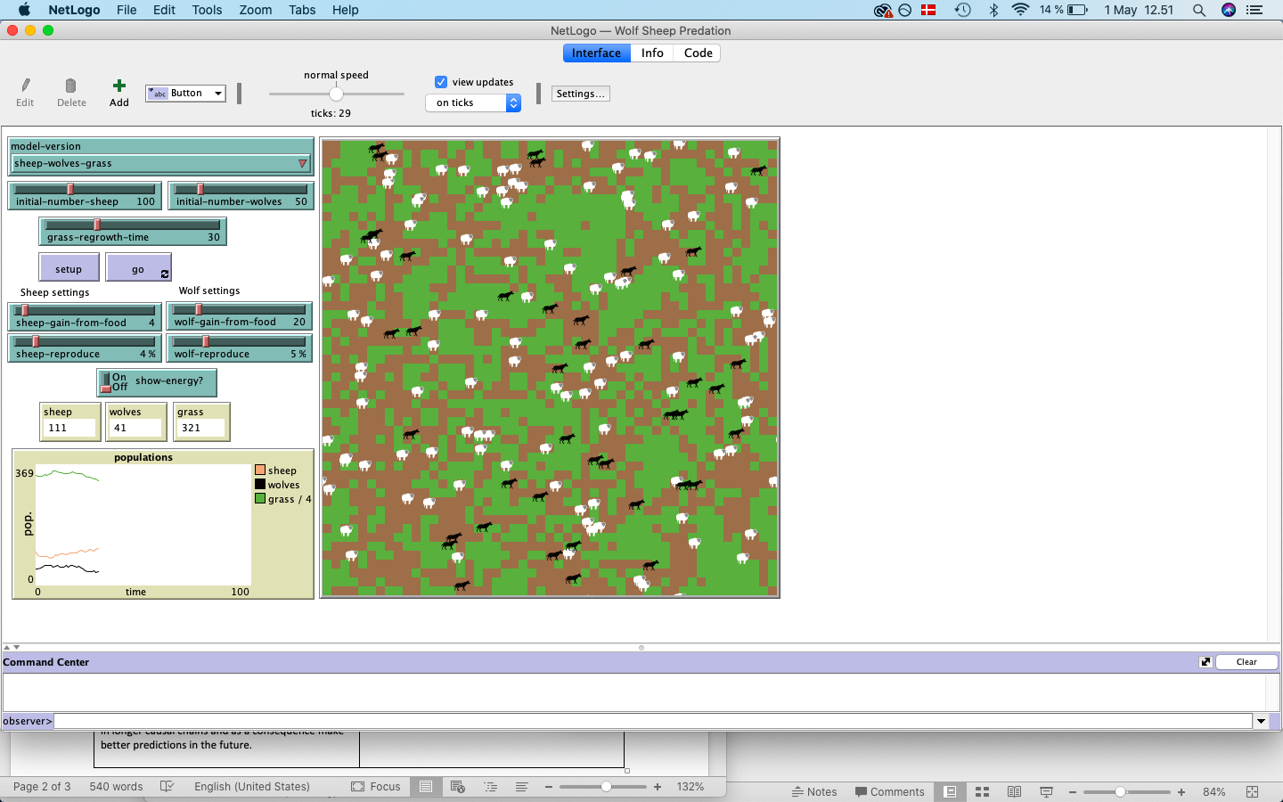
[Running model in Netlogo for Preview]
Notes:
So, now we have described the agents of the systems and the behavior between them. And just like that, we have described a complex system in such simple terms that even a kindergartener could understand it.
*run the model*

Slide 7
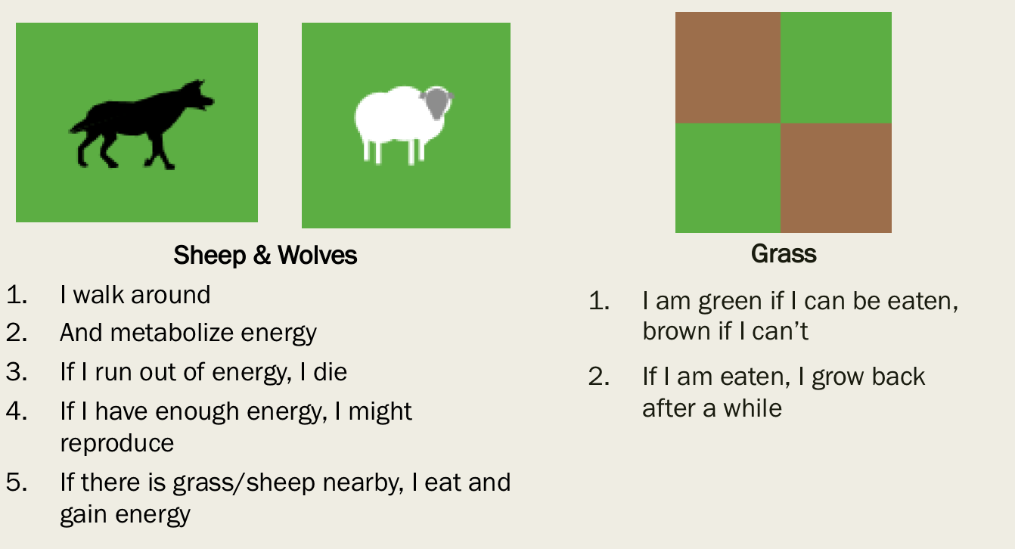
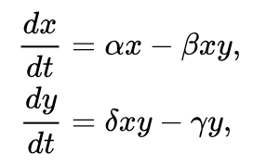
Comparing Representations
Concise
Conceptually difficult to experiment on
Deterministic -> predicable, less accurate
Few people have necessary training to solve them
Less concise, but underlying logic clear to everyone
Kindergarteners understand the logic
Easy to experiment on
Probabilistic -> less predictable, more accurate
Notes:
If we compare the ABM that we have just made to its mathematical equivalent, it is clear that understanding the mathematical model is much more difficult. And this is a great strength of ABM – the underlying logic is very clear.
Another strength is that it is easy experiment on. We can test out ideas and observe the results. For example, what do we expect to happen if the grass regrows faster? The results might very well surprise us! Because the outcomes of complex systems are indeed difficult to predict – but, ABM enables us not only to test out our ideas, but also helps us to think in longer causal chains and as a consequence make better predictions in the future.

