Slide 1
Applied Analytics Practicum Midterm Report
OneBlood Project
June 15, 2020 – Arthur Wang

Slide 2
Outline
Background and objectives
Challenges
Progress
Methods
Plan

Slide 3
Background and objectives
OneBlood is a non-profit that collects blood donations and blood products to hospitals
Project objectives:
Predict “inventory practicality”: expected supply of blood products available over the next 30 days
Guide direct marketing activities: identify high-value potential donors for outreach efforts

Slide 4
Challenges
Predicting inventory practicality
Unlike a traditional supply chain, OneBlood does not directly control its inputs (blood products)
Donors must voluntarily give blood – it cannot be procured like raw materials in manufacturing
Donation is not guaranteed
Generating more supply may require marketing activities (outreach to donors)

Slide 5
Challenges
Guiding direct marketing activities
The database of past donors is very large
Marketing resources are limited – cannot contact every past donor
How to prioritize limited resources?
Identify donors who are most likely to respond (i.e. have greatest propensity)

Slide 6
Progress
Data cleansing
Feature engineering
Exploratory analysis and training

Slide 7
Data cleansing
Removed a small number of records with invalid/missing values
Added 00 seconds to some RegistrationTime values to enable conversion to a timestamp
Those steps allowed me to combine all provided data into one set

Slide 8
Feature engineering
Transformed data to generate features and enable donor propensity scoring
Data is provided in transactional form: one record for each registration (i.e. donation attempt)
Predicting donor propensity requires data that characterizes donors
I used a target window/cutoff date approach to generate the feature set
The feature set allowed me to reduce noise by eliminating ineligible donors

Slide 9
Target window/cutoff date approach
Pick an arbitrary point in time (CutoffDate)
Establish a target window: the 30 days following the cutoff date
For all donors who have donated prior to that cutoff date, calculate RFT features:
Recency: how many days between their most recent donation and the cutoff date
Frequency: how many total donations prior to the cutoff date
Time: how long the donor has been in the system
Target: whether the donor registered to donate in the 30-day target window
Random_ID | RegistrationTime
1253498 | 2015-01-01 12:05:00
8349921 | 2016-02-24 13:15:00
5132947 | 2015-11-15 08:30:00
4257796 | 2016-03-08 09:30:00
... | ...
Random_ID | CutoffDate | Recency | Frequency | Time | Target
1253498 | 2016-03-31 23:59:59 | 23 | 5 | 396 | 1
8349921 | 2016-03-31 23:59:59 | 45 | 2 | 212 | 0
5132947 | 2016-03-31 23:59:59 | 6 | 1 | 200 | 1
4257796 | 2016-03-31 23:59:59 | 23 | 1 | 23 | 0
... | ... | ... | ... | ... | ...

Slide 10
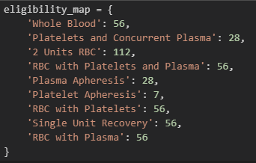
Eliminating ineligible donors
Based on the type of that donation, a donor cannot donate more blood until after they have waited a certain number of days
Donors who donated too recently prior to a given target window are excluded from the training set
They are not useful data because their negative target is unrelated to their features
Removing them helps prevent swamping of positive targets
Generating a recency feature allows this filtering

Slide 11
Exploratory analysis
In order to better understand the newly formed data and gauge usefulness of features, I performed basic exploratory analysis:
Performed a basic 80/20 train/test split
Trained a logistic regression model on:
Recency
Frequency
Time
Whether the donor’s modal donation location is a center (as opposed to a mobile location)
Percent of days in the 30-day target window during which the donor was eligible

Slide 12
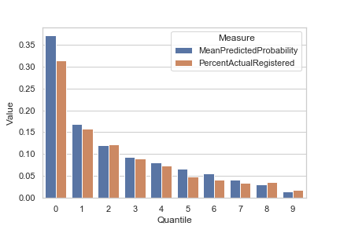
Exploratory analysis: initial findings
My model scored well on a test set, but a summary of predicted classes showed that it was mostly predicting a negative target
Following the project sponsor’s projection, I formed my test set into quantiles based on predicted probability of donating, then compared each quantile’s:
Mean predicted probability of donating
Actual probability of donating (actual percentage of donors in the quantile who donated in the target window)
The quantiles/cohorts formed by my initial model have mean predicted probabilities close to their actual probabilities. An expected value calculation for each cohort predicts donation counts close to the actual donation counts.

Slide 13
Further exploratory analysis
The dataset has imbalanced classes: most people do not donate
I downsampled the majority class (negative target) and trained a new model on 80% of the downsampled dataset
The accuracy score is much lower (68.2%), but it no longer predicts only negatives
I also estimated the number of donations by:
Specifying an entire target window as a holdout/test set
Classifying donors from that target window holdout set
Aggregating the predicted positives to get total estimated donors
This method imitates how the model would be used in production: features would be formed from the donor database using an upcoming cutoff date for date/time calculations, and the model would classify each donor
Using the model trained on downsampled data, I overestimated donations by a large amount (155,783 vs. 50,480)

Slide 14
Summary of methods so far
Feature engineering
Date/time logic for calculating RFT features
Transform transactions into donor characteristics at various points in time
Downsampling to balance classes in training set
Classification
Logistic regression
Prediction of available product
Estimation of donations by cohort/quantile
Classifying all donors for a given target window and counting predicted positives

Slide 15
Plan
Explore more classification methods
Different models
Classification tree
Support vector machine
K-nearest neighbors
Different combinations of features
Compare classification methods using cross-validation
Explore time series analysis to predict total number of donations for a given 30-day window
ARIMA
Holt-Winters/triple exponential smoothing
Compare to performance of estimation based on donor propensity
Select best-performing classification model
Train on full training set
Test on test set to report performance
Include best-performing time series model if total donation prediction is superior to propensity-based estimation
Document findings and analysis in final report
Create project code package for OneBlood

