Slide 1

Mobile Touch
Joseph Lin
2014/11/12

Slide 2
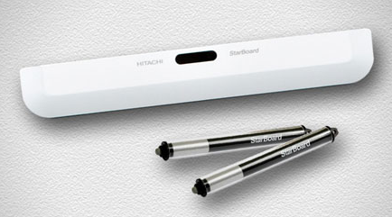
Hitachi Starboard
1.1 Specification
Dimension
Configuration
Stylus
1.2 Installation
Adhesive tape / Projectors
Magnets / Whiteboards

Slide 3
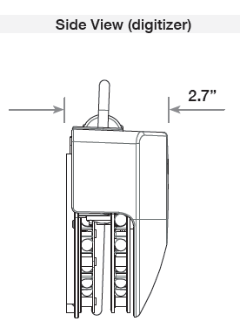
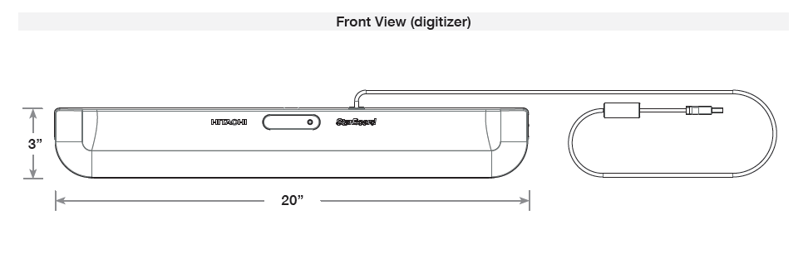
Hitachi StarBoard
Dimension: 510.5 x 76.2 x 40.6 mm
Model Name | StarBoard LINK EZ2-Pen
Digitizing Technology | Infrared Image Sensor System
Interface to Computer | USB 1.1, 2.0 (cable length: 19.7 ft)
Active Area Size | 60”- 90” (aspect ratio 4:3) 60”- 90” (aspect ratio 16:10)
Coordinate Resolution | Approx. 500 lpi
Tracking Speed | Approx. 100 points/sec
Digitizer Dimensions | 510.5 x 76.2 x 40.6
Power Consumption | 5V 500mA (USB Bus Power)

Slide 4
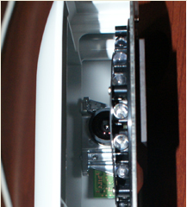
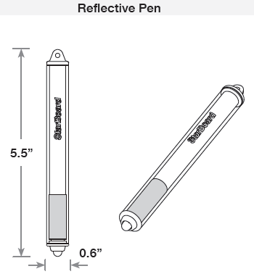
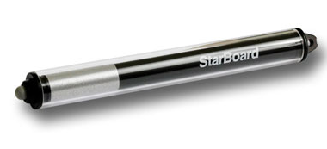
Hitachi StarBoard
Configuration
140 x 15 mm

Slide 5
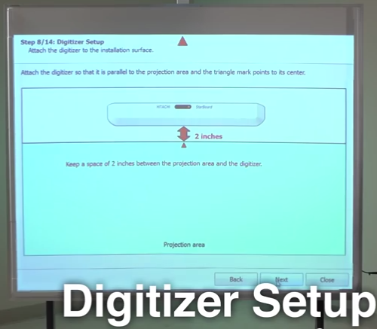
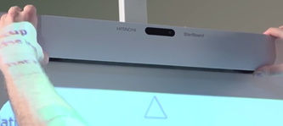
Installation
5 cm
觸控模組安裝
Using magnetic surface:磁鐵安裝
Using nonmagnetic surface:雙面膠安裝或螺絲鎖固

Slide 6
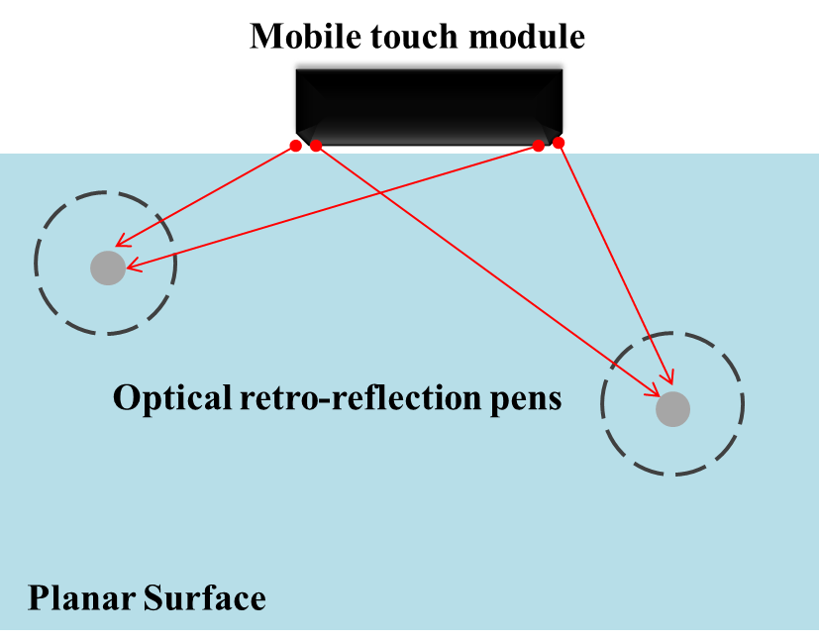
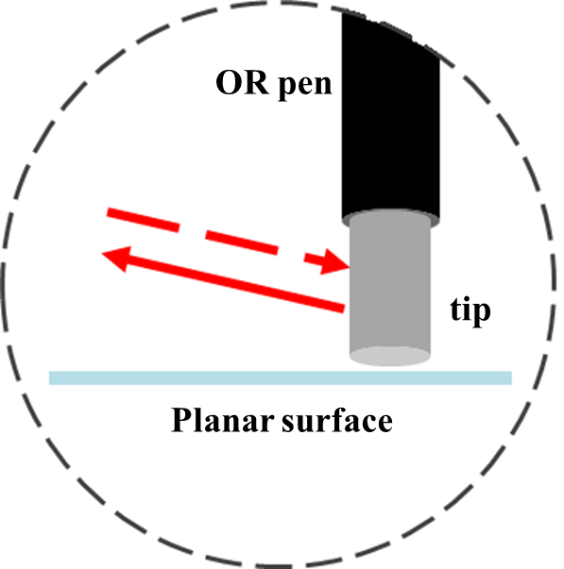
Mobile Touch
2.1 Specification
Dimension
Configuration
Noiseless stylus
2.2 Installation
Adhesive tape / Projectors
Magnets / Whiteboards
Holder / TV& Displays

Slide 7
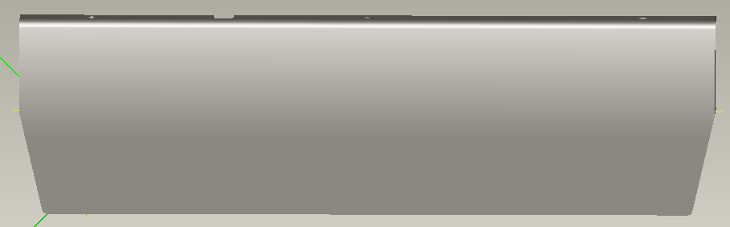
2.1.1 Intro. & Dimension
Dimension: 420 x 121 x 28 mm v.s. 510.5 x 76.2 x 40.6 mm
Model Name | Mobile Witouch | StarBoard LINK EZ2-Pen
Digitizing Technology | IR (4 Xiroku sensors) | Infrared Image Sensor System
Interface to Computer | USB | USB 1.1, 2.0 (cable length: 19.7 ft)
Active Area Size | Max to 90” (aspect ratio 4:3 , 16:9 , 16:10) | 60”- 90” (aspect ratio 4:3) 60”- 90” (aspect ratio 16:10)
Coordinate Resolution | - | Approx. 500 lpi
Tracking Speed | Frame rate < 100 Hz (current status) | Approx. 100 points/sec
Digitizer Dimensions | 420 x 121 x 28 mm | 510.5 x 76.2 x 40.6 mm
Power Consumption | 5V 500mA / Rechargeable Power 1A | 5V 500mA (USB Bus Power)

Slide 8
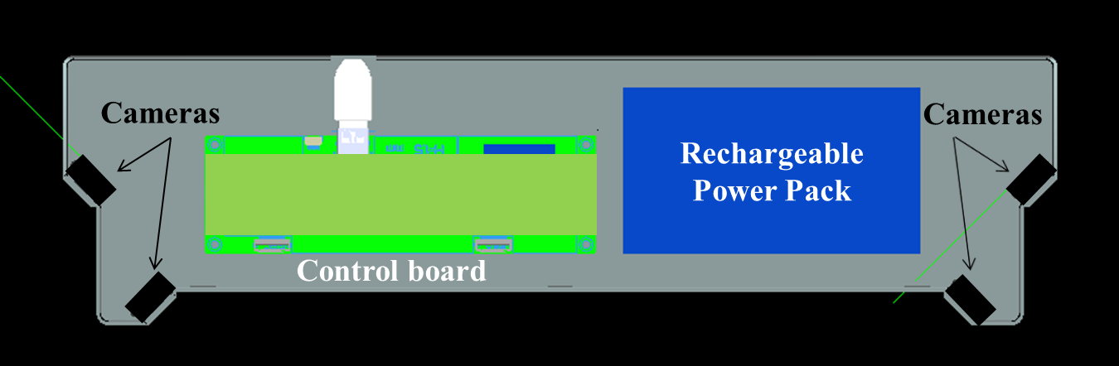
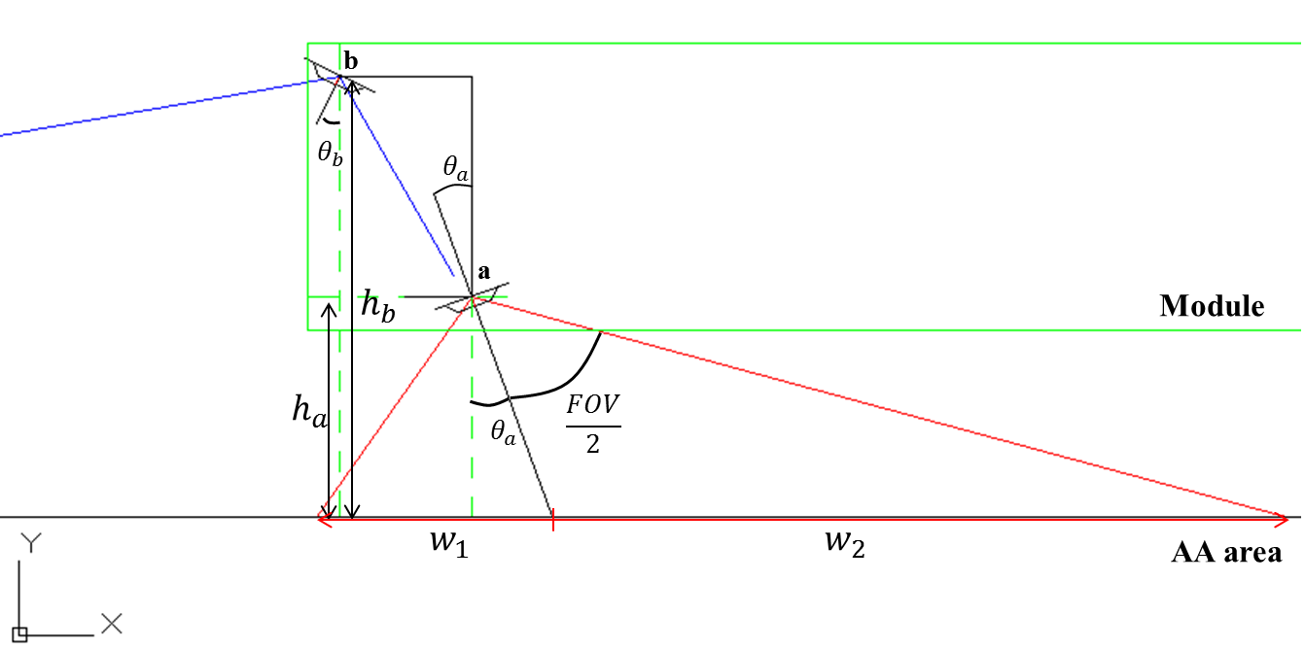
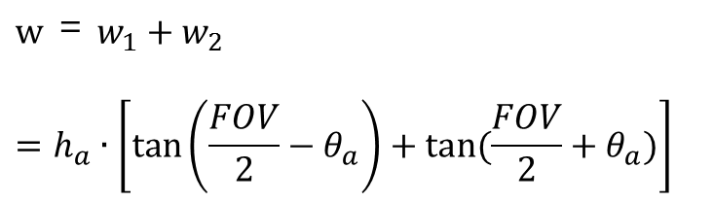
2.1.2 Configuration
Configuration
IR cameras arrangement
The overall FOV of the module satisfies the active area of displays or projectors
$$w ＝ w_{1}+w_{2}$$
$$=h_{a}∙\left[\tan\left(\frac{FOV}{2}−θ_{a}\right)+tan(\frac{FOV}{2}+θ_{a})\right]$$

Slide 9
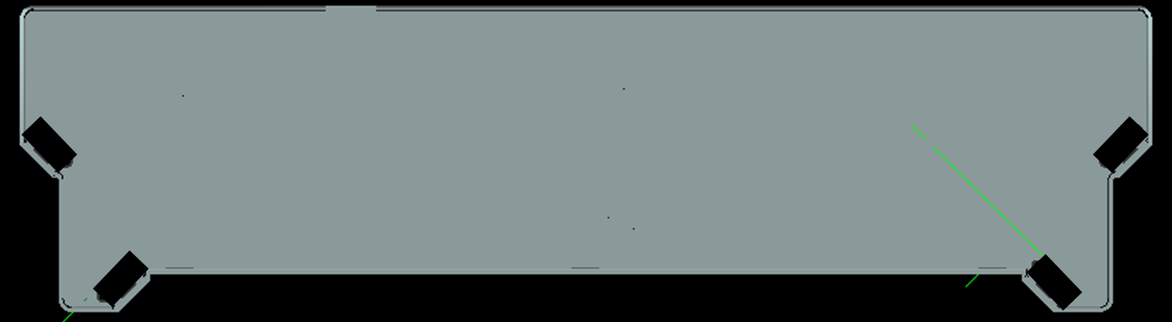
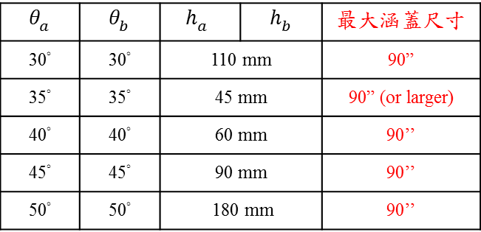
2.1.2 Configuration
IR cameras arrangement
$$θ_{a}$$ | $$θ_{b}$$ | $$h_{a}$$ | $h_{b}$ | 最大涵蓋尺寸
30° | 30° | 110 mm |  | 90”
35° | 35° | 45 mm |  | 90” (or larger)
40° | 40° | 60 mm |  | 90’’
45° | 45° | 90 mm |  | 90’’
50° | 50° | 180 mm |  | 90’’
在這個範圍選取合適的解
40°
錯位增加兩鏡頭之視差
助於解決遠側偏移問題
40°

Slide 10
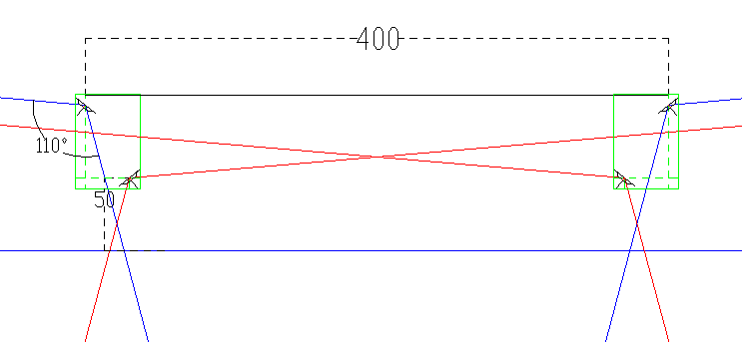
2.1.2 Configuration
FOV and position relative to AA area
打光方式
18 mm
FOV 緩衝區
18 mm
左同時打光
無對看問題
接著,右同時打光

Slide 11
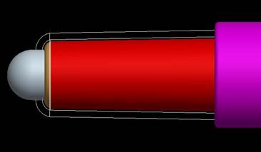
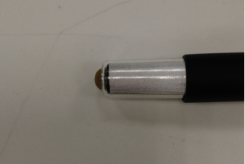
2.1.2 Configuration
Mobile touch module
Noiseless stylus: 最小半徑處約8.5mm
1785 mm
90”
雖為90” 但最遠距離僅有1785mm
故反光筆直徑8.5mm即可
Display Size (inch) | Diagonal (mm) | Required Optical Reflecting size (mm) | Diameter of the reflecting pen (mm)
92 | 2336.8 | 10.8 | 12
70 | 1778 | 8.2 | 8.5
65 | 1651 | 7.6

Slide 12
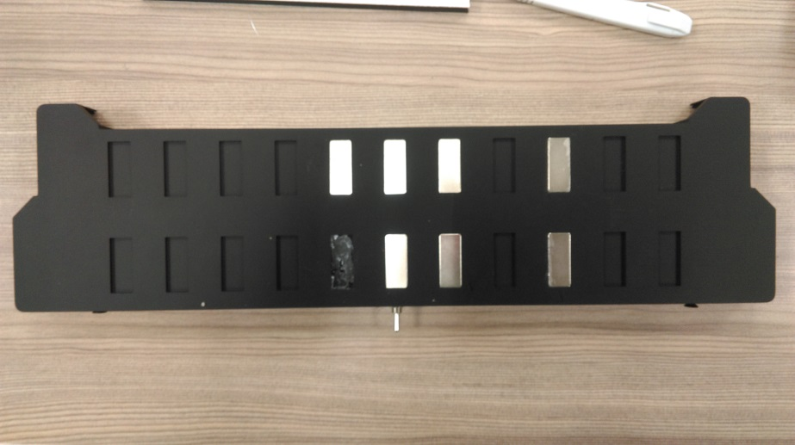
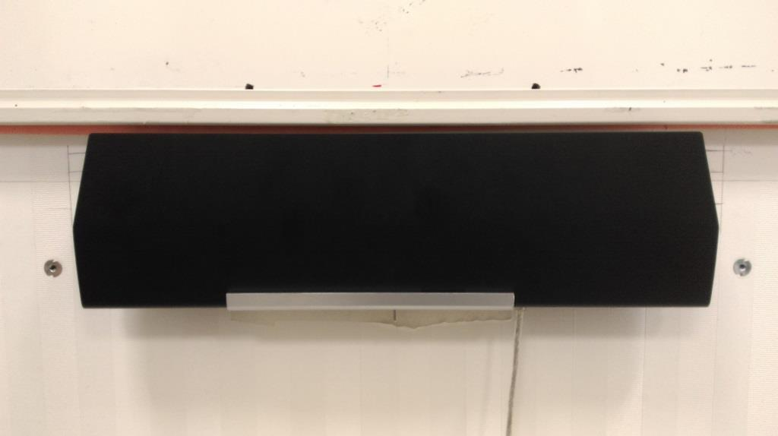
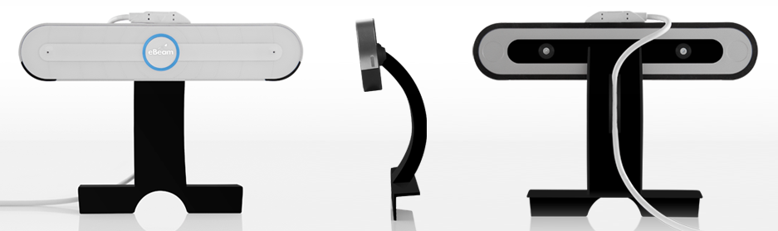
2.2 Installation

Slide 13
121mm
210mm
60mm
50mm
Dongle
18mm
200mm
Battery Pack
30mm
Control Board
60mm
210mm

Slide 14
121mm
210mm
60mm
50mm
Dongle
18mm
Battery Pack
Control Board
60mm
210mm

