Slide 1

Design of Shapes and Tool Bar for Mobile WiTouch Software Application
Arthur Shr
PUI, Value Creation Center
2015/1/6

Slide 2
Design of Shapes -- Mobile WiTouch SW System Analysis
1. Basic Shapes:
Line, Arch, Triangle, Round, Star

Slide 3
Design of Shapes -- Mobile WiTouch SW System Analysis (cont.)
2. New Shapes Derived from Basic Shapes
2.1 Shapes

Slide 4
Design of Shapes -- Mobile WiTouch SW System Analysis (cont.)
2.2 Endpoints

Slide 5
Design of Moving Tool Bar -- Mobile WiTouch SW System Analysis
1. Tool Bar can move or shrink to a small icon (hide)
-- To go around or stay away from users’ activities such as drawing, highlight…
2. Users can call the tool bar to the other side of WB or Screen
-- Easy/friendly function for users

Slide 6
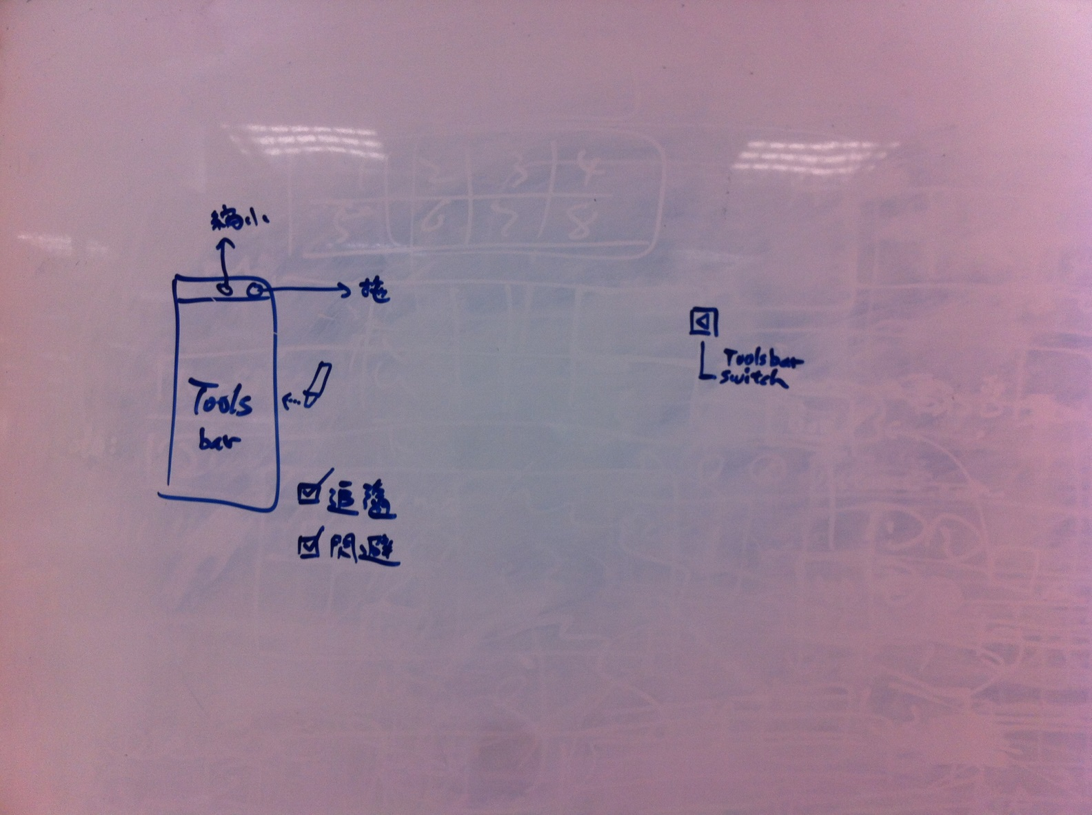
Design of Moving Tool Bar -- Mobile WiTouch SW System Analysis (cont.)

Slide 7
Function List
System Setting
1. Select System setting
2. Set Setting Parameter
3. Update System Parameter
Sharing
1. Open File
2. Set Tool
2.1 Set Pan
2.2 Select Shape
2.3 Select Object
3. Setup Board
3.1 Insert Object
3.2 Open MS-Office
3.3 Launch Website
4. Do Action
4.1 Draw Stuff
4.2 Crop or Resize Stuff
4.3 Copy and Paste Stuff
4.4 Move Object
4.5 Erase Stuff
5. Save File
Capturing
1. Select Target
2. Create Photo Shot
Preserving
1. Select Target
2. Create Photo Shot
3. Save File

