Slide 1

Mobile WiTouch Software Application
Arthur Shr
PUI,
Value Creation Center

Slide 2
Mobile WiTouch SW Application System Analysis
Share ideas, info, …
Sharing anything – Drawings, Highlights, Notes..
on the – White Board (WB) or Screen Board (SB)
to others by – Copy, Email, File transfer, …
Capture the idea, info,…
Capturing the Results – Whole or partial area of the Board (WB or SB)
Preserve the idea, info,…
Preserving the Results

Slide 3
System Setting
Create
Update
Setting:
1. Language,
2. White Board (WB) or Screen Board (SB)
3. Handwriting Recognition
4. Key Pad
5. Screen Setting: Whole or Two divided Areas
6. WB Resize
Select Setting
User A
Set Parameter
Update System
Parameter

Slide 4
Sharing
Create
Operate
Share
Open File
Set Tool
Do Action
User A
Select Shape
Set Pan
Draw Stuff
Move Object
Select Object
Copy & Paste
Stuff
Crop &Resize
Stuff
…
Setup Board
Save File
Open
MS-Office
User B
Launch
Website
Insert Object
User C

Slide 5
Capturing
Create
Operate
Select Target
User A
Create
Photo Shot
Target:
1. Drawing s or Objects
2. Partial or Whole SB,
3. Partial or Whole WB

Slide 6
Preserving
Capture
Operate
Capture Target
Save File
User A

Slide 7
Function List
System Setting
1. Select System setting
2. Set Setting Parameter
3. Update System Parameter
Sharing
1. Open File
2. Set Tool
2.1 Set Pan
2.2 Select Shape
2.3 Select Object
3. Setup Board (SB or WB)
3.1 Insert Object
3.2 Open MS-Office (SB)
3.3 Launch Website (SB)
4. Do Action
4.1 Draw Stuff
4.2 Crop or Resize Stuff
4.3 Copy and Paste Stuff
4.4 Move Object
4.5 Erase Stuff
5. Save File
Capturing
1. Select Target
2. Create Photo Shot
Preserving
1. Select Target
2. Create Photo Shot
3. Save File

Slide 8
Design of Moving Tool Bar
1. Tool Bar can move or shrink to a small icon (hide)
-- To go around or stay away from users’ activities such as drawing, highlight…
2. Users can call the tool bar to the other side of WB or Screen
-- Easy/friendly function for users

Slide 9
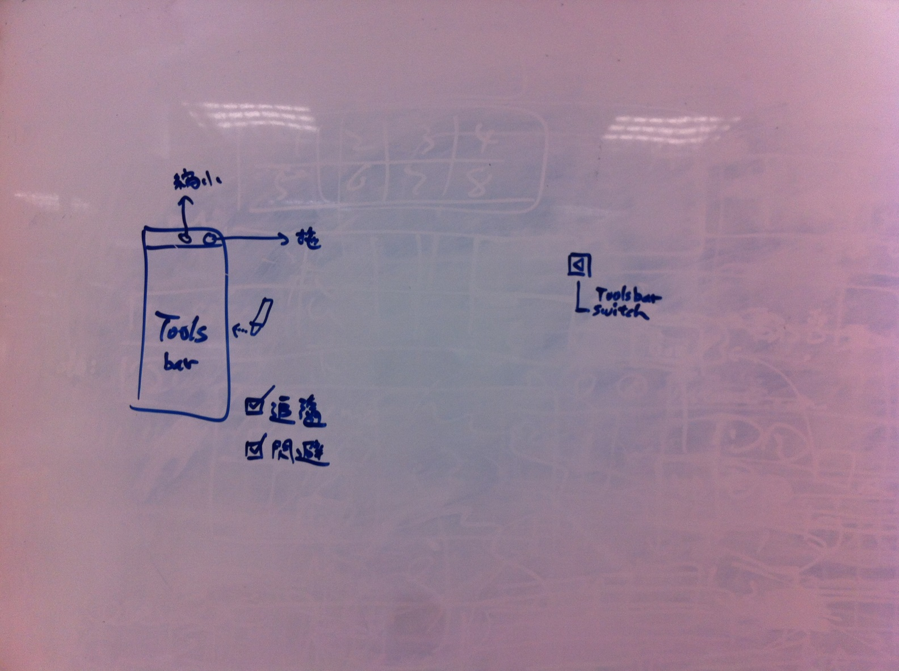
Design of Moving Tool Bar -- Mobile WiTouch SW System Analysis (cont.)

