Slide 1
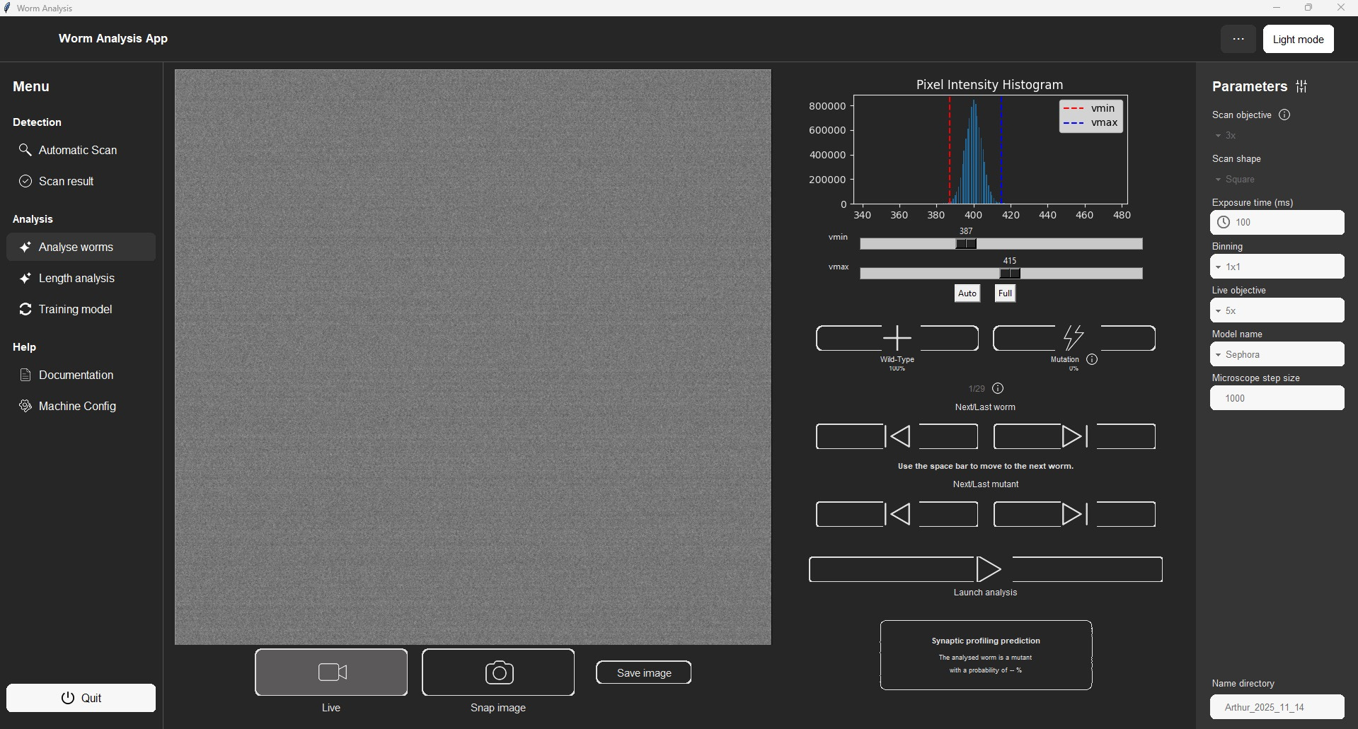
USER GUIDE
FOR THE SCANNING AND ANALYSIS SOFTWARE
ARTHUR SKOWRONEK
arthur.skowronek13@gmail.com
Notes:
Hello everybody, as you may know, my contract is coming to an end.
So, it’s time for me to show you my project :
the worm analysis software!

Slide 2
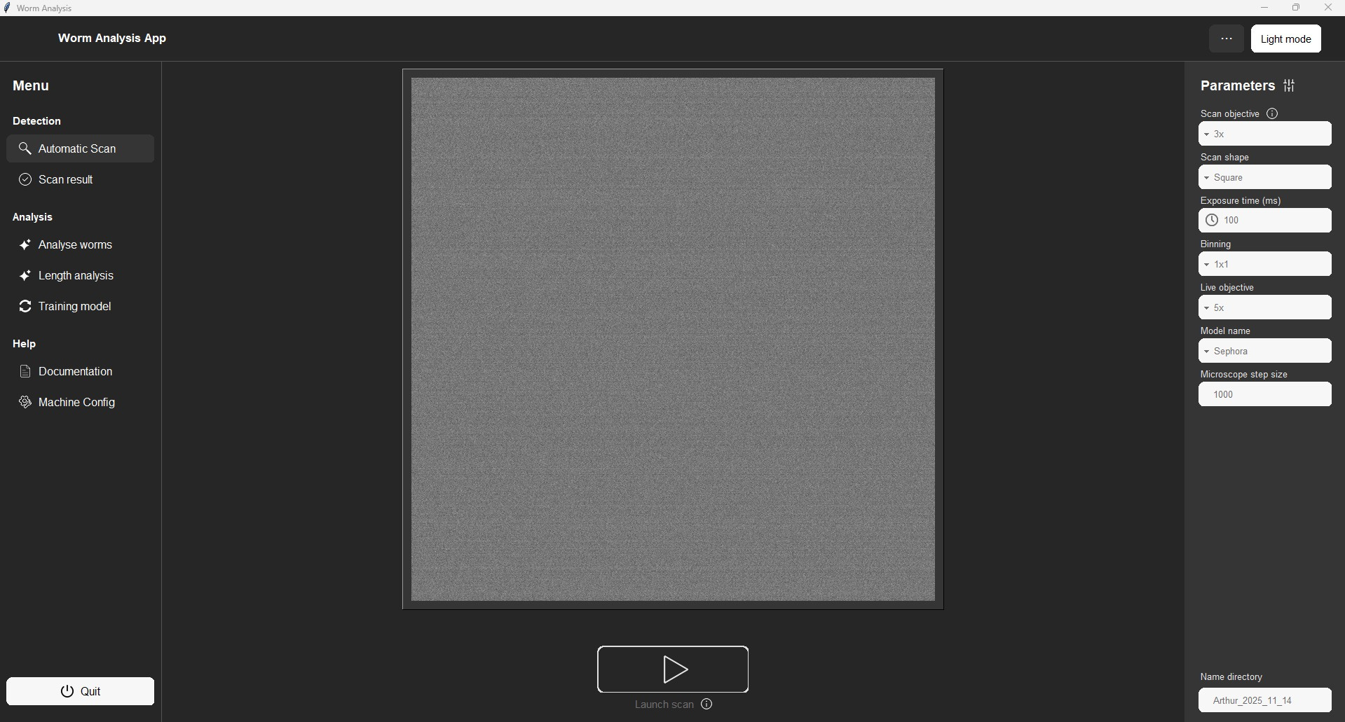


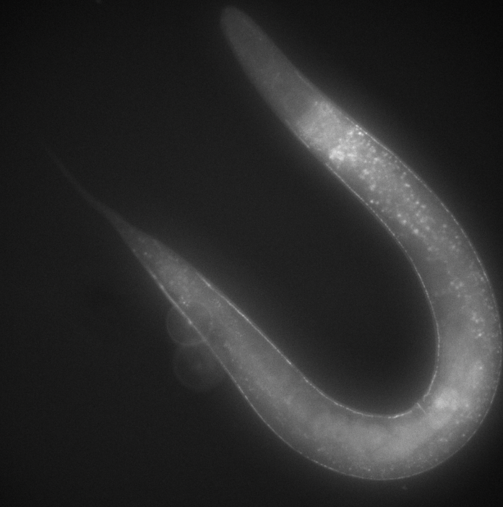
Open and close the settings bar
Menu section :
Click on the desired title to navigate to a different page.
Start the scanning program
Live image
Notes:
Everything starts with this page. On the left, you have the menu with all the available pages. On the right, a parameter panel—I will explain that later. At the top, you can decide to close or open the parameter panel, and switch between dark or light mode.
You always start with this page that lets you perform a scan. You see a live image in the square at the center so that you can focus the microscope, and then click on the start button just under it to launch the scan. That means the microscope will move by itself, take an image, move, take another image, etc., to cover the whole plate. At the end, it reconstructs a large image representing the entire plate.
But it's not magic.
You have to move the microscope to the lower right corner position and use the right objective. On the Nikon microscope, you have to use objective 4, and on the macrozoom, objective 2.
But, as you know, on the macrozoom, you can also zoom with the dial, and you have to use the 3rd position.

Slide 3

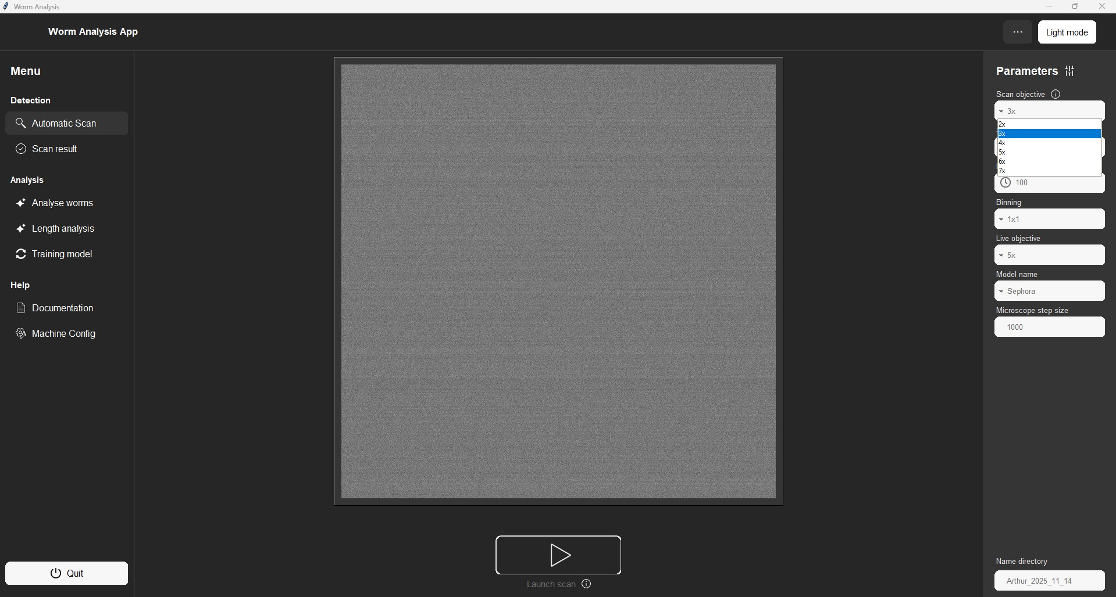
How to scan ?
Select the used objective (corresponds to the 3 dial for the Macrozoom)
Use the right objective :
Macrozoom : x2 with the dial 3
Nikon : x4
Focus the image
Move the microscope to the lower right corner
Launch the scan
Notes:
Did you already forget what to use? It’s not a problem. You have a small reminder here:
The text is different for the two microscopes. One last important thing on this page: you have to tell the software which zoom you are using in this box. For the Nikon, it’s the objective you need to enter, so 4. For the macrozoom, you always use objective 2, but it’s the dial position you have to tell the software, so 3.
Most of the time, I recommend using the objectives I told you, but if the worms you are seeing are really small—for example, at the L1 stage—you can use another zoom; just don't forget to tell the software.

Slide 4
NOTES
If you are looking at tiny worms : you can use a higher magnification to do the scan.
For the Macrozoom : ALWAYS use the x2 objective. But you can change the dial.
For the Nikon : Use whichever objective you prefer
In both cases : Don’t forget to update the value in the parameters panel in “Scan Objective”
You can set the scan shape to either square or rectangle.
Scan shape :
Notes:
Hello everybody, as you may know, my contract is coming to an end.
So, it’s time for me to show you my project :
the worm analysis software!

Slide 5
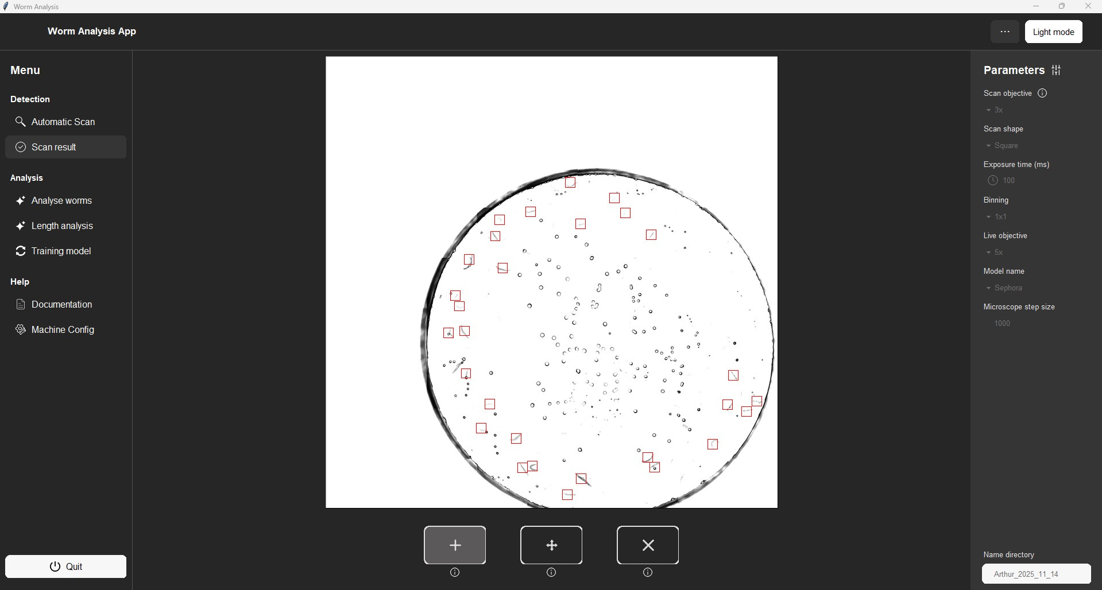
Add worm : you only have to click on the image where you want to add a worm
Remove worm : click on the worm you want to delete. Or drag your mouse on the worms
Move worm : click on a red rectangle and drag it to the desired position
After performing the scan : clean the results by adding undetected worms or removing errors
Select the mode you want to use to clean the worm detection
Notes:
So, when a scan is done, in about a minute, you get to this page.
You see the big reconstructed image and all the worms that have been detected. It’s not perfect, so before going to the analysis page, you can clean it up here by adding a new worm, removing one, or moving a worm. All you have to do is click on the button to choose which mode you want to use. A quick summary is also available if you hover over the info icon with the mouse.

Slide 6

Counter : Displays the ID of the worm being viewed over the total number of detected worms
Tell the microscope to move to the next (or last) worm position
You can save an image regardless of the mode used (live or snap). The image will be saved in the folder defined here:
(the folder will be created automatically if it does not exist)
Notes:
And now comes the fun part! You can switch to the worm analysis page.
You have a live image on the left; you can switch to a snap mode with the button just under it and save an image.
And, thanks to the scan part, the software knows where all the worms are. So you can just click on the arrow buttons to go to the next worm, or the previous one. All of this can be used in a lot of contexts, even if you don't want to search for synapse mutations.
In the case of mutation detection, you just have to click on this button and a few seconds later, you get a probability of having a mutation. You can also count how many worms with a mutation you have; it’s just a counter, so you can use it for anything.

Slide 7
You can tag the worm being viewed as having a mutation or not
By hovering the info icon you can see the list of the ID of the worm being tag as Mutant
Tell the microscope to move to the next (or last) worm with a mutation
Notes:
And now comes the fun part! You can switch to the worm analysis page.
You have a live image on the left; you can switch to a snap mode with the button just under it and save an image.
And, thanks to the scan part, the software knows where all the worms are. So you can just click on the arrow buttons to go to the next worm, or the previous one. All of this can be used in a lot of contexts, even if you don't want to search for synapse mutations.
In the case of mutation detection, you just have to click on this button and a few seconds later, you get a probability of having a mutation. You can also count how many worms with a mutation you have; it’s just a counter, so you can use it for anything.

Slide 8
Change the image displayed with the sliders and buttons
Notes:
And now comes the fun part! You can switch to the worm analysis page.
You have a live image on the left; you can switch to a snap mode with the button just under it and save an image.
And, thanks to the scan part, the software knows where all the worms are. So you can just click on the arrow buttons to go to the next worm, or the previous one. All of this can be used in a lot of contexts, even if you don't want to search for synapse mutations.
In the case of mutation detection, you just have to click on this button and a few seconds later, you get a probability of having a mutation. You can also count how many worms with a mutation you have; it’s just a counter, so you can use it for anything.

Slide 9
Select the wanted AI model :
Launch the analysis to get a prediction about the worm mutation
Notes:
And now comes the fun part! You can switch to the worm analysis page.
You have a live image on the left; you can switch to a snap mode with the button just under it and save an image.
And, thanks to the scan part, the software knows where all the worms are. So you can just click on the arrow buttons to go to the next worm, or the previous one. All of this can be used in a lot of contexts, even if you don't want to search for synapse mutations.
In the case of mutation detection, you just have to click on this button and a few seconds later, you get a probability of having a mutation. You can also count how many worms with a mutation you have; it’s just a counter, so you can use it for anything.

Slide 10

On the Nikon microscope, select the used objective during the analysis (necessary if you want to click on the live image to move the microscope)
Live image : If you click on it, the microscope move to center to the clicked point
You can use the arrow keys on your keyboard to move the microscope.
The size of a step is defined here :
Notes:
And now comes the fun part! You can switch to the worm analysis page.
You have a live image on the left; you can switch to a snap mode with the button just under it and save an image.
And, thanks to the scan part, the software knows where all the worms are. So you can just click on the arrow buttons to go to the next worm, or the previous one. All of this can be used in a lot of contexts, even if you don't want to search for synapse mutations.
In the case of mutation detection, you just have to click on this button and a few seconds later, you get a probability of having a mutation. You can also count how many worms with a mutation you have; it’s just a counter, so you can use it for anything.

Slide 11
Notes:
On this page, you can also adjust the contrast using the histogram. On the Nikon microscope—and only on this one—you can click on the live image, and the microscope will move to center the point you clicked. Before clicking, you just have to tell the software which objective you are using in this box. Because right now, you can do whatever you want: if you want to zoom in, go ahead!

Slide 12
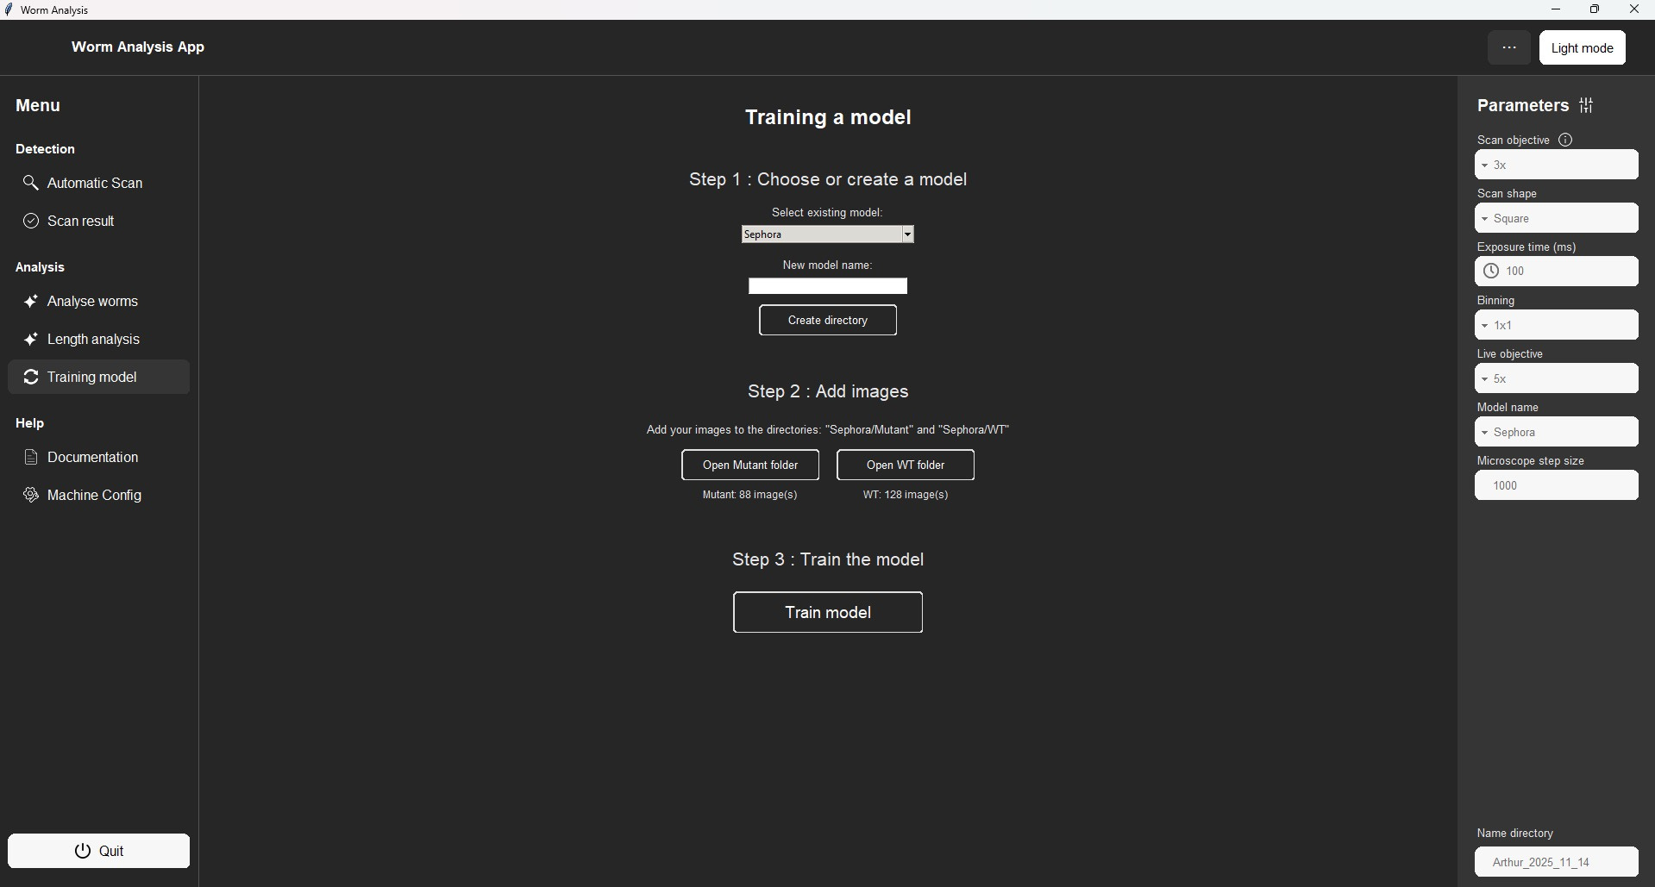
Give a name to your model (either create a new one or improve an existing one)
How to train a new AI model for the mutation detection ?
Drop images in the following folders to train a new model
To use this new model, you can select it here
Launch the training
WARNING : a AI model can’t be moved between computers. You have to create it on the computer you will use
You don’t necessarily need to have the camera turn on to train a model
Notes:
We have three other pages. I will not talk about the length analysis page, as it’s not working for now.
First, the model training page. As I told you, there is nothing magical. The model for synapse mutation detection was trained on a dataset with a specific mutation. If images are too different, the model won't work. To let you use it even when I am gone, you can use this page to create your own new AI models. I tried to create something simple so you don't have to think too much about it.
All you have to do is take a lot of images of the mutation you are looking at—more than a hundred—and put the mutant images in this folder and the wild-type images in that folder. Choose a name for your new model and click on the training button. That’s it! The computer will then work for a few hours, and at the end, you get a new model that you can select in this menu. The more images you have, the more precise your model will be.

Slide 13
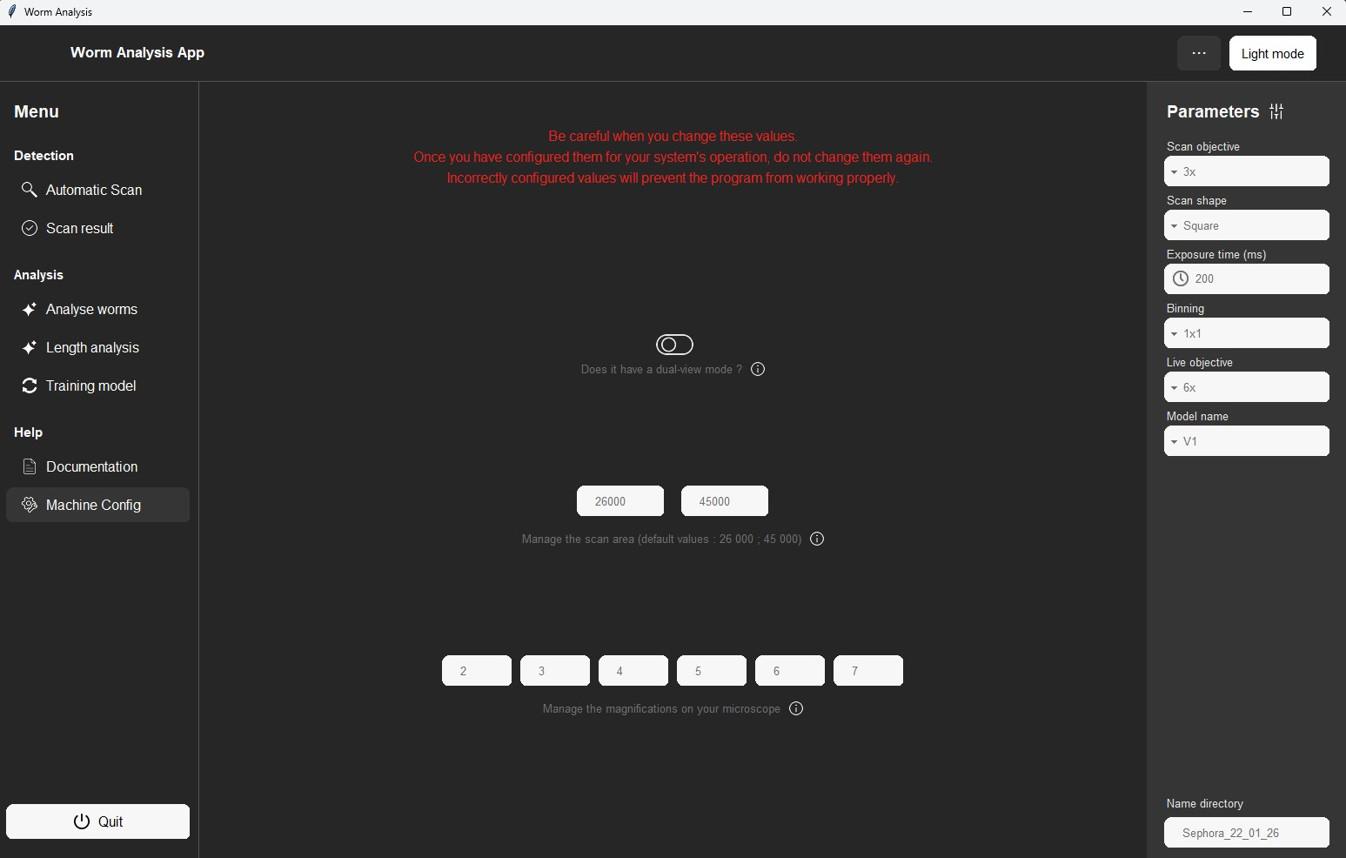
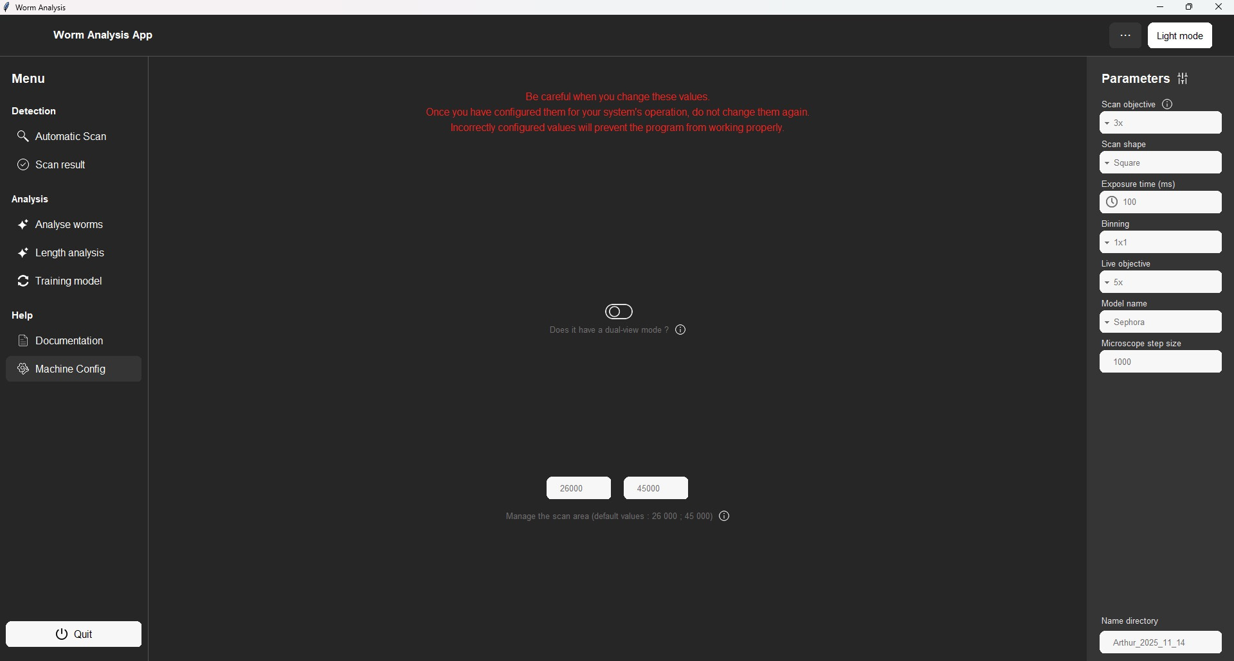

Change the scan length
List all the objective size available on the microscope
Notes:
Then you have a configuration page. If you have a new objective, you can add it to the list. You can also change the size of the scan if you want to scan a bigger plate. Earlier, I showed you a scan that was a square, but if you want to scan a rectangle, you just have to change it in the parameter panel.

Slide 14
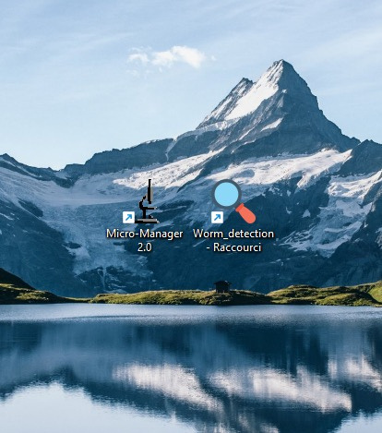
Click on this app to open the software.
The launching can take 10-20s.
Notes:
One last thing: to use it, you only have to click on this icon on the desktop. You have to wait until the camera is on, and the launch can take 15-20 seconds. So don't worry if nothing happens just after you click!

