Slide 1
ASE420: Individual Project
By: W. Brooks Arthur

Slide 2
Project Overview
Time Recording
Time Querying
Generation of Usage Report
Generation of Priority Report

Slide 3
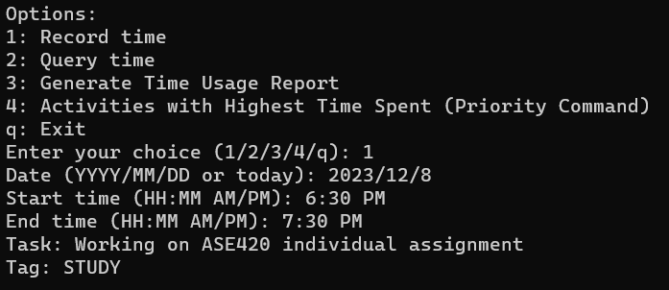
Time Recording
Upon input of date, time, task, and tag information is saved to a local database

Slide 4
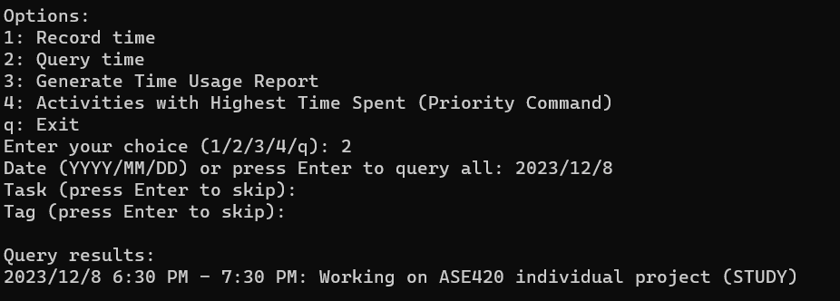
Time Querying
Upon inputting the requested query parameters, a list of items will be displayed.

Slide 5
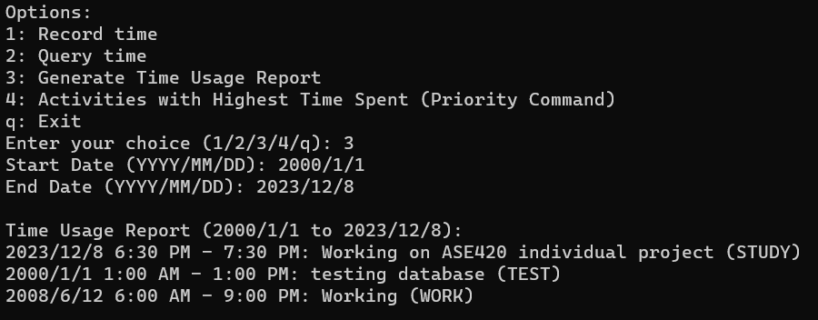
Generation of Usage Report
The user inputs a start date and end date and receives all of the inputs that occurred between those dates.

Slide 6
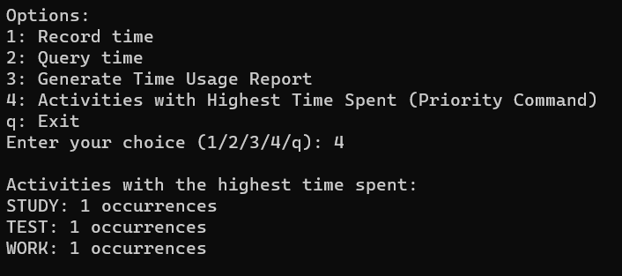
Generation of Priority Report
Upon selecting the priority report option, the user is given a list of all tasks completed by tag and the number of tasks assigned to those tags.

Slide 7
Total Lines of Code: 215
Program.py: 3 lines
App: 42 lines
TimeTracker: 49 lines
DatabaseManager: 11 lines
Tests: 110 lines

Slide 8
Testing Breakdown
Unit Tests: 5
Acceptance Tests: 3
Regression Tests: 2

Slide 9
What I learned
How to handle multiple projects at the same time.
How to find code smells and apply refactoring techniques in order to create a better application.
How to make use of design patterns in the creation of an application to avoid code smells.
Start early, end early.

