Slide 1
Software Design Patterns
The Agile Unified Methodology
Dr. David Kung
University of Texas Arlington
May 2010

Slide 2
The Unified Process
Requirements
Requirements
Design
Design
Code
Code
Test
Test
Deploy
Deploy
Time
time
TIME
The waterfall process
Increment 1
Increment 2
Increment 3
The unified process

Slide 3
The Agile Unified Process
Before the iterations, there is a "plan and elaborate" phase
  motivation, business needs, alternatives
  requirements elicitation and specification
  feasibility study
  use cases and use case diagrams
  requirements and use cases traceability matrix
  draft conceptual model
  schedule, resources, budget

Slide 4
Steps of the Unified Process
1) Identifying requirements
2) Deriving use cases to satisfy the requirements
3) Allocating use cases to increments
4) Carrying out each increment

Slide 5
Carrying out each increment
4) Carry out each increment
4.1) Use case modeling
4.2) Domain modeling
4.3) Interaction modeling
4.4) Derive design class diagram
4.5) Implementation and deployment

Slide 6
Steps of the Agile Unified Method
domain knowledge
Requirements
Engineering
requirements
requirements
Use Case Modeling
Domain Modeling
abstract, high level &
expanded use cases,
use case diagrams,
RUCTM, UI prototypes
domain
model
Object Interaction
Modeling & Design
sequence diagrams
Design Class Diagram
data flow
DCD & implementation order
control flow
Implementation

Slide 7
The Unified Process
Use case driven
  each iteration is driven by the use cases allocated to the iteration
Architecture centric
  “a system's architecture is used as a primary artifact for conceptualizing, constructing, managing, and evolving the system under development."
--- Grady Booch
Incremental
Iterative

Slide 8
What Is a Use Case
The key concept: A use case is a business process --- an abstraction of a business process
A use case is initiated by (or begins with) an actor.
A use case must accomplish a business task (for the actor).
A use case must end with an actor --- the actor explicitly or implicitly acknowledges the accomplishment of the business task.

Slide 9
What Is an Actor
An actor denotes a business role played by (and on behalf of) a set of business entities or stakeholders.
Actors are not part of the system.
Actors interact with the system.
Actors are often human beings but can also be a piece of hardware, a system, or another component of the system.
Actors initiate use cases, which accomplish business tasks for the respective actors.

Slide 10
Use Case Specification: 3 Levels of Abstraction
We specify use cases at three levels of abstraction:
  1) Abstract use case: using a verb and a noun phrase
  2) High level use case: stating exactly when and where the use case begins and when it ends using TUCBW/TUCEW (This use case begins with/This use case ends with)
  3) Expanded use case: describing step by step how the actor and the system interact to accomplish the business task using a two column table

Slide 11
High level and Expanded Use Cases
Use Cases are classified into:
  High level use cases, e.g.:
    Use Case: Initiate a Call
    This use case begins with (TUCBW) the caller picks up the phone and dials a number.
    This use case ends with (TUCEW) the caller hears the ring tone.
  Expanded Use Cases:

Slide 12
Expanded Use Case
Actor: Caller
System:
Telco
1.TUCBW the caller
picks up the handset
from the phone base.
2. The system generates
a dial tone.
3. The caller dials each
digit of the phone
number.
4. The system responds
with a DTMF tone for
each digit dialed.
5. The caller finishes
dialing.
6. The system produces
the ring tone.
7. TUCEW the caller
hears the ring tone.
system
response
actor input and
actor action

Slide 13


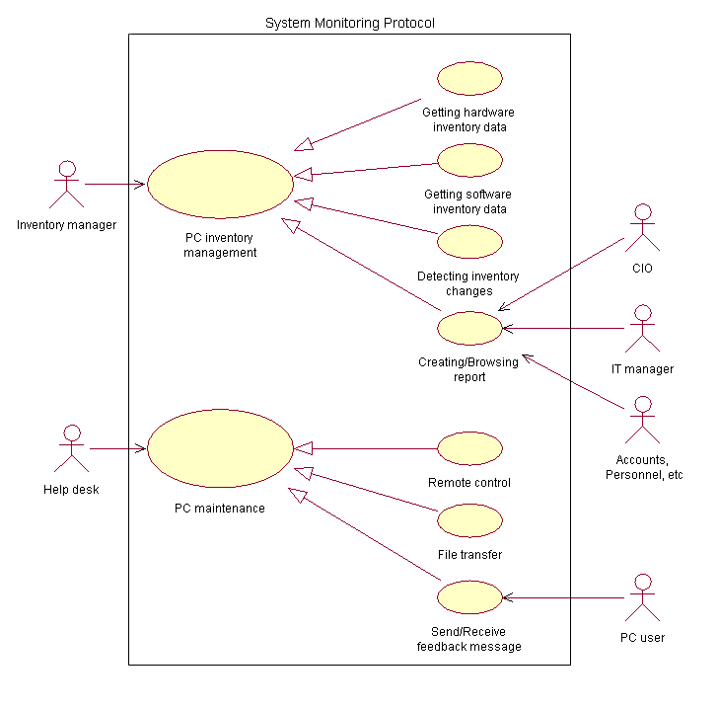
Use Case Modeling
planning phase
incremental phase
requirements
Deriving use cases
from requirements
abstract use cases
(e.g., Initiate a Call)
Defining use case scope
abstract &
high level use cases
Example high level use case:
TUCBW caller picks handset from base
TUCEW caller hears the ring tone.
Specifying actor-
system interaction
(expanded use cases)
Depicting use case contexts

Slide 14
Steps for Use Case Modeling
Step 1) Deriving (abstract) use cases from requirements
Step 2) Describing when and where each use case begins and when it ends (high level use cases).
Step 3) Depicting use case contexts according to subsystems/aspects using Use Case Diagrams.
Step 4) Relating use cases, and actors if desired.
Step 5) Specifying step by step how actor and system interact to accomplish the business task (for the actor) (expanded use cases).
Steps 1)-4) are performed during the planning phase. Step 5 is performed during each increment.

Slide 15
Deriving Use Cases from Requirements
In the requirements specification, look for verb noun phrases or verb-nouns that indicate
  “do something”
  “something must be done” or
  “perform some task”
  in the application domain.
Verify the verb noun phrases using use case definition (next slide)

Slide 16
Verify the Use Cases Identified
Verify the use cases identified using use case definition:
  (1) Is it a business process? y/n
  (2) Is it initiated by an actor? y/n
  (3) Does it end with an actor? y/n
  (4) Does it accomplish something useful for the actor? y/n
All of the answers to the above questions must be “y”.

Slide 17
Identify Actor, System, & Subsystem
From the requirements, identify also
  the actors, who initiate the tasks, or for whom the tasks are performed
  the system or subsystem that the use case belongs to

Slide 18
Example: Library System
Requirements of a library system:
R1. The library system must allow a patron to check out documents.
R2. The library system must allow a patron to return documents.
actor
use case
system
System: Library System
Actor: Patron
Use Cases:
UC1: Checkout Document
UC2: Return Document

Slide 19
Use Case Diagram: Library Example
system name
use case
actor
Library System
Checkout Document
Return Document
Patron
Search for Document
association
system boundary

Slide 20
Class Exercises
Ex 1. What are the use cases for the Vending Machine on the next slide?
Ex 2. Banking system.
  State two requirements for a banking system.
  Derive use cases from the requirements.
Ex 3. Your team project.
  State two requirements for your team project.
  Derive use cases from these requirements.

Slide 21
Class Exercise: The Vending Machine
The Vending Machine has a display, an alphanumeric keypad, a coin insertion slot, and an item dispenser. The display shows the vending items like chocolates, candies, potato chips, Coke, sprite, etc. Each type of item has a price and a label consisting of a letter A, B, C, ... and a digit 1, 2, ... A customer inserts coins through the coin slot. Each time a coin is inserted an LCD displays the total amount. The customer can press a letter and a digit to enter his selection after enough coins have been inserted. If the total amount is greater than or equals to the item selected, the vending machine dispenses the item and returns the change to the customer. A customer can change his mind and request that the coins be returned by pressing the return button.

Slide 22
High Level Use Case
Definition: A high level use case specification is a description of when and where the use case begins and when it ends.
It is formulated using third person, simple present tense:
  This Use Case Begins with (TUCBW) <when and where it begins>.
  This Use Case Ends with (TUCEW) <when it ends>.

Slide 23
High Level Use Case Example
Use Case: Withdraw Money (from an ATM)
TUCBW the ATM user inserts an ATM card into the card slot.
TUCEW the ATM user receives the correct amount of cash and a withdraw slip.
Use Case: Search for Programs
TUCBW a SAMS user clicks the ``Search for Programs'' link on any of the SAMS pages.
TUCEW the user sees a list of programs satisfying the search criteria.

Slide 24
Guidelines for High Level Use Case
High level use case specifications should not specify background processing, i.e.,
  Do not specify how the system process the request such as update the database.
  Background processing is modeled by sequence diagrams.
High level use case specifications should end with what the actor wants to accomplish.

Slide 25
Domain Modeling
What: A process performed by the development teams to acquire domain knowledge.
Why:
  Because software engineers need to work in different domains or different projects. They need domain knowledge to develop the system.
  Software engineers come from different background. This may affect their perception of the application domain.
How:
  Collect domain information, perform team brainstorming and classification, and visualize the domain knowledge using UML class diagram
  Detail is given in the next slide

Slide 26

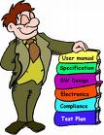


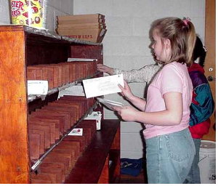
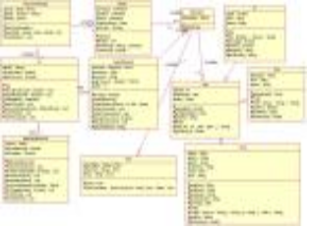
Steps for Domain Modeling
2. Brainstorming
1. Collecting application domain information
4. Visualization
3. Classification

Slide 27
Object and Attribute
A noun/noun phrase can be a class or an attribute, how do we distinguish?
This is often a challenge for beginners.
Rules to apply:
An object has an "independent existence" in the
application/application domain, an attribute does not (have).
Example: "Number of seats", class or attribute?
Attribute, because "number of seats" cannot exist without
referring to a car, airplane, or classroom as in
"number of seats of a car"
"number of seats of a classroom"

Slide 28
Object and Attribute
Rules to apply:
  attributes describe objects or store state information of objects
  you can enter an attribute (value) from the keyboard, but you cannot enter an object
  objects must be created by invoking a constructor (explicitly or implicitly)

Slide 29
Inheritance Relationship
Inheritance relationships
  express the generalization/specialization relations between concepts
  one concept is more general/specialized than the other
  example: vehicle is a generalization of car, car is a specialization of vehicle
  also called IS-A relation
Vehicle
model#
horse power
manufacturer
start()
drive()
Car
drive()
Boat
drive()

Slide 30
Two Tests for Inheritance
IS-A test: every instance of subclass is also an instance of superclass.
Conformance test: relationships of superclass are also relationships of subclass.
Engine
model#
horse power
manufacturer
start()
stop()
Professor
name
phone
teach(...)
Retirement Plan
enroll
Car is not an engine.
Visiting Professor
signContract()
Car
drive()
Visiting professors cannot enroll in a retirement plan at the host university.

Slide 31
Aggregation Relationship
Aggregation relationships
  express the fact that one object is part of another object
  engine is part of a car
  also called part-of relationships
Car
model#
horse power
manufacturer
start()
stop()
part-of relationship
Engine
model#
horse power
manufacturer
start()
stop()

Slide 32
Association Relationship
Association relationships
  expressing general relationships other than inheritance and aggregation
  these can be application specific relationships between two concepts
  example: "instructor teach course", "user has account"
Professor
name
phone
teach(...)
Retirement Plan
enroll
Neither inheritance nor aggregation can apply.

Slide 33
Steps for Domain Modeling
1) Collect application domain information
  focus on the functional requirements
  also consider other requirements and documents
  Also consider business descriptions
2) Brainstorming
  listing important application domain concepts
  listing their properties/attributes
  listing their relationships to each other
(to be continued)

Slide 34
Steps for Domain Modeling
3) Classifying the domain concepts into:
  classes
  attributes / attribute values
  relationships
    association, inheritance, aggregation
4) Document result using UML class diagram

Slide 35
Brainstorming: Rules to Apply
The team members get together to identify & list domain specific
  nouns / noun phrases
  "X of Y" expressions (e.g., color of car)
  transitive verbs
  adjectives
  numeric
  possession expressions (has/have, possess, etc.)
  "constituents / part of" expressions
  containment / containing expressions
  "X is a Y" expressions

Slide 36

Example
adjective, but not
domain specific
Functional requirement:
[PFR1] The web-based application must provide a search capability for overseas exchange study programs using a variety of search criteria.
domain specific
transitive verb
nouns but
not domain
specific
Brainstorming result:
  nouns/noun phrases
      programs
  search criteria
  transitive verbs
  search for
domain specific
noun/noun phrase

Slide 37
Classifying Brainstorming Result
nouns/noun phrases
"X of Y" expressions
transitive verbs
adjectives
numeric
possession expressions (has/have, possess, etc.)
"consist of/part of" expression
containment / containing expressions
"X is a Y" expressions
class or attributes
X is an attribute of Y
X is a role in an association
association relationships
attribute values
attribute / multiplicity values
aggregation relationships or attributes
aggregation relationships
association or aggregation relationships
inheritance
Objects have independent existence, attributes do not.

Slide 38
Example
Rule: noun/noun phrase ➔ class or attribute
Domain specific
nouns/noun phrases
transitive verbs
  program
  search criteria
  user
  search for (programs)
(c)
(c)
(c)
search for
Rule: transitive verbs ⇒
association relationships
Because they can exist
independently.

Slide 39
Example
A car has a make, model, horse power, number of seats ...
(c) car
(a) make
(a) model
(a) horse power
(a) number of seats
Car has independent existence.
Make, model, horse power, and
number of seats do not.
A customer can rent one or more cars ...
(c) customer
(c) car
rent
1+

Slide 40
Class Exercise
Do the following for your team project or the vending machine.
Identify the concepts that exist in the application domain.
Classify the concepts in terms of
  classes
  attributes of classes
  relationships between the classes
    inheritance
    aggregation and
    association

Slide 41
Class Exercise: The Vending Machine
The Vending Machine has a display, an alphanumeric keypad, a coin insertion slot, and an item dispenser. The display shows the vending items like chocolates, candies, potato chips, Coke, sprite, etc. Each type of item has a price and a label consisting of a letter A, B, C, ... and a digit 1, 2, ... A customer inserts coins through the coin slot. Each time a coin is inserted an LCD displays the total amount. The customer can press a letter and a digit to enter his selection after enough coins have been inserted. If the total amount is greater than or equals to the item selected, the vending machine dispenses the item and returns the change to the customer. A customer can change his mind and request that the coins be returned by pressing the return button.

Slide 42
Association Class
An association class defines properties and operations for an association between two classes.
Students enroll in courses
and receive grades.
Student
enroll
*
Course
Enroll
indicate Enroll
class is a class
for the association
grade: char
getGrade()
setGrade(grade:char)

Slide 43
Understand Association Class
Alex got an “A” and Eric got a “B” for OOSE.
object
identifier
type
Alex:Student
enroll
OOSE:Course
Eric:Student
enroll
OOSE:Course
:Enroll
:Enroll
an instance of
Course indicated
by underline
‘A’: char
‘B’: char
getGrade()
setGrade()
getGrade()
setGrade()
Alex:Student
enroll
AI:Course
:Enroll
Alex also got an
“A” for AI.
‘A’: char
getGrade()
setGrade()

Slide 44
Understand Association Class
Design Implementation
Student
enroll
Course
class Student { ... }
class Course {...}
class Enroll {
private:
char grade;
Student* student;
Course* course;
public:
Enroll (Student* s, Course* c);
char getGrade();
void setGrade(char grade);
}
Enroll::Enroll(Student* s, Course* c) {
student=s; course=c;
}
Enroll
grade: char
getGrade()
setGrade(grade:char)
Student *alex=new Student( ... );
Course *oose=new Course ( ... );
...
Enroll *e=new Enroll(alex, oose);
e->setGrade(‘A’);

Slide 45
Understand Association Class
Student
Student
enroll
Course
sid
name
phone
...
...
001
Alex
...
...
...
002
Eric
...
...
...
Enroll
grade: char
getGrade()
setGrade(grade:char)
Course
cn
title
desc
...
...
c1
oose
...
...
...
c2
AI
...
...
...
OO Realm
Enroll
sid
cn
grade
...
...
001
c1
A
...
...
001
c2
A
...
...
002
c1
B
...
...
RDB Realm

Slide 46



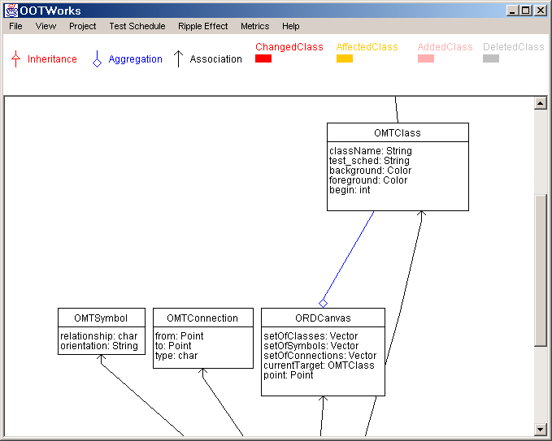
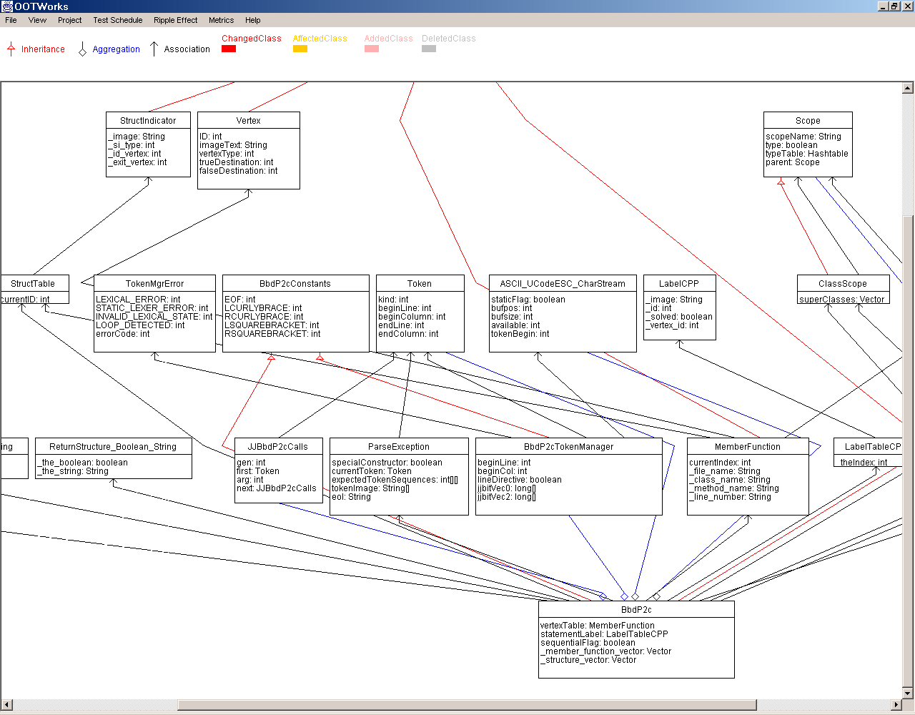

Tip for Domain Modeling
Do not do brainstorming and drawing at the same time. The result could be very poor.
1) List the concepts, and then classify them on a whiteboard.
2) Take a picture(s) of the whiteboard using a digital camera.
3) Email the digital images to team members.
4) Have a member or two to convert the result to UML class diagram.
5) Email the UML class diagram to all members to review.
6) Modify the diagram to reflect corrections and comments.

