Slide 1
Software Design Patterns
The Agile Unified Methodology
Dr. David Kung
University of Texas Arlington
May 2010

Slide 2
Object Interaction Modeling
It specifies how objects interact with each other to carry out the background processing of a business process.
Object interaction modeling is aided by the specification of scenarios and a scenario table.
A scenario is an informal, step-by-step description of object interaction.
A scenario table organizes the interaction into a five column table. It facilitates the translation into a sequence diagram.

Slide 3
Steps for Interaction Modeling
For each expanded use case do the following:
  Step 1. Identify and mark nontrivial steps in the right column of the expanded use case.
    A nontrivial step is one that requires background processing that goes beyond the presentation layer (i.e., the Graphical User Interface or GUI).
  Step 2. For each nontrivial step, describe a scenario, i.e., how objects interact to carry out the step, beginning with the step on the left column of the expanded use case.
  Step 3. If desired, convert the scenario into a scenario table.
  Step 4. Convert the scenarios/scenario table into a sequence diagram.

Slide 4
Scenarios
Each sentence of the scenario is a declarative sentence consisting of
  a subject,
  an action of the subject,
  an object that is acted upon, and
  possibly other objects required by the action.
The sentences are arranged in a scenario table to
  facilitate scenario description and
  translation into sequence diagrams.

Slide 5
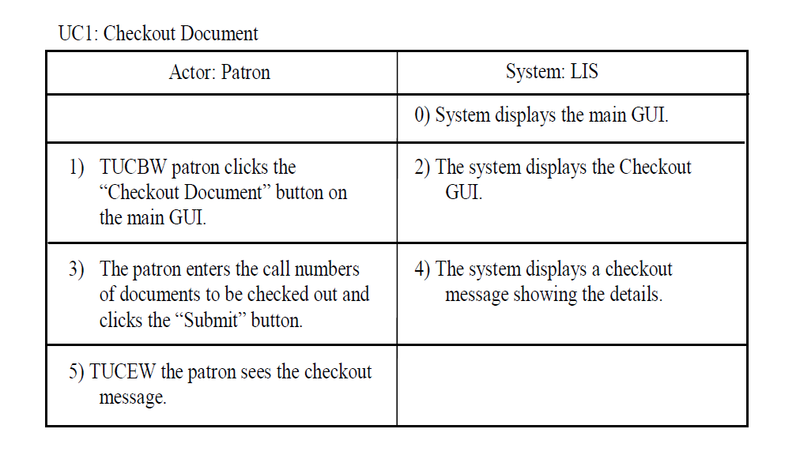
Example
*
nontrivial
step

Slide 6
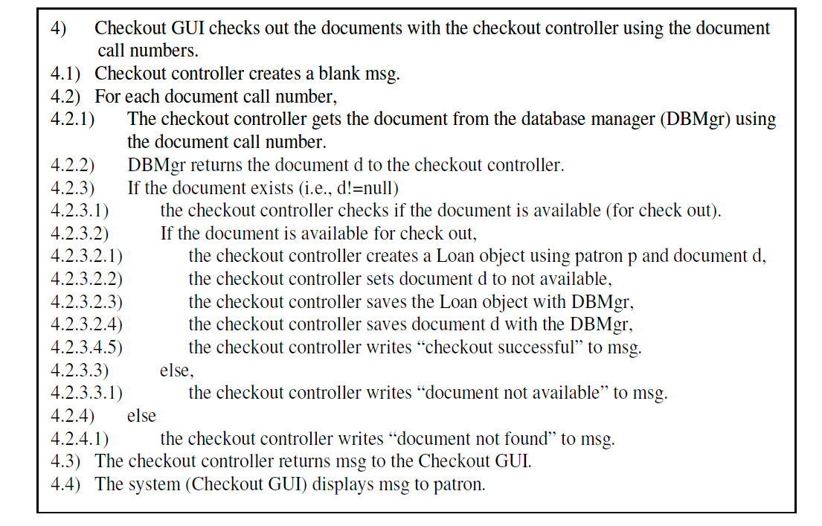
Scenario Description
3) Patron enters the call numbers into the checkout GUI.
Could be simplified, e.g.,
reducing the number of steps.

Slide 7
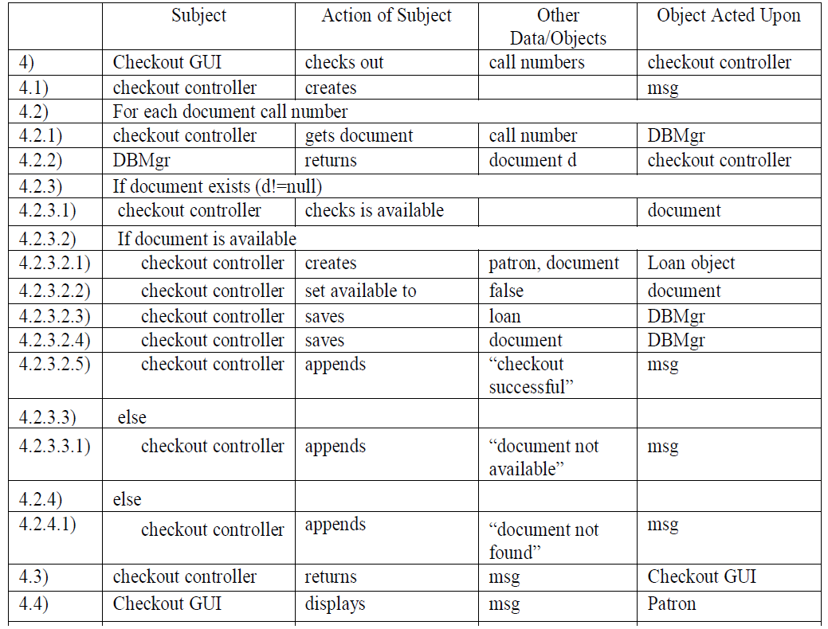
(Message)
Could be simplified, e.g.,
reducing the number of steps.

Slide 8
Guidelines for Scenario Construction
Keep it simple and stupid --- leave details to coding.
Specify the normal scenario first (i.e., assume everything will go as expected)
Augment the normal scenario with alternative flows if needed
Leave exception handling to the code
It is sometimes desirable to construct a prototype for the normal scenarios to validate the design idea

Slide 9
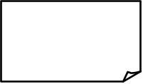
From Scenario Table to Sequence Diagram
:object acted upon
for each line of the scenario table:
Case 1: subject is an Actor
action + other
objects/data
object
acted upon
Actor
Example:
card scanner:
<<slide card>>
Patron

Slide 10

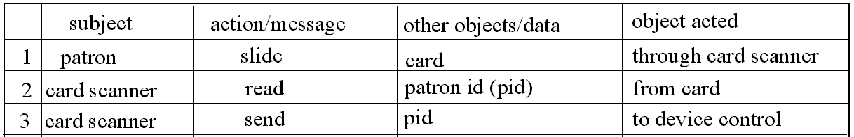
From Scenario Table to Sequence Diagram
: Subject
:object acted upon
Case 2: subject is an object
action + other
objects/data
action
performing
Example
cards canner:
device control:
send pid
action
performing

Slide 11
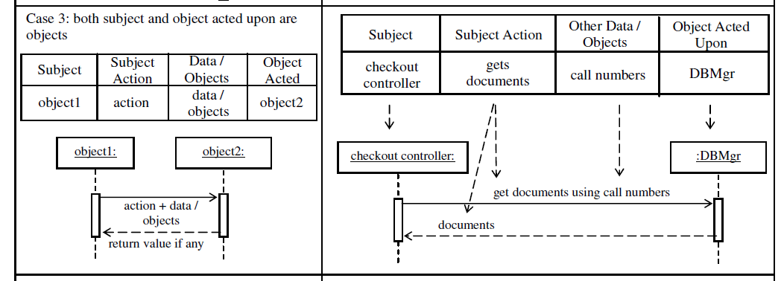

Slide 12
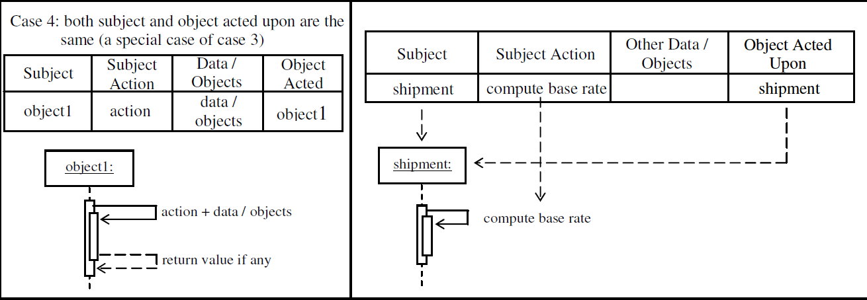

Slide 13
Difference of Analysis and Design
Analysis
application problem-oriented
modeling application domain
describes what the world is
project-oriented decisions
should allow multiple design alternatives
Design
software solution-oriented
modeling the software system
prescribes a software solution
system-oriented decisions
usually reduces implementation choices

Slide 14
Modeling a Manual Library System
Patron presents id card to librarian.
:Librarian
These are analysis sequence diagrams that model an existing system.
<<id card>>
Patron
Librarian pulls out patron’s folder using id number.
:Librain
:PatronFolders
<<uid, pass-word>>
get folder using patron id
patron folder
Patron

Slide 15
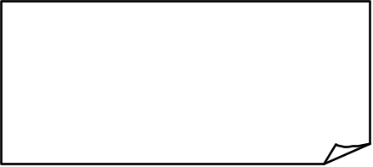
Analysis/Informal Sequence Diagram
info exchange b/t actor and object
:LoginGui
an object of LoginGui class
<<uid, password>>
the object is processing the request.
Patron
Patron submits uid and password
to LoginGui.
:LoginGui
:LoginController
<<uid, pass-word>>
LoginGui object verifies w/
LoginController object
LoginGui calls LoginController to
verify the login. The controller returns a msg indicating result of verification. LoginGui shows msg to Patron.
<<msg>>
<<msg>>
Patron

Slide 16

From Analysis to Design
:LoginGui
:LoginController
<<uid, pass-word>>
LoginGui calls LoginController to
verify the login. The controller returns a msg indicating result of verification. LoginGui shows msg to Patron.
LoginGui object verifies w/
LoginController
<<msg>>
<<msg>>
Patron
:LoginGui
:LoginController
<<uid, pass-word>>
msg := verify (uid:String, password: Password) : String
Patron
<<msg>>
return value
function call
parameter & type
return type

Slide 17
Sequence Diagram: Flow of Control
:LoginGui
:LoginController
1
2
<<uid, pass-word>>
msg := verify (uid:String, password: Password) : String
<<msg>>
Patron
3
(1) patron submits uid and password to LoginGui object
(2) LoginGui object calls the verify function of a LoginController object. The called function returns msg of type String.
(3) The LoginGui object shows msg to patron.

Slide 18

An Analysis Sequence Diagram
real world object within the library system
collection
:Librarian
:Patron Folder
book:Book
f:Patron Folder
id card, book
get patron folder w/id
patron
patron folder f
[patron folder not found] error msg, id card
outside
library
system
[patron folder found] get book card
book card
[patron folder found] insert book card into patron folder
[patron folder found] id card, book
[patron folder found] return patron folder
This an analysis sequence diagram models the current, manual operation, little design decision is made.

Slide 19

A Design Sequence Diagram
:Checkout
GUI
:DBMgr
l:Loan
d:Document
<<uid,call# list>>
u:=
getUser(uid):
User
Patron
<<msg>>
[u!=null]
process(callNumList)
Loop
(for each cn in callNumList)
d:=get
Document(cn):
Document
loop
[d!=null]a:=isAvailable():boolean
conditional
call
[a]create(u,d)
[a]saveLoan(l)
[a]setAvailable(false)
[a]save-
Document(d)

Slide 20
Deriving Design Class Diagram
Design class diagram (DCD) is a structural diagram.
It shows the classes, their attributes and operations, and relationships between the classes. It may also show the design patterns used.
It is used as a basis for implementation, testing, and maintenance.
It should contain only classes appear in the sequence diagrams, and a few classes from the domain model.

Slide 21
Deriving Design Class Diagram
It is derived from the domain model (DM) and the sequence diagrams:
  the domain model provides the attributes and some relationships
  the sequence diagrams determines the classes and methods, and provides dependence relationships
DCD may contain design classes like controller, command, GUI classes. Domain model only contains application objects (classes).
DCD must be carefully specified. DM is more liberal.

Slide 22
Steps for Deriving DCD
1) Identify all classes used in each of the sequence diagrams and put them down in the DCD:
  classes of objects that send or receive messages
  classes of objects that are passed as parameters or return types/values

Slide 23
Identify Classes Used in Sequence Diagrams
classes used.
<<singleton>>
:Checkout
GUI
:Checkout
Controller
:DBMgr
l:Loan
d:Document
<<uid,
cnList>>
msg:=check-
out(uid, cnList)
u:=get
User(uid):User
[u!=null]
process(cnList)
Tip: Identify objects that send or receive messages, passed as parameters or return type.
Loop
(for each cn in cnList)
b:=get
Document(cn)
a:=isAvailable()
[a]create(u,d)
[a]save(l)
[a]setAvailable(false)
[a]save(d)
<<msg>>

Slide 24
Classes Identified
CheckoutGUI
User
CheckoutController
DBMgr
Loan
Document

Slide 25
Steps for Deriving DCD
2) Identify methods belonging to each class and fill them in the DCD:
  methods are identified by looking for messages that label an incoming edge of the object
  the sequence diagram may also provide detailed information about the parameters, their types, and return types

Slide 26
Identify Methods
:Checkout
GUI
:Checkout
Controller
:DBMgr
l:Loan
d:Document
<<uid,
cnList>>
msg:=check-
out(uid, cnList)
u:=get
User(uid):User
[u!=null]
process(cnList)
Loop
(for each cn in cnList)
methods of CheckoutController
d:=get
Document(cn)
a:=isAvailable()
[a]create(u,d)
[a]save(l)
[a]setAvailable(false)
[a]save(d)
methods of Document
<<msg>>

Slide 27
Fill In Identified Methods
CheckoutGUI
User
CheckoutController
checkout(uid,cnList)
process(cn:String[])
Loan
<<singleton>>
DBMgr
Document
getUser(uid)
getDocument(callNo)
saveLoan(loan)
saveDocument(book)
create(u:User, d:Document)
isAvailable() : boolean
setAvailable(a:boolean)

Slide 28
Steps for Deriving DCD
3) Identify and fill in attributes from sequence diagrams and domain model:
  attributes are not objects and have only scalar types
  attributes may be used to get objects
  attributes may be identified from getX() and setX(...) methods
  needed attributes may also be found in the domain model

Slide 29
Identify Attributes
:Checkout
GUI
:Checkout
Controller
:DBMgr
l:Loan
d:Document
<<uid,
cnList>>
msg:=check-
out(uid, cnList)
attribute of User
u:=get
User(uid):User
[u!=null]
process(cnList)
Loop
(for each cn in cnList)
b:=get
Document(cn)
attributes of Document
a:=isAvailable()
[a]create(u,d)
[a]save(l)
[a]setAvailable(false)
[a]save(d)
<<msg>>
attribute value

Slide 30
Fill In Attributes
CheckoutGUI
User
display(msg:String)
uid : String
CheckoutController
from domain model
checkout(uid,cnList)
process(cn:String)
Loan
<<singleton>>
dueDate : Date
DBMgr
Document
callNum : String
isAvailable : boolean
getUser(uid)
getDocument(callNo)
saveLoan(loan)
saveDocument(book)
create(u:User, d:Document)
isAvailable() : boolean
setAvailable(a:boolean)

Slide 31
Steps for Deriving DCD
4) Identify and fill in relationships from sequence diagram and domain model:
  arrows from one object to another is a call and hence it is a dependence relationship
  objects passed as parameters or return type/value is an association or uses relationship
  two or more objects passed to a constructor may indicate association and an association class
  the domain model may contain useful relationships as well

Slide 32
Identify Relationships
:Checkout
GUI
:Checkout
Controller
:DBMgr
l:Loan
d:Document
<<uid,
cnList>>
msg:=check-
out(uid, cnList)
u:=get
User(uid):User
CheckoutController and DBMgr uses User.
[u!=null]
process(cnList)
call relationship
Loop
(for each cn in cnList)
b:=get
Document(cn)
a:=isAvailable()
association w/ an association class.
[a]create(u,d)
[a]save(l)
[a]setAvailable(false)
[a]save(d)
<<msg>>

Slide 33
Fill In Relationships
The dashed arrow lines denote uses or dependence relationships.
CheckoutGUI
The creator
pattern
display(msg:String)
<<create>>
CheckoutController
checkout(uid,cnList)
process(cn:String)
User
uid : String
Loan
dueDate : Date
create(u:User, d:Document)
<<singleton>>
DBMgr
Document
callNum : String
available : boolean
getUser(uid)
getDocument(callNo)
saveLoan(loan)
saveDocument(book)
isAvailable() : boolean
setAvailable(a:boolean)

Slide 34
From Sequence Diagram to Implementation
:Checkout
GUI
:DBMgr
l:Loan
d:Document
public class CheckoutGUI {
DBMgr dbm=new DBMgr ();
public void process(String[] cnList) {
for(int i=0; i<cnList.length; i++) {
Document d=dbm.getDocument(cnList[i]);
if (d.isAvailable()) {
Loan l=new Loan(u, d); dbm.saveLoan(l);
d.setAvailable(false); dbm.saveDocument(d);
}
}
<<uid,cnList>>
u:=
getUser(uid):
User
Patron
<<msg>>
[u!=null]
process(cnList)
Loop
(for each cn in cnList)
d:=get
Document(cn):
Document
a:=isAvailable():boolean
[a]create(u,d)
[a]saveLoan(l)
[a]setAvailable(false)
[a]save-
Document(d)

