Slide 1
Software Design Patterns
Section 1. Introduction

Slide 2
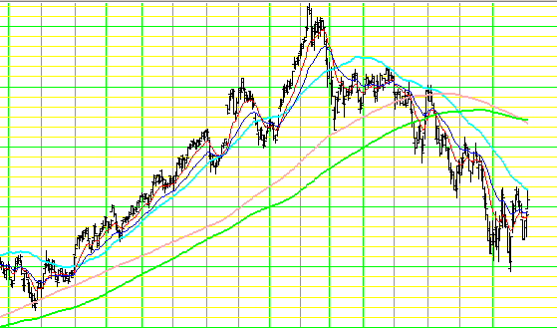
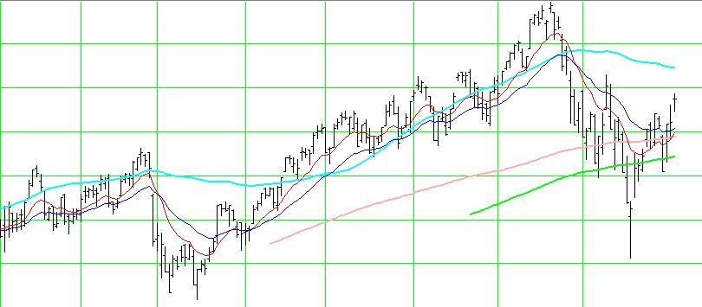
What Is a Design Pattern?
Patterns are repeated phenomena that have significant impact or implications
  stock chart patterns, cloud patterns, feng shui
  design patterns
Inverted
Head and Shoulder
Head and Shoulder

Slide 3
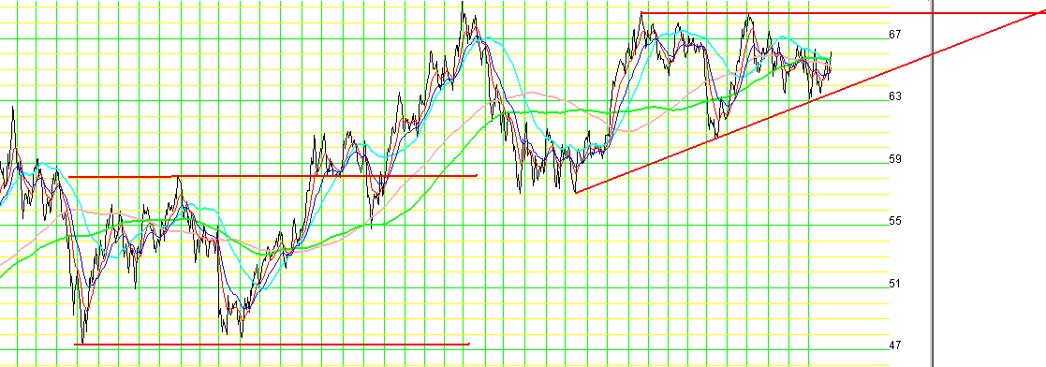
Stock Chart Patterns
Double Bottom
Ascending Triangle

Slide 4

Japanese Candle Chart Patterns
Engulfing Minus
Select industrial ETF

Slide 5

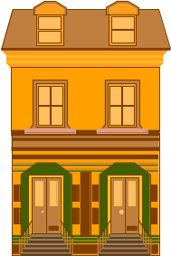




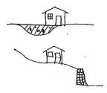
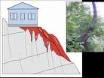

Fei Shui Patterns
Tian An Men
Tombs of Sun Yat-sen, and
emperors Ming Dynasty
Lot for Wealth
Lot to avoid (bad luck or poverty?)
Slope in back of house makes it difficult to run business because of lack of support.
Okay
Avoid
Stair must not run into the
entrance door or wealth will go out of the door.

Slide 6
Example: The Singleton Pattern
Pattern name: Singleton
The Problem: How do we ensure that a class has only one globally accessible instance?
Example uses:
  Database manager class
  System configuration class
  System log file
  Recovery manager class
  etc.

Slide 7
The Singleton Pattern
How do we ensure that a class has only one instance?
How do we make that instance easily and globally accessible?
The singleton pattern provides a solution.
(Note: restricted access by librarians can be provided by the proxy pattern.)

Slide 8
The Singleton Pattern
public class Catalog {
private static Catalog instance;
private Catalog() { ... } // private constructor
public static Catalog getInstance() {
if (instance==null) instance=new Catalog();
return instance; }
// other code
}

Slide 9
What Is a Design Pattern?
Design patterns are proven design solutions to commonly encountered design problems.
Software design patterns codify general software design principles and idiomatic solutions.
Software design patterns are presented in structures with associated behaviors and characteristics for building highly maintainable and extensible software.

Slide 10
What is a design pattern?
Design patterns are structures with associated behaviors and characteristics for building highly maintainable and extensible software.
Design patterns improve communication among software developers.
Design patterns can empower less experienced developers to produce high-quality designs.

Slide 11
What is a design pattern
"Each pattern describes a problem which occurs over and over again in our environment, and then describes the core of the solution to that problem, in such a way that you can use this solution a million times over, without ever doing it the same way twice."
--- Christopher Alexander, 1977

Slide 12
What is a design pattern?
it is a named problem/solution pair
it codifies general software design principles and idiomatic solutions in a structured format
it can be applied in new context
it provides advice on how to apply it in novel situations
it discusses the consequences and trade-offs

Slide 13
What is not a design pattern?
patterns are repeating things
therefore, they are not new design ideas
most design patterns are not meant to improve efficiency or performance

Slide 14
Describing design patterns
The pattern name: abstractly describes in one or two words
  the design problem
  the solution
  the consequences (of the solution)
The problem: describes when to apply the pattern.

Slide 15
Describing Design Patterns
The solution: describes the participants, their responsibilities, relationships and collaborations.
The consequences: the results and trade-offs, the costs and benefits.

Slide 16
Example: The Singleton Pattern
<<Singleton>>
Config
-$ instance: Config
- platform: String
- Config()
+$ getInstance(): Config
+ getPlatform(): String
+ setPlatform(p:String)
if (instance==null)
instance=new Config();
return instance;
+: public -: private $: static

Slide 17
Usefulness of Design Patterns
Provide good design abstraction
Support various design requirements & constraints
Designing for change
Bring good design principles to your system

Slide 18
Provide Good Design Abstraction
Reality
Design Model Using Design Patterns as Design Abstraction
design with patterns
direct
mapping
Ad Hoc Design Model
A design in which software objects
are direct mappings of real world
objects.

Slide 19
Design Abstraction: Examples
Every pattern is a design abstraction
Some examples are
  design abstraction of a globally accessible database manager (singleton pattern)
  how to design and implement object state behavior (the state pattern)
  how to build families of products for different markets or platforms, for example
    deploy a software for Windows, Solaris, Unix and Linux systems
    The abstract factory pattern provides a solution.

Slide 20
Support Various Design Needs
When a system consists of many subsystems, how do you encapsulate the subsystem to provide a simple interface to the client? (the facade pattern)
Sometimes, a complex component may consist of many different components, which may consist of other components, etc. How do you design and implement such a component? (the composite pattern)

Slide 21
Support Various Design Needs
In an agent oriented system, an agent's plan is dynamically generated and executed.
How do we design and implement the plan? (the composite pattern and the command pattern)

Slide 22
Support Various Design Needs
In a software fault tolerant system, multiple implementations are utilized to provide fault tolerance.
In such a system, which implementation is being used should be transparent to the client.
How do you design and implement such a fault tolerant system? (the bridge pattern)

Slide 23
Principles Used by Design Patterns
Design to provide flexibility through "program to an interface, not to an implementation".
Design using object composition & delegation.
Design using polymorphism to provide variation in behavior.
Design patterns bring good design principles to your system.

Slide 24
Program to an Interface
"Program to an interface, not to an implementation"
the advantages are:
  clients are unaware of the specific types of object they use
  clients are unaware of the classes that implement the objects
  you can change the implementation dynamically and transparently at running time

Slide 25
Program to Interface
<<interface>>
Sorter
setOrder(…)
sort()
BubbleSorter
QuickSorter
BinSorter
sort()
sort()
sort()
Sorter sorter;
…
switch (SITUATION) {
case 1: sorter=new BubbleSorter(); break;
case 2: sorter=new QuickSorter(); break;
...
}

Slide 26
Design with Object Composition
Object composition is used extensively by many design patterns
Object composition is defined through references to other objects
Object composition can dynamically change an object's behavior by changing the referenced object
"Favor object composition over inheritance"

Slide 27
Composition and Inheritance
Hashtable
Dispenser
add(item)
dispense(item#)
Dispenser
put(i#, item)
dispense(item#)
Item
*
Collection
*
Item
Item1
...
Itemk
Composition
Item1
...
Itemk
Inheritance

Slide 28
Composition and Delegation
delegate
Sorter
setOrder(…)
sort()
imp
<<interface>>
SorterImp
setOrder(…)
sort()
BubbleSorter
QuickSorter
BinSorter
sort()
sort()
sort()

Slide 29
Favor Object Composition
Composition
  reusing component's implementation
  black-box reuse
  defined at run time
  fewer implementation dependencies
  keep encapsulation
  no change propagation(?)
  high reusability
  limited feature interaction
Inheritance
  easy to reuse parent's implementation
  white-box reuse
  defined at compile time
  parent defines part of data structure
  breaks encapsulation
  change propagation
  limit subclass reuse
  feature interaction

Slide 30
Composition and Delegation
Delegation is a way to support compositional reuse
The composite object delegates requests to the delegate (to handle the requests)
The composite object may need to pass itself to the delegate
Delegation is used by many design patterns

Slide 31
Delegation
<<Plan>>
NavigationPlan
<<Agent>>
AutoPilot
plan
execute()
execute()
<<Plan>>
NavigationPlan1
<<Plan>>
NavigationPlan2
plan.execute();
execute()
execute()

Slide 32
Design for Change
"Software systems go through continual changes" -- Belady and Lehman 1975
Reasons for software change
  new requirements
  change in environment
  bugs and performance issues
  new technology
  change in schedule and budget
  etc.

Slide 33
Common Practice and Problems
Person x=new Person();
Implementation of a method
Hardware or platform dependent implementation
Inadequate information hiding
Algorithm dependency
Tight coupling
x is bound to type Person
commit to only one way to satisfy a request
hard to keep it up to date
changes may propagate to clients
need change when algorithm changes
system is hard to change

Slide 34
Patterns Offer Solutions
Abstract factory delays the binding to run time, it can also hide platform dependencies
Bridge lets you change the implementation at run time, it supports device independent design
Proxy can be used to hide network or database dependencies
Strategy can be used to hide algorithm dependencies

Slide 35
Commonly Used Design Patterns
The General Responsibility Assignment Software Patterns (GRASP)
The Gang of Four Patterns due to the four authors of the book.

Slide 36
GRASP Patterns
Expert
Creator
Controller
Low coupling
High cohesion
Polymorphism
Pure fabrication
Indirection
Do not talk to strangers

Slide 37
The GoF Patterns
Creational Patterns
Abstract factory
Builder
Factory method
Prototype
Singleton
Structural Patterns
Adapter
Bridge
Composite
Decorator
Facade
Flyweight
Proxy
Behavioral Patterns
Chain of responsibility
Command
Interpreter
Iterator
Mediator
Memento
Observer
State
Strategy
Template method
Visitor

Slide 38
Gang of Four Patterns
Creational patterns deal with creation of complex, or special purpose objects.
Structural patterns provide solutions
for composing or constructing large, complex structures that exhibit desired properties.
Behavioral patterns are concerned with
  algorithmatic aspect of a design
  assignment of responsibilities to objects
  communication between objects

Slide 39
Brief History of Design Patterns
Design Patterns began with Christopher Alexander, an architect, in the early 1960's to recognize that urban planning and architecture as repeated applications of basic principles of best designs.
His work was published in "A Pattern Language: Towns, Buildings, Construction," Oxford University Press, New York, 1977.

Slide 40
Brief History of Design Patterns
Software design patterns began with Ward Cunningham and Kent Beck who developed a set of patterns for user interfaces in Smalltalk (Kent Beck, "Using a pattern language for programming", OOPSLA'87).
At the same time, Jim Coplien was developing a catalog of C++ patterns ("Advanced C++: Programming Styles and Idioms," Addison-Wesley, 1992).

Slide 41
Brief History of Design Patterns
The Gang of Four Pattern Catalog began with Erich Gamma's Ph.D. thesis (50% of the patterns) in 1991.
Helm, Johnson and Vlissides joined Gamma and completed the catalog by 1993.
It was too big for a conference paper. So they turned the catalog into the famous book published in 1995.

