Slide 1
Software Design Patterns
Composite, Observer, Adapter

Slide 2
Designing a Document Editor
We will learn some of the GoF patterns through a case study.
It is a "what you see is what you get" editor.
It has a number of nice features:
  automatic formatting and arrangement of texts and graphics
  it has a GUI which may evolve
  supporting multiple look-and-feel standards
  supporting multiple window systems
  spelling checks and hyphenation

Slide 3
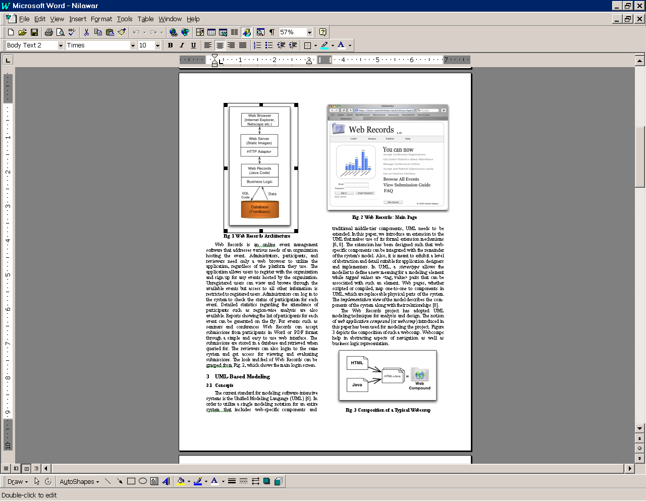
Challenge 1: Document Representation

Slide 4
Document Conceptual Model
How do we represent and
process such a complex,
recursive structure?
Document
*
TOC
...
Chapter
TitlePage
*
...
Section
*
Paragraph
*
*
Subsection
Row
Shape
...
*
*
*
Subsubsection
Character
Graphics
...
Image
...

Slide 5
The Solution Is the Composite Pattern
DocComponent
*
Section
TitlePage
TOC
Composite Component
*
Glyph
Paragraph
*
*
Row
Character
Graphics
Shape
Image

Slide 6
The Solution Is the Composite Pattern
Glyph
x,y:int
for each c in children
c.draw(g)
draw(g:Graphics)
intersect(p:Point)
insert(g:Glyph,i:int)
...
*
children
Character
Rectangle
Polygon
Row
c:char
draw(g:Graphics)
intersect(p:Point)
...
draw(g:Graphics)
intersect(p:Point)
...
draw(g:Graphics)
intersect(p:Point)
insert(g:Glyph,
i:int)
...
draw(g:Graphics)
intersect(p:Point)
...
g.drawString(c,x,y)

Slide 7
The Composite Pattern
public abstract class Glyph extends JComponent { int x, y;
public abstract void draw (Graphics g);
public abstract boolean
intersect (Point p);
public abstract void insert (Glyph g,
int i);
// other features
}
public class Character extends Glyph {
private char c;
public void draw (Graphics g) {
g.drawString (c); }
public boolean intersect(Point p) { ... }
... }
public class Row extends Glyph {
Glyph[] children;
// ...
public void draw (Graphics g) {
for(int i=0; i< children.length;i++)
children[i].draw(g);
}
public void insert(Glyph g, int i) {
// insert g in children[i]
}
public boolean intersect(Point p) {
for(int i=0;i< children.length;i++)
if (children[i].intersect(p))
return true;
return false; }

Slide 8
Composite Pattern
The composite pattern describes recursive, part-whole relationships.
It can be used to represent very complex objects.
It allows clients to treat each object uniformly.

Slide 9
The Composite Pattern
Benefits
  makes the client simple
    the client can treat composite objects and primitive objects uniformly
    the client does not know if it is dealing with a composite or primitive object
  it is easy to add new kinds of composite or primitive component
Liabilities
  the client has to check to ensure certain integrity constraints

Slide 10
Class Exercise
In an agent-oriented system, agents dynamically generate and execute plans to accomplish their goals. A plan consists of conditional actions and subplans (reusability).
  sketch a design for representing plans
  what are the classes and attributes of each class?
  what operations each class should have?
  what are the appropriate semantics of the operations?

Slide 11
Challenge: Handling GUI Events
GUI events are generated when the user performs editing operations, e.g.,
  creating a new document
  editing, saving and printing an existing document
There are numerous GUI events because there are many buttons, menu items, etc.
The same editing operation can be invoked in different ways (tool bar, pull-down, pop-up, control boxes, using the keyboard)
How does the system work?

Slide 12
Event Handling in Window Systems
GUI
component
(e.g., a button)
Window
System
Application
Event Handler
user
operation
primitive
system
event
event object
Example: Java Event Handling Model
submit:
JButton
:Window
System
eventHandler:
ActionListener
e:ActionEvent
<<user clicks>>
(x,y) is
clicked
create e using submit button info
actionPerformed(e)
process
submit
event

Slide 13
Using Java Event Handling
The common
observer interface
ActionListener
GUI contains:
buttons, scrollbars
menu items
pop-up menu items
etc.
actionPerformed(...)
Window
System
EventHandler
invoke
actionPerformed(e)
actionPerformed(...)
The observables
The observers
The Java event handling model is an application of the
observer pattern.

Slide 14
The Observer Pattern
Observable
state
getState()
add(o:Observer)
notify()
remove()
Observer
update()
observer
*
forall o in observers
o.update();
subject
Model
View1
View2
get state
update()
subjectState=subject.
getState()

Slide 15
The Observer Pattern
model:
observer:
add(self)
setState(s)
notify()
[ for all observer ]*: update()

Slide 16
The Observer Pattern
View1
redraw(x,y,z)
Model
redraw(p,q)
View2

Slide 17


The Observer Pattern
how do we design and implement presentations to dynamically reflect the changes in the market?

Slide 18
Observer Pattern
Define a 1-to-many dependency between objects so that when one object changes state, all its dependents are notified and update automatically.

Slide 19
The Observer Pattern
Benefits
  abstract coupling between subject and observer.
  the model is unaffected by the addition or removal of observers.
  the model can be reused independently of the views.
  views can be added/removed at any time, even during system operation.
  support broadcast communication
  the broadcast mechanism is hidden from the model code by being inherited from the Observable class.
Liabilities
  observers may change the subject unexpectedly due to lack of knowledge of each other’s presence.

Slide 20
The Model View Controller Architecture
DocDisplay
View
Glyph
DocStruct
*
p:Point
*
*
*
RowView
ClassView
Row
Class
gContext
name
View
Model

Slide 21
Separating Model and View
Model: The underlying computational object in the system is usually invisible to the user.
View: A visual representation of part or all of the state of the model object.
A model may have several different views showing different faces of its state.
Direct Coupling: A reference to each view is held in the model, which sends a redraw message to each view when the state of the model changes

Slide 22
Using Java Event Handling
ActionListener
GUI contains:
buttons, scrollbars
menu items
pop-up menu items
etc.
actionPerformed(...)
Window
System
EventHandler
invoke
actionPerformed(e)
actionPerformed(...)
A central event handler handles all types of event.

Slide 23
Common Practice and Problems
public void itemStateChanged(ItemEvent e)
{
if (e.getItemSelectable()==noc) {
if (noc.getState())
metricsVector.add("noc");
else metricsVector.remove("noc");
}
if (e.getItemSelectable()==nol) {
if (nol.getState())
metricsVector.add("nol");
else metricsVector.remove("nol");
}
if (...) {
...
}
Common practice:
Using a central event handler to handle all types of event
Problems:
Complexity is high
Difficult to test and maintain

Slide 24
Applying Separation of Concerns
Instead of:
GUI
button scrollbar
menu item
pop-up menu item
Window
System
Event Handler
Use different event handlers for different types of event:
OK button
OK button Handler
scrollbar
Window
System
scrollbar Handler
open menu item
open menu item handler
pop-up menu item
pop-up menu item handler

Slide 25
IDE Generated Design
GUI class
OK button:
scrollbar:
Window
System
Adapter pattern
is applied
adaptee
handleOKBtn(...)
OK Button Listener
actionPerformed(...)
ActionListener
actionPerformed(...)
Scrollbar Listener
actionPerformed(...)
handleScrollbar(...)
adaptee
adaptee.handleScrollbar(...)

Slide 26
Adapter Pattern
Problem
  Want to use an existing class but its interface does not match the one needed
Solution
  Convert original interface into the needed interface through an intermediate adapter class
The Adapter pattern has two forms
  class adapter
  object adapter

Slide 27
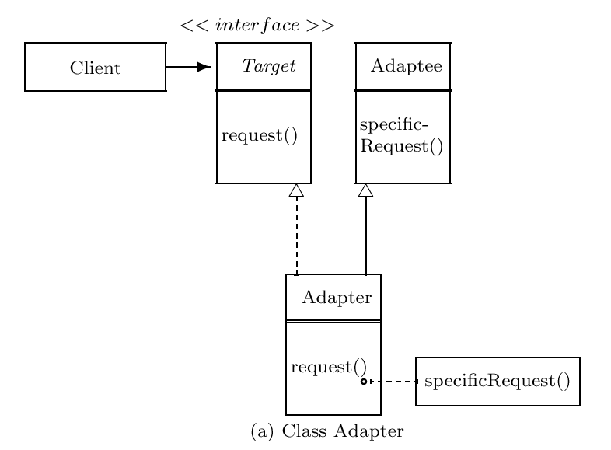

Slide 28
Target
Client
:Adaptee
request()
specificRequest()
delegate to
a specific
object
Adapter
request()
Object Adapter

Slide 29
An Adapter Example
Problem
  An application program wants to read from an ascii file using
    readString()
    readChar()
    readInt()
    etc.
  But Java IO does not provide this convenience
  How can we do?
    implement an adapter class to convert the needed interface to an appropriate Java API

Slide 30
An Adapter Example
AsciiInputInterface
Client
public String readString()
public char readChar()
public int readInt()
...
StreamTokenizer
String returnValue;
if(nextToken()==TT_EOF) {
throw new EOFException();
}else if(ttype != TT_WORD) {
throw new IOException
("Not a string!");
}else {
returnValue=sval; checkEolEof();
return returnValue;}
AsciiInputInterfaceAdapter
public String readString()
public char readChar()
public int readInt()
...

Slide 31
Class Adapter and Object Adapter
Class adapter
  commit to a concrete adaptee subclass
  cannot adapt a class and all of it subclasses
  can override some of the adaptee’s behavior
  introduces only one object
Object adapter
  do not commit to a single concrete adaptee subclass
  can adapt the adaptee superclass and all of its subclasses
  can add functionality to the adaptees
  to override an adaptee’s behavior, use subclassing and adapt an instance of the subclass

Slide 32
Pluggable Adapters
*
File
Class0
subClasses():String[]
NormalFile
Directory
list():String[]
Class1
Class2
A directory hierarchy
An inheritance hierarchy
How do we design a generic display that can display any hierarchical structures?
The solution is using pluggable adapters.

Slide 33
Pluggable Adapters
HierarchicalDisplay
getChilder(n:Node):Node
createGraphNode(n:Node)
display()
buildHierarchy(n:Node)
Directory
ClassHierarchy
DirectoryDisplay
InheritanceTreeDisplay
getChilder(n:Node):Node
createGraphNode(n:Node)
getChilder(n:Node):Node
createGraphNode(n:Node)

Slide 34
Class Exercise
What are the similarities and differences between Adapter and Bridge?
Can you think of situations in which one of these patterns should be applied but the other should not?

