Slide 1
Software Design Patterns
State, Chain of Responsibility, Memento
Dr. David Kung
UTA

Slide 2
Challenge 9: Keep Track of GUI State
The GUI should be able to keep track of editing state
  you cannot copy or cut objects unless you have selected the objects
  you cannot paste objects unless there are objects in the clipboard
  you cannot save a document unless you have opened one
  etc.

Slide 3
Other State Behavior Example
season switch
[timerOff() & roomTemp
>=setTemp]furRelay.off(),
[timerOff() & roomTemp
<setTemp]furRelay.on()
[timerOff() & roomTemp
>setTemp]acRelay.on(),
[timerOff() & roomTemp
<=setTemp]acRelay.off()
heat()/
setTimer()
cool()/
setTimer()
heat
off
cool
off()/
stopTimer()
off()/
stopTimer()
ac relay
furnace
relay
off()
off()
off
off
heating
cooling
on()
on()

Slide 4
Conventional Implementation
Using nested switch statements (season switch)
  switch (STATE) {
  case OFF: switch (EVENT) {
  case COOL: setTimer();
  STATE=COOL; break;
  case HEAT: setTimer();
  STATE=HEAT; break; }
  case COOL: switch (EVENT) { ... }
  case HEAT: switch (EVENT) { ... }
  }
Using a state transition matrix

Slide 5
Conventional Implementation
event
Off()
Cool()
Heat()
state
OFF
COOL
HEAT
setTimer()
setTimer()
COOL
OFF
stopTimer()
OFF
HEAT
stopTimer()
Season switch state transition matrix

Slide 6
Problems with Conventional Approach
high cyclomatic complexity (number of states multiplied by number of transitions)
nested case statements make the code difficult to comprehend, modify and maintain
difficult to add a new state (need to change every event case)
difficult to add a new event (need to change every state case)

Slide 7
The State Pattern
state=state.t1()
return this;
State
Subject
t1() : State
t2() : State
t3() : State
t4() : State
t5() : State
t6() : State
t7() : State
Client
t1()
t2()
…
t7()
t1
t2
t3
t7
ti(), i=1,..,7
state
1
2
3
4
t6
t5
t4
// do work for t1
return states[1];
1
t1():State
t7():State
2
3
4
t2():State
t6():State
t3():State
t5():State
t4():State

Slide 8
Object Interaction in the State Pattern
:Client
:Subject
state:State
:State
:State
ti(), i=1,2,..,7
process
Request()
state := ti()
state :=
get(NEXT)

Slide 9
The Season Switch State Pattern
season switch
SeasonSwitch
State
cool
cool()
heat()
off()
state
cool():state
heat ():state
off ():state
cool
off
off
Cool
Off
Heat
off
heat
off ():state
cool():state
heat ():state
off ():state
heat
turnOffAC()
return states[OFF]
turnOffHeater()
return states[OFF]

Slide 10
Object Interaction in the State Pattern
:Thermos
Control
:Season
Switch
state:State
:State
:State
timer:
cool()
state := cool()
setTimer()
state :=
get(COOL)

Slide 11
The State Pattern
Benefits
  significantly reduces the cyclomatic complexity of the state handling code
  easy to add new states and transitions --- simply adding new state subclasses and new operations to the state superclass
  easy to understand and maintain
Liabilities
  more classes to design and implement
  but this is paid off by the benefits

Slide 12
Class Exercise
Draw a state diagram for the vi editor
Draw a UML design class diagram for the state diagram using the state pattern
Write pseudo-code for the methods

Slide 13
Challenge 10: Providing Context Dependent Help
The user should be able to obtain help information by clicking on any part of the GUI.
The help information should be context dependent.
Context dependent help information should be search from the most relevant to more general help information.

Slide 14
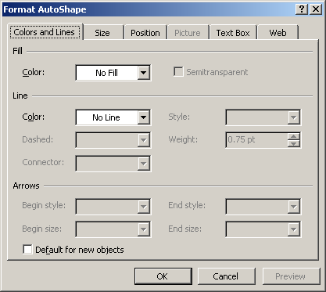
Providing Context Dependent Help
how do we design and implement context dependent help?

Slide 15
A Possible Solution
Using if-then-else or case statement
  if (context==X)
  showHelp1()
  else if (context==Y)
  showHelp2()
  else if ...
  This solution has high cyclomatic complexity.
  It is difficult to change.
  New context dependent help cannot be added dynamically

Slide 16
The Chain of Responsibility Pattern
Successors are listed
from smaller scope
to larger scope.
If one cannot handle
the request, it passes
it to a higher level.
Handler
successor
handleRequest()
Handler1
Handler2
handleRequest()
handleRequest()

Slide 17
if (successor!=null)
successor.
handleHelp()
HelpHandler
hasHelp():boolean
create(HelpHandler,Topic)
handleHelp()
successor
DocumentEditor
WidgetHelp
handleHelp()
DialogHelp
ButtonHelp
handleHelp()
showHelp()
handleHelp()
showHelp()
if (hasHelp()) showHelp()
else super.handleHelp();

Slide 18
:DocumentEditorHelp
:DialogHelp
:ButtonHelp

Slide 19
The Chain of Responsibility Pattern
Benefits
  Resulting in stupid objects
    each chain element knows only the successor
    chain elements do not know what the other chain elements handle
  The chain can be dynamically updated
Liabilities
  A request may not be handled.

Slide 20
Class Exercise
Can we use Chain of Responsibility to design and implement exception handlers?
If so, how this can be done?
Is there any other uses of Chain of Responsibility?
Can you use this pattern in your project work?

Slide 21
Challenge: Storing and Restoring Object State
You want to store and restore the state of an object but you don't want to expose the internals of the state to a third party.
This is useful in undo and redo, and fault tolerant computing.

Slide 22
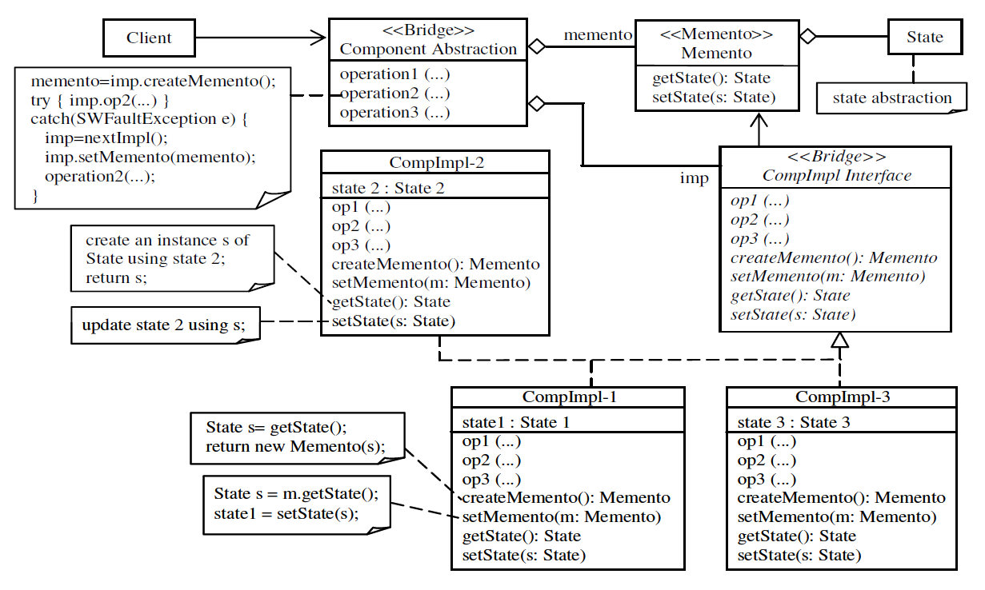
Memento in Software Fault Tolerance

