Slide 1
Software Design Patterns
Other Gang of Four Patterns
Dr. David Kung
University of Texas at Arlington

Slide 2
Template Method
op() {
op1();
op2();
}
AbstractClass
op()
op1()
op2()
Concrete1
Concrete2
op1()
op2()
op1()
op2()

Slide 3
The Template Method Pattern
Benefits
  defines the code skeleton with hook methods to provide varying behaviors implemented by subclasses
  can be used to extract common code from subclasses’ method into a superclass template method to facilitate maintenance
  it may reduce subclassing effort in cases that the subclasses’ methods share common code segments

Slide 4
Class Exercise
Can Template Method be applied to the Command pattern that implements database operations?
If so, how can this be done?

Slide 5
The Builder Pattern
Problem: How do we construct a complex object like a composite?
Solution:
  decompose the construction process into individual steps
  implement each step as an operation of a builder class
  each step operation builds part of the complex object
  use a supervisor to direct the construction process

Slide 6
The Builder Pattern
Supervisor
Builder
builder
create(b:Builder)
construct()
buildX()
buildY()
getProduct():Product
calls builder to build
the product one piece
at a time according to
the construction process.
Product
ConcreteBuilder
build
buildX()
buildY()
getProduct():Product

Slide 7
Object Interaction in the Builder Pattern
:Client
b:ConcreteBuilder
s:Supervisor
b:=create()
s:=create(b)
r:=construct()
buildX()
buildY()
r:=getResult()

Slide 8
The Builder Pattern
Benefits
  The builder hides the representation and internal structure of the product from the supervisor.
  It separates the product representation and construction concerns:
    the builder builds parts and keep the partial product
    the supervisor controls the construction process
  The supervisor can control the construction process at any level of detail.

Slide 9
Difference between Builder and Abstract Factory
Abstract factory makes the parts of a concrete product of a product family
  MSLookAndFeel makes the GUI components for MS Windows look and feel
  ToyotaFactory makes the car components for Toyota cars of the car family
Builder includes the supervisor and the builder. They together build the complex object
  builder builds the product incrementally under the supervision of the supervisor

Slide 10
Factory Method
Creator
...
Product p=factoryMethod();
...
operation ()
factoryMethod():Product
ConcreteCreator1
ConcreteCreator2
Factory method lets the subclasses to create the concrete product through factory methods.
factoryMethod():Product
factoryMethod():Product
create
create
Product1
Product2

Slide 11
Reducing Number of Classes
Car
housepower
numOfSeats
milesPerGallon
...
Toyota
Santana
Ford
Camry
Corolla
Escort
Granada

Slide 12
<<Singleton>>
ProtoMgr
get prototype
get(key):Object
add(key, Object)
remove(key)
maintain
Client
operation()
prototype
*
Prototype
clone():Object
*
...
Prototype p1=ProtoMgr.
getInstance().get(“Car”);
...
Car c=(Car)p1.clone();
c.setMake(“Toyota”);
c.setHousepower(...);
c.setNumOfSeats(...);
...
Car
Document
housepower
numOfSeasts
milesPerGallon
type
callNumber
author
title
clone():Object
...
...
clone():Object
...

Slide 13
Object Interaction in Prototype
client:
:ProtoMgr
:TypeK
c:Car
prototype:
c:=get(“Car”)
c:=get(“Car”)
setMake(“Toyota”)
setModel(“Camry”)

Slide 14
The Prototype Pattern
Benefits
  support dynamically loaded classes (DLC)
    DLC cannot be referenced at compile time.
    the class loader creates and registers an instance of the DLC at run time when the DLC is loaded
  avoid building a factory hierarchy parallel to the product hierarchy
  easy to add/remove prototypes at run time
  improve complex object creation efficiency
  reducing the number of classes

Slide 15
The Prototype Pattern
Liabilities
  each subclass of Prototype must implement the clone operation
    deep copy if copy and original must be independent
    shallow copy is sufficient otherwise
  implementing clone may be difficult when
    the component objects do not support cloning, or
    there are circular references

Slide 16
Class Exercise
Can Prototype be applied to Command to reduce the number of classes in the Command pattern?
If so, when and how?
Can Prototype be applied to eliminate an Abstract Factory?
If so, when and how?

Slide 17
The Façade Pattern
How do we simplify the interface to a complex set of subsystems?
Graphical User Interface
Source
Parser
Graphical
Layout
Graphical
Display
source
code
classes &
relations
Layout
info

Slide 18
The Façade Pattern
The main characteristics are:
  The complex web of connections between a systems components are hidden behind a single class acting as the façade.
  The system or sub-system presents a simple interface to the client.
  Changes can be made easily to the structure of the sub-system without impacting on the user.
Represents encapsulation at a higher level - a system or sub-system level, rather than at the class level.
This is one of the simplest patterns and yet one which is used most often.

Slide 19
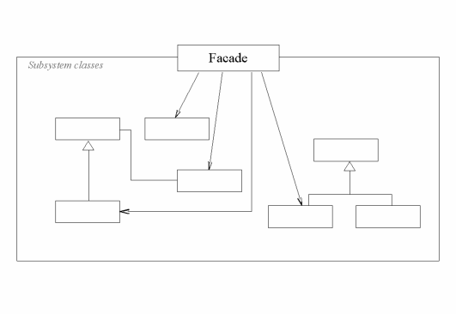
The Facade Pattern

Slide 20
Façade Pattern
Takes a group of closely coupled objects and wraps them up in a container presenting a single interface to the client. (i.e. a black box)
If one of the components is not suitable as the façade, a special class is created.

Slide 21
The Facade Pattern
Benefits
  makes the subsystems easier to reuse
  reduces coupling between the subsystem components and the client
  reduces the change impact of the subsystem components to the client
  access to subsystem components is still allowed

