Slide 1

DATA 481 | Networks
Sampling rate constraints, not model complexity, fundamentally limit WiFi protocol classification from low-resolution IQ signals.

Slide 2
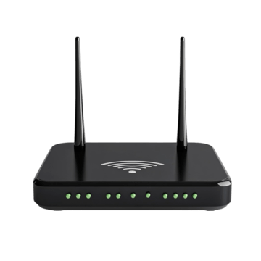

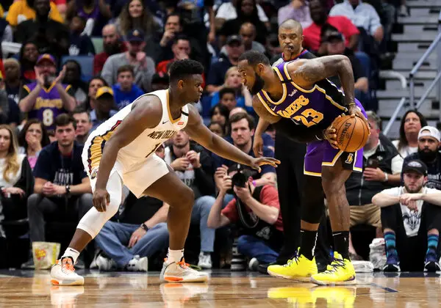
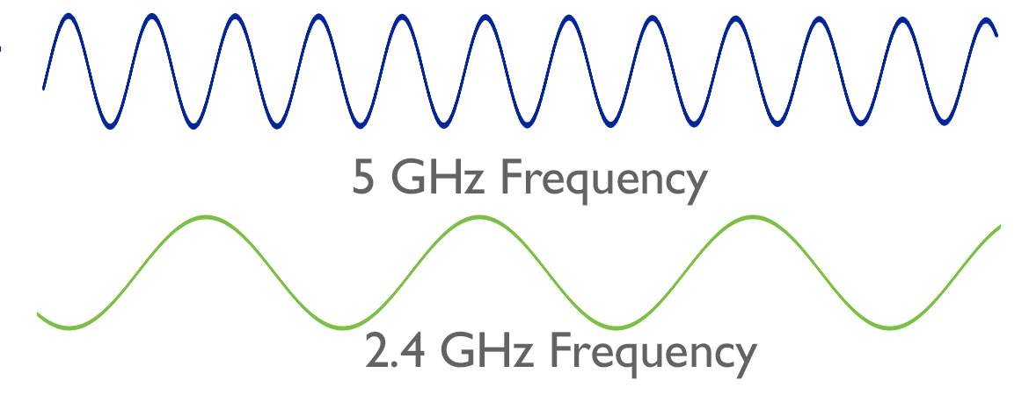
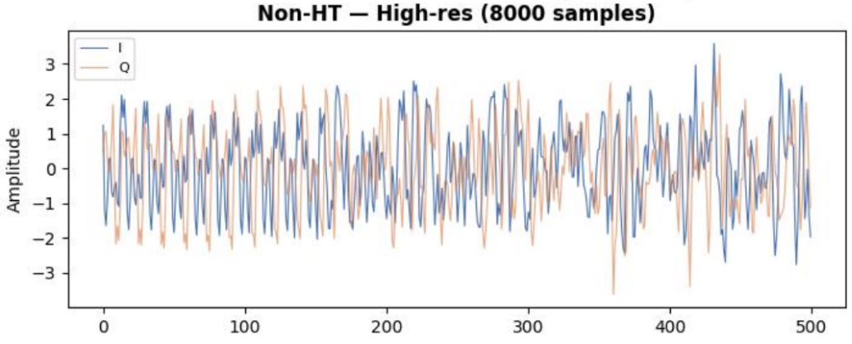
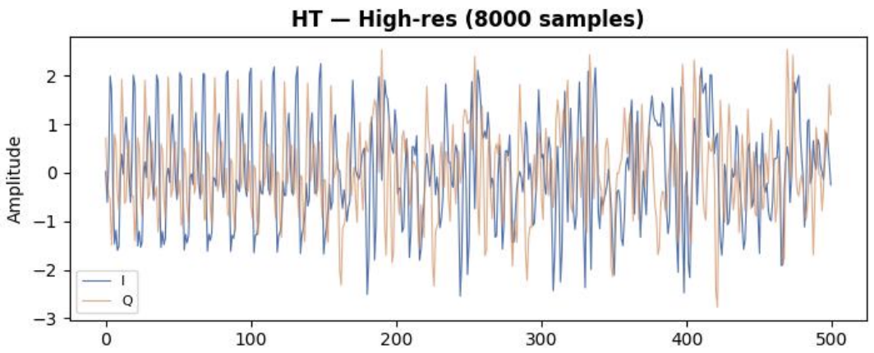
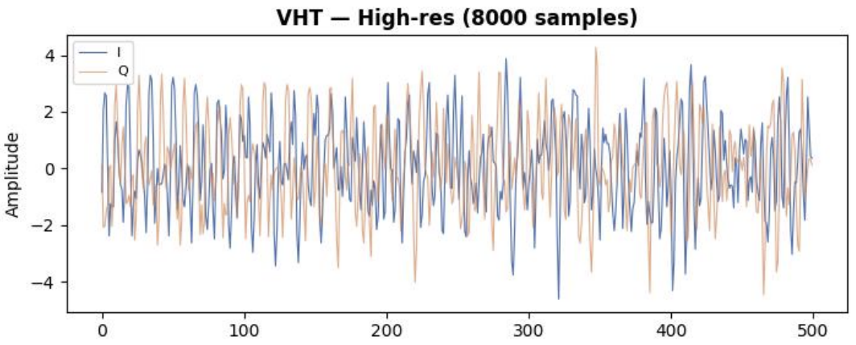
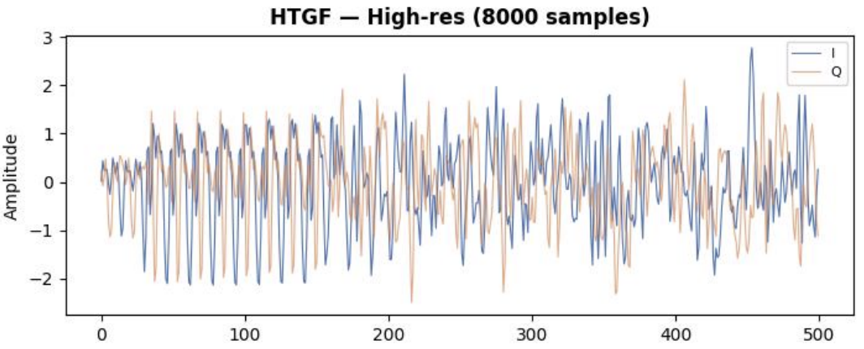
What are networks?
Every device around you is constantly broadcasting, but how does a receiver know who sent what?
WiFi devices communicate by transmitting radio waves and each generation of WiFi (Non-HT, HT, VHT, HT-GF) does it differently, leaving a unique physical fingerprint in the signal.

Slide 3
How are Networks communicated?
WiFi has four protocol generations: each one transmits radio waves differently, leaving a physically distinct fingerprint in the signal.
Non-HT
Oldest, simplest signal
HT
Added multiple antennas
VHT
Faster, denser, wider signal
HTGF
HT with no legacy baggage
Every WiFi transmission, regardless of which protocol, gets recorded as IQ data.

Slide 4
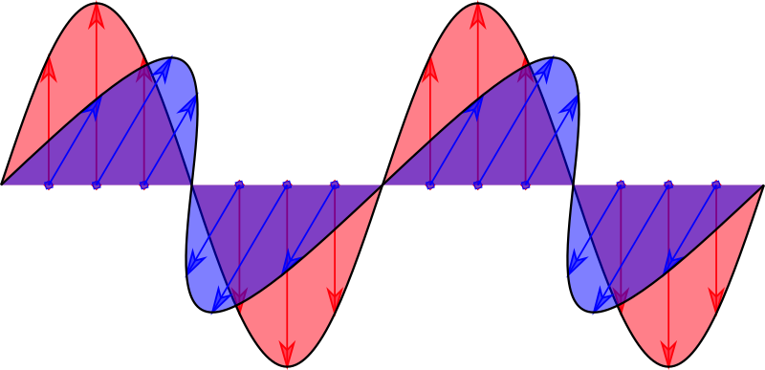
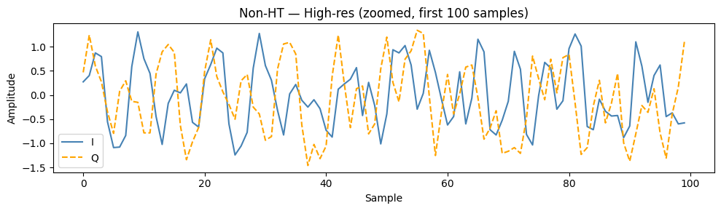
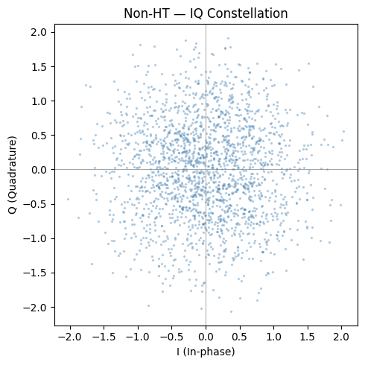
How is Network Data Captured? IQ Data
All radio signals are electromagnetic waves: every electromagnetic wave has two components oscillating at 90° to each other.
Two numbers, captured millions of times per second: that's the entire raw signal.
I (In-phase) — left/right position of the wave
Q (Quadrature) — up/down position of the wave

Slide 5
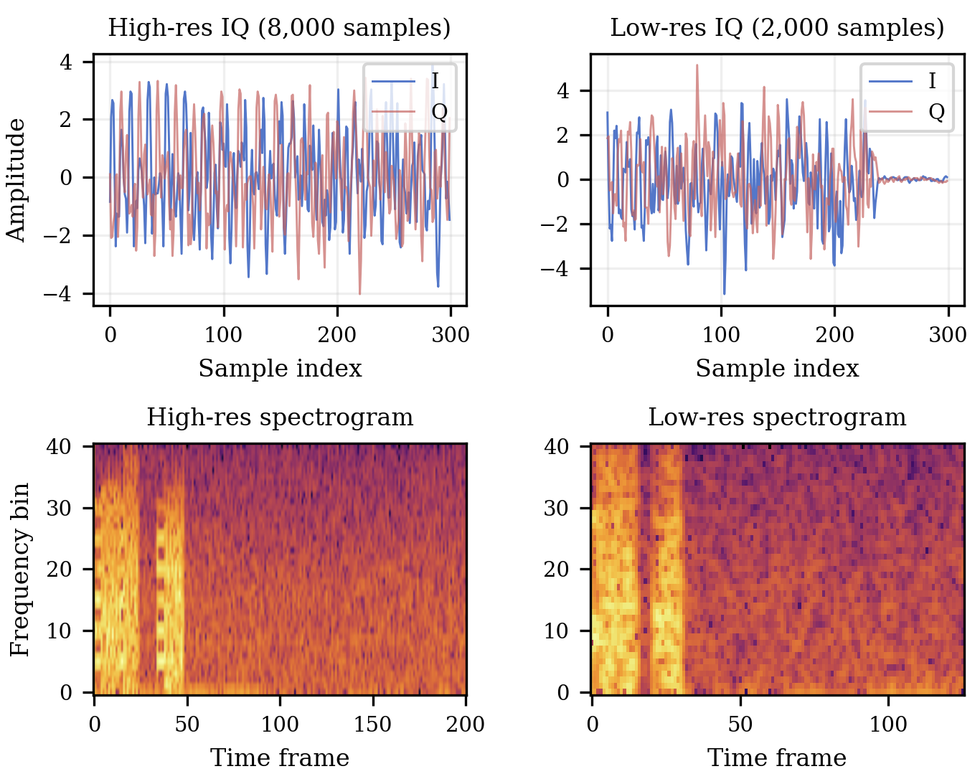

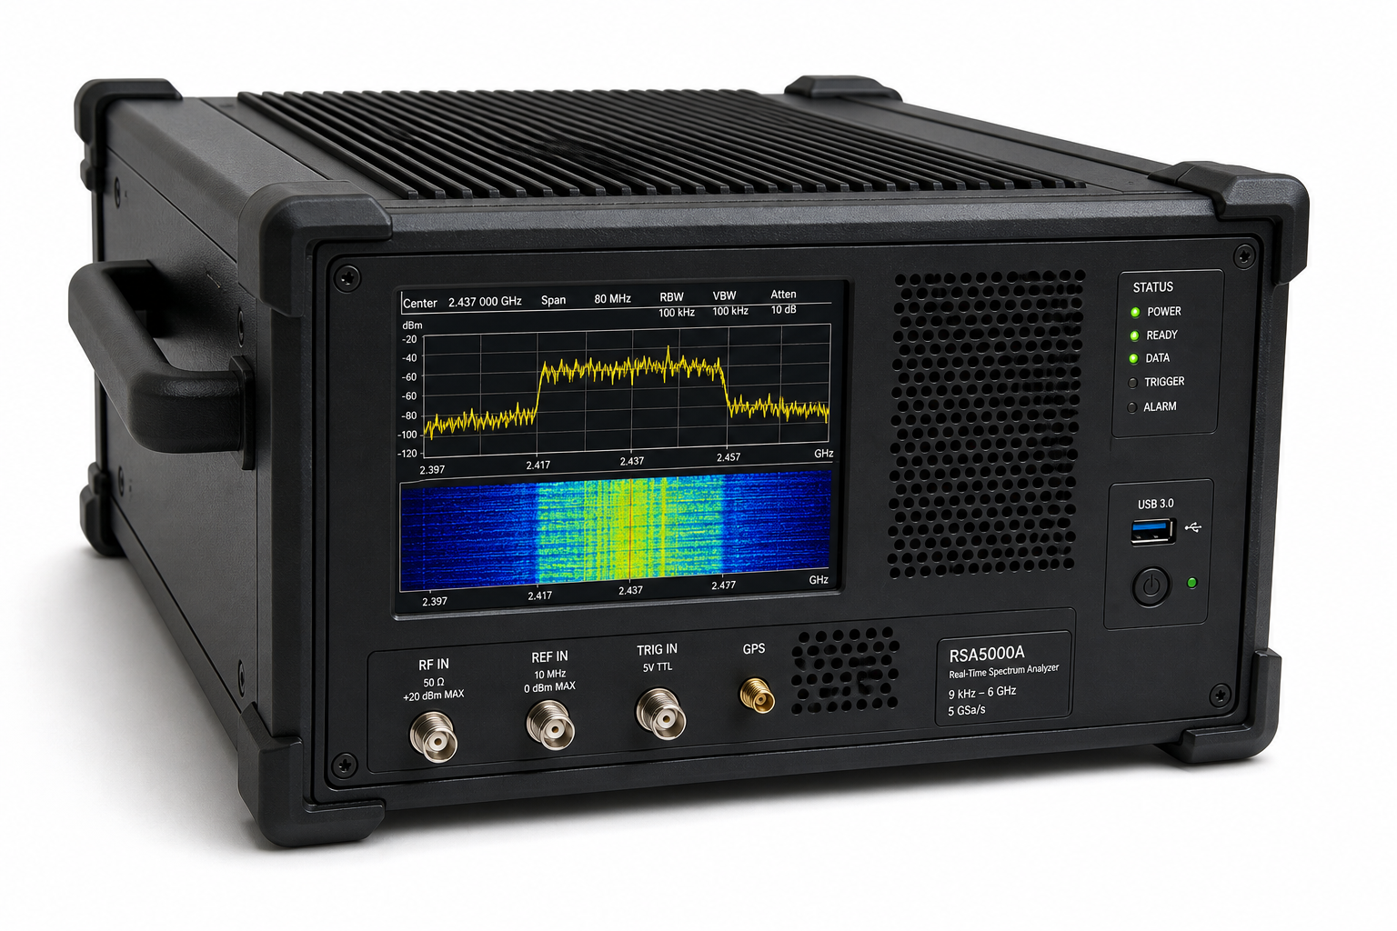
The Problem
Real-world monitoring devices can't always capture signals at full quality.
We were given high resolution data and low resolution data through 4x downsampling.

Slide 6
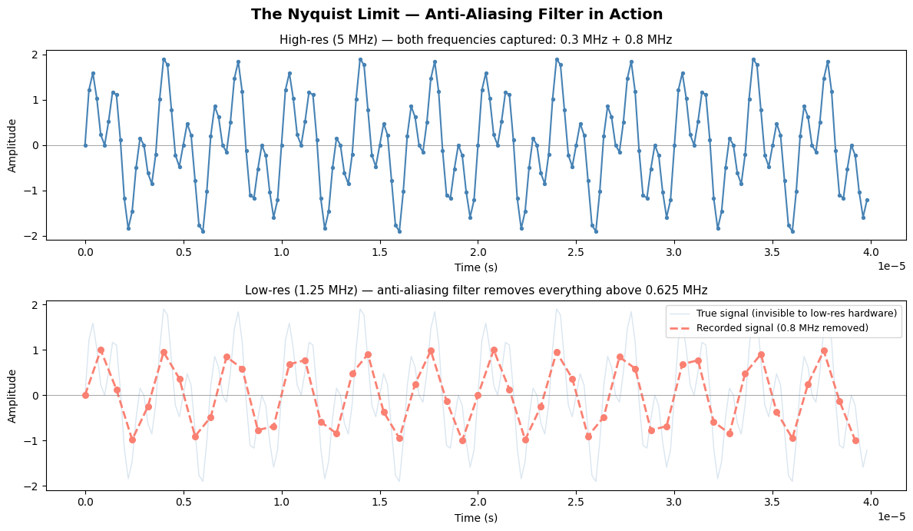
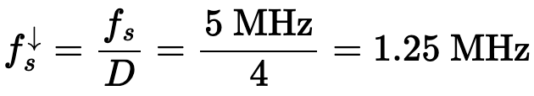
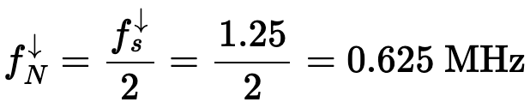

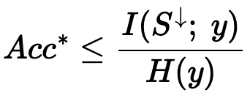

The Nyquist Limit
To accurately capture a frequency, you must sample at least twice as fast as it.
Imagine filming a spinning fan. Film too slowly and it looks frozen or spinning backwards, you didn't capture enough frames to represent the true motion. Radio signals work exactly the same way.
This is the Nyquist-Shannon Sampling Theorem
Proof from our Data:
The complex signal — two frequencies mixed together, fully captured at 5 MHz
The ghost — what the true signal actually looked like, invisible to low-res hardware
What gets recorded — only the 0.3 MHz component survives. The 0.8 MHz component is gone before any model sees the data.

Slide 7
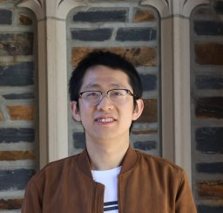
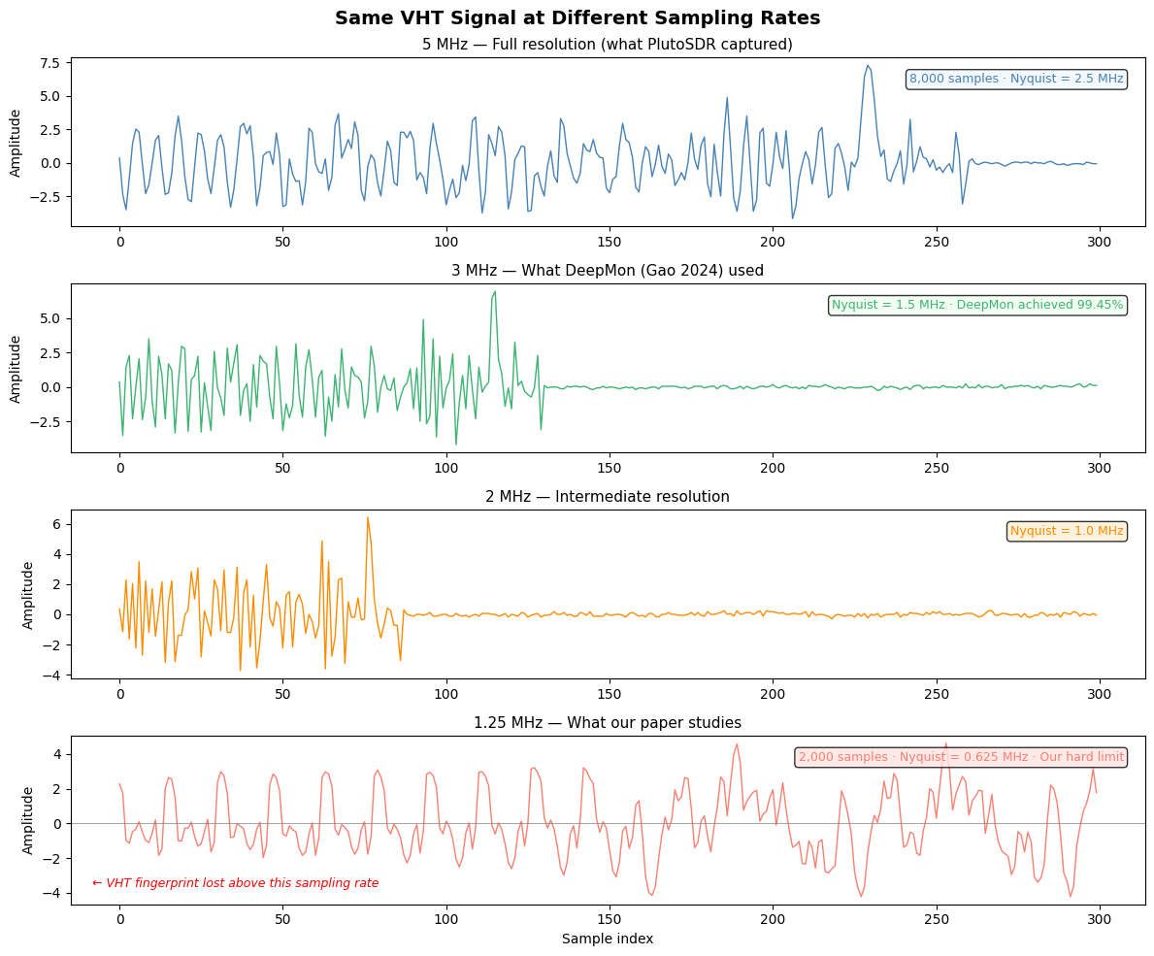
Data
Zhihui Gao - Electrical and Computer Engineering
Duke University
Gao et al. captured raw WiFi signals using PlutoSDR receivers in a real indoor environment and stored them as binary .bin files with paired .mat label files in MATLAB format. Each file contained raw IQ samples: just the two streams of numbers, I and Q, recorded directly from the air.
They answered: Can a cheap low-power radio still extract useful WiFi information?

Slide 8
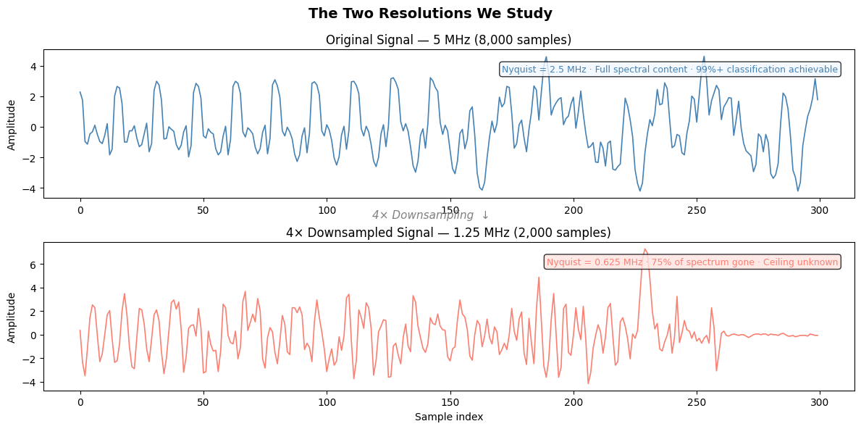
Our Task

Slide 9
Our Task
Gao's dataset contains WiFi signals captured at 5 MHz and their 4× downsampled versions at 1.25 MHz. We focused exclusively on these two resolutions.
At 5 MHz, classification is a solved problem. Models achieve above 99% accuracy across all protocol classes.
At 1.25 MHz, 75% of the spectral content is permanently destroyed by the anti-aliasing filter before any model ever sees the data.
Can deep learning still classify WiFi protocols accurately from a signal that has lost three quarters of its frequency content and if not, where exactly does it fail and why?

Slide 10
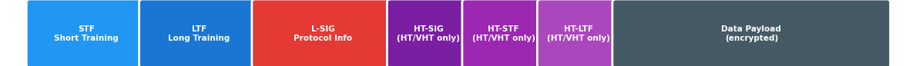
Procedure 1
Early attempts focused on decoding extracting L-SIG bits and preamble structure directly.
STF: A fixed pattern sent at the start of every WiFi packet. It tells the router that data is coming
LFT:How the signal was distorted by walls, interference, and reflections. Information for the receiver to calibrate itself to read what follows.
LSIG: Contains the rate, packet length, and a protocol hint. This is what you tried to decode first.
HT-SIG: Only in HT + VHT. Contains protocol-specific parameters. Used as protocol identifier.
HT-STF: Only in HT/VHT. A second training sequence specifically for multiple antenna systems.
HT-LTF: Only in HT/VHT. Additional channel estimation for each spatial stream.

Slide 11
Procedure 2
You do not need to read the bits at all. The entire content before the data STF, LTF, L-SIG leaves a physical pattern in the IQ signal that a neural network can learn to recognize without ever decoding a single bit.
Traditional Approach
Detect preamble
Decode L-SIG bits
Read protocol from header
Requires clean signal
Fails below Nyquist
Breaks at 1.25 MHz
Our Approach
Feed raw IQ directly
No decoding needed
No bit extraction
Model learns the pattern
Works on degraded signals
Scales to any resolution

Slide 12
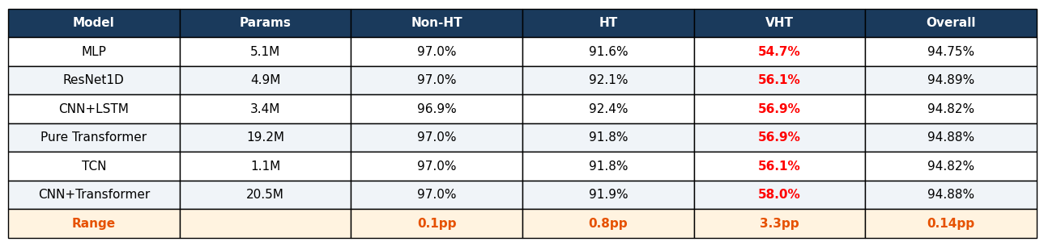
Procedure 2
Before claiming a ceiling exists, we had to prove no standard architecture could break it.
Observations
The 1.1M parameter TCN and the 20.5M parameter CNN+Transformer achieved identical Non-HT and HT accuracy and differed by under 2 points on VHT. That is a 20× difference in size with essentially zero difference in outcome.
VHT accuracy spans only 54.7% to 58.0% above random chance for a 4-class problem. Adding more parameters, more layers, more attention heads: none of it helped.
All six models achieve between 94.75% and 94.89% overall. This looks like success until you look at VHT.

Slide 13
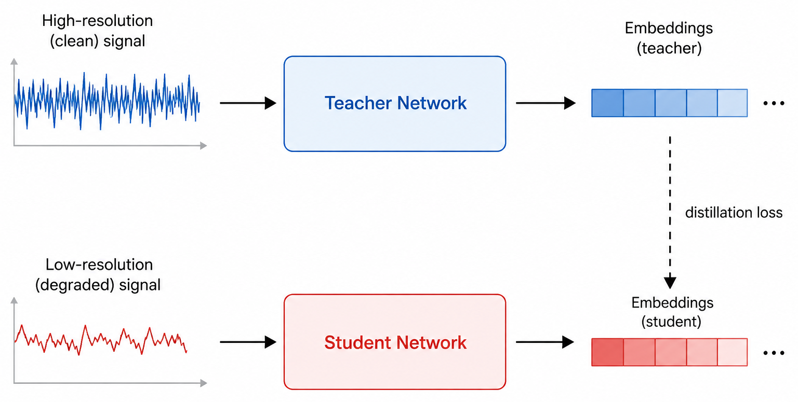
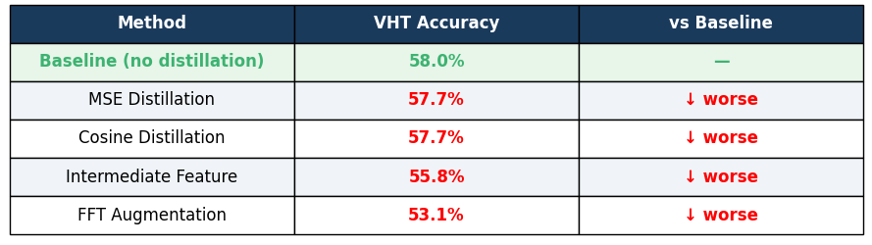
However: A 99.8% accurate teacher provided zero benefit to a low-resolution student. The bottleneck is not in the model. It is in the input.
Procedure 3: Knowledge Distillation
Surely a Smarter Teacher Can Help?
No simple architecture broke the ceiling. But what if we use a model that has already seen the full signal and transfer its knowledge to the low-resolution student?
Teacher model on high res accuracy:
99.7% Non-HT
99.1% HT
98.7% VHT
MSE Distillation
Force student embeddings to match teacher embeddings exactly using mean squared error
Cosine Distillation
Align the direction of student and teacher embeddings rather than exact magnitude
Intermediate Feature Distillation
Match not just the final embedding but intermediate CNN feature maps at two points inside the network
FFT Augmentation + Distillation
Give the student explicit access to the frequency content of the preserved band as an extra input channel alongside distillation
A 99.8% accurate teacher provided zero benefit. The bottleneck is not in the model. It is in the input.

Slide 14
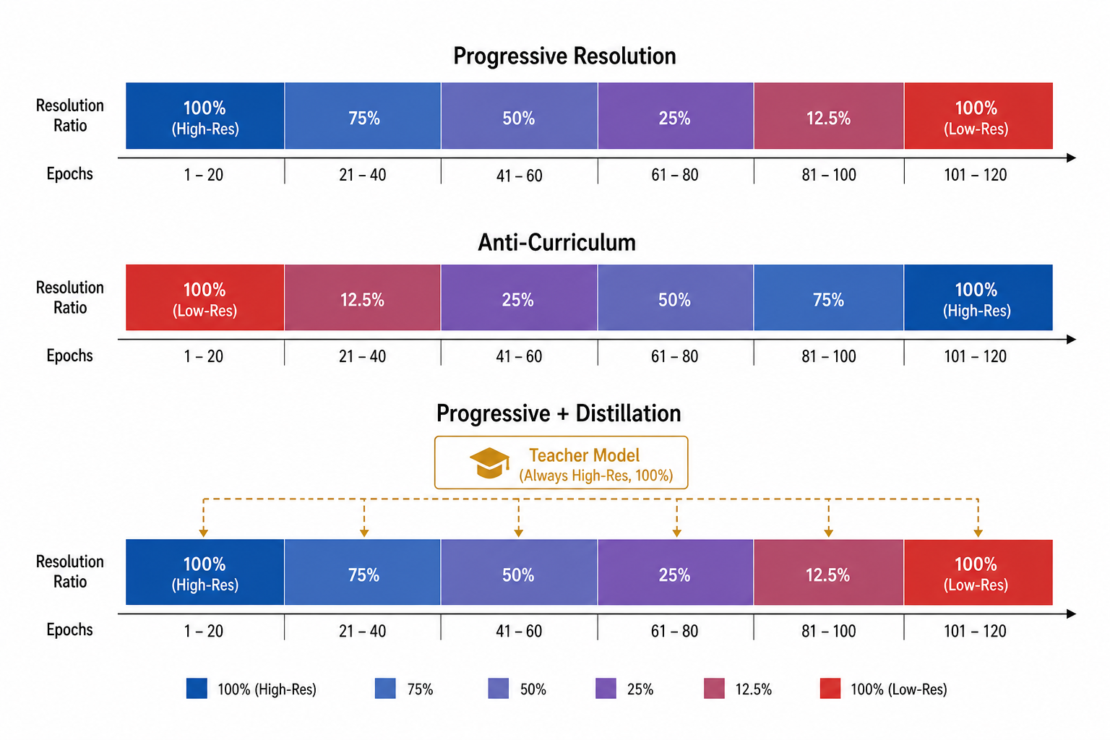
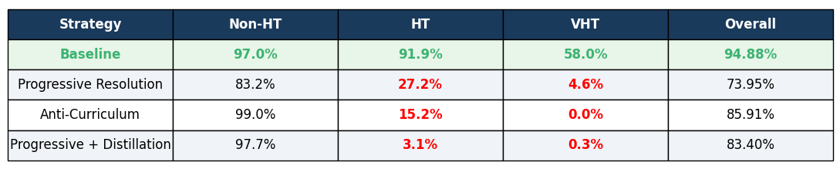
Procedure 3: Curriculum Learning
Humans learn better when taught from easy to hard. Can a neural network do the same with signal resolution?
Curriculum Learning: A model that first learns what VHT looks like at full resolution (where it is 98.7% classifiable) should retain some of that knowledge as resolution decreases, rather than starting from scratch on the harder problem.
Progressive resolution: start high-res, gradually introduce low-res
Anti-curriculum: start with hardest examples first
Progressive + live distillation: curriculum with teacher guidance throughout

Slide 15
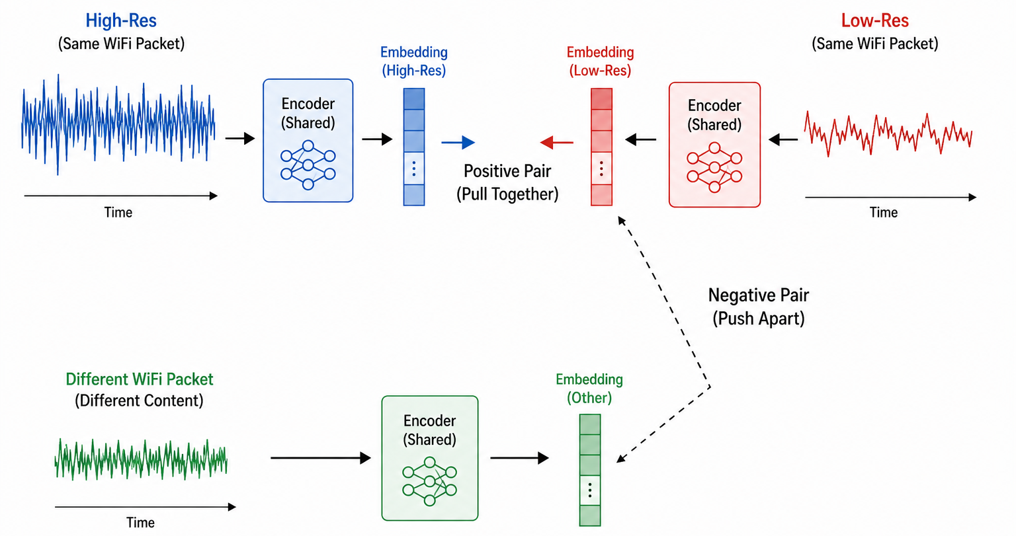
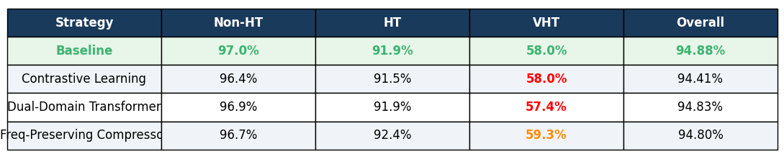
Procedure 3: Representation Learning
Humans learn to recognize things by comparing a dog looks different from a cat, even in bad lighting. Can a neural network learn protocol differences the same way, even in degraded signals?
Representation Learning: If we force the model to build representations that work across both high-res and low-res versions of the same signal it might learn features that survive downsampling.
Contrastive Learning: Match high-res and low-res embeddings
Dual-Domain Transformer: Time and frequency processed together
Frequency-Preserving Compressor: Amplify surviving discriminative frequencies

Slide 16
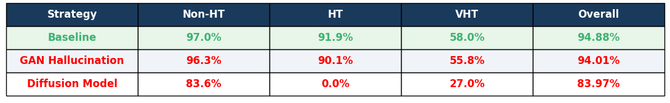
Procedure 3: Generative Upsampling
If the high-frequency content is gone, what if we generate it?
Generative Upsampling: A generative model trained on real high-res signals might learn to reconstruct plausible high-frequency content from a low-res input, giving the classifier something richer to work with.
GAN: Generate fake high-res signals from low-res input
Diffusion Model: Reconstruct high-res signal through 200 steps of iterative denoising conditioned on the low-res input
Notes:
GAN:
The discriminator only cares if the signal looks real — not if it helps classify VHT. Collapsed to near-zero loss by epoch 8.
Diffusion:
Reconstructing high-res from low-res is an underdetermined problem — infinitely many valid solutions exist. The model found realistic ones, not discriminative ones. HT dropped entirely to 0.0%.
Hallucinating missing content produces signals that look right but carry no discriminative information. Realism and discriminability are not the same thing.

Slide 17
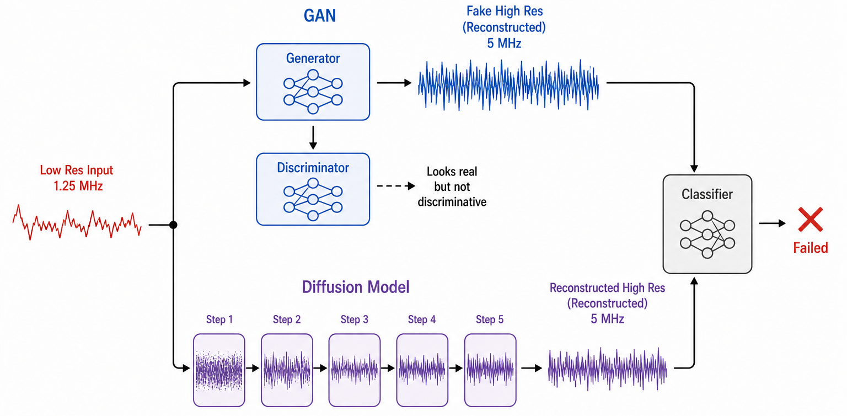
Procedure 3: Generative Upsampling
If the high-frequency content is gone, what if we generate it?
Generative Upsampling: A generative model trained on real high-res signals might learn to reconstruct plausible high-frequency content from a low-res input, giving the classifier something richer to work with.
GAN: Generate fake high-res signals from low-res input
Diffusion Model: Reconstruct high-res signal through 200 steps of iterative denoising conditioned on the low-res input
Notes:
GAN:
The discriminator only cares if the signal looks real — not if it helps classify VHT. Collapsed to near-zero loss by epoch 8.
Diffusion:
Reconstructing high-res from low-res is an underdetermined problem — infinitely many valid solutions exist. The model found realistic ones, not discriminative ones. HT dropped entirely to 0.0%.
Hallucinating missing content produces signals that look right but carry no discriminative information. Realism and discriminability are not the same thing.

Slide 18
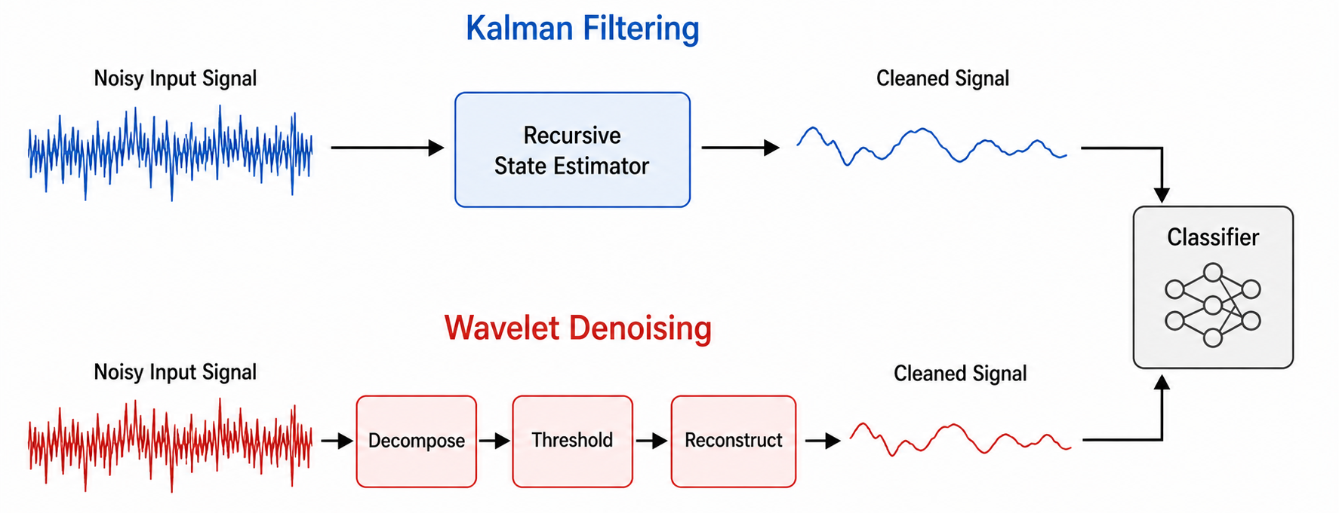
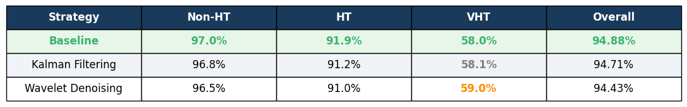
Procedure 3: Spectral Preprocessing
Every method so far tried to recover what was lost or transfer knowledge from better data. What if we just clean up what actually survived?
Spectral Preprocessing: Downsampling introduces noise and distortion in the preserved 0 to 0.625 MHz band. Cleaning that band before classification might expose structure the model cannot currently see.
Kalman FIlter: Smooth I and Q channels recursively
Wavelet Denoising: Threshold wavelet coefficients, reconstruct cleaner signal
Notes:
GAN:
The discriminator only cares if the signal looks real — not if it helps classify VHT. Collapsed to near-zero loss by epoch 8.
Diffusion:
Reconstructing high-res from low-res is an underdetermined problem — infinitely many valid solutions exist. The model found realistic ones, not discriminative ones. HT dropped entirely to 0.0%.
Hallucinating missing content produces signals that look right but carry no discriminative information. Realism and discriminability are not the same thing.

Slide 19
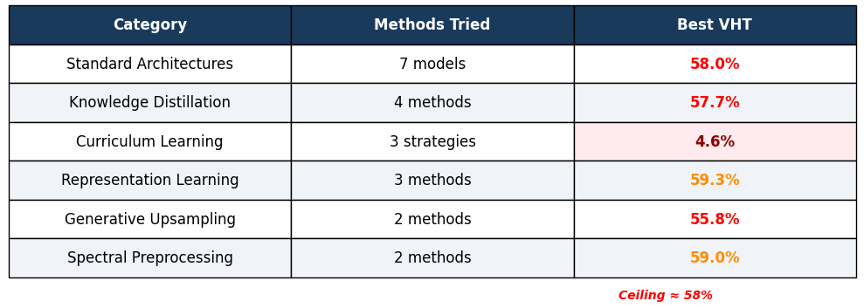
Procedure 4: All approach same ceiling
Every single method we tried hit the same wall.
Theory
The bottleneck is not architectural. It is representational.
Every method that changed the model, the training, or the data failed.
None of them changed how the signal was represented.
Notes:
GAN:
The discriminator only cares if the signal looks real — not if it helps classify VHT. Collapsed to near-zero loss by epoch 8.
Diffusion:
Reconstructing high-res from low-res is an underdetermined problem — infinitely many valid solutions exist. The model found realistic ones, not discriminative ones. HT dropped entirely to 0.0%.
Hallucinating missing content produces signals that look right but carry no discriminative information. Realism and discriminability are not the same thing.

Slide 20
Procedure 4: All approach same ceiling
Every single method we tried hit the same wall.
Theory
The bottleneck is not architectural. It is representational.
Every method that changed the model, the training, or the data failed.
None of them changed how the signal was represented.
Notes:
GAN:
The discriminator only cares if the signal looks real — not if it helps classify VHT. Collapsed to near-zero loss by epoch 8.
Diffusion:
Reconstructing high-res from low-res is an underdetermined problem — infinitely many valid solutions exist. The model found realistic ones, not discriminative ones. HT dropped entirely to 0.0%.
Hallucinating missing content produces signals that look right but carry no discriminative information. Realism and discriminability are not the same thing.

Slide 21
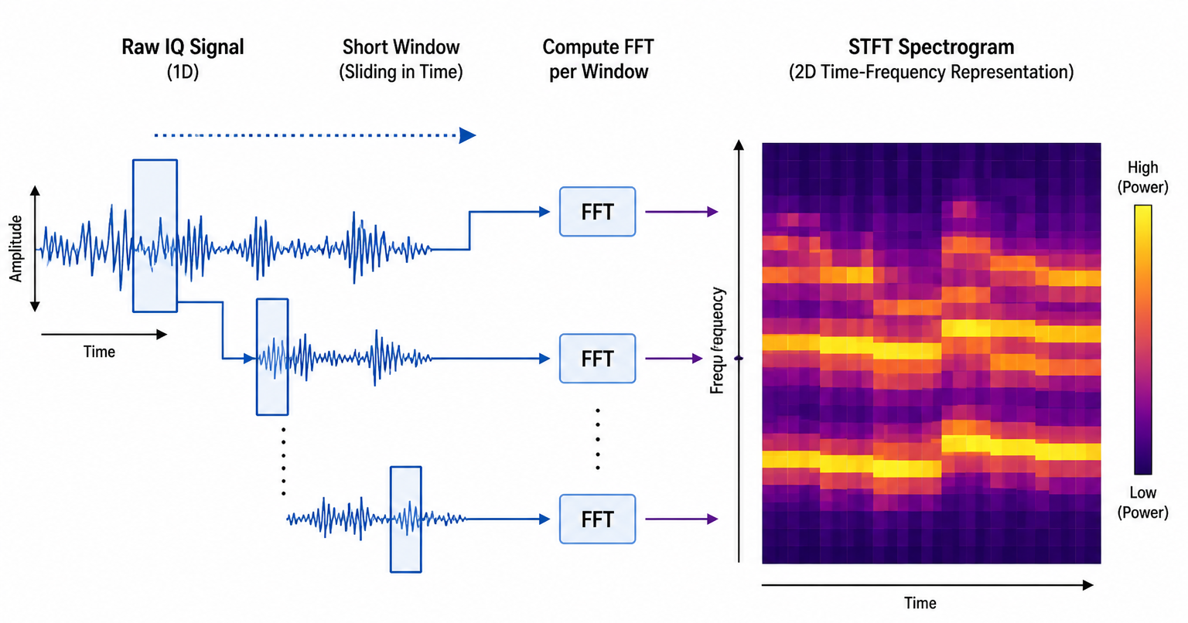
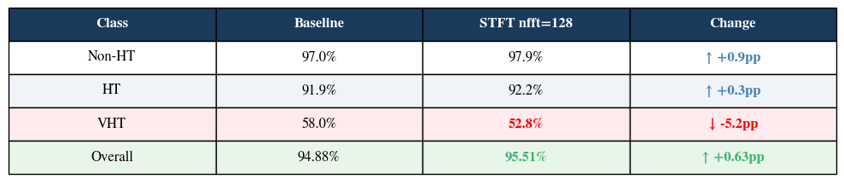
Procedure 5: The Breakthrough - STFT
What if instead of feeding the model raw numbers, we fed it a picture of the frequency content?
Slides a window along the signal, computes FFT at each position, stacks the results into a 2D image.
STFT does not add information: it reorganizes it into a form where the frequency differences between protocols become directly visible to the model.
Two classes improved, overall accuracy was the best ever seen: the representation was right. Only the resolution was wrong. That was worth investigating.
Notes:
GAN:
The discriminator only cares if the signal looks real — not if it helps classify VHT. Collapsed to near-zero loss by epoch 8.
Diffusion:
Reconstructing high-res from low-res is an underdetermined problem — infinitely many valid solutions exist. The model found realistic ones, not discriminative ones. HT dropped entirely to 0.0%.
Hallucinating missing content produces signals that look right but carry no discriminative information. Realism and discriminability are not the same thing.

Slide 22

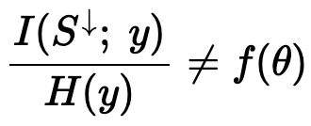
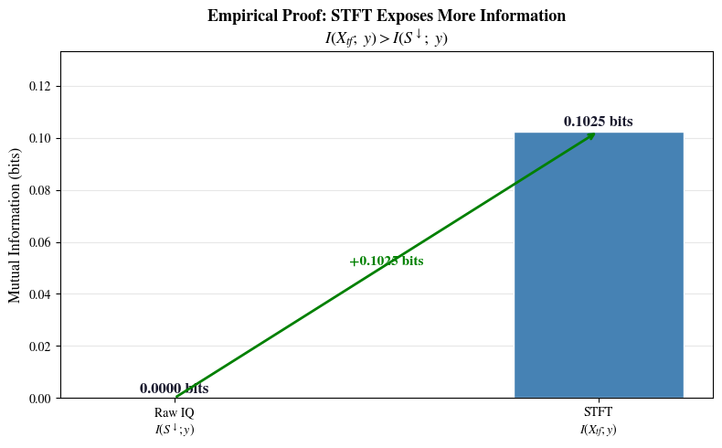


Procedure 5: All approach same ceiling
Theory
The bottleneck is not architectural. It is representational.
Every method that changed the model, the training, or the data failed.
None of them changed how the signal was represented.
Proof
1.
Everything above 0.625 MHz is multiplied by zero. It does not exist in the recorded data. This is not compression, it is permanent deletion in hardware proven in the Nyquist Limit.
3.
This is not theoretical. We computed mutual information directly from 2,000 real test samples. Raw IQ carries zero measurable information about the protocol label. STFT exposes 0.1025 bits.
Maximum accuracy is capped by how much information the input shares with the correct label, and this bound has nothing to do with the model. Every weight, every layer, every architecture choice is represented by theta and theta does not appear anywhere in this equation. This is why 21 approaches all failed.
2.
STFT does not recover deleted frequencies. It looks more carefully at what survived. By resolving fine frequency structure within the preserved band, it exposes patterns the raw signal hid, increasing mutual information with the label.
3.
STFT provably achieves a higher accuracy ceiling than any raw signal model.
Notes:
GAN:
The discriminator only cares if the signal looks real — not if it helps classify VHT. Collapsed to near-zero loss by epoch 8.
Diffusion:
Reconstructing high-res from low-res is an underdetermined problem — infinitely many valid solutions exist. The model found realistic ones, not discriminative ones. HT dropped entirely to 0.0%.
Hallucinating missing content produces signals that look right but carry no discriminative information. Realism and discriminability are not the same thing.

Slide 23
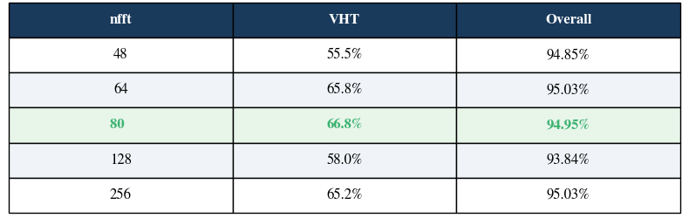
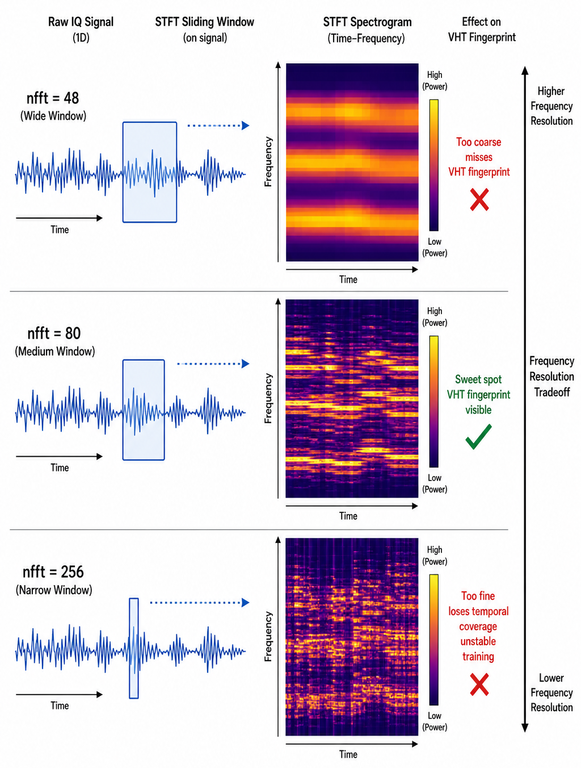
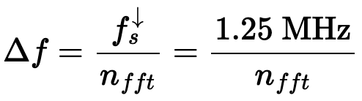
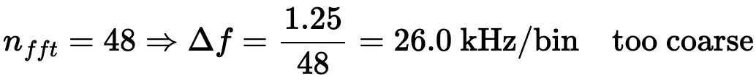
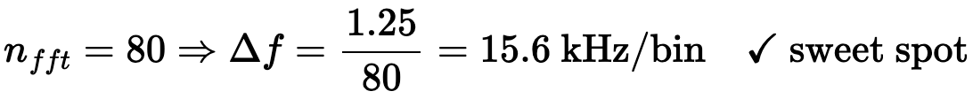
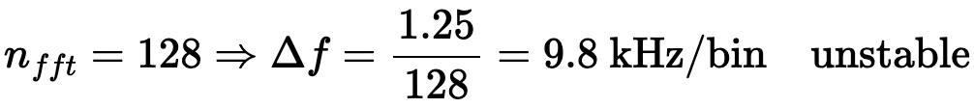

Procedure 5: Furter nfft Sweep
nfft is the window size used in the STFT. It controls how finely the frequency axis is divided.
Frequency resolution formula:
Notes:
GAN:
The discriminator only cares if the signal looks real — not if it helps classify VHT. Collapsed to near-zero loss by epoch 8.
Diffusion:
Reconstructing high-res from low-res is an underdetermined problem — infinitely many valid solutions exist. The model found realistic ones, not discriminative ones. HT dropped entirely to 0.0%.
Hallucinating missing content produces signals that look right but carry no discriminative information. Realism and discriminability are not the same thing.

Slide 24
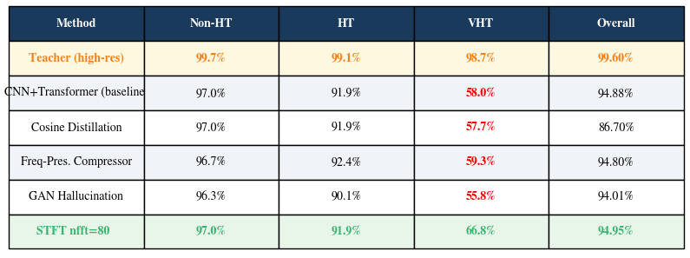
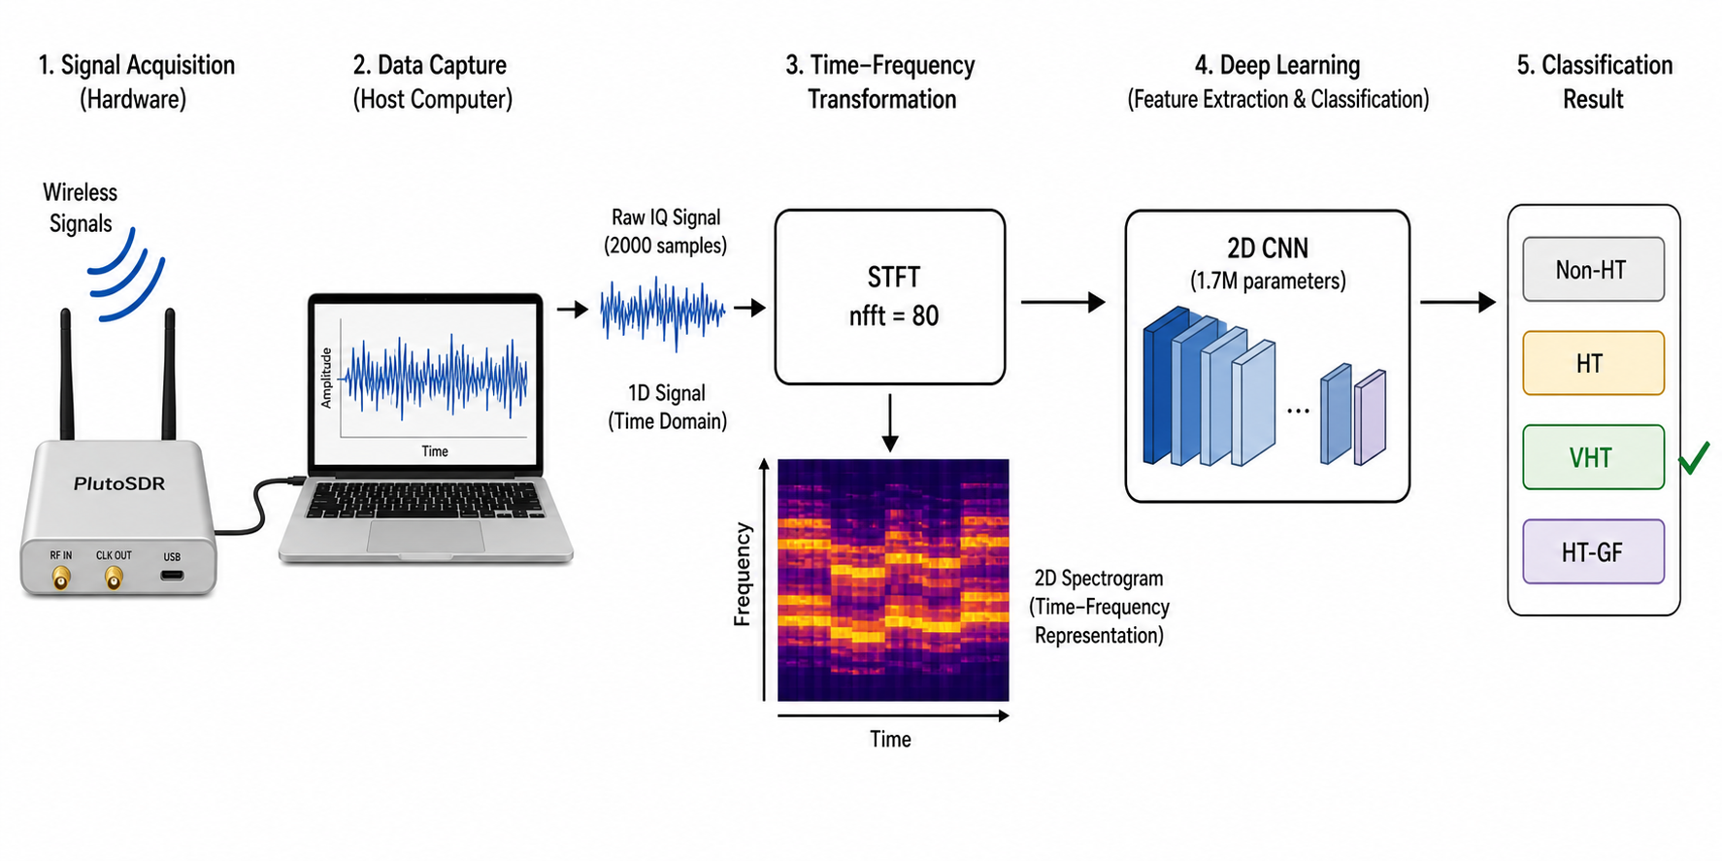
Results
21.7% of the gap between baseline and teacher closed by STFT
78.3% of the gap is irreducible: spectral content above 0.625 MHz is permanently gone
STFT uses only 1.7M parameters: 12× fewer than the strongest baseline
One method broke the ceiling. Everything else hit the same wall.
Where this matters:
Battery-powered spectrum sensors monitoring buildings 24/7
Drone-mounted radio scanners with power constraints
Edge devices doing real-time interference detection
Any RF classification system running on cheap hardware
Notes:
GAN:
The discriminator only cares if the signal looks real — not if it helps classify VHT. Collapsed to near-zero loss by epoch 8.
Diffusion:
Reconstructing high-res from low-res is an underdetermined problem — infinitely many valid solutions exist. The model found realistic ones, not discriminative ones. HT dropped entirely to 0.0%.
Hallucinating missing content produces signals that look right but carry no discriminative information. Realism and discriminability are not the same thing.

Slide 25
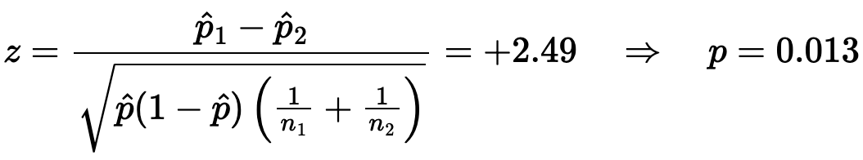
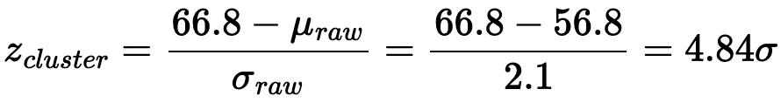
Conclusion
The 8.8 percentage point VHT improvement is statistically significant at p=0.013. The STFT result sits 4.84 standard deviations above the raw-signal cluster. Genuine outlier confirmed by bootstrap resampling across 10,000 iterations.
The improvement is too large to be random
STFT sits nearly 5 standard deviations above every other method
Effect size confirms the gap is real, not marginal
Notes:
GAN:
The discriminator only cares if the signal looks real — not if it helps classify VHT. Collapsed to near-zero loss by epoch 8.
Diffusion:
Reconstructing high-res from low-res is an underdetermined problem — infinitely many valid solutions exist. The model found realistic ones, not discriminative ones. HT dropped entirely to 0.0%.
Hallucinating missing content produces signals that look right but carry no discriminative information. Realism and discriminability are not the same thing.

Slide 26
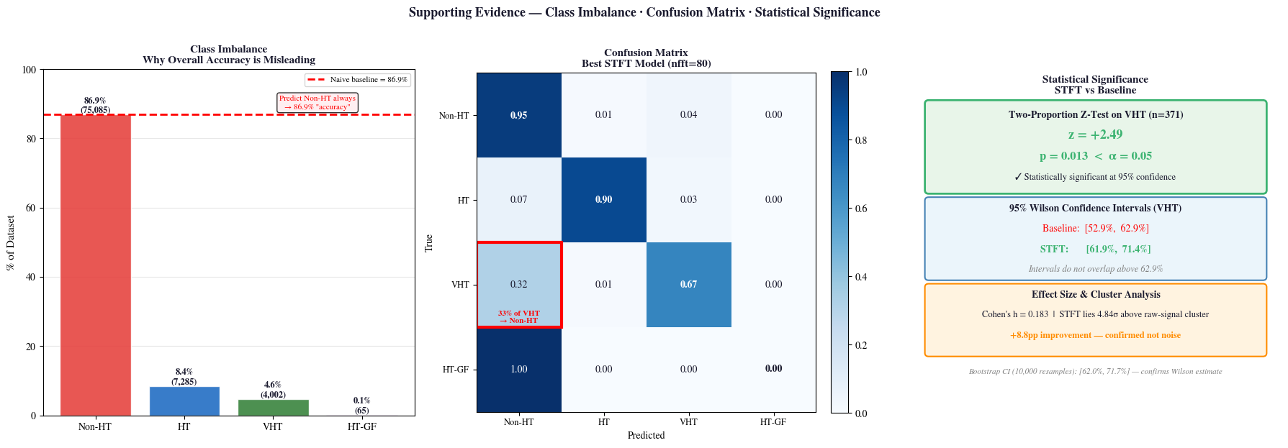
Conclusion
Class Imbalance:
86.9% of our dataset is Non-HT. A model that never learns anything still scores 86.9% overall so we weighted rare classes heavily and report per-class accuracy instead.
Confusion Matrix:
Our best model misclassifies 33% of VHT frames as Non-HT. This is not random — VHT and Non-HT look the most similar within the surviving frequency band. The confusion tells us exactly where the information loss hurts most.
The 8.8 point VHT improvement from STFT is statistically significant at p=0.013. STFT sits 4.84 standard deviations above every other method we tested.
The raw signal simply could not show what needed to be seen. Changing the representation was the only intervention that worked.
Notes:
GAN:
The discriminator only cares if the signal looks real — not if it helps classify VHT. Collapsed to near-zero loss by epoch 8.
Diffusion:
Reconstructing high-res from low-res is an underdetermined problem — infinitely many valid solutions exist. The model found realistic ones, not discriminative ones. HT dropped entirely to 0.0%.
Hallucinating missing content produces signals that look right but carry no discriminative information. Realism and discriminability are not the same thing.

Slide 27
Future Work
Sweep hyperparameters for all 21 methods equally and not just STFT
Test at other downsampling factors: 2×, 8×, 16×
Longer observation windows, more samples, finer frequency resolution, no hardware changes
Preamble-aware classification, separate preamble from payload, apply targeted representations
Generalize across hardware platforms, environments, and wireless protocols beyond WiFi
Multiple training runs to report variance across all methods
Notes:
GAN:
The discriminator only cares if the signal looks real — not if it helps classify VHT. Collapsed to near-zero loss by epoch 8.
Diffusion:
Reconstructing high-res from low-res is an underdetermined problem — infinitely many valid solutions exist. The model found realistic ones, not discriminative ones. HT dropped entirely to 0.0%.
Hallucinating missing content produces signals that look right but carry no discriminative information. Realism and discriminability are not the same thing.

Slide 28
Acknowledgements
Professor Jingping Nie - University of North Carolina at Chapel Hill: mentorship, and computational resources
Dr. Zhihui Gao - Duke University: provided the dataset and technical context for the wireless signal domain
Professor James Stephen Marron - University of North Carolina at Chapel Hill — broader research guidance and support
Title: References
Bengio et al. — Curriculum Learning. ICML, 2009
Chen et al. — A Simple Framework for Contrastive Learning. ICML, 2020
Gao et al. — Swirls: Sniffing Wi-Fi Using Radios with Low Sampling Rates. ACM MobiHoc, 2023
Gao et al. — DeepMon: WiFi Monitoring Using Sub-Nyquist Sampling Rate Receivers. ACM MobiCom, 2024
Goodfellow et al. — Generative Adversarial Nets. NeurIPS, 2014
Hinton et al. — Distilling the Knowledge in a Neural Network. arXiv, 2015
Ho et al. — Denoising Diffusion Probabilistic Models. NeurIPS, 2020
McCloskey & Cohen — Catastrophic Interference in Connectionist Networks. 1989
O'Shea et al. — Convolutional Radio Modulation Recognition Networks. arXiv, 2016
O'Shea et al. — Over-the-Air Deep Learning Based Radio Signal Classification. IEEE JSTSP, 2018

