Slide 1


Preserving Heritage : Augmented Reality in Ancient Murals
SVPM’s COE, Malegaon BK Baramati.
Tabe Arti Ravindra
Under The Guidance Of
Prof. P. N. Kadam
October 17, 2024

Slide 2
Introduction
1
Ancient murals tell captivating stories of a civilization’s history, beliefs, and daily life.
The skilled work and careful details seen in these murals show the artistic talent of people from the past.
Murals provide important insights into a region’s cultural history and traditions.
Augmented reality brings ancient murals to life, allowing us to explore their history and significance.

Slide 3
Problem Statement
2
Problem Statement:
"Ancient murals are very delicate and can be easily damaged by environmental factors like humidity and temperature changes.
Researchers often need to look at them closely, which can
accidentally harm these valuable artworks. This creates a big challenge for studying and appreciating these cultural treasures, making it harder to understand their history and artistic value."

Slide 4

Motivation
3
Easy for scientists to research.
Anyone who wishes to visit cultural heritage sites but cannot do so for various reasons can still experience them.
Our next generation should not miss out on seeing cultural heritage due to its destruction.
Accessible to student for help in studying such places.

Slide 5

Objective
4
Develop techniques to protect and preserve ancient murals.
Provide interactive digital models for detailed analysis by researchers.
Minimize risks of damage from traditional examination methods.
Increase accessibility for scholars and the public to learn and enjoy murals.

Slide 6
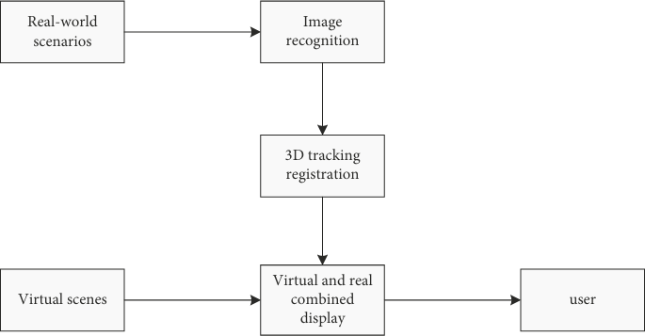
System Architecture
7
Figure: System composition diagram of augmented reality technology
Figure: Operation process diagram of image recognition technology

Slide 7
SURF Algorithm
8
Step 1: Image Acquisition
Step 2: Scale Space Creation
Step 3: Keypoint Detection
Step 4: Finding Local Maxima
Step 5: Assigning Orientation
Step 6: Keypoint Descriptors
Step 7: Feature Matching
Step 8: Transformation Estimation
9. Step 9: AR Overlay
Preservin₁g ₀He.rita_{S}ge_{t}: _{e}Au_{p}gme₁nt₀ed:Re_{R}alit_{e}y i_{a}n A_{l-}nc_{T}ien_{im}t Mu_{e}rals_{P}| _{rocessing}

Slide 8
FREAK Algorithm
9
Step 1: Keypoint Detection
Step 2: Orientation Assignment
Step 3: Sampling Pattern Definition
Step 4: Image Sampling
Step 5: Binary Descriptor Creation
Step 6: Descriptor Normalization
Step 7: Feature Matching
Step 8: Refinement and Validation
9. Step 9: AR Overlay
Preservin₁g ₀He.rita_{S}ge_{t}: _{e}Au_{p}gme₁nt₀ed:Re_{R}alit_{e}y i_{a}n A_{l-}nc_{T}ien_{im}t Mu_{e}rals_{P}| _{rocessing}

Slide 9

RANSAC Algorithm
10
Step 1: Input Data
Step 2: Random Sampling
Step 3: Model Fitting
Step 4: Inlier Determination
Step 5: Count Inliers
Step 6: Iteration
Step 7: Best Model Selection
Step 8: Final Model Fitting
Step 9: Apply Model
Preservin₁g ₀He.rita_{S}ge_{t}: _{e}Au_{p}gme₁nt₀ed:Re_{O}alit_{u}y in_{tp}An_{u}cie_{t}nt_{R}Mu_{e}ra_{s}ls_{u}| _{lts}

Slide 10

Technologies/Software Used
11
AR Platforms:
  ARCore (Google):Frameworks for building AR experiences on Android
  Vuforia:Frameworks for building AR experiences on Android and iOS
3D Modeling Tools:
  Blender:Open-source software for 3D modeling.
  Unity 3D ,Unreal Engine:Game engines for developing interactive AR experiences.
AR Devices:
  Microsoft HoloLens:AR headset for interacting with digital content.
  AR Glasses (e.g., Nreal Light):Lightweight glasses for displaying digital overlays.

Slide 11
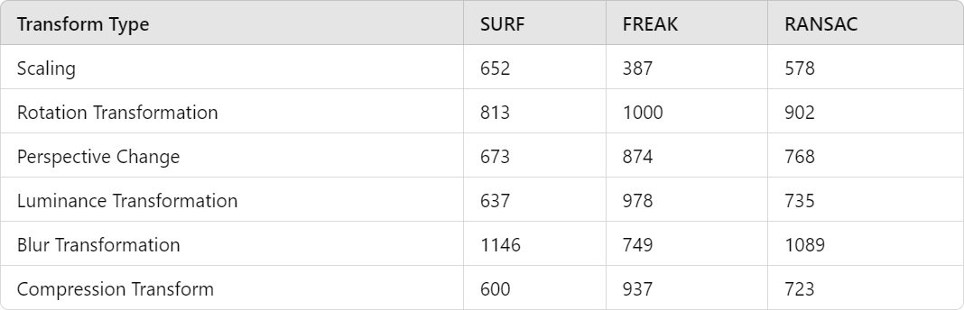
Analytic Study I
12
Figure: Average Number of Matches for Different Algorithms under Various Transformations

Slide 12
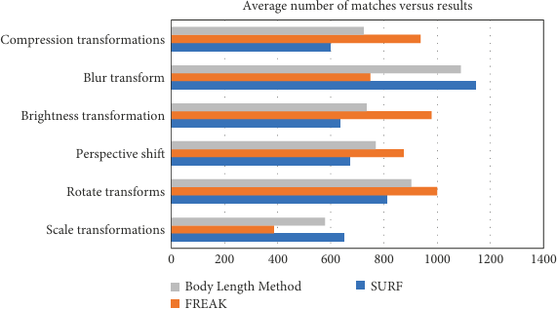
Analytic Study II
13
Figure: Average match count comparison results

Slide 13
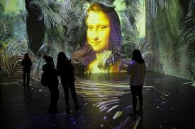
Analytic Study III
14
Figure: Preservation Of Ancient Murals using Augmented Reality

Slide 14
Conclusion
15
This study introduces a new way to improve preservation of ancient murals using augmented reality technology.
The platform provide researchers with detailed, interactive digital representations of murals for in-depth analysis and study.
It reduce the risks of accidental damage caused by traditional close examination methods.
It makes ancient murals available to broader audiences.
In the end, it makes the experience of ancient murals smoother and more reliable for everyone involved.

Slide 15
Future Work
16
Technological Advancements:
  Enhance AR features with AI and ML.
  Develop user-friendly AR hardware.
Broader Applications:
  Expand to diverse cultural contexts.
  Create interactive educational tools.

Slide 16
References
17
Mingming Zhang, The Application of Computer Augmented Reality Technology in Ancient Murals, Mobile Information Systems 2022.
Eliana Siotto ,Paolo Cignoni Digital methods and techniques for reconstructing and visualizing ancient 3D polychromy –An overview, Journal of Cultural Heritage,June 2024

