Slide 1
Let’s suppose you're asked to design a cylindrical can that must:
Hold 1 liter of liquid (i.e., 1000 cm³)
Be made of materials with different costs:
Side: $0.02 per cm²
Top and bottom: $0.05 per cm²
👉 Your task: Choose the radius and height to minimize material cost.

Slide 2
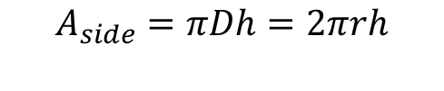


r
r
D
Volume: 1 liter
Side: $0.02 per cm²
Top and bottom: $0.05 per cm²
👉 Your task: Choose the radius and height to minimize material cost.
h
h
$$V=πr^{2}h$$
$$A_{side}=πDh=2πrh$$
$$A_{end}=πr^{2}$$

Slide 3
Overall approach
Formulate the problem as equations: Volume and cost
Identify dependent and independent variables
Combine and formulate, having the dependent variable as a function of the independent variables
Find the optimal solution out of the infinite possibilities.

Slide 4



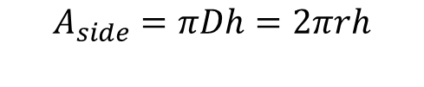

Volume
$$V=πr^{2}h=1000{cm}^{3}$$
Formulate the problem as equations: Volume and cost
Identify dependent and independent variables
Combine and formulate, having the dependent variable as a function of the independent variables
Find the optimal solution out of the infinite possibilities.
Cost
$$Cost={cost}_{side}+{cost}_{ends}$$
r
r
D
h
h
$$V=πr^{2}h$$
$$A_{side}=πDh=2πrh$$
$$A_{end}=πr^{2}$$

Slide 5
Volume
$$V=πr^{2}h=1000{cm}^{3}$$
Formulate the problem as equations: Volume and cost
Identify dependent and independent variables
Combine and formulate, having the dependent variable as a function of the independent variables
Find the optimal solution out of the infinite possibilities.
Cost
$$Cost={cost}_{side}+{cost}_{ends}$$
$$Cost=0.02×\left(2πrh\right)+2×0.05×\left(πr^{2}\right)$$
r
r
D
h
h
$$V=πr^{2}h$$
$$A_{side}=πDh=2πrh$$
$$A_{end}=πr^{2}$$

Slide 6

Volume
$$V=πr^{2}h=1000{cm}^{3}$$
Formulate the problem as equations: Volume and cost
Identify dependent and independent variables
Combine and formulate, having the dependent variable as a function of the independent variables
Find the optimal solution out of the infinite possibilities.
Cost
$$Cost={cost}_{side}+{cost}_{ends}$$
$$Cost=0.02×\left(2πrh\right)+2×0.05×\left(πr^{2}\right)$$
$$Cost=0.04πrh+0.1πr^{2}$$
r
r
D
h
h
$$V=πr^{2}h$$
$$A_{side}=πDh=2πrh$$
$$A_{end}=πr^{2}$$

Slide 7


Volume
$$V=πr^{2}h=1000{cm}^{3}$$
Formulate the problem as equations: Volume and cost
Identify dependent and independent variables
Combine and formulate, having the dependent variable as a function of the independent variables
Find the optimal solution out of the infinite possibilities.
Cost
$$Cost=0.04πrh+0.1πr^{2}$$

Slide 8


Volume
$$V=πr^{2}h=1000{cm}^{3}$$
Formulate the problem as equations: Volume and cost
Identify dependent and independent variables
Combine and formulate, having the dependent variable as a function of the independent variables
Find the optimal solution out of the infinite possibilities.
Cost
$$Cost=0.04πrh+0.1πr^{2}$$

Slide 9

Volume
$$V=πr^{2}h=1000{cm}^{3}$$
Formulate the problem as equations: Volume and cost
Identify dependent and independent variables
Combine and formulate, having the dependent variable as a function of the independent variables
Find the optimal solution out of the infinite possibilities.
$$h=\frac{1000}{πr^{2}}$$
Cost
$$Cost=0.04πrh+0.1πr^{2}$$

Slide 10
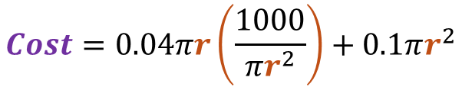
Volume
$$V=πr^{2}h=1000{cm}^{3}$$
Formulate the problem as equations: Volume and cost
Identify dependent and independent variables
Combine and formulate, having the dependent variable as a function of the independent variables
Find the optimal solution out of the infinite possibilities.
$$h=\frac{1000}{πr^{2}}$$
Cost
$$Cost=0.04πrh+0.1πr^{2}$$
$$Cost=0.04πr\left(\frac{1000}{πr^{2}}\right)+0.1πr^{2}$$

Slide 11

Volume
$$V=πr^{2}h=1000{cm}^{3}$$
Formulate the problem as equations: Volume and cost
Identify dependent and independent variables
Combine and formulate, having the dependent variable as a function of the independent variables
Find the optimal solution out of the infinite possibilities.
$$h=\frac{1000}{πr^{2}}$$
Cost
$$Cost=0.04πrh+0.1πr^{2}$$
$$Cost=0.04πr\left(\frac{1000}{πr^{2}}\right)+0.1πr^{2}$$
$$Cost=\frac{40}{r}+0.1πr^{2}$$

Slide 12
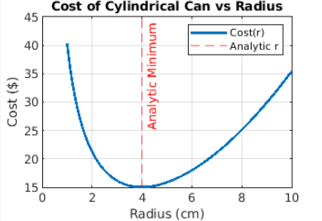

$$Cost=\frac{40}{r}+0.1πr^{2}$$
Formulate the problem as equations: Volume and cost
Identify dependent and independent variables
Combine and formulate, having the dependent variable as a function of the independent variables
Find the optimal solution out of the infinite possibilities.

Slide 13










$$Cost=\frac{40}{r}+0.1πr^{2}$$
Formulate the problem as equations: Volume and cost
Identify dependent and independent variables
Combine and formulate, having the dependent variable as a function of the independent variables
Find the optimal solution out of the infinite possibilities.
$$\frac{dCost}{dr}=−\frac{40}{r^{2}}+0.2πr$$
Optimal solution
$$\frac{dCost}{dr}=0$$
$$h=\frac{1000}{πr^{2}}$$
$$−\frac{40}{r^{2}}+0.2πr=0$$
$$h=\frac{1000}{π{×3.99}^{2}}$$
$$−40+0.2πr^{3}=0$$
$$r^{3}=\frac{40}{0.2π}=\frac{200}{π}$$
$$h=19.96$$
$$r≈3.99$$

Slide 14
Numerical Optimization
While some problems can be solved analytically, sometimes
The math is too complex
A closed-form solution is impossible
It is hard to formulate constrains
In those cases, you can use numerical methods, e.g.
Matlab’s fminsearch

Slide 15

Numerical Optimization
$$Cost=\frac{40}{r}+0.1πr^{2}$$
While some problems can be solved analytically, sometimes
The math is too complex
A closed-form solution is impossible
It is hard to formulate constrains
In those cases, you can use numerical methods, e.g.
Matlab’s fminsearch
% Define cost as a function of radius
costFunc = @(r) (40 ./ r) + 0.10 * pi * r.^2;
% Initial guess
r0 = 5;
% Run optimization
[optR, minCost] = fminsearch(costFunc, r0);
% Calculate corresponding height
optH = 1000 / (pi * optR^2);
fprintf('Optimal radius: %.2f cm\n', optR);
fprintf('Optimal height: %.2f cm\n', optH);
fprintf('Minimum cost: %.2f $\n', minCost);

Slide 16
%% Step 5 (Alternative): Numerical Optimization Using patternsearch
% Requires Global Optimization Toolbox
costFunc = @(r) (40 ./ r) + 0.10 * pi * r.^2;
% Bounds: radius must be positive and realistic
lb = 0.1; % lower bound
ub = 20; % upper bound
r0 = 1; % initial guess
% Run patternsearch
opts = optimoptions('patternsearch', 'Display', 'iter'); % 'iter' to show output
[optR_ps, minCost_ps] = patternsearch(costFunc, r0, [], [], [], [], lb, ub, [], opts);
% Calculate height using volume constraint
optH_ps = 1000 / (pi * optR_ps^2);
fprintf('\n\nNumerical Solution (patternsearch):\n\n');
fprintf(' Optimal radius: %.2f cm\\n', optR_ps);
fprintf(' Optimal height: %.2f cm\\n', optH_ps);
fprintf(' Minimum cost: %.2f $\n', minCost_ps);
… or Matlab’s patternsearch

