Slide 1
Unit -1
Introduction to C language

Slide 2
History of C Language
History of C language is interesting to know. Here we are going to discuss a brief history of the c language.
C programming language was developed in 1972 by Dennis Ritchie at bell laboratories of AT&T (American Telephone & Telegraph), located in the U.S.A.
Dennis Ritchie is known as the founder of the c language.

Slide 3
It was developed to overcome the problems of previous languages such as B, BCPL, etc.
Initially, C language was developed to be used in UNIX operating system. It inherits many features of previous languages such as B and BCPL.
Let's see the programming languages that were developed before C language.

Slide 4
language | Year | Developed By
Algol | 1960 | International Group
BCPL | 1967 | Martin Richard
B | 1970 | Ken Thompson
Traditional C | 1972 | Dennis Ritchie
K & R C | 1978 | Kernighan & Dennis Ritchie
ANSI C | 1989 | ANSI Committee
ANSI/ISO C | 1990 | ISO Committee
C99 | 1999 | Standardization Committee

Slide 5
Features of C Language
C is the widely used language. It provides many features that are given below:
Simple
Machine Independent or Portable
structured programming language
Rich Library
Memory Management
Fast Speed
Pointers
Recursion

Slide 6
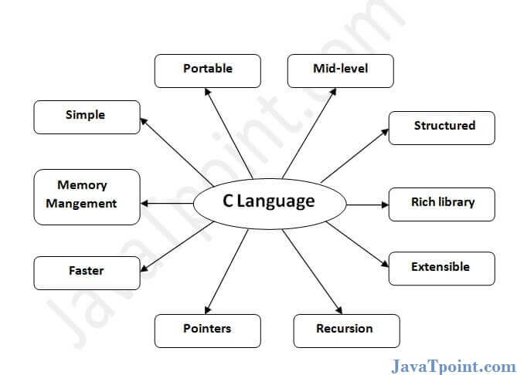

Slide 7
Program Development Steps:
When we want to develop a program by using any programming language, we have to follow a sequence of steps. These steps are called phases in program development.
The program development life cycle is a set of steps or phases which are used to develop a program in any programming language.

Slide 8
Phases of program development
Program development life cycle contains 6 phases, which are as follows −
Problem Definition.
Problem Analysis.
Algorithm Development.
Coding & Documentation.
Testing & Debugging.
Maintenance

Slide 9
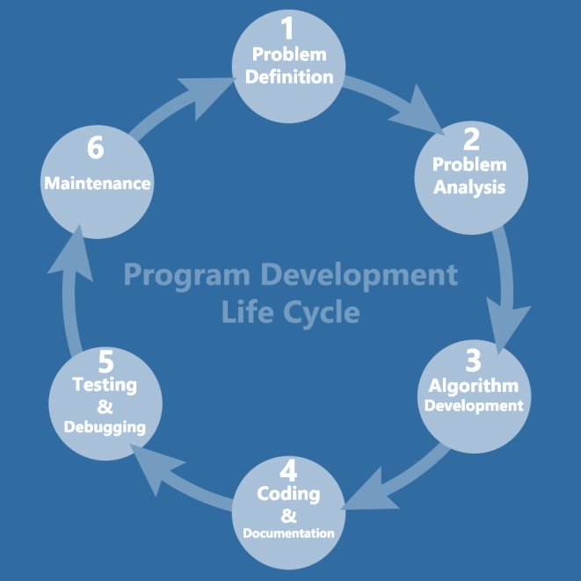

Slide 10
Problem Definition:
Here, we define the problem statement and decide the boundaries of the problem.
In this phase, we need to understand what is the problem statement, what is our requirement and what is the output of the problem solution. All these are included in the first phase of program development life cycle.

Slide 11
Problem Analysis:
Here, we determine the requirements like variables, functions, etc. to solve the problem. It means that we gather the required resources to solve the problem, which are defined in the problem definition phase. Here, we also determine the bounds of the solution.
Algorithm Development:
Here, we develop a step-by-step procedure that is used to solve the problem by using the specification given in the previous phase. It is very important phase for the program development. We write the solution in step-by-step statements

Slide 12
Coding & Documentation:
Here, we use a programming language to write or implement the actual programming instructions for the steps defined in the previous phase. We construct the actual program in this phase. We write the program to solve the given problem by using the programming languages like C, C++, Java, etc.
Testing & Debugging:
In this phase, we check whether the written code in the previous step is solving the specified problem or not. This means, we try to test the program whether it is solving the problem for various input data values or not. We also test if it is providing the desired output or not.

Slide 13
Maintenance:
In this phase, we make the enhancements. Therefore, the solution is used by the end-user. If the user gets any problem or wants any enhancement, then we need to repeat all these phases from the starting, so that the encountered problem is solved or enhancement is added.

Slide 14
Structure of C programe:
There are 6 basic sections responsible for the proper execution of a program. Sections are mentioned below:
Documentation
Pre-processor Section
Definition
Global Declaration
Main() Function
Sub Programs

Slide 15
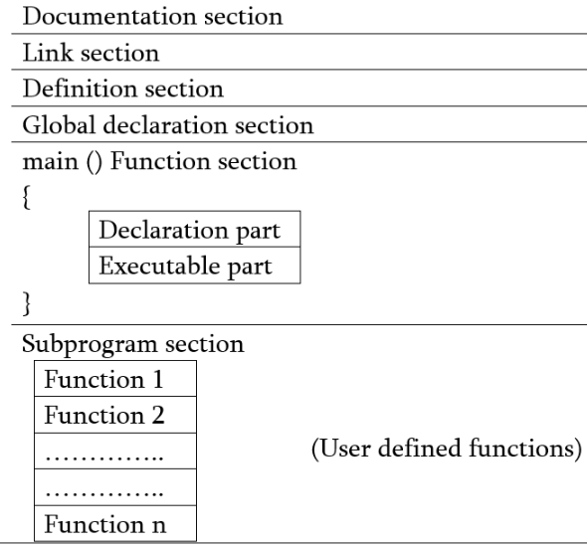
STRUCTURE OF C PROGRAM:
Documentation – comments about program
Link- instructions to compiler
Definition- defines all symbolic constants
Global declaration- variable that is frequently used
Main()-
Declaration: all variables
Execution: programming
Subprogram- user defined functions

