Slide 1
FAKE NEWS REPORT
Aarti Ambhore.

Slide 2
PROBLEM STATEMENT:
Fake news has become one of the biggest problems of our age. It has serious impact on our online as well as offline discourse. One can even go as far as saying that, to date, fake news poses a clear and present danger to western democracy and stability of the society.
Content:
What's inside is more than just rows and columns. Make it easy for others to get started by describing how you acquired the data and what time period it represents, too.

Slide 3
What is a Fake News?
Fake news's simple meaning is to incorporate information that leads people to the wrong path. Nowadays fake news spreading like water and people share this information without verifying it. This is often done to further or impose certain ideas and is often achieved with political agendas.
For media outlets, the ability to attract viewers to their websites is necessary to generate online advertising revenue. So it is necessary to detect fake news.
Workflow
In this project, we are using some machine learning and Natural language processing libraries like NLTK, re (Regular Expression), Scikit Learn.

Slide 4
Natural Language Processing
Machine learning data only works with numerical features so we have to convert text data into numerical columns. So we have to pre-process the text and that is called natural language processing.
In-text pre-process we are cleaning our text by steaming, lemmatization, remove stop words, remove special symbols and numbers, etc. After cleaning the data we have to feed this text data into a vectorizer which will convert this text data into numerical features.
-Dataset
You can find many datasets for fake news detection on Kaggle or many other sites. I download these datasets from Kaggle. There are two datasets one for fake news and one for true news. In true news, there is 21417 news, and in fake news, there is 23481 news. You have to insert one label column zero for fake news and one for true news. We are combined both datasets using pandas built-in function.

Slide 5
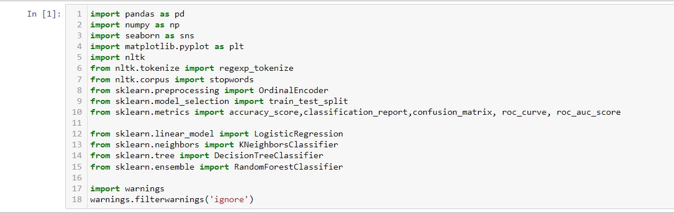
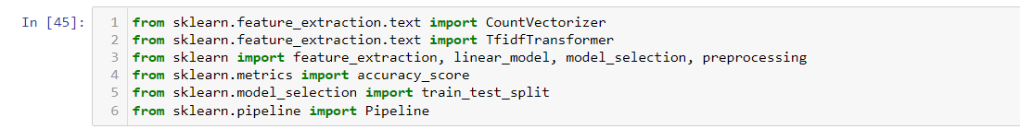
Following libraries are used :

Slide 6
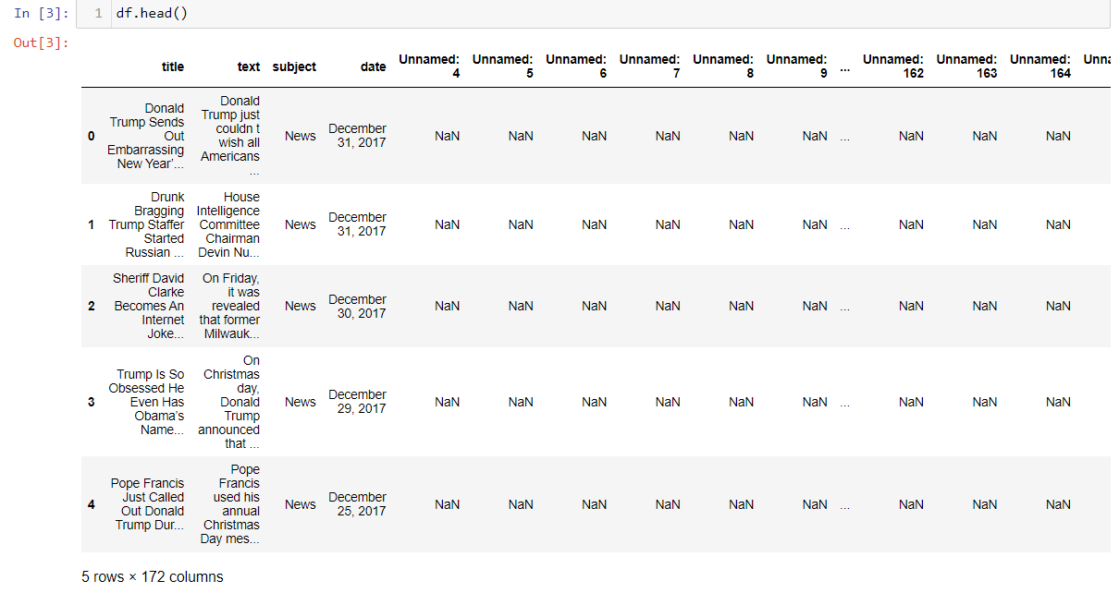
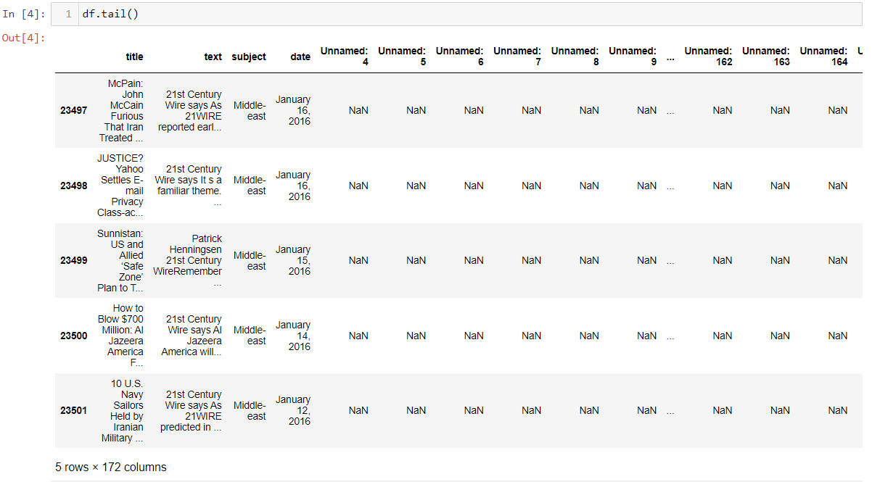
Read the datasets:
The fake news dataset is read as ‘df’.
To confirm the values and correctness of the dataset, I have ran the code:
df.head() and
df.tail()
It showed the first five and last five data of the dataset respectively.

Slide 7
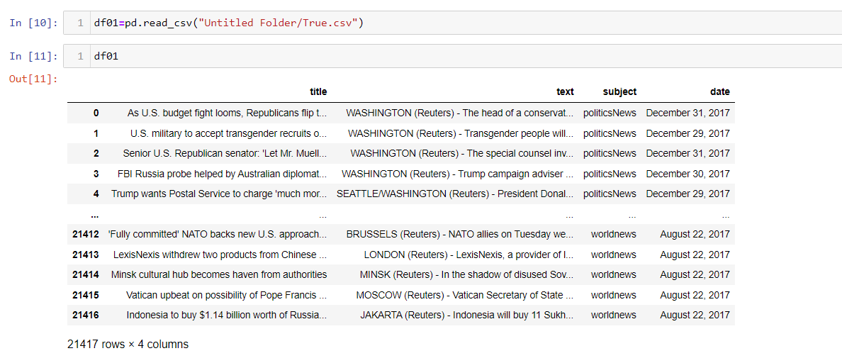
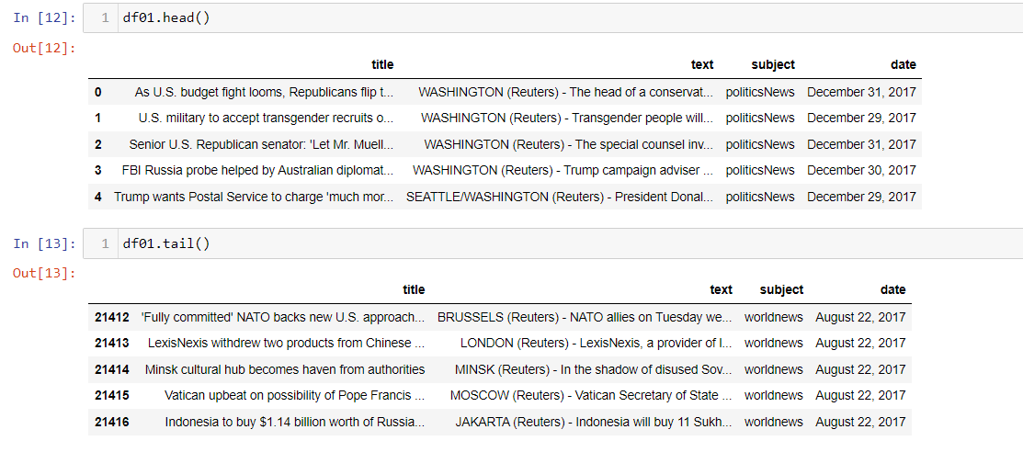
True news dataset is read as ‘df01’.
It is having 4 columns :
Title, text, subject and date.
The data in the true news dataset is correct.
This is also cross verified by df01.head() and
df01.tail()

Slide 8
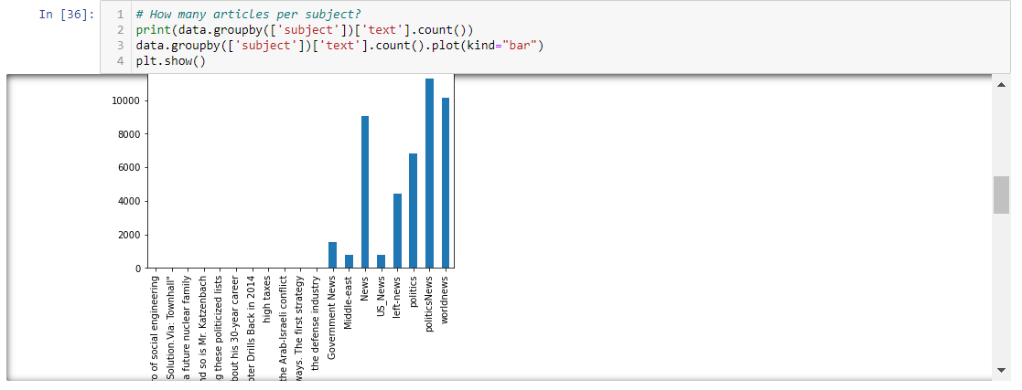
EDA:
To check how many article per subject we have ran the following code:

Slide 9
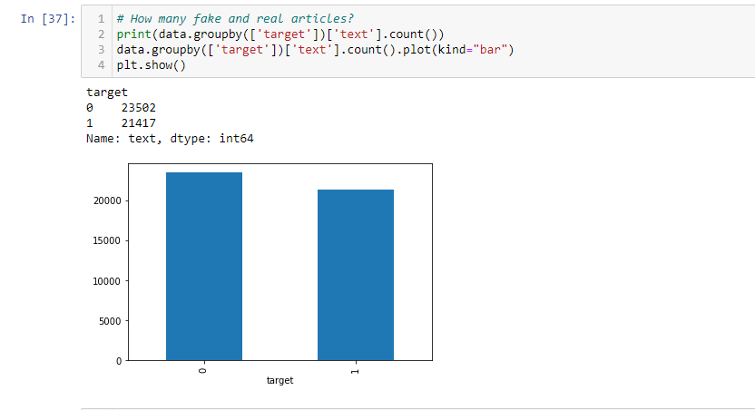
To check how many fake and real articles are there we ran the following code:
From the above graph we can say that there are
23502 fake articles as it is denoted by 0.
21417 real articles and it is denoted by 1.

Slide 10
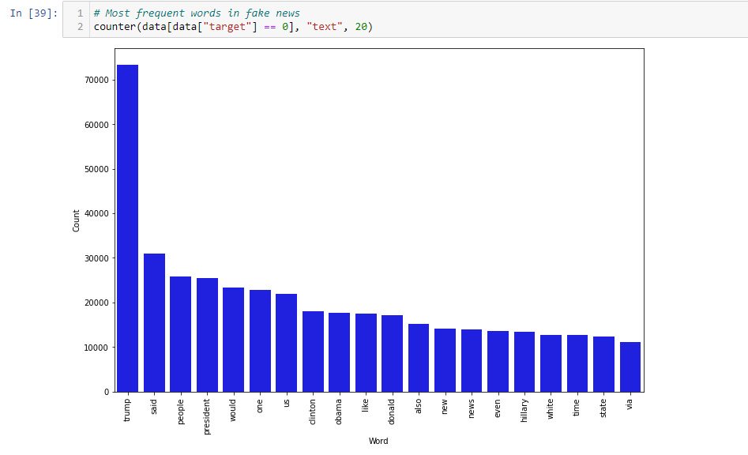
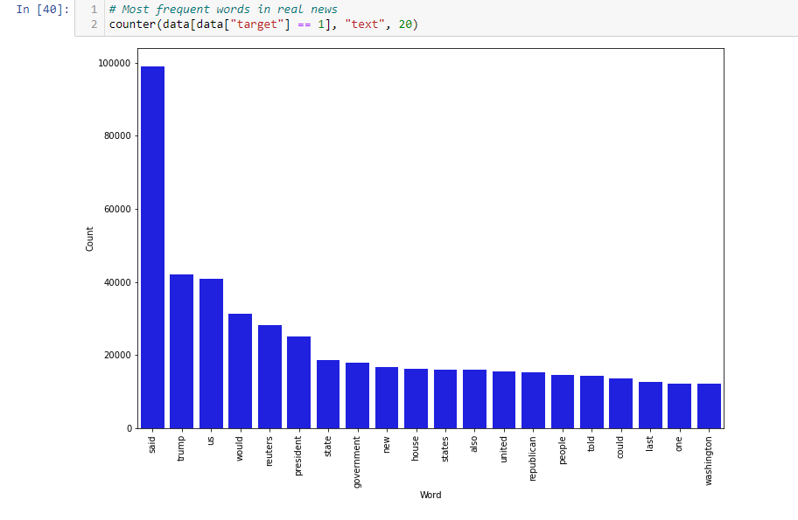
Most frequent words used in fake and real news:

Slide 11
Model Building:
The following models are used :
Naïve Bayes Model
Logistic regression Model
Decision Tree Model
Random Forest Model

Slide 12
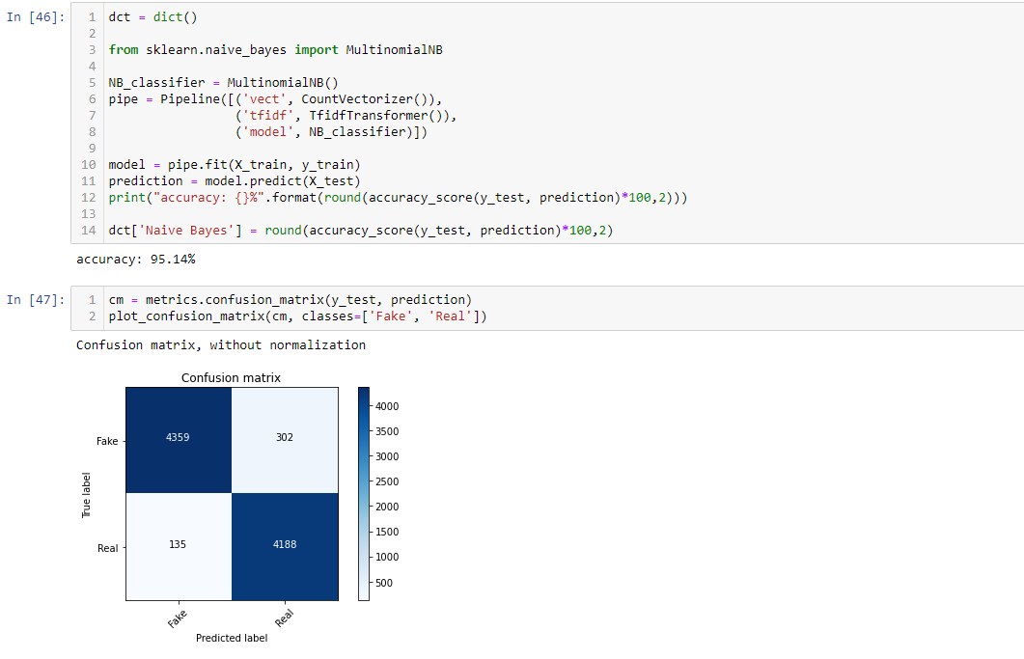
Naïve Bayes Model:
The accuracy for this model is 95.14 %

Slide 13
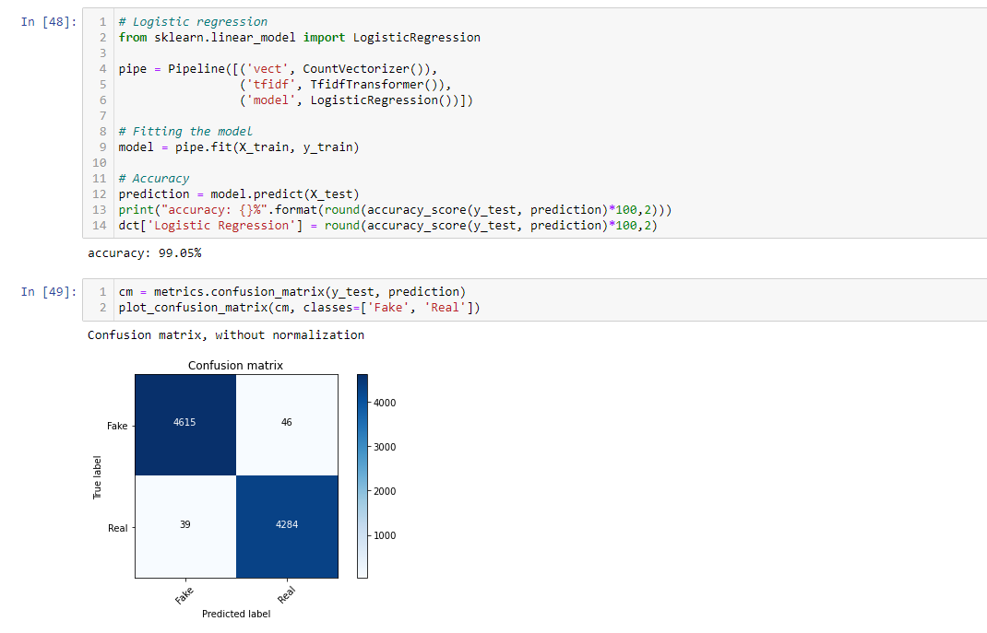
Logistic Regression Model:
The accuracy of this model is 99.05%.

Slide 14
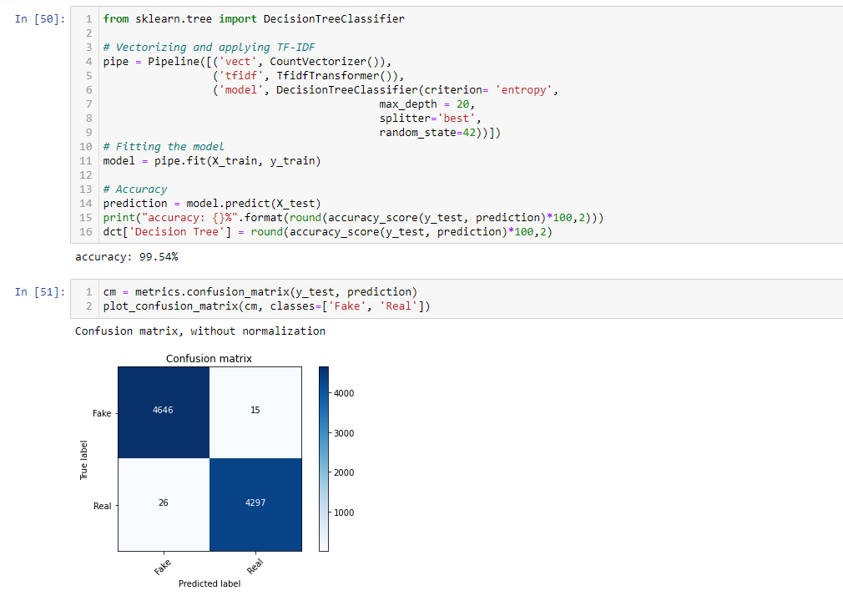
Decision Tree Classifier Model:
The accuracy of this model is 99.54%

Slide 15
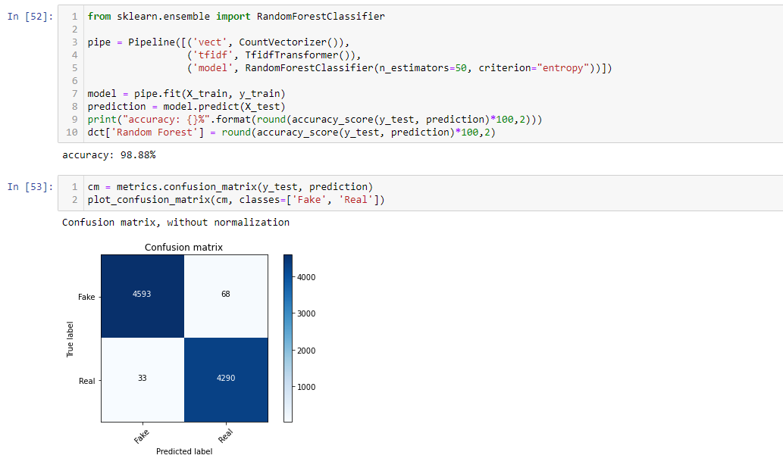
Random Forest Model:
The accuracy of the model is 98.88%

Slide 16
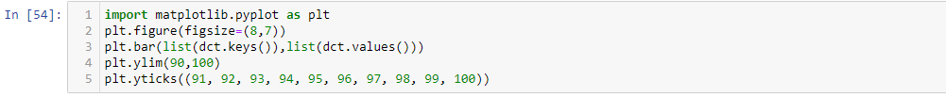
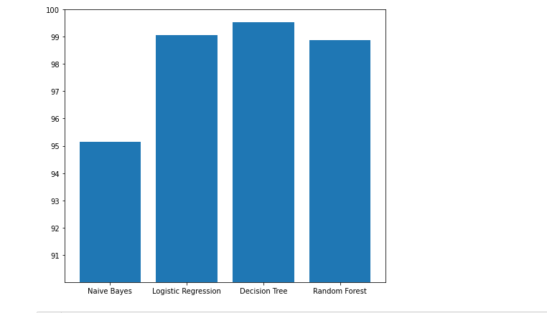
So by comparing all the above models we can say which is the best fit model
From the above graph plot, the Decision Tree Classifier shows high accuracy

Slide 17
Saving the best fit model:

Slide 18
Conclusion:
Among the four models, Decision Tree Classifier Model is the best fit model for the given dataset. As it is showing 99.54% of accuracy.

Slide 19
THANK YOU

