Slide 1
Housing Project
Aarti A Ambhore

Slide 2
INTRODUCTION
Housing is one out of the 3 basic needs for human survival hence research about housing and all that relates to it can never be over emphasized.
In this particular presentation we will be looking on:
How to analyze the dataset for housing price prediction.
What are the EDA steps in cleaning the dataset.
Overall analysis on the problem.
Model building from train dataset.
Predicting housing price for test dataset.

Slide 3
PROBLEM STATEMENT
Houses are one of the necessary need of each and every person around the globe and therefore housing and real estate market is one of the markets which is one of the major contributors in the world’s economy.
A us-based housing company named surprise housing has decided to enter the Australian market. The company uses data analytics to purchase houses at a price below their actual values and flip them at a higher price. For the same purpose, the company has collected a data set from the sale of houses in Australia. The data is provided in CSV
The company is looking at prospective properties to buy houses to enter the market. You are required to build a model using machine learning in order to predict the actual value of the prospective properties and decide whether to invest in them or not. For this company wants to know:
• which variables are important to predict the price of variable?
• How do these variables describe the price of the house?

Slide 4
HOUSING PRICE PREDICTION
Prediction house prices are expected to help people who plan to buy a house .
Predicting house prices can help to determine the selling price of a house of a particular region and can help people to find the right time to buy a home.
House Price Prediction using machine learning, our task is to use data from the Australia census to create a machine learning model to predict house prices in the country. The data includes features such as population, geographical condition, median income, and median house prices for each block group in Australia.

Slide 5
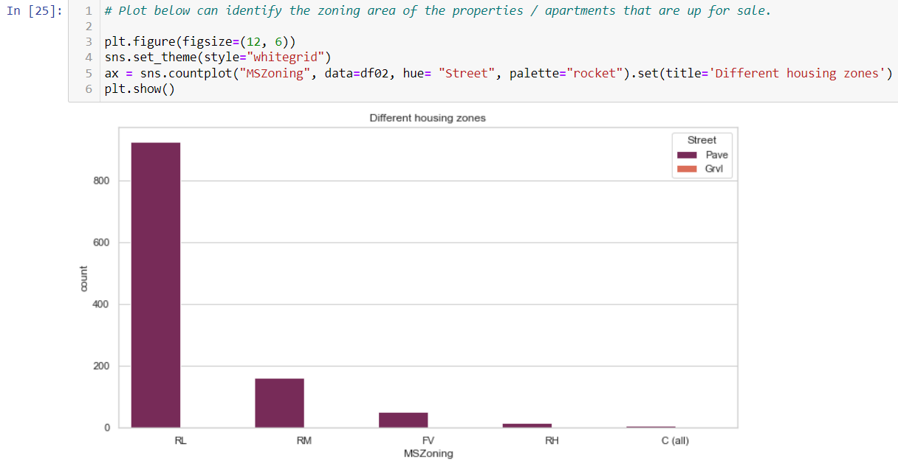
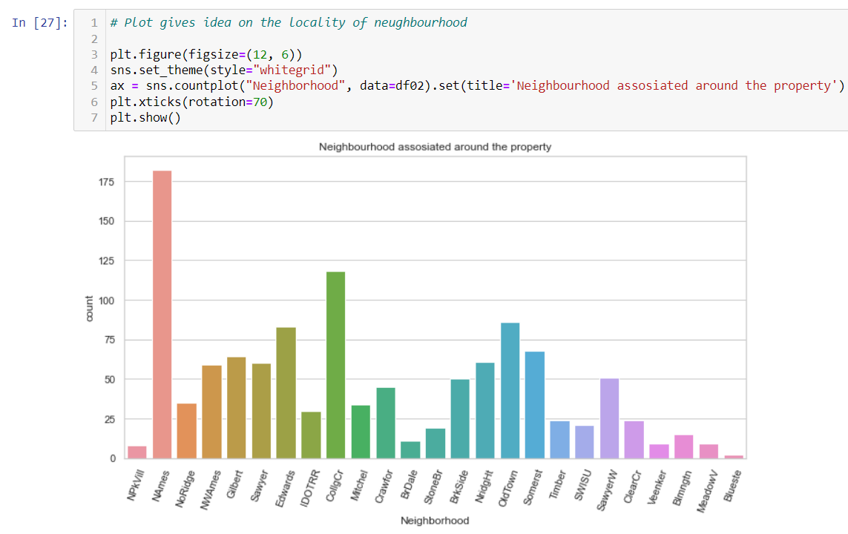
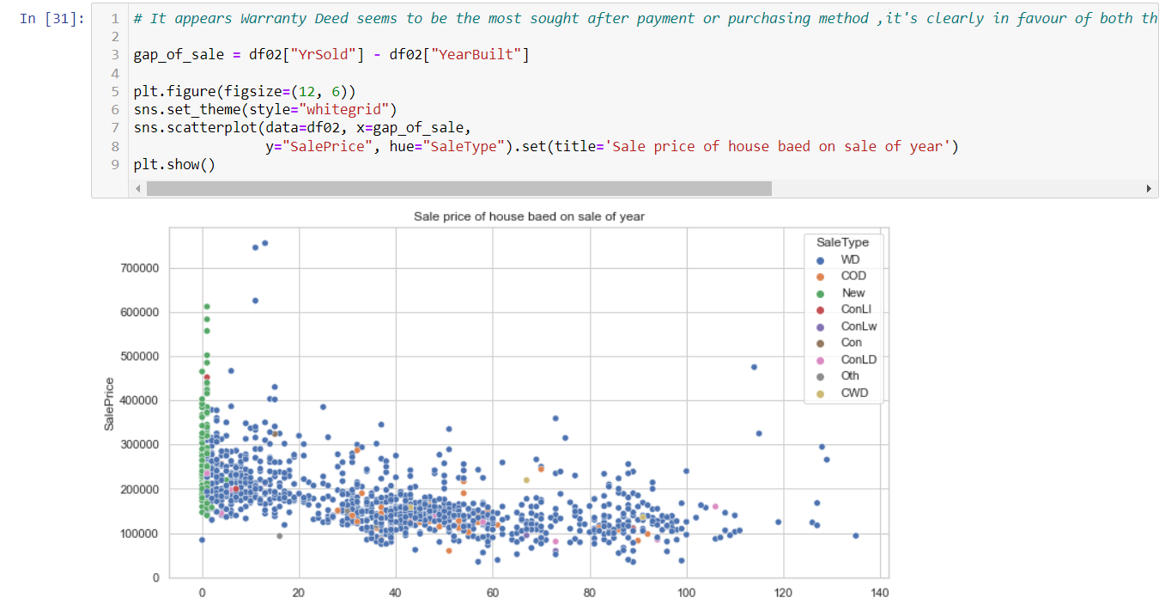
VISUALIZATION
Zone of property
Neighbourhood
Sale Price

Slide 6
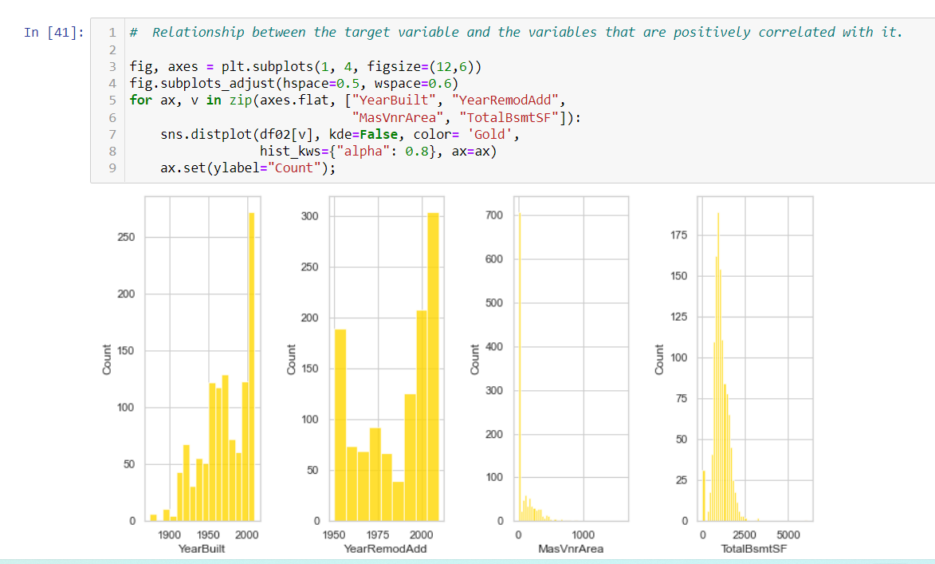
RELATION BETWEEN POSIIVELY CORRELATED VARIABLE AND TARGET VARIABLE

Slide 7
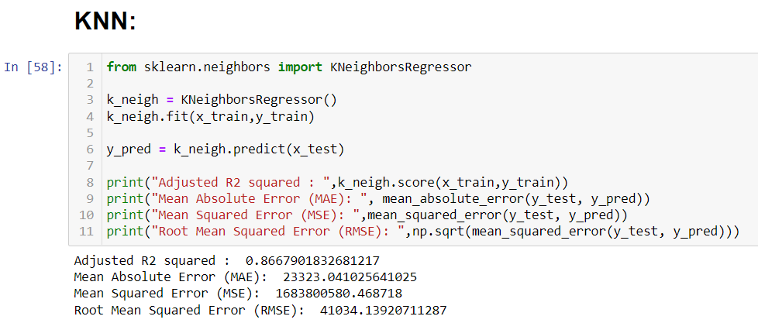
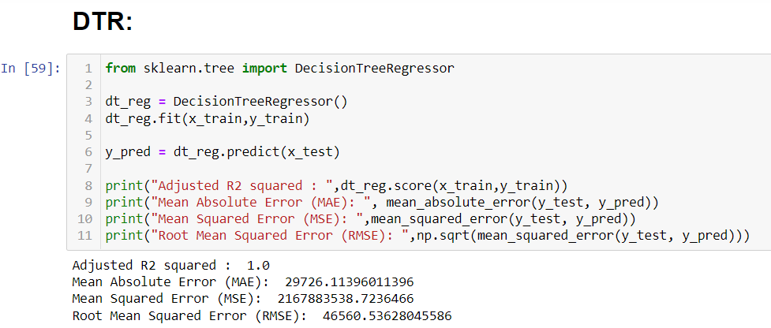
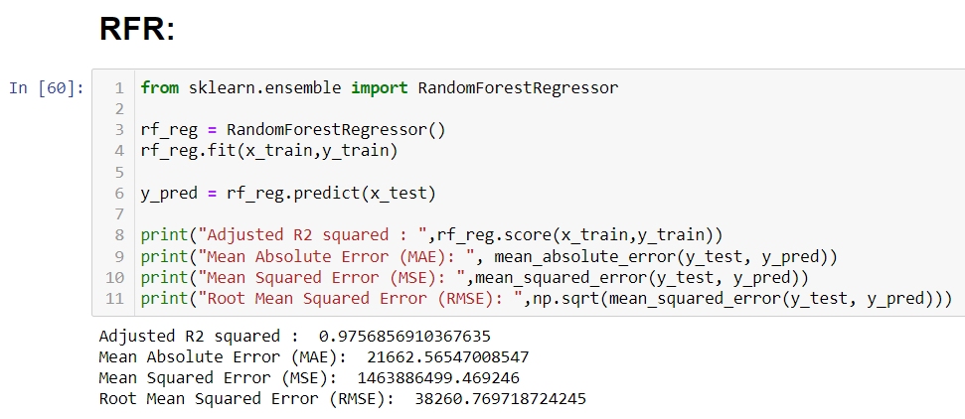
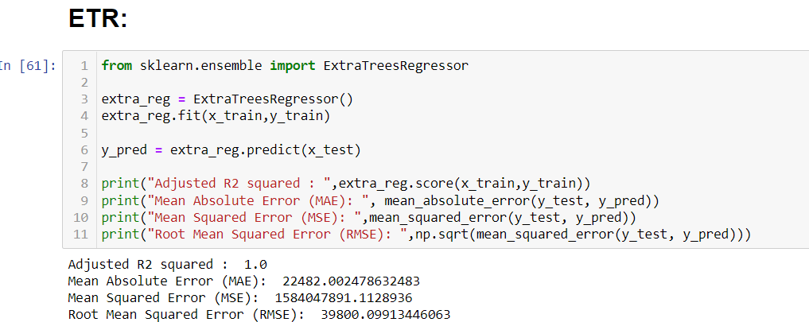
MODELS

Slide 8
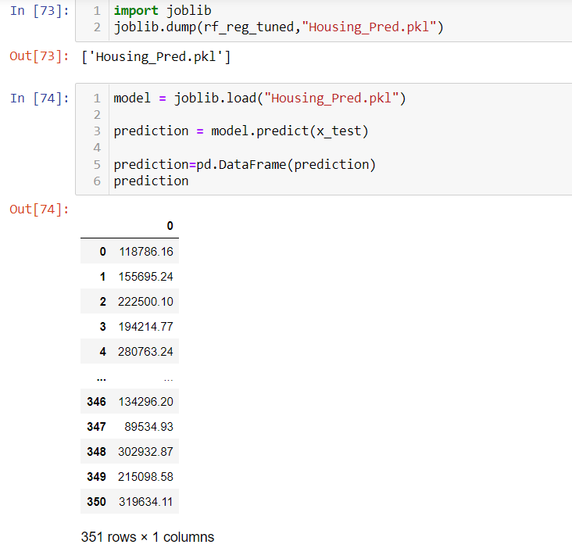
SAVING THE MODEL

Slide 9
Interpretation of the Results
o In this research, two experiments were performed, the first experiment was conducted using all the variables available in the dataset after pre-processing, while the second experiment was conducted using most important variables and the goal of this is to be able to improve the model's performance using fewer variables.
o There requirement of train and test and building of many models to get accuracy of the model.
o There are multiple of matric which decide the best fit model like as : R-squared ,RMSE value, etc.
o Database helped in making perfect model and will help in understanding Australian market

Slide 10
CONCLUSION
In conclusion after reviewing the above papers the first thing I noticed with the dataset is that a lot of research has been done in the past on US housing sector hence I got data for other country, Australian houses.
Also different algorithms have been used to predict housing prices but the most efficient one is regression of which my research work will perform on this dataset using different regression algorithms and present the result to know which gives the best accuracy using the R-squared and RMSE value.

Slide 11
THANK YOU…

